Slide 1
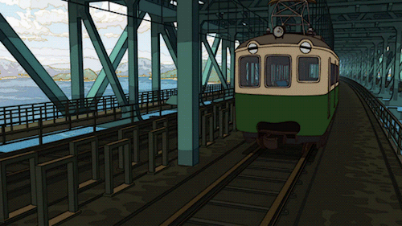
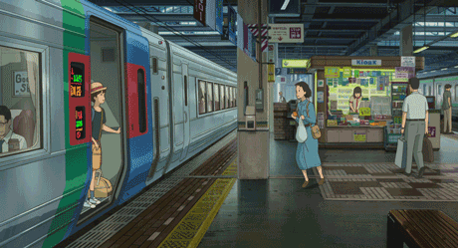

Slide 2
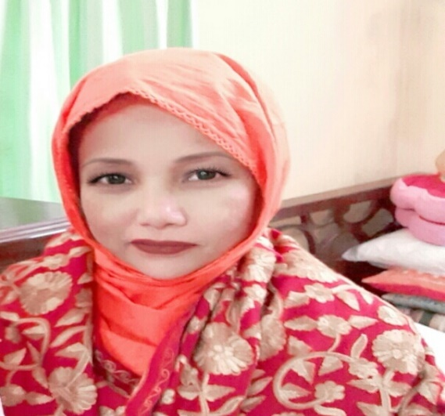
Teacher’s Identity
Mst. Lucky Akhter Parveen
Assistant teacher
Bihari Govt Primary school
Pirgachha, Rangpur

Slide 3
Subject Identity
English for Today
Class: five
Unit: 1, Hello
Lesson: 1,
Time: 45 minutes
Date: 02/ 07/ 2020

Slide 4
Learning outcomes: Students will be able to
Listening:
1.3.1 recognize which words in a sentence are stressed.
1.4.1 recognize and use intonation patterns for Yes/ No and WH questions.
1.4.2 recognize and use intonation patterns for greetings and statements.
3.2.1 understand questions about family and friends of students.
3.4.1 understand statements made by the teacher and students.
Speaking:
1.1.1 say words, phrases and sentences with proper sounds and stress.
1.1.2 say sentences with proper intonation
2.1.1 exchange greetings and farewells.
2.1.2 make introductions.
3.1.1 ask and answer WH questions.
3.1.2 ask and answer Yes/ No questions.
8.1.1 take part in conversations on appropriate topics.
Reading:
1.5.1 read words, phrases and sentences in the text with proper pronunciation, stress and intonation.
1.6.1 recognize and read statements, commands, greetings, questions and answers.
1.7.6 read paragraphs, dialogues stories, letters and other texts.

Slide 5
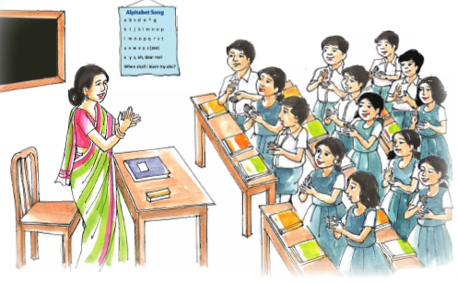
Warm up activities: Singing ‘ Hello song’.

Slide 6
Look at the picture.
What are they doing?

Slide 7
Todays lesson

Slide 8
Word meaning
to make someone or something known.
introduce
(কোন ব্যক্তি বা কোন কিছুকে চেনান।)
truly.
really
( সত্যি! )

Slide 9
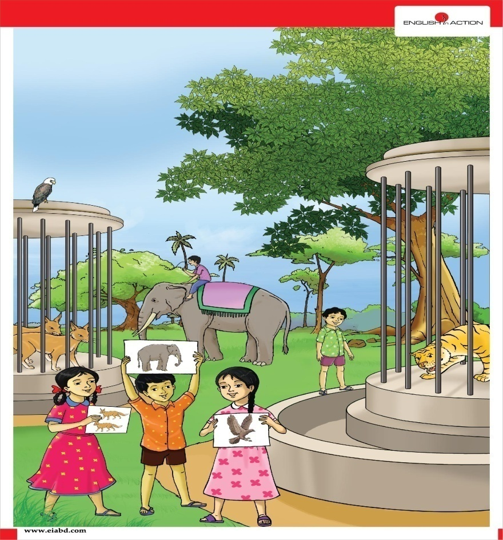
Word meaning
an expression used to greet someone.
hello
ওহে (কোন ব্যক্তিকে শুভেচ্ছা জানানোর অভিব্যক্তি)
a period of time free from routine work .
holiday
( ছুটির দিন)

Slide 10
Word meaning
go to away
Leaving
( ছেড়ে যাবে )
meeting
to face someone.
( সাক্ষাৎ করা)

Slide 11
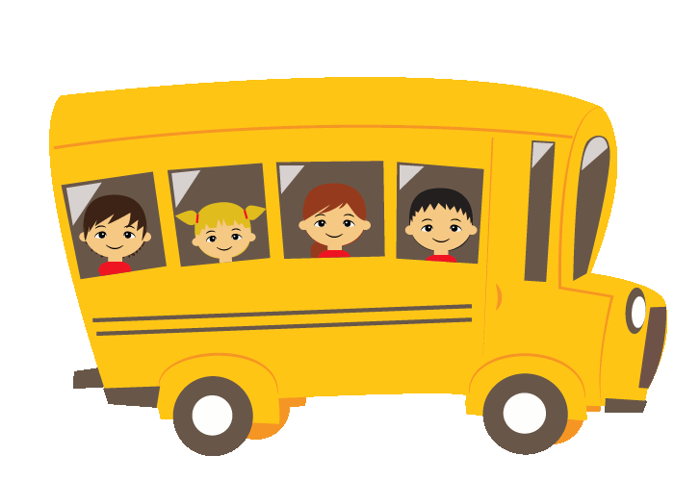
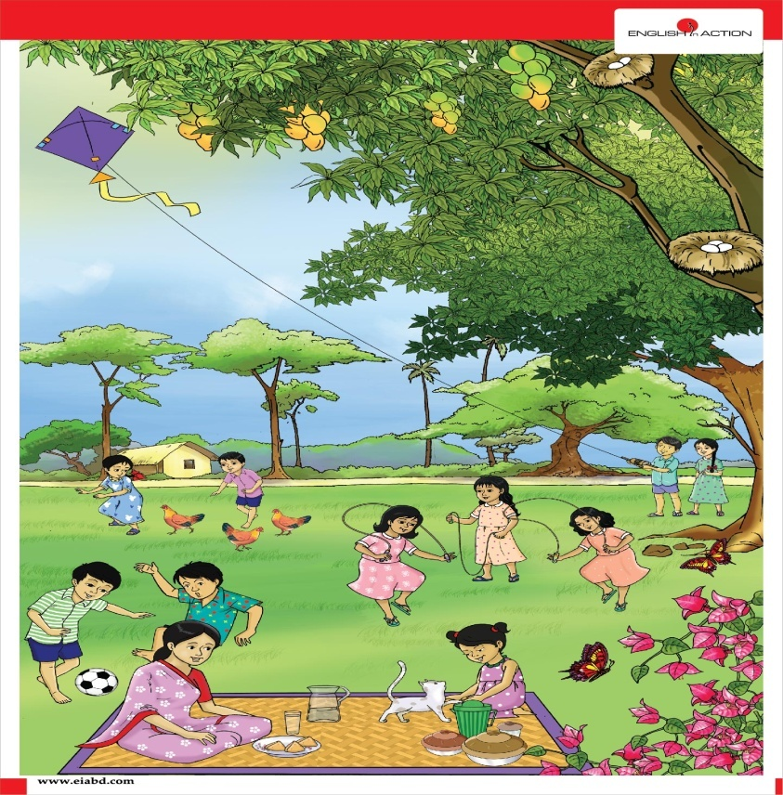
Word meaning
journey
travelling from one place to another
( ভ্রমণ করা )
amusement or light- hearted pleasure.
fun
( মজা)

Slide 12
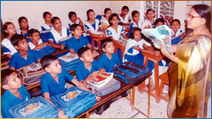
Teacher’s reading

Slide 13
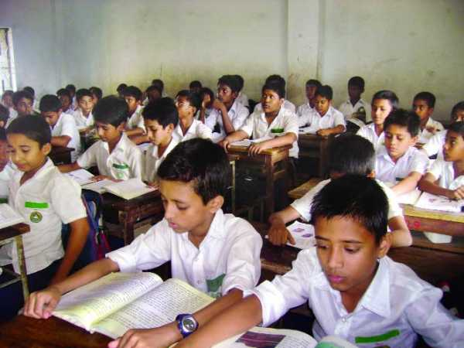
Student reading

Slide 14
Pair Work.
Read the dialogue.

Slide 15
Group work.
Read the text then answer the following questions.
Where is Jessica going?
2. Where is Sima from?
3. Why is Jessica going there?
Answer: Jessica is going to Chattogram.
Answer: Sima is from Sylhet.
Answer: Jessica is going there to spend her holiday with her father.

Slide 16
Pair work. Read the text then fill in the gaps.
Jessica is on _________ in Bangladesh.
Sima is going to _________.
Sima ___________ herself to Jessica.
holiday
Sylhet
introduce

Slide 17
IW.
Say ‘True’ for correct statement or ‘False’ for incorrect statement.
Sima and Jessica are talking at a bus terminal.
They are waiting for their friends.
Sima’s train is to leave in ten minutes.
Chattogram is Jessica’s home town.
Sima and Jessica is happy meeting each.
False.
False.
True.
False.
True.

Slide 18
Pair work. Matching the given words with their meanings:
Column A | Column B
fun | a period of time free from routine work
journey | an expression used to greet someone
holiday | go to away
hello | amusement
leave | travelling from one place to another place

Slide 19
Pair work. Make Wh questions from the given statements:
1. Jessica is going to Chittagong.
Answer: Where is Jessica going?
2. Jessica is going there to enjoy her holiday.
Answer:Why is Jessica going there?
3. Sima’s train is leaving in 10 miuntes.
Answer: When is Sima’s train leaving?

Slide 20
Evaluation
Answer the following questions.
1.How do we introduce ourselves?
Answer: Hello! May I introduce myself? I am __.
2. What do we say at the end of the conversation or at the time of leaving?
Answer: Nice meeting you. See you, take care.
3. Where are Sima and Jessica?
Answer: Sima and Jessica are at railway station.

Slide 21
