Slide 1
Welcome to all.

Slide 2
Palash Chakrabarty
Assistant Teacher(Computer)
Chitoshi R.M High School
Shahrasti, Chandpur
Mobile- 01836815687
Email-palashd2k66@gmail.com

Slide 3
Subject : English 2nd Paper (Grammar)
Class : VI-VII
Time : 50 Minutes
Date : 05/07/2020

Slide 4
Let us observe some images.
Notes:
No need to click.

Slide 5
Rahim is a Student.

Slide 6
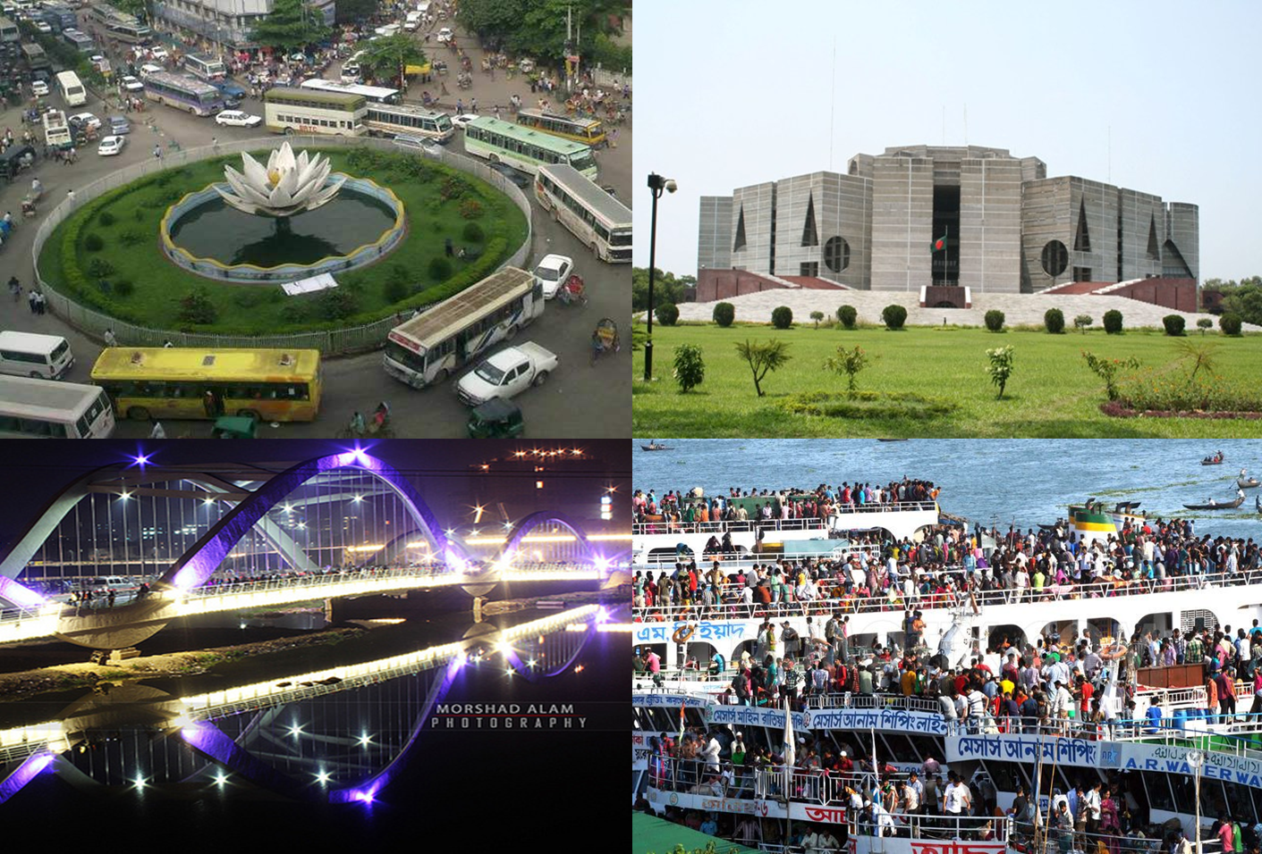
Dhaka is an ancient city.

Slide 7
Rahim is a Student.
Dhaka is an ancient city.

Slide 8
What have you observed?
Let us see what our today’s lesson is-
Notes:
Four kinds of noun are shown.

Slide 9
Our Today’s lesson is-
Parts of Speech
Notes:
Lesson declaration.

Slide 10
Learning outcomes
After we have studied this lesson, we will be able to ---
define parts of speech;
identify the classification of parts of speech;
identify eight kinds of parts of speech.
Notes:
Aims of this lesson.

Slide 11
Parts
of
Speech
The words used in a sentence are called Parts of Speech.

Slide 12
Parts of Speech
Rahim is a good boy.
Dhaka is the capital of Bangladesh.

Slide 13
Classification of Parts of Speech
There are eight types of parts of speech according to their functions or job in a sentence.

Slide 14
Classification of Parts of Speech
8. Interjection
1. Noun
Parts of Speech
2. Pronoun
7. Conjunction
6. Preposition
3. Adjective
5. Adverb
4. Verb

Slide 15
Noun
A noun is a word used for naming something. (Noun expresses a person, a place, a thing or idea/ quality.)
Example- Kamal, Book, Dhaka, Honesty, Function etc.

Slide 16
Pronoun
A pronoun is a word used in place of a noun.
Example- I, He, She, You, They, It etc.

Slide 17
Adjective
An adjective is a word which is used to qualify a noun or a pronoun.
Example- Bad, good, old, happy, rich, small, two etc.

Slide 18
Verb
A word which states something about a person or a thing is called verb.
Example- Eat, read, write, see, play, do etc.

Slide 19
Adverb
An adverb is a word that modifies an adjective, verb, noun, pronoun or a whole sentence.
Example- Fast, very, slowly, now, again etc.

Slide 20
Individual Work
Mention the name of the Parts of Speech of the followings :
Loudly, is, class, we, poor, go, now, much, sweet, they, health, milk, bad, water, late.
Notes:
Class activities.

Slide 21
Preposition
A preposition is a word placed before a noun or a pronoun to show its relation to some other word of the sentence.
Example- By, with, of, from, between etc.

Slide 22
Conjunction
A conjunction is a word that connects words or groups of words or sentences.
Example- And, but, when, for, or etc.

Slide 23
Interjection
A word or phrase that expresses feelings and emotions are known as interjection.
Example- Alas! Oh! Bravo! Hi! Good-bye! etc.

Slide 24
Home Work
What do you mean by “Parts of Speech”? How many kinds of Parts of Speech are in English? Give their names with five examples for each?

Slide 25
Thank you all.

