Slide 3
INTRODUCTION
Classes : xi & xii
Sub : English for Today
Unit : 7(seven)
Lesson : 1(one)
Abdul Latif
Lecturer in English
Alauddin Siddique College
Auliabad, Kalihati
Tangail

Slide 4
How are these Expressions?
Sorry

Slide 5
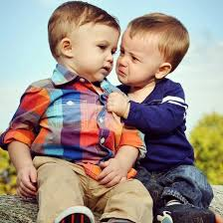
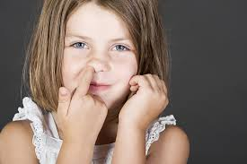
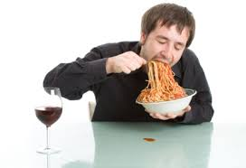
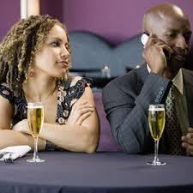
Look at these pictures
Bad Manners

Slide 6
Announcement of the lesson
Etiquette
and
Manners

Slide 7
Learning Outcomes
The students will be able
to learn some rules of good manners
to write a paragraph on good manners

Slide 8
Reading the text
As a child you must have been told to greet your elders and visitors to your home according to your culture and tradition. You must also have been taught to be polite in company and keep quiet while others, especially your elders, spoke. Possibly, you at times grudged such schooling. Possibly, at times you even protested such disciplining. Now, certainly you know that you can’t always behave the way you want specially in the presence of others. There are rules of behavior you have to follow in a company. We are social beings and have to consider the effect of our behaviour on others, even if we are at home and dealing with our family members.
Grudge – Dislike, annoy

Slide 9
We have two terms to describe our social behaviour- “etiquette” and “manners.” “Etiquette” is a French word and it means the rules of correct behaviour in society. The word “manners” means the behaviour that is considered to be polite in a particular society or culture. Manners can be good or bad. For example, it is a bad manner to speak with food in one’s mouth. No one likes a bad-mannered person. Remember that etiquette and manners vary from culture to culture and from society to society.

Slide 10
We learn etiquette and manners from our parents, families and various institutions, such as schools, colleges or professional bodies. There are rules of behaviour for all kinds of social occasions and it is important to learn them and practise them in everyday life. The manners that are correct in a wedding reception will not do in a debating club. Therefore, we have to be careful about etiquette and manners. We know how important it is to say ‘please’ and ‘thank you’ in everyday life. A few more polite expressions such as ‘pardon me,’ ‘excuse me’, ‘may I,’ are bound to make your day smooth and pleasant.

Slide 11
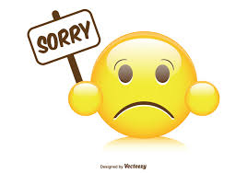
Some expressions showing good manners

Slide 12
Read the following passage and make short notes in each of the boxes showing the things we are taught. ( one has been done for you)
As a child you must have been told to greet your elders and visitors to your home according to your culture and tradition. You must also have been taught to be polite in company and keep quiet while others, especially your elders, spoke. Possibly, you at times grudged such schooling. Possibly, at times you even protested such disciplining. Now, certainly you know that you can’t always behave the way you want specially in the presence of others. There are rules of behavior you have to follow in a company. We are social beings and have to consider the effect of our behaviour on others, even if we are at home and dealing with our family members.
1.Greeting the elders
2. Greeting the visitors
3.Being polite in company
4.Keeping quiet while other speaking
5. Knowing the way of behavior before others
6.Considering the effect of behave on others

Slide 13
Read the following passage and make short notes in each of the boxes describing etiquette and manners. ( one has been done for you)
We have two terms to describe our social behaviour- “etiquette” and “manners.” “Etiquette” is a French word and it means the rules of correct behaviour in society. The word “manners” means the behaviour that is considered to be polite in a particular society or culture. Manners can be good or bad. For example, it is a bad manner to speak with food in one’s mouth. No one likes a bad-mannered person. Remember that etiquette and manners vary from culture to culture and from society to society.
We learn etiquette and manners from our parents, families and various institutions, such as schools, colleges or professional bodies. There are rules of behaviour for all kinds of social occasions and it is important to learn them and practise them in everyday life. The manners that are correct in a wedding reception will not do in a debating club. Therefore, we have to be careful about etiquette and manners. We know how important it is to say ‘please’ and ‘thank you’ in everyday life. A few more polite expressions such as ‘pardon me,’ ‘excuse me’, ‘may I,’ are bound to make your day smooth and pleasant.
1. Meaning the rules of correct behavior
2. Being good or bad
3. Varying from culture to culture
4. Learning from our parents
5. Practising them in every day life
6. Making your day smooth and pleasant

Slide 14
Home work
Write a paragraph on “ Good Manners”

