Slide 1
WELCOME

Slide 2
INTRODUCTION
Md. Nurul Amin
Assistant Teacher.
Goplar Bazar High School.
Nabiganj, Habiganj.
01745633703
nurulaminteacher@gmail.
com
Class : Nine
Sub.English 1st Paper
Unite : Two
Lesson: One
Date: 02.07.2020

Slide 3
Learning outcomes
After finishing the lesson, Students will be able to
*What is Yoga?
*Write the health benefit of Yoga .
*Explain our pastimes .
*Participate in conversation and discussion.

Slide 4
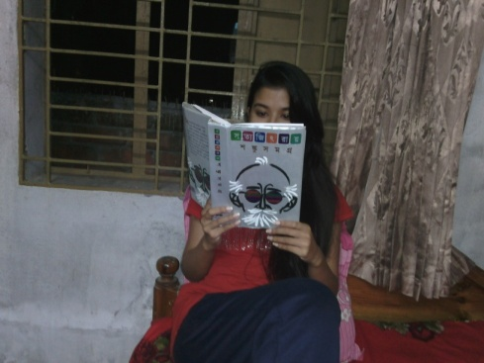
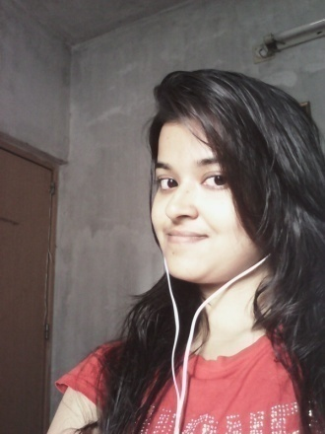
Picture No 02
Picture No 03
Picture No 01
Playing Game on Computer
Reading Story Book
Listeing Musicn

Slide 5
What are the people doing here?
1.What do you see in picture 1 ?
2. What do you see in picture 2 ?
3.What do you see in picture 3 ?
Question: When do the people do these kind of work ?

Slide 6
Today’s Lesson
Pastime

Slide 7
Two SS act out the dialogue (Page-16,Stage-B)
Listen to dialogue and answer the questions
Questions:
1. Why does Anusha like going to the job ?
2.What are her pastime ?
3. Make a list of Tiya’s pastimes .
4.How will Tiya learn about yoga ?

Slide 8
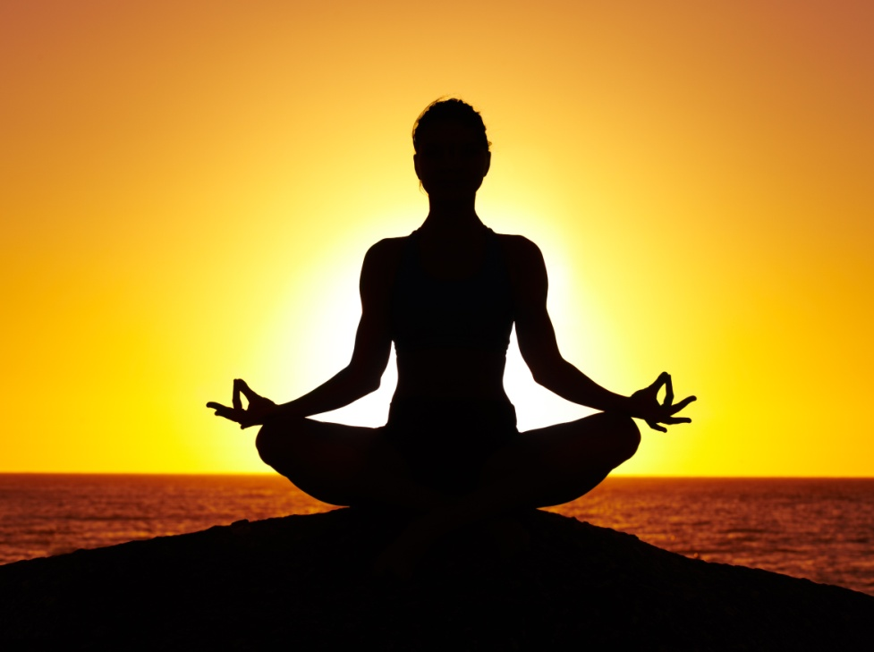

Slide 9
Dear students open page at 17 read the texts C :
The health benefits of yoga…..
1. Stress reduction of y
2 .Increased fitness
3 .Management of chronic health
4.Weight loss

Slide 10
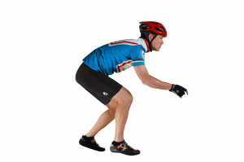
Word meaning
Posture(Noun)
Gesture/pose
Reduction(Noun)
Decrease/Shortening
Flexibility(Noun)
Softness
Endeavor(verb)
Strive/Try

Slide 11
Chronic(adjective)
Severe/Repeating
Depression(noun)
Dejection/Dumps

Slide 12
Work in pairs. Talk about these questions with your partner. Give Your own opinion.
1.How does exercise work on our memory ?
2.What other benefits can you think of from exercise ?
3. What is the most important benefit of exercise to you and why?

Slide 13
Complete the sentences.
Posture and breathing.
Yoga is a practice of …………..
Traditional Yoga works through…………
Yoga is very effective in managing………
Through the poses of balance and concentration
Yoga………….
………………………………………………………………. results in increased fitness.
Yoga can reduce or work for ………………………………
Yoga can control …………………………………..
Yoga cannot cure 100 percent, but…
Behaviour , diet and meditation .
Stress and anxiety .
Draws our focus away from our busy ,chaotic day towards calm .
Learning as well as refining new poses
Reducing heart rate and blood pressure .
Our eating and weight.
it can help some health conditions when combined with proper treatment.

Slide 14
Check (Yes)the statements about yoga below.
a. | Yoga improves fitness.
b. | Yoga has little to do with eating habits .
c. | I may differ according to doer levels .
d. | It helps people shake off all types of physical and mental disorders.
e. | It works both body and mind together .
f. | It helps practitioners undergo similar level of difficulty .
g. | If you know yoga , you have better control over your real life hazards .
h. | It also helps you live longer .
Correct
Incorrect
Correct
Incorrect
Correct
Correct
Correct
Correct

Slide 15
Home work
Write a paragraph about “How to Yoga help you a happy life .

Slide 16
Thank You

