Slide 1
Welcome

Slide 2
IDENTITY
Abdul Aziz
B.A(Hon’s), M. A(English)
Assistant Teacher (English)
Madhaia Bazar Sadim High School
E-mail: azizabidpur@yahoo.com
Class Eight
English First Paper
Unit -8
Lesson : 2
Topic : News! News! News!(2)

Slide 3
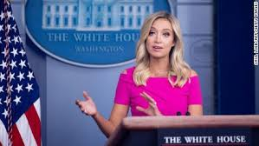
Look at the pictures and discuss with your partner what can you see in them
Pair Work
In the first picture , I can see that a man is reading the
newspaper. In second picture 2, a woman is presenting
news in a TV channel.

Slide 4
Our today’s topic is
News! News! News! (2)

Slide 5
Learning Outcomes
After the end of the lesson, students will be able to-
Talk about News
Participate debate on news
Infer vocabulary

Slide 6
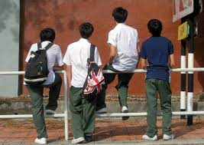
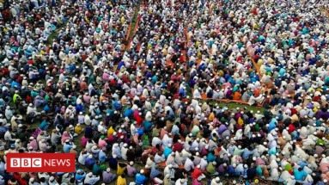
Key words
Individual Work
Bunk of
To run away from school
Mass People
People in general
Objective
Based on facts
bias
partiality

Slide 7
Key words
Broadcast
To send out programmes
on tv or radio
refer
To mention or speak of
something
Editorial
Written by an editor
informative
Providing information

Slide 8
“I eat rice everyday. I play cricket. I don’t bunk off school, blah….. Blah…… blah…… .” There are common events. They happen everyday or on some occasions. Are these events news? Should they be published in newspapers? The answer is big “No”. Then what is news anyway?
Read the text.

Slide 9
When a dog bites a man that is not news but when a man bites a dog that is news,” Charles Anderson Dana

Slide 10
The first thing is that a news should be a piece of information. Secondly, the information should be present and new and here it is ‘new’. Thirdly, the mass people should take interest in it.

Slide 11
Fourthly, it should be self explanatory. That is, it should answer all the questions with who, which, what, where, when, why, and how. Finally, it should be objective. Recently, another aspect has been added: news is either printed or broadcast or on the internet.

Slide 12
There are opinions that the term ‘new’ comes from ‘new’. Others say it is news because it comes from all directions: North, East, West and South

Slide 13
Group work
What features should news have?
A news should be informative, new, recent, self –explanatory and
objective in which mass
People can take interest.
What is the difference between news and event?
An event happens everyday but a piece of news is not a natural
phenomenon.

Slide 14
Evaluation
Look at the table below and match the words with their meanings in the right column.
Words /Phrase | Meaning
Bunk of | Not in influenced by personal feelings
Media | To send out programmes on TV or radio
Objective | Ways of getting information e.g: radi,TV
Broadcast | Stay away/leave school/work without permission

Slide 15
Home work
Suppose a man in your locality really bites a dog. Imagine, you are a reporter
And you interview the man. Share with your partner and write the dialogue

Slide 16
Thank you

