Slide 1


Slide 2

স্বাগতম

Slide 3


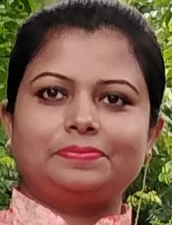
TEACHER’S IDENTITY
NAHIDA AKHTER
ASSISTANT TEACHER
KALIKACCHA NORTH GOVT. PRIMARY SCHOOL
SARAIL,BRAHMANBARIA.

Slide 4

TODAY’S LESSON
CLASS: FIVE
UNIT : 6 LESSON:1 LESSON’S TITLE:EAT HEALTHY
TODAYS LESSON:A,B&C

Slide 5
LEARNING OUTCOMES
Listening:
3.3.1 understand students about objects around them.
3.4.1 understand statements made by the teacher.
Speaking:
1.1.1 say words,phrases and sentence with proper sound and stress
Reading:
1.5.1 read words phrases and sentences in the text with proper pronunciation and stress and intonation.

Slide 6
Let’s watch a video

Slide 7
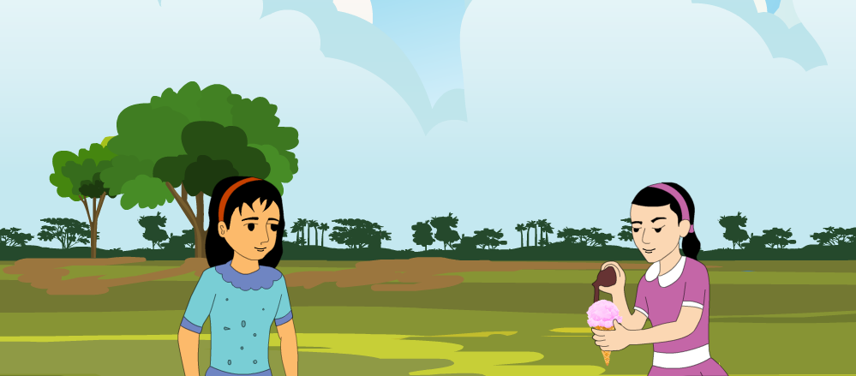
Look at the picture
What’s the girl eating?
Ice-cream.
Is it healthy?
No ,it’s not.

Slide 8
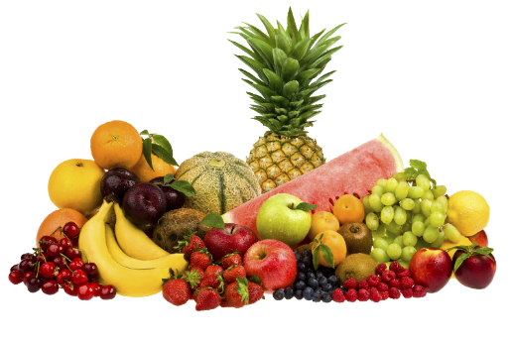
Dear students, today we will study about
Eat healthy

Slide 9
NEW WORDS

Slide 10
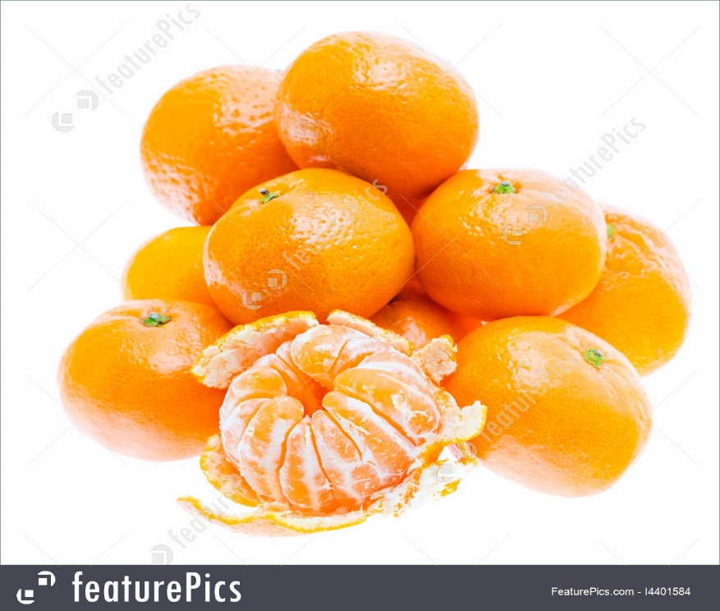
What is the name of the food?
Orange
One kind of fruit.

Slide 11
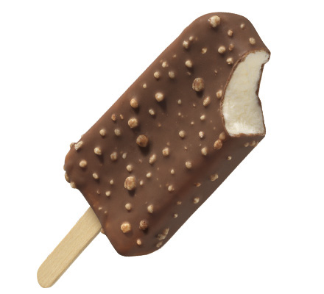
What is the name of this food ?
Ice-cream
Frozen dessert.

Slide 12
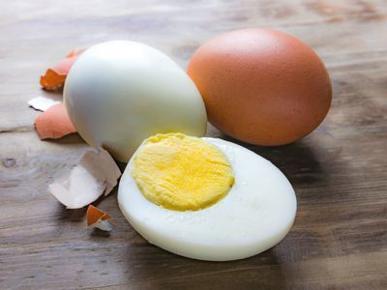
What is the name of this food ?
Egg
One kind of food.

Slide 13
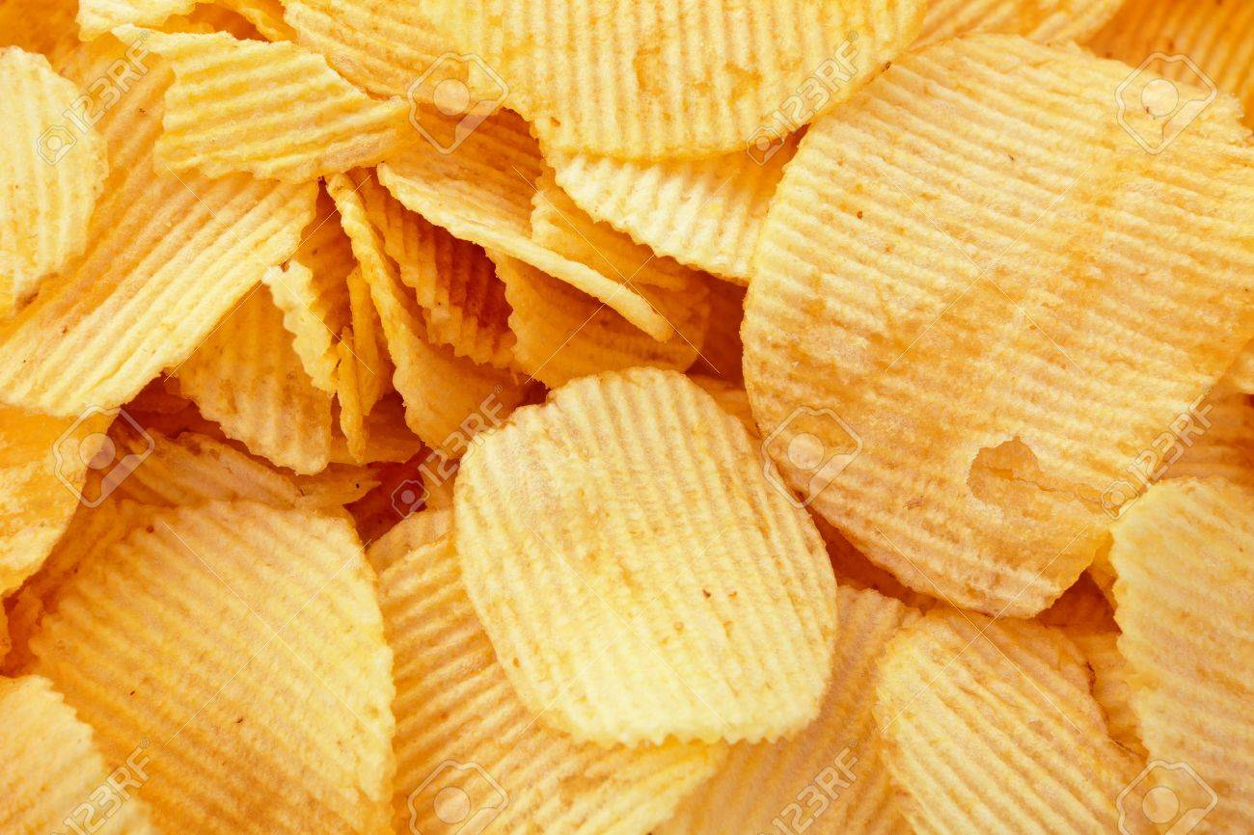
What is the name of this food ?
Chips
One type of junk food.

Slide 14
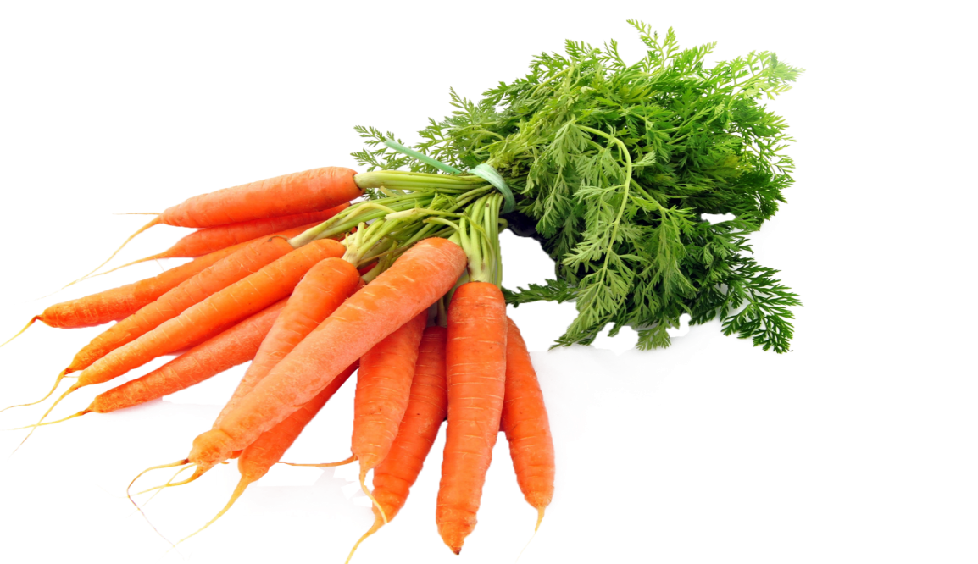
What is the name of this food ?
Carrot
One type of vegetables.

Slide 15
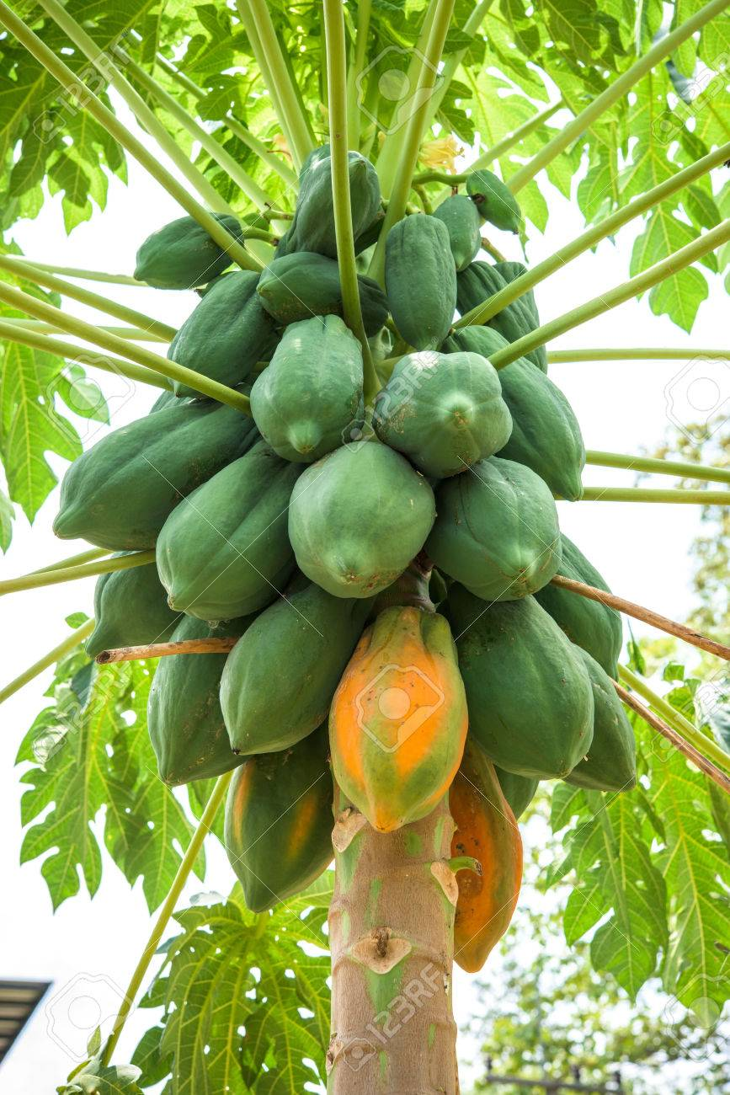
What is the name of this food ?
Papaya
One kind of fruit.

Slide 16
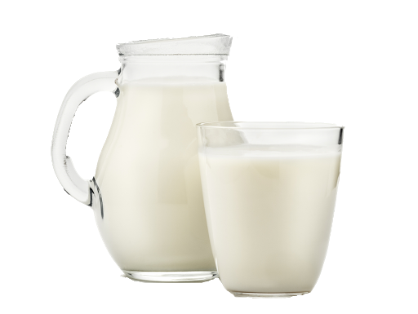
What is the name of this food ?
Milk
One kind of liquid produced by cows, goats etc.

Slide 17
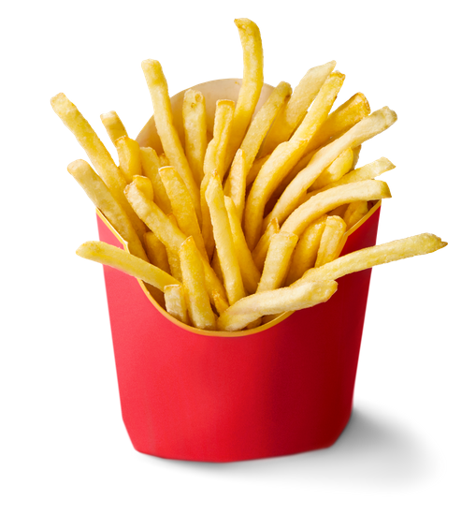
What is the name of this food ?
Fries
Cook something in hot fat or oil.

Slide 18
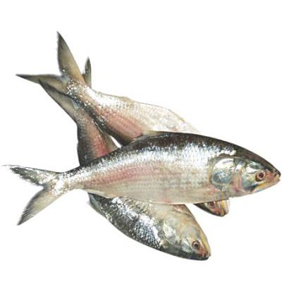
What’s this?
Fish

Slide 19
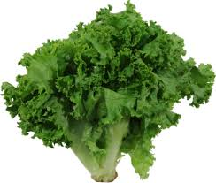
What’s this?
Lettuce
One kind of vegetables.

Slide 20
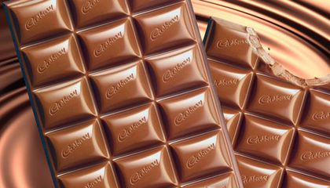
What’s this?
Chocolate
A sweet made of chocolate .

Slide 21
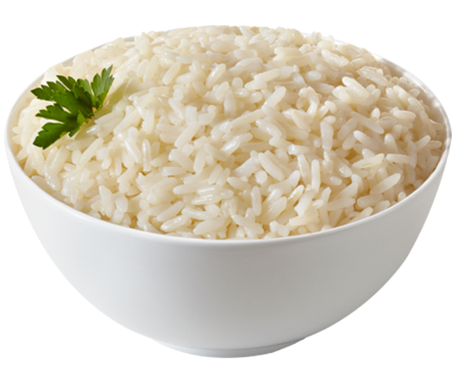
What’s this?
Rice
The starchy seeds or grain of an annual marsh grass.

Slide 22
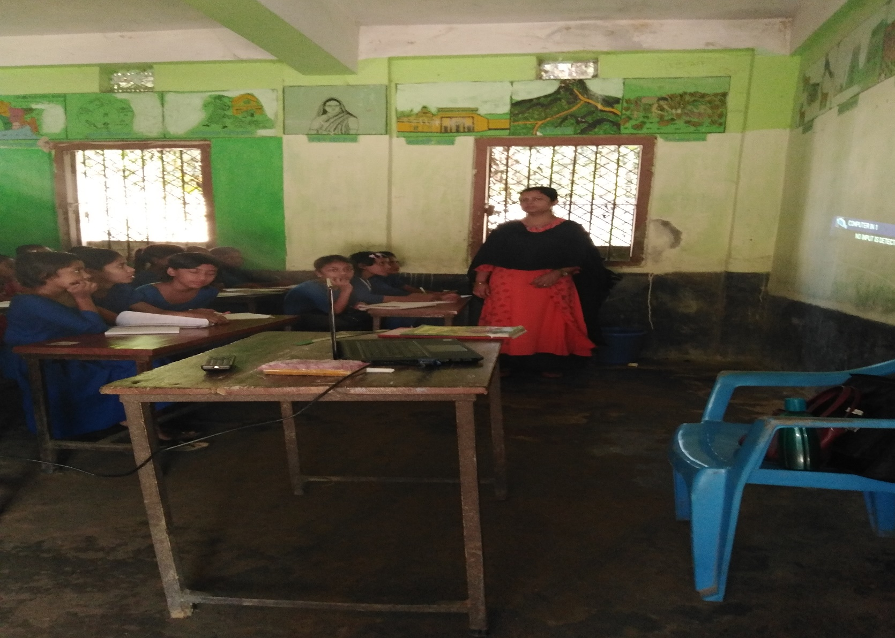
TEACHER’S LOUD READING

Slide 23
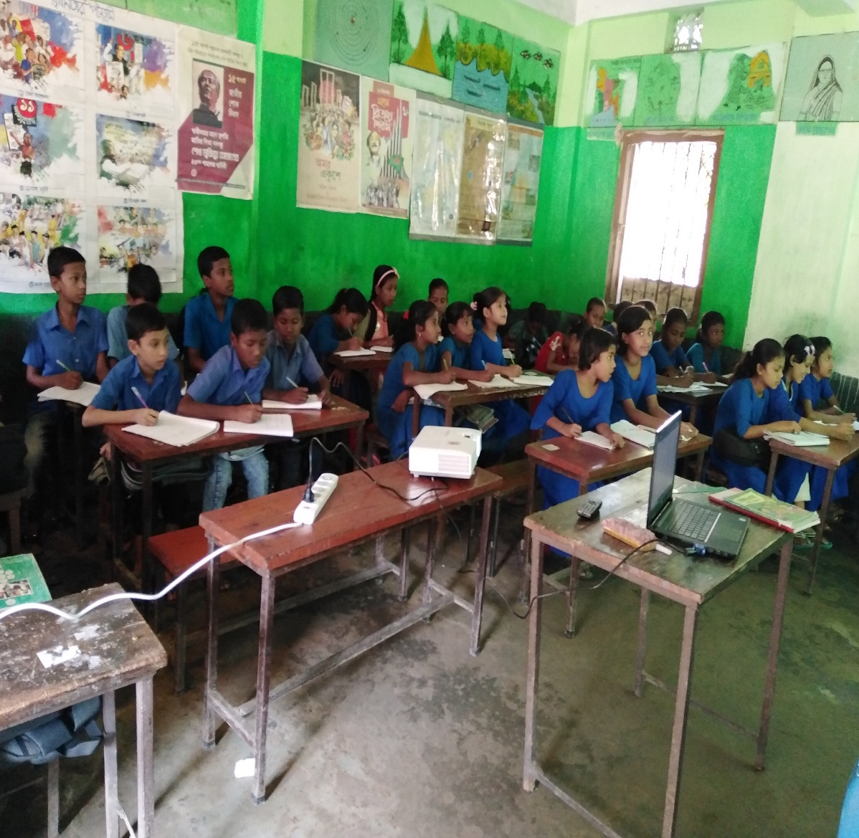
STUDENT’S SILENT READING
Open the book ,page no 22

Slide 24
GROUP WORK

Slide 25
Underline the foods you like and Circle the foods you think are healthy….

Slide 26
A. Look, listen and say
Let’s do the activity
Say the name
of
the next pictures ?
carrots
Oranges
chips
ice-cream
milk
egg

Slide 27
Let’s talk about food such as talking A & B.
          A: Do you like Ice-cream ?
          B: Yes, I like ice-cream. You?
          A: I like .too
          B: I also like chocolate.
          A: I don’t like it.

Slide 28
HOME WORK
Write the name of ten healthy foods.
Write the name of ten unhealthy foods.

Slide 29
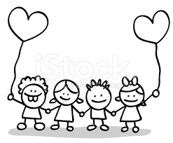

GOODBYE

