Slide 1
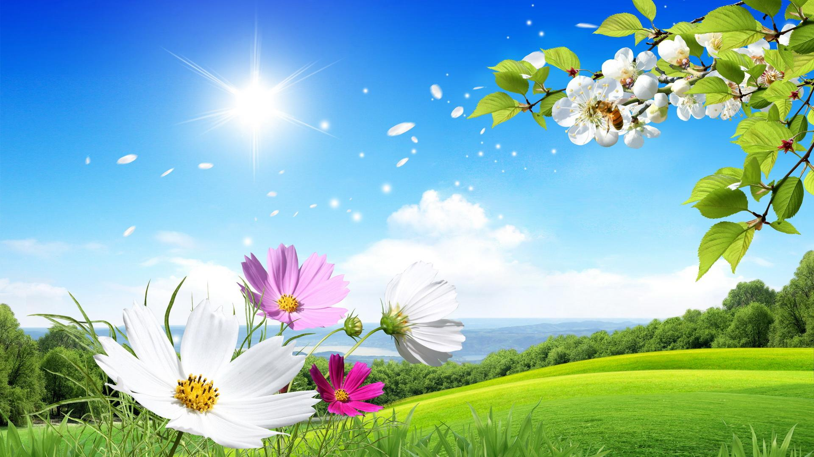
Welcome
To the Students
of class
five

Slide 2
Teacher’s Identity
Mohammad Hannan Miah
Assistant Teacher
Baniadi Govt. Primary School
Rupganj, Narayanganj
Mobile: 01977377177
E-mail: hannanmiah1@gmail.com

Slide 3
Class: Five
Subject : English
Unit : 15 (Happy Birthday)
Time : 40 minutes
Date : 07/07/2020

Slide 4
Learning Outcomes:

Slide 5
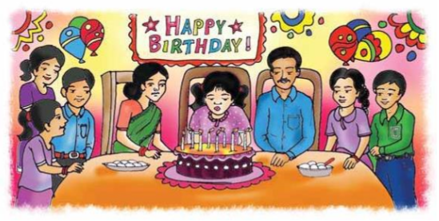
What do you see in the picture?
What are they doing?

Slide 6
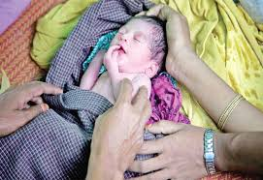
What is a birthday?
A person’s birthday is a special day. This is the date when the person was born.

Slide 7
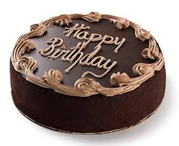
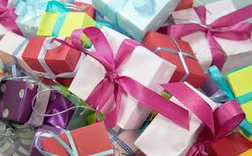
Look at the following pictures.
Birthday cake
Gift
Do you know when your birthday?

Slide 8
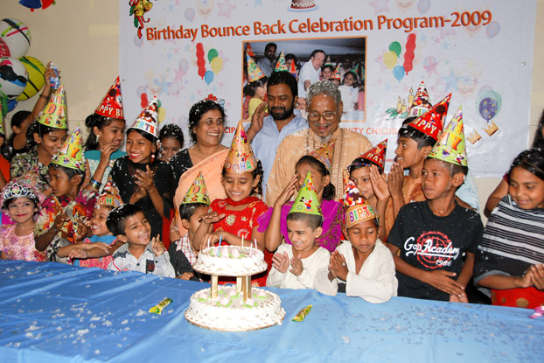
We enjoy our today’s lesson about-
Happy Birthday

Slide 9
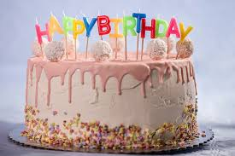
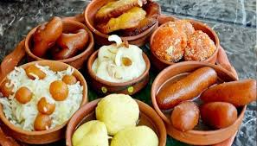
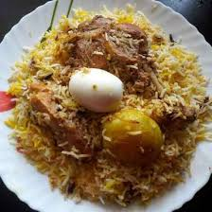
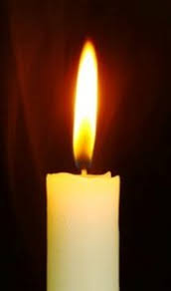
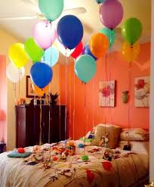
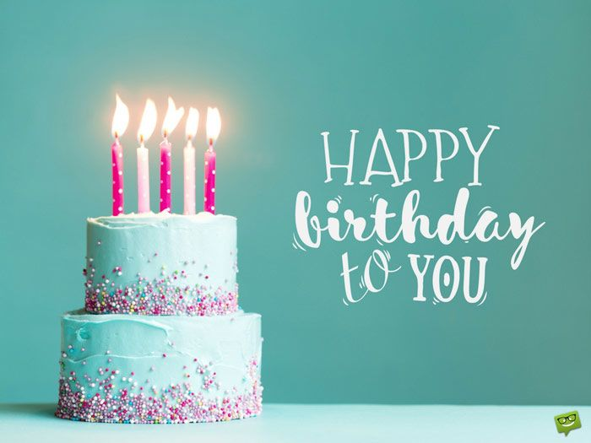
What things are needed to celebrate birthday?
cake
sweets
Special food
candle
balloon

Slide 10
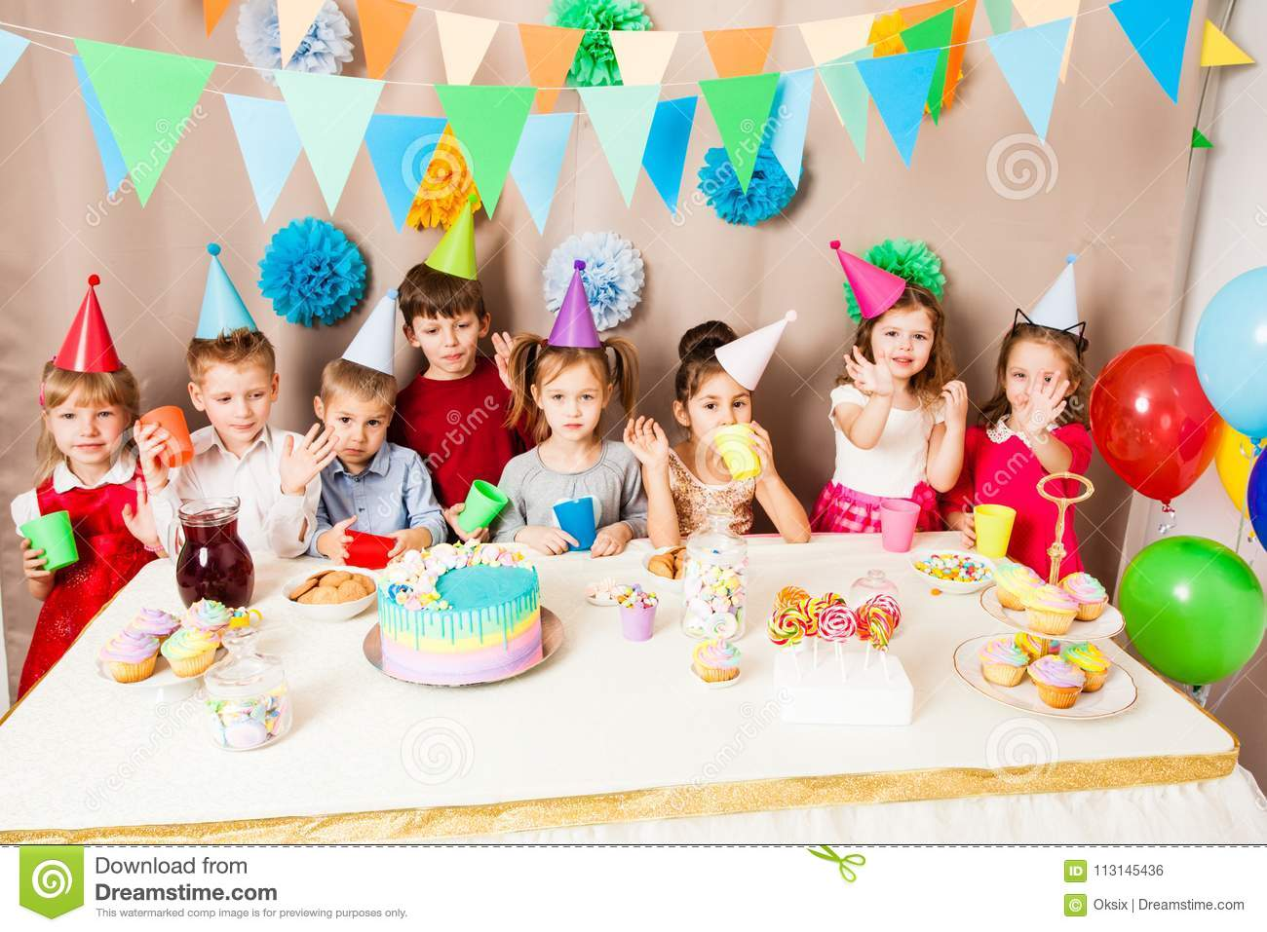
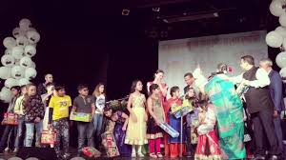
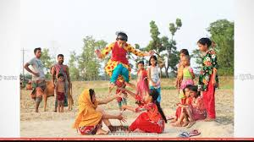
Birthday Activity
The children celebrate with a cake, play games and sing.

Slide 11
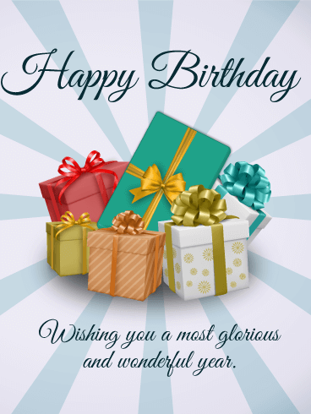
The friends often bring a birthday gift.

Slide 12
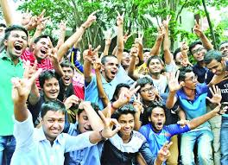
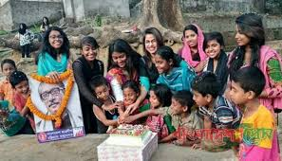
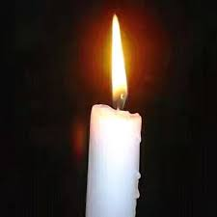
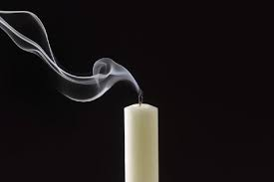
New Words
Birthday
The day when a child is born.
Enjoy
Pleasure in an activity or occasion.
Celebrate
Observe a happy day or event.
Candle
Block of wax with a wick.
Blow out
Put out fire by air.

Slide 13
Making sentences
Birthday
Today is my birthday.
Enjoy
We enjoy swimming.
Celebrate
We will celebrate our birthday.
Candle
I have a colour candle.
Blow out
Blow out the candle.

Slide 14
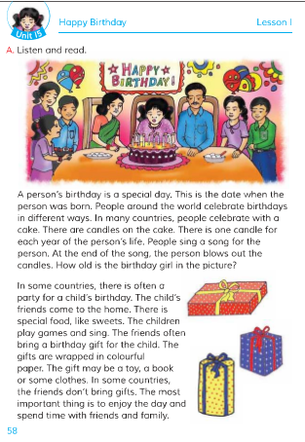
Now please open your English book
Unit: 15
Page: 58

Slide 15
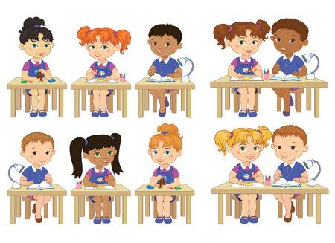
Text reading
and
Presentation

Slide 16
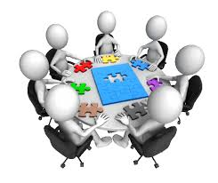
Group Work
Answer the following questions by discussing in your group
1. What day is a special day for a person?
2. Do people around the world celebrate their birthdays in the same way?
3. How do most people in the world celebrate their birthday?

Slide 17
pair Work
Write ‘True’ for correct statement and
‘False’ for incorrect statement.
1. People around the world celebrate birthdays in the same way.
2. A birthday is a special day.
3. People sing a birthday song for the birthday person.
4. The friends do not bring any gift for the birthday person.
5. The most important thing is to enjoy the day.
False
True
True
False
True

Slide 18
individual Work
Fill in the blanks with the following words:
candles, each, around, wrapped, play, often, spend.
1)People _________the world celebrate birthdays.
2)There are __________on the cake.
3)There is one candle for __________ year of the persons birthday.
4)The children __________games and sing song.
5)The gifts are ___________ in colourful paper.
around
candles
each
play
wrapped

Slide 19
evaluation
1.What is the most important thing for a birthday?
Ans: The most important thing is to enjoy the day and spend time with friends and family.
2. What do the children do on a birthday party?
Ans: The children play games and sing.
3. What do people bring to the birthday party?
Ans: People bring a birthday gift to a birthday party

Slide 20
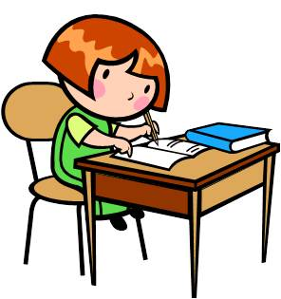
Home work
Write a short composition about
A birthday Party
by answering the following questions:
When is your birthday?
What do you do on this day?
Whom do you invite on your birthday?
What do people bring for you?
How do you enjoy the day?

Slide 21
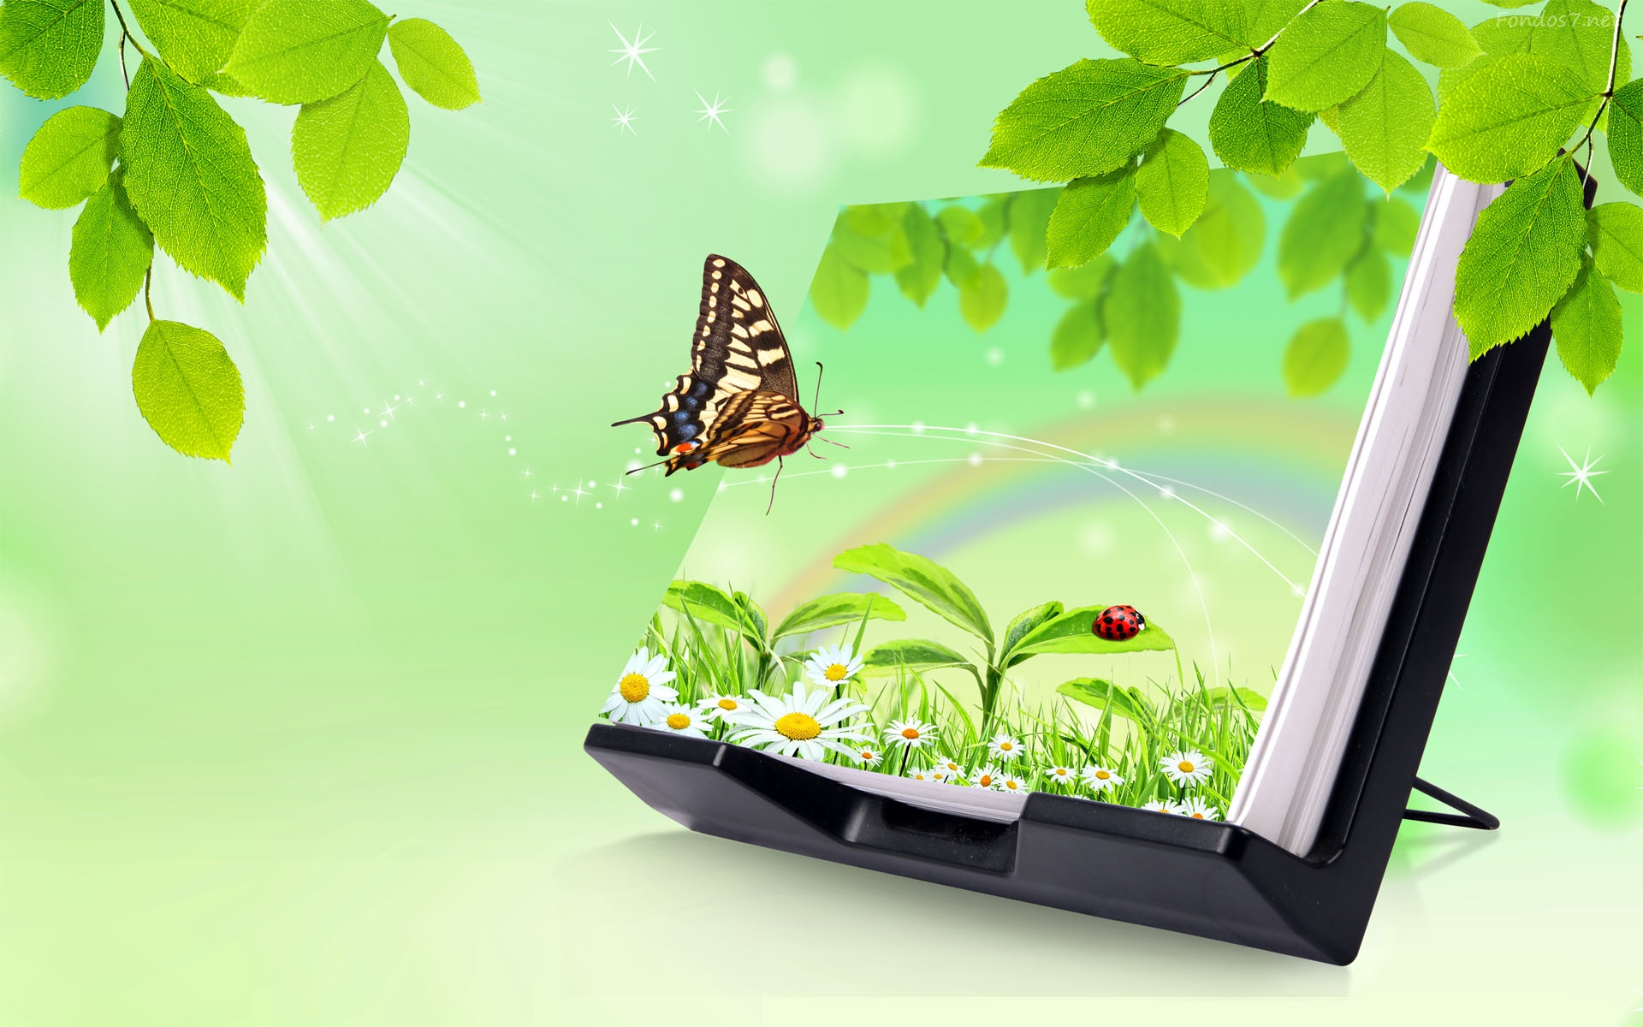
Thank You All

