Slide 1
Welcome
Notes:
Welcome slide.

Slide 2
Identity
Khandoker Mufakkher Hossain
Assistant Teacher
AftabUddin School & College
Bhagulpur, Bajitpur, Kishoregonj
CLASS: NINE-TEN
SUBJECT: ENGLISH 1ST PAPER

Slide 3
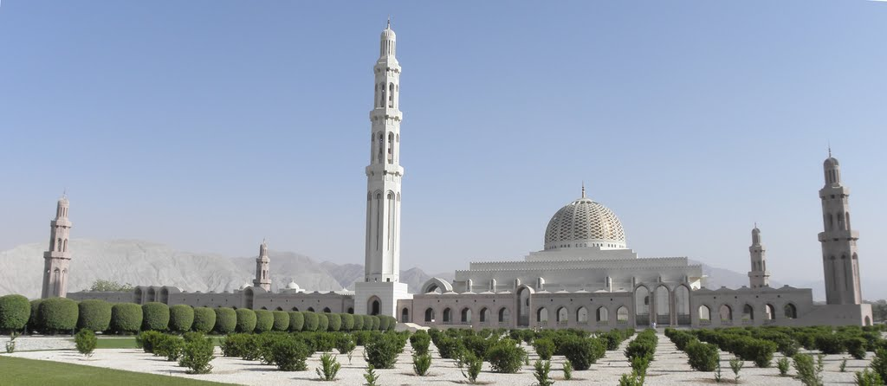

Slide 4
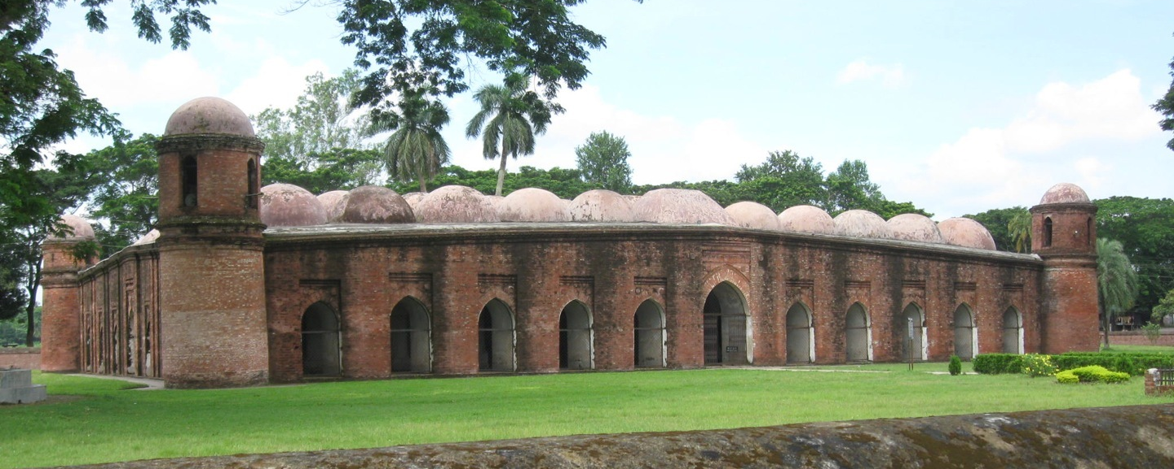
What do you see in the picture? Describe it.
This is the Shat Gombuj Mosque. It is one of the historical places of Bangladesh. It is also one of the world heritages.

Slide 5
Today our topic is
The Shat Gambuj Mosque
Unit- 8
Lesson- 1

Slide 6
Our Today’s Lesson is-
Knowledge, skills and attitudes
Unit-1, Lesson- 2

Slide 7
Learning Outcomes Of The Lesson
After this lesson the students will be able to-
1. talk about a picture.
2. listen for specific information.
3. read and understand the text through silent reading.
4. write about a place.
5. infer the meaning from the text.
Notes:
All the four skills of English will be focused in this lesson.

Slide 8
First read the questions then listen to the audio about the Shat Gombuj Mosque and choose the best answer.
1. How many world heritage sites are there in Bangladesh?
a) one b) two c) three d) four
$$$$
2. Where is the Shat Gombuj Mosque situated in?
a) centre of Bagerhat b) out of Bagerhat
c) suburb of Bagerhat d) centre of Khulna
$$$$
3. Which have worn away with the passage of time?
a) pillars b) domes c) doors d) roof
$$$$
4. When Khan Jahan Ali established this mosque?
a) before 1405 b) after 1405
c) before 1459 d) after 1500
$$$$

Slide 9
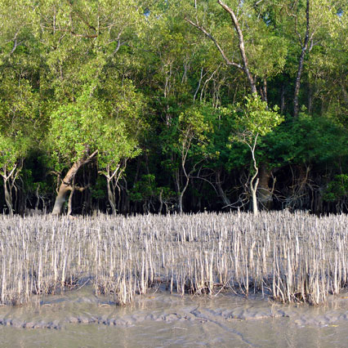
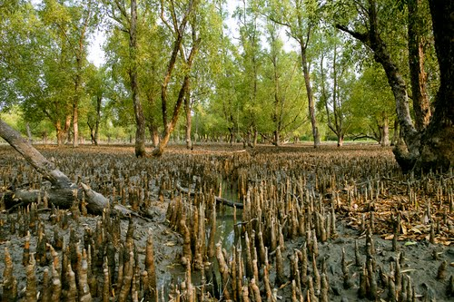
Mangrove
A tree or shrub that grows in wet mud at the edge of river
Meaning
Sundarban is a mangrove forest.

Slide 10
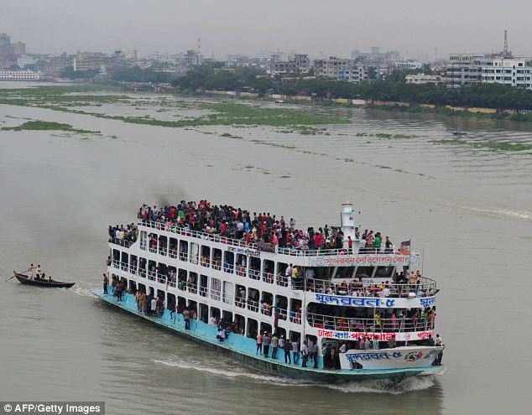
Outskirts
The outer parts of a town or city.
Meaning
The Buriganga river is at the outskirts of Dhaka city.

Slide 11
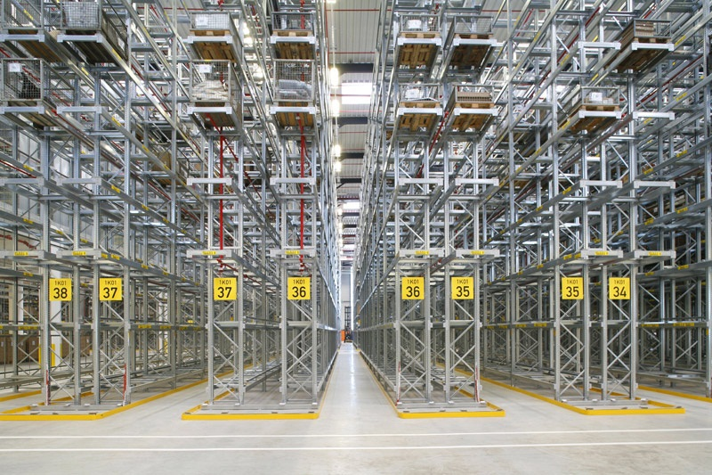
Meaning
Path/ corridor
We can see five aisles in the picture.

Slide 12
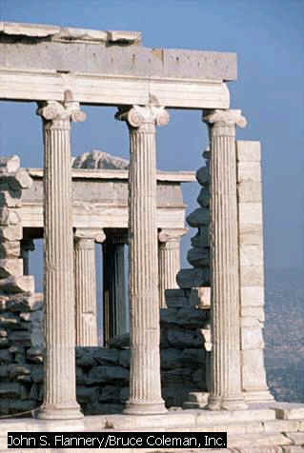
Slender
Column
A tall pillar made of stone
Thin
Few slender columns of the destroyed building are still standing.

Slide 13
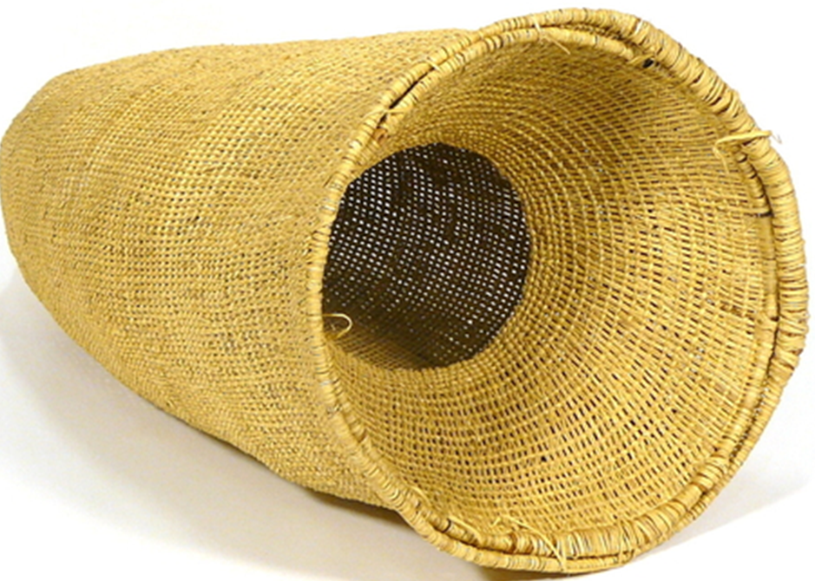
Hollow
Empty space inside
Meaning
Hollow
There is a hollow in the basket.

Slide 14
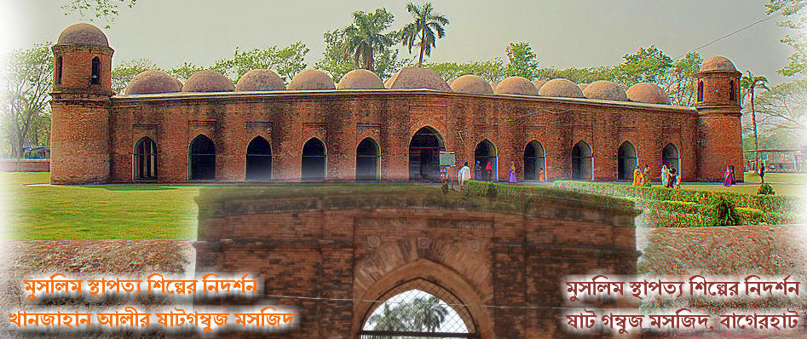
Have a look outside the mosque.
Four corners have 4 smaller dooms
77 low height dooms
11 Arched doorways on east

Slide 15
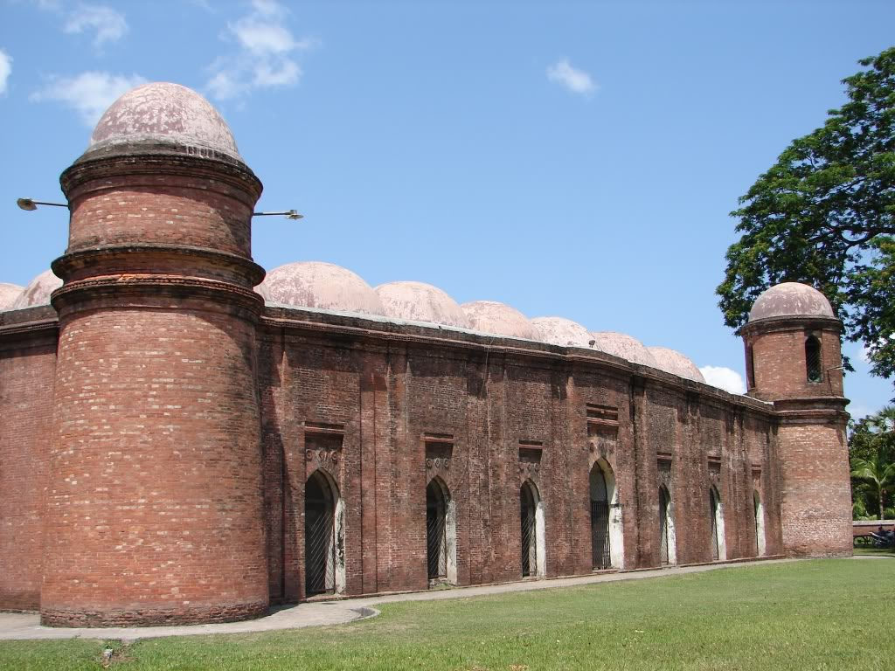
7 Arched doorways each on north and south

Slide 16
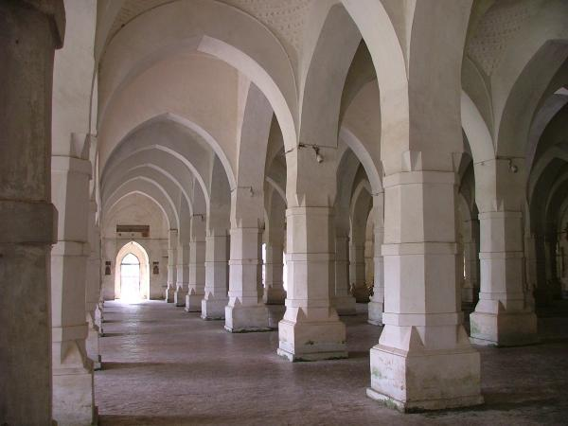
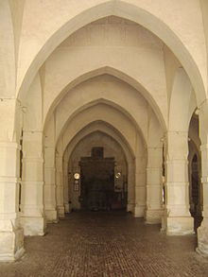
What do you see inside the mosque?

Slide 17
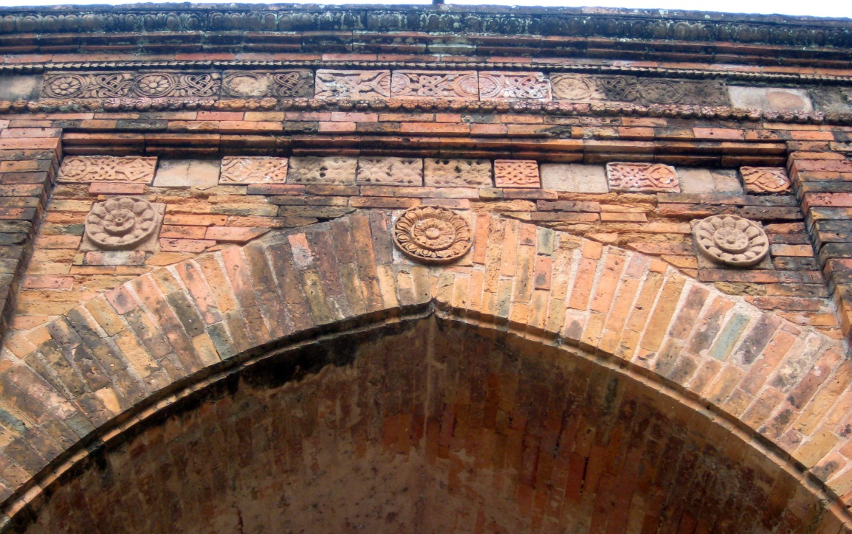
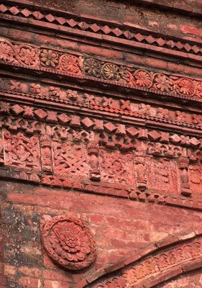
The interior western wall of the mosque is beautifully decorated with terracotta .

Slide 18
Read the text in the book and write the answers of the following questions.
Q 1. Why is the Shat Gombuj Mosque a world heritage?
Q 2. How are the decorations of the mosque?
Q 3. Why were there many doorways in the mosque?
Q 4. For what purpose was the mosque used?

Slide 19
Read the text again and fill the table . [pair work]
Who/What | Event/Activities | When/Why
The Shat Gombuj Mosque | a) …………….. | in 1985
It | was founded | b) ………………
Khan Jahan Ali | c) ……………... | to fit the city to live in.
The mosque | is unique | d) ….………….
It | e) ……………… | for its architectural beauties.
a) became a UNESCO World Heritage Site
b) in the 15th century.
c) built a networks of roads, bridges, public buildings and reservoirs
d) for its 60 pillars that supports the roof with 77 low height domes.
e) attracts the tourists

Slide 20
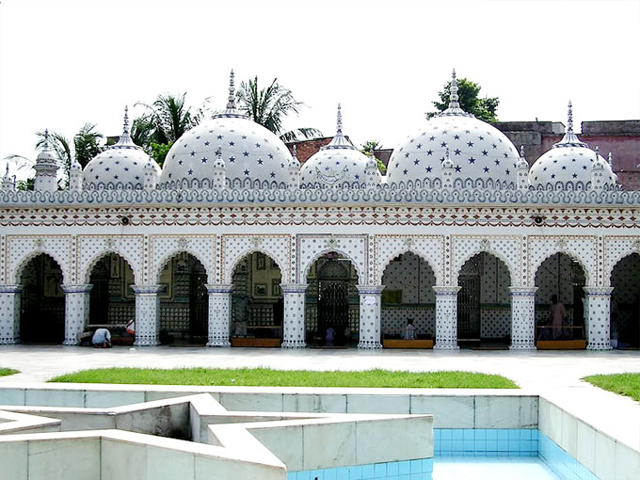
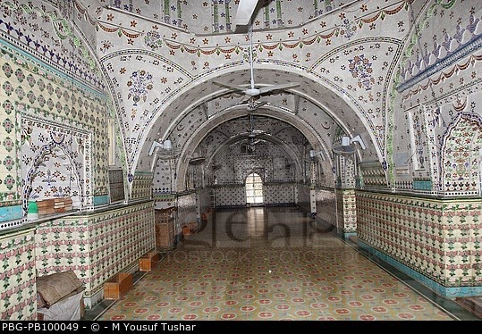
Group work
Look at the picture of the Star Mosque in Dhaka. Write a description on the Star Mosque with the help of the given clues. ( See the clues in the text book).
Notes:
Teacher may conduct rest this session manually by silent reading and loud reading according to his will.

Slide 21
Homework
Do your area has such building like the Shat Gombuj Mosque or the Star Mosque? Write about that building. (Not more than 15 lines)

