Slide 1
WELCOME

Slide 2
INTRODUCTION
Suranjit Talukder
( BA, B-Ed; MSS, M-Ed; C-in-Ed )
Assistant teacher
Voishber Govt. Primary School.
Sunamgonj Sadar , Sunamgonj.
Class: Five
Subject: English
Unit:14 ,Lesson: Two
Date:
Time:40 Minutes

Slide 3
CREATING EMOTION
Good morning , students.
Good morning , teacher.
How are you?
Fine . And you?
I’m also fine. Do you want to enjoy sing a song?
Let’s sing a song …

Slide 4
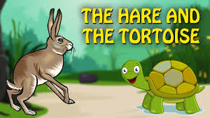
Today’s topic is ……..

Slide 5
LEARNING OUTCOMES
Students will be able to………
enjoy and understand simple stories.
say words, phrases and sentences with proper sounds, stress and intonation.
To read silently with understanding simple sentences , paragraphs and other texts.
To make sentences using words and phrases.

Slide 6
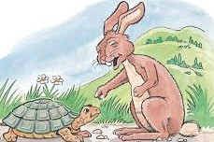
Please think about the picture and discuss in pair
What do you see in the picture?
The hare is teasing the tortoise

Slide 7
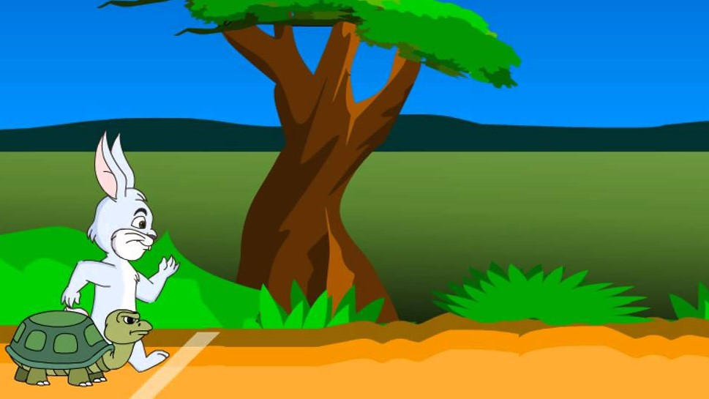
Please think about the picture and discuss in pair
What do you see in the picture?
The Hare and the Tortoise are ready to start their race.

Slide 8
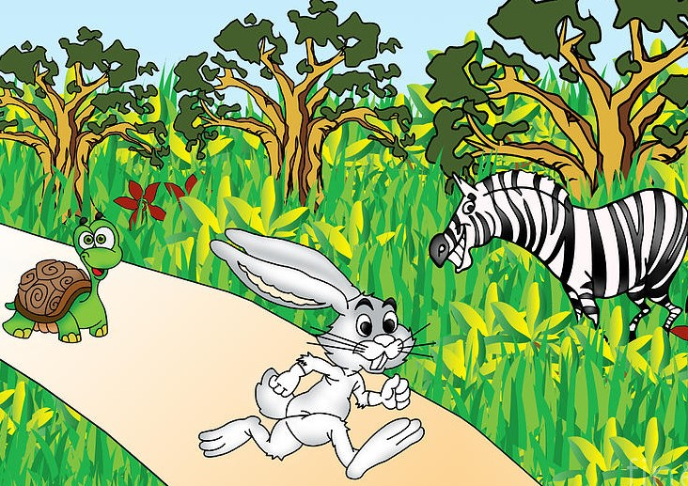
Please think about the picture and discuss in pair
What do you see in the picture?
The race has been starting between the hare and
the tortoise and others are enjoying .

Slide 9
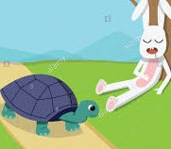
Please think about the picture and discuss in pair
What do you see in the picture?
The Hare is sleeping and the Tortoise is running.

Slide 10
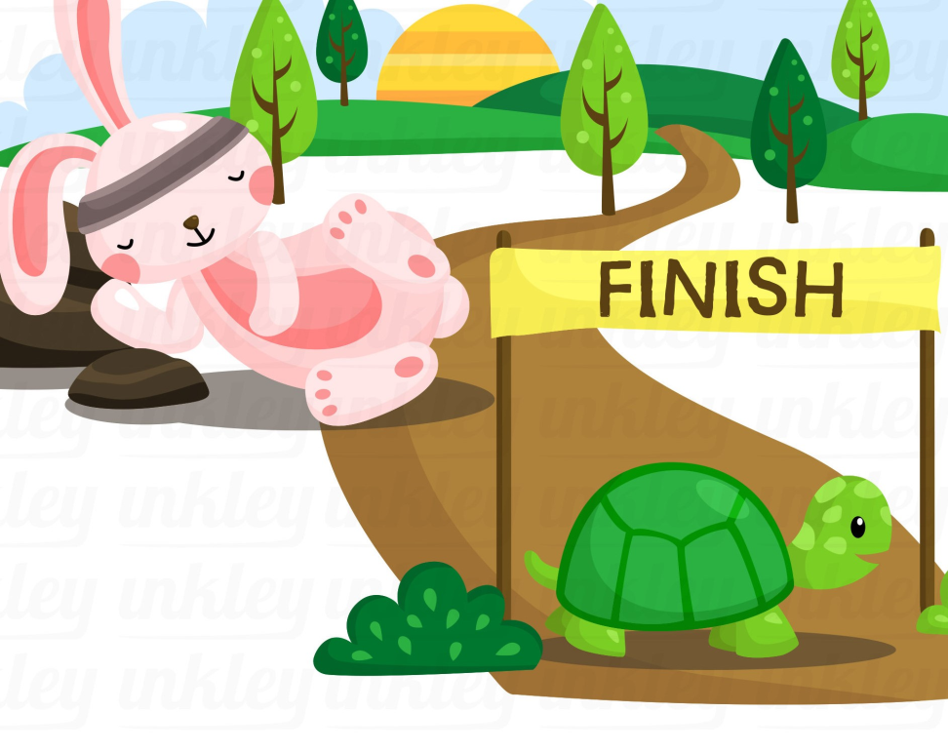
Please think about the picture and discuss in pair
What do you see in the picture?
The Tortoise is already at the finish line but the hare is sleeping.

Slide 11
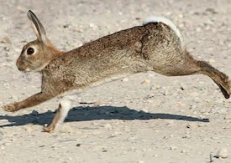
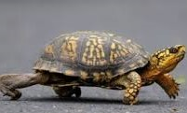
New Words Meanings
Hare : Rabbit
Tortoise : Turtle

Slide 12
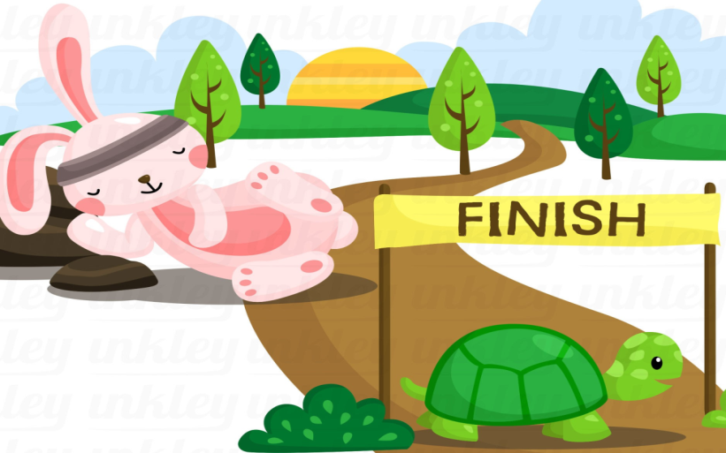
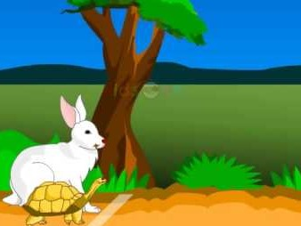
New Words Meanings
Finish : End
Began: Started

Slide 13
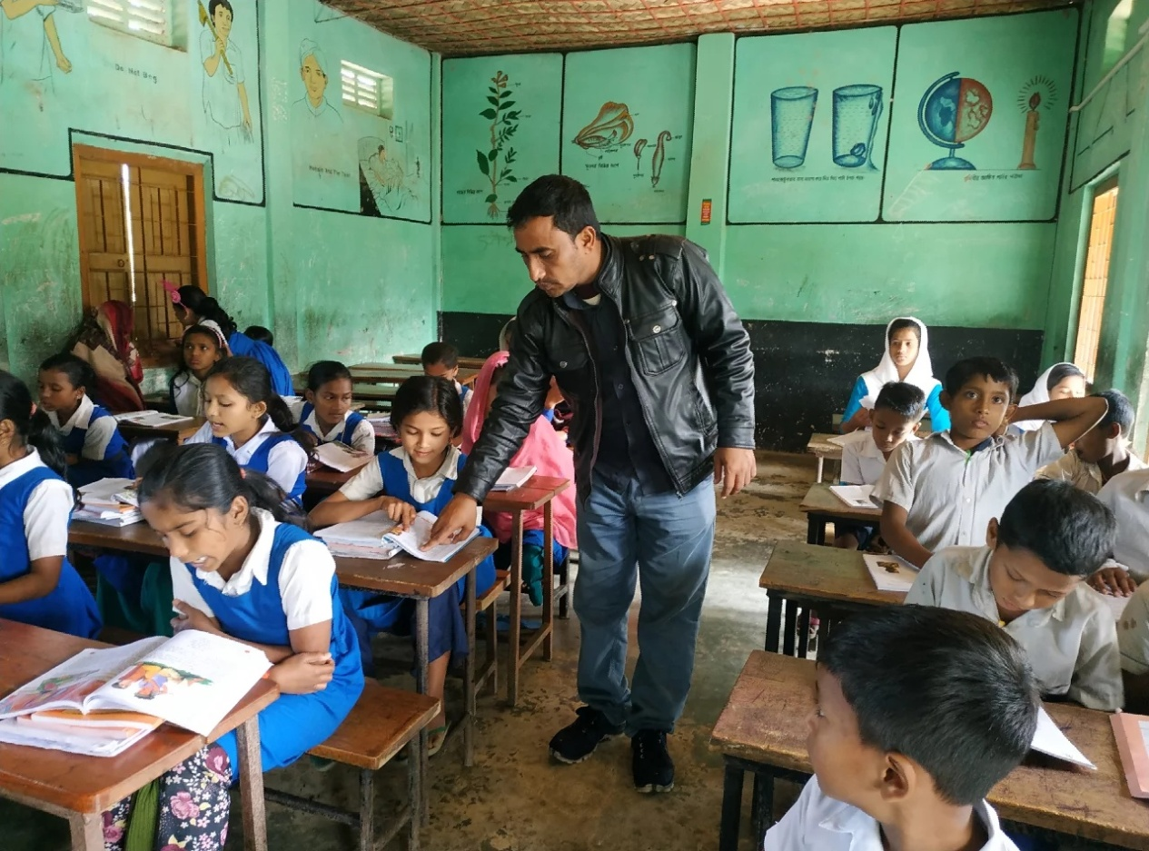
Listen to the text with me and put your finger under the line.

Slide 14
Now read loudly after me.

Slide 15
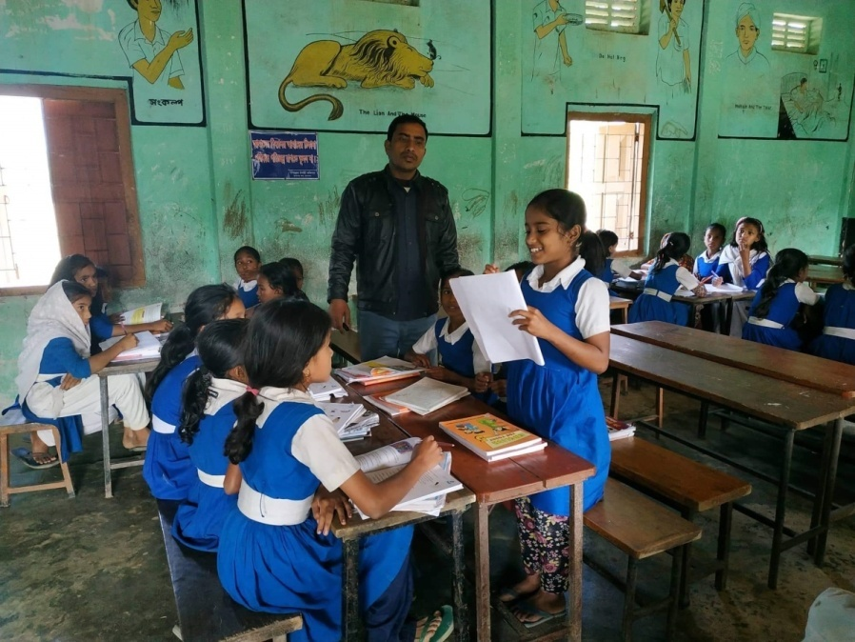
A student will be selected from every group to present their group work.

Slide 17
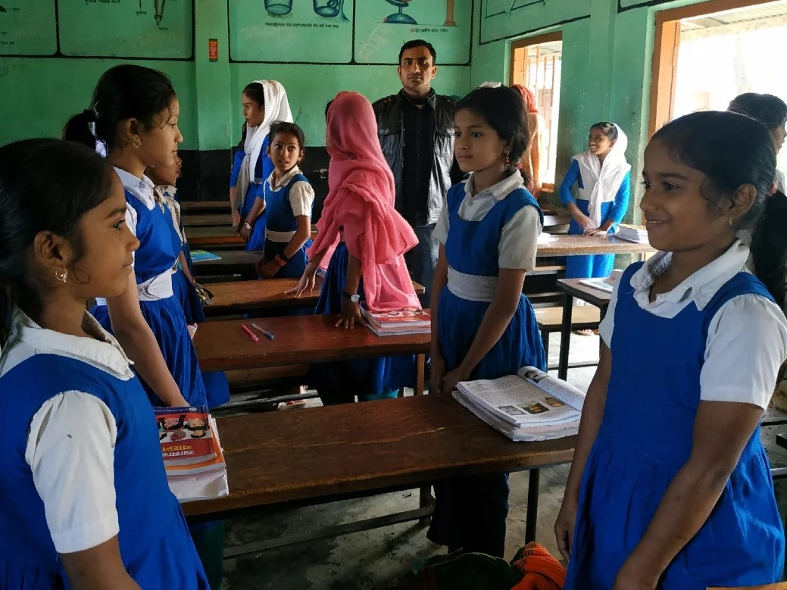
Pairwork.

Slide 18
Indivisual work
Write the answer.
1.What did the hare say to himself?
2.How much time did the sleep?
3.When did the hare wake up?
4.What did the tortoise say to the hare at last?
5. Who won the race?

Slide 19
PAIR WORK
True or False
1.The tortoise was the fastest animal in the forest.
2.The hare was the slowest animal in the forest.
3.The tortoise felt angry .
4.The hare took a nape.
5. The tortoise won the race.

Slide 20
Homework
Write the meanings of the following words and then make sentences by using them.
Hare, Tortoise, Forest, Animal, Race, steadily, , smiled, won,.

