Slide 2
Welcome

Slide 3
Presentation by
Aung Shing Thoing
Assistant of
Thaikhong para Govt. primary school
Thanchi, Bandarban.

Slide 4
Introduction of the lesson
Class : Three
Unit : 23
Lesson Title : What do they do(4-6)
Today’s lesson : A
Total time : 40 Minute

Slide 5
Learning Outcomes
By the end of the lesson the students will able to
Listening : 1.1.1 recognize English sound differences in
the context of words.
Speaking : 1.1.1 repeat words, phrases and sentences
after the teacher with proper sounds and
stress.
Reading : 1.5.1 read simple sentences with proper
pronunciation and stress.

Slide 6
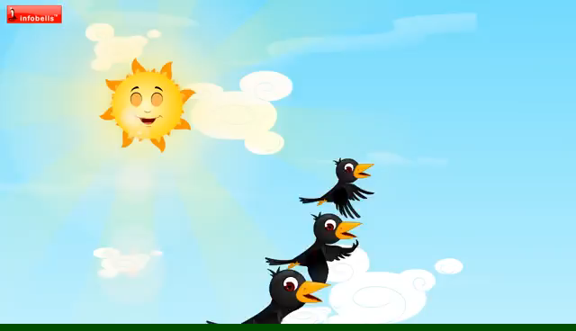
Let’s watch a videos

Slide 7
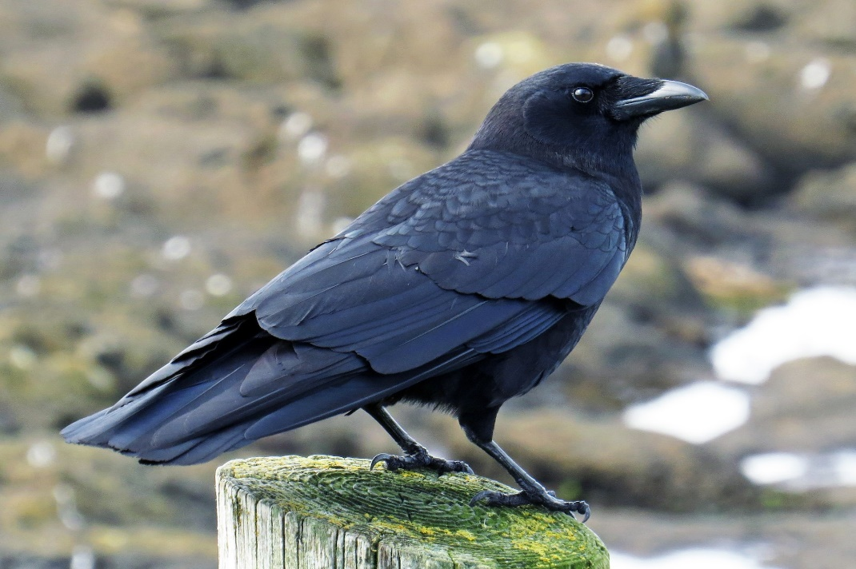
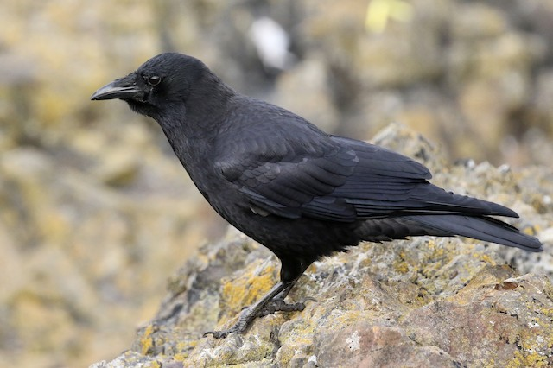
Look at the picture
Students, you can recognize this bird?
What is the name of the bird?
The bird name is crow.
Today we will learn about crows.

Slide 8
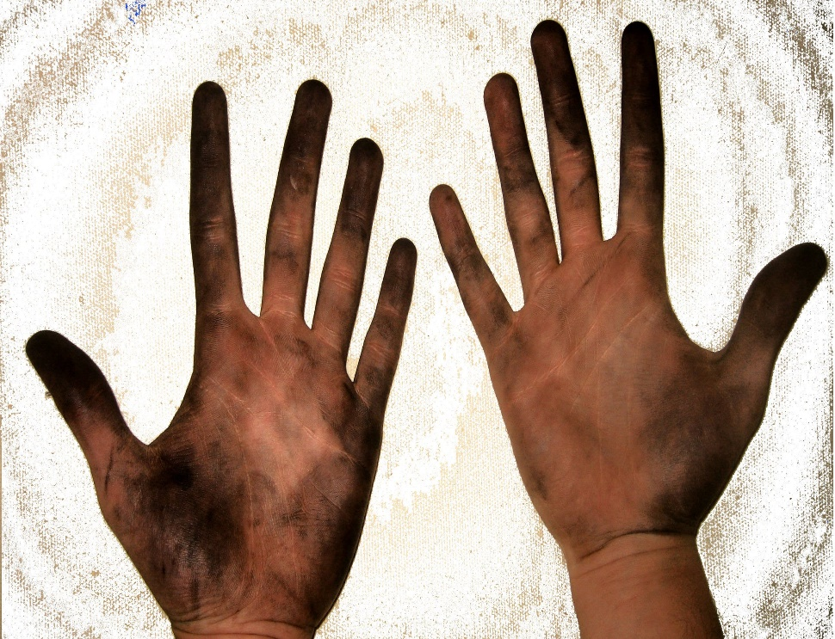
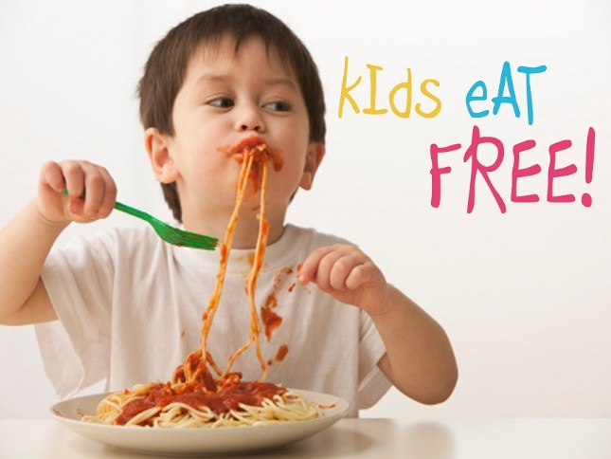
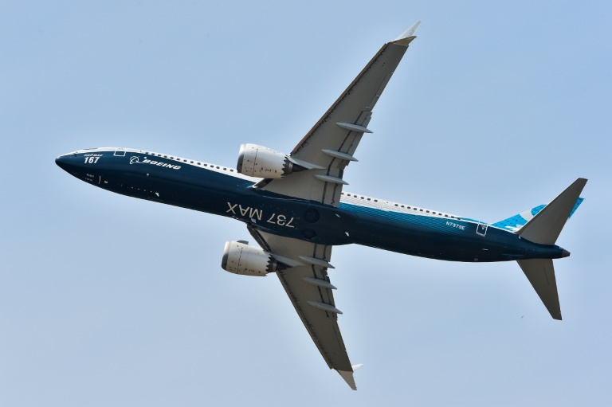
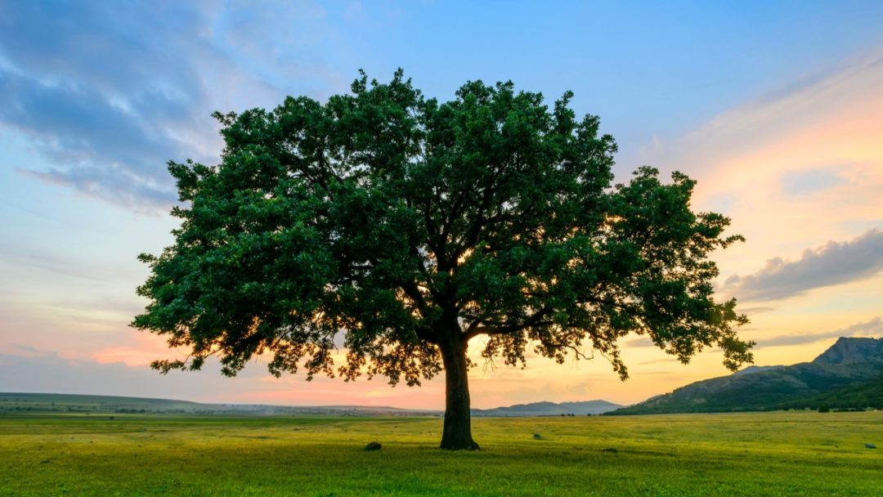
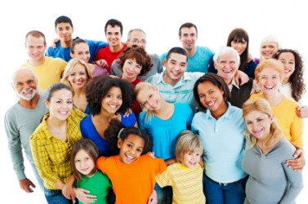
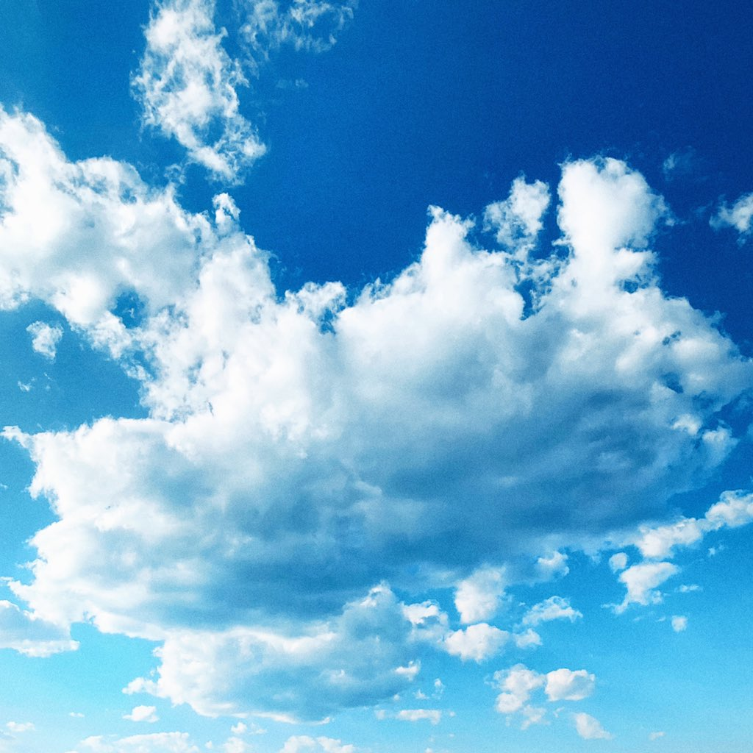
New word
The heavens
Take food
A woody plant.
Not clean
Go by airplane
Persons generally
Eat
People
Sky
Dirty
Fly
Tree
This is a tree.
The blue sky.
The plane fly in the sky.
This hand is dirty .
The boy is eating noodles .
The people are very nice.

Slide 9
Word meaning
ময়লা
খাওয়া
জনসাধারণ
আকাশ
উড়া
গাছ
Dirty
Eat
People
Sky
Fly
Tree

Slide 10
Teacher Reading

Slide 11
Students Reading

Slide 12
Individual work
1. Where does the crow live?
a) Stable b) tree c) home d) River
2. The crow ___ up early in the morning.
a) Gone b) got c) get d) gets
3. Who takes food from people?
a) Crow b) cow c) hen d) dog
4. The crow eats ______ things.
a) Dirty b) fresh c) good d) vitamin

Slide 13
Pair work
Match the word words in column A with their opposites in column B
A | B
Take | Early
Clean | Lazy
Quickly | Dirty
Active | Give
Late | Slowly

Slide 14
Group work
Make five sentences from the table below
The crow | Gets Is Eats flies | Active all day. Dirty things. Up early. A common bird. In the sky.

Slide 15
Checking learning
True/False
1. The crow lives in a tree.
2. The crow gets up late in the morning.
3. The crow is lazy.
4. The crow takes food from people.
5. The crow is slow.
6. The crow doesn’t eat dirty things.
True
False
False
True
False
False

Slide 16
Home task
# Write five sentence about the crow.

Slide 17
Thanks all students

