Slide 1
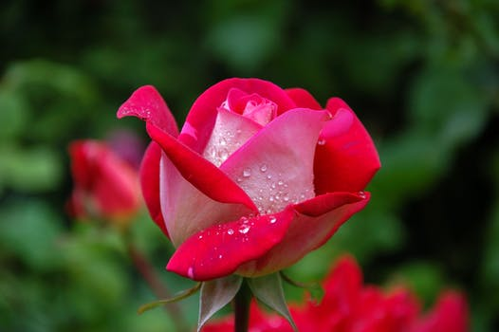
WELCOME

Slide 2
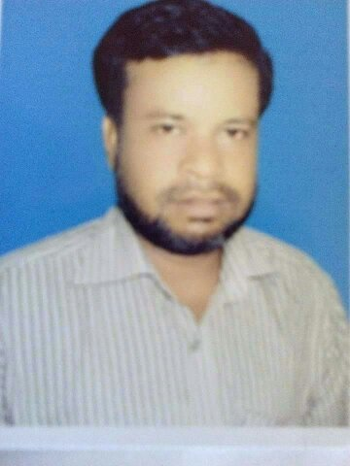
Prepred By
Md. Mukul Mia M.A in English, B.Ed
English Teacher
M.A Sattar Adarsha High School,Kurigram.
Mob:0171717171741
E-mail:mukulict30@gmail.com

Slide 3
Class-vi
Lesson-17
Subject-English 1st Paper
Title of the lesson-
“Hason raja”

Slide 4
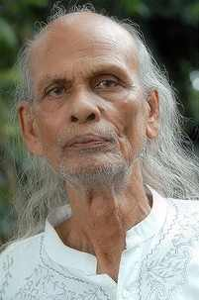
Look at the picture.
Do you know who is the man?

Slide 5
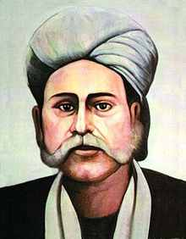
Do you know who is the man?

Slide 6
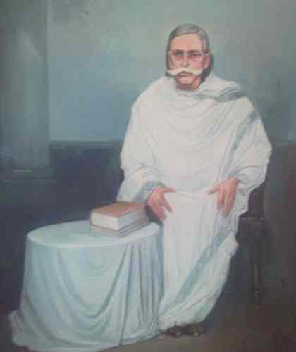
So today’s topic is
HASON RAJA;
The mystic bard of Bangladesh

Slide 7
By the end of the lesson Students will be able to—
Ask and answer question
Read and understand text.
Write short
composition.

Slide 8
Vocabulary
mystic
supernatural
meditation
Thought, contemplation.
bard
Poet, lyricist
luxury
Lavishness, opulence.
crazy
Wild, passionate, mad.

Slide 9
Read the text and answer the question;
Hason Raja was born in 1854 in a welthy landlord’s family in Sylhet.
He did not receive much formal education.
In his youth, he led a life of luxury.
Hason Raja wrote a lot of songs, about a thousand in number.
His book called ‘ Hason Udash’ was a published in 1906.

Slide 10
1.When was Hason Raja born?
2.When his book “Hason Udas” was published?t

Slide 11
GROUP WORK

Slide 12
Read the text and make a five sentences from the table;
Hason Raja His songs He | Are Was brought up Found Is called | In the midst of comfort and pleasure.
 |  | All sorts of pleasure and comfort insignificantly.
 |  | A famous mystic poet in Bangladesh.
 |  | Himself ‘Pagla Hason Raja’
 |  | Popular not only in Bangladesh but also in west Bengal in India

Slide 13
Evaluation;
(a) When was Hason raja born?
Hason raja was born in 1854
(b) Where did he come from?
Ans; He came from Sylhet.
(c) What was his childhood like?
Ans; Full of luxury, comfort and pleasure.
(d) How many songs did Hason Raja write?
Ans; 500

Slide 14
Home work
Write a paragraph based on the text’s information about “Hason Raja’. The paragraph should not exceed 70 words.

Slide 15
THANK YOU

