Slide 1
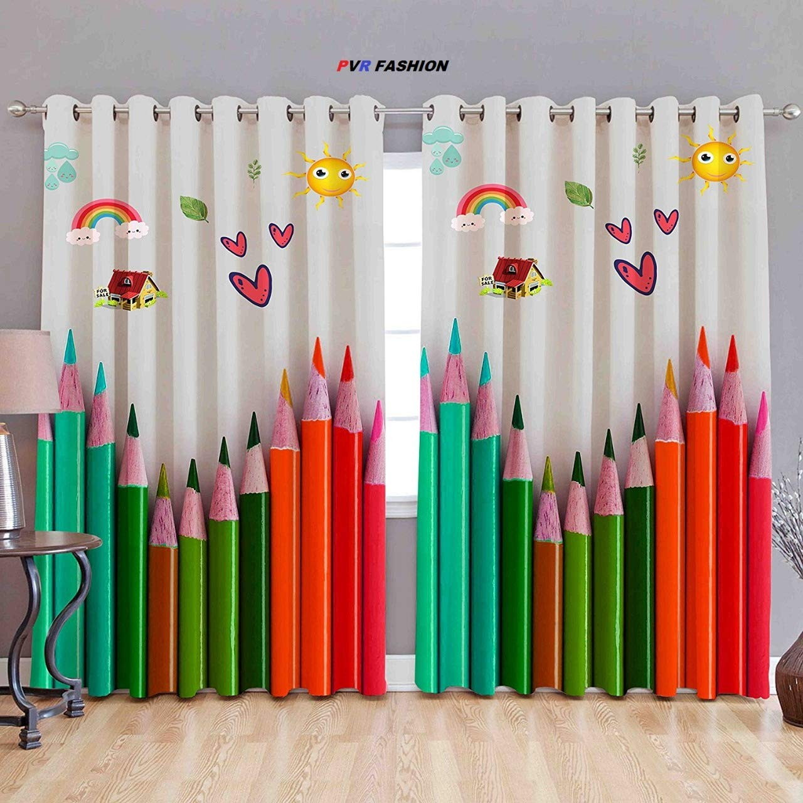

Slide 2
Welcome to my class.

Slide 3
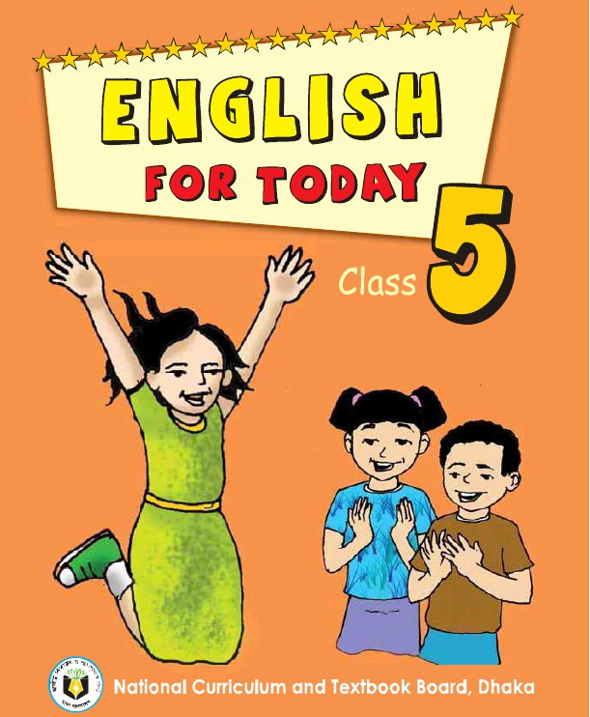
Identity
Khalidur Rahman Manik
Assistant Teacher
Khasgaon GPS
Chhatak Sunamganj.
EFT
Class:5
Unit:19
Activity: A (P:1)

Slide 4
Good morning dear students.
How are you today?
Let’s sing the good morning song
together with clap.

Slide 5
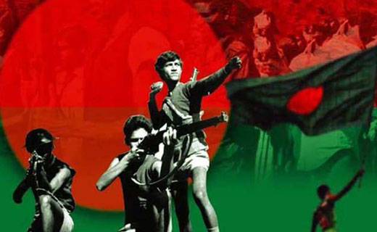
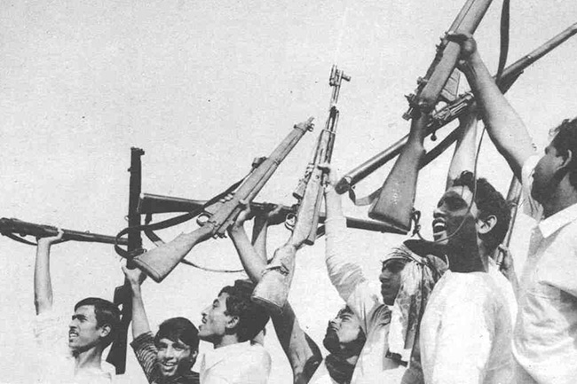
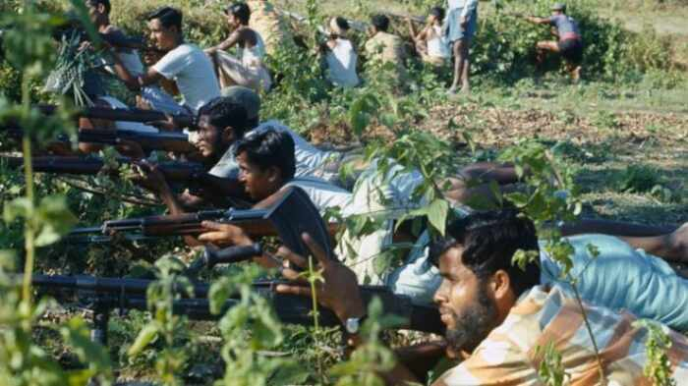
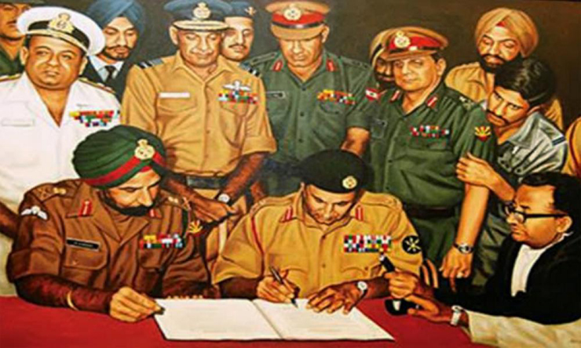
Look at the pictures.
What are the pictures about?
The pictures are about our Liberation War.
Can you guess about our today’s lesson?

Slide 6
Our today’s lesson is…
A visit to the Liberation War Museum.

Slide 7
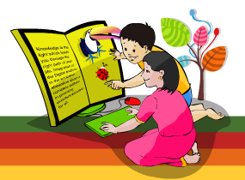
Learning outcomes.
Students will be able to…
understand and enjoy simple stories;
say words, phrases and sentences with
proper sounds and stress;
read words, phrases and sentences in the text
with proper pronunciation, stress and intonation.

Slide 8
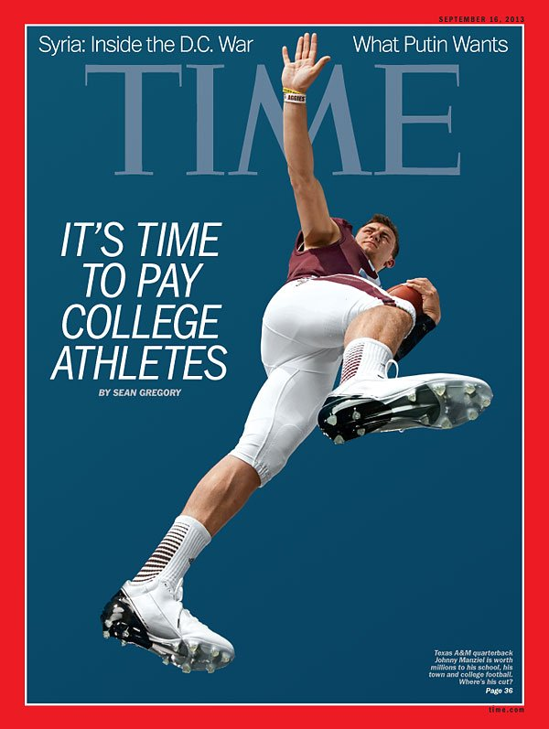
Look at the pictures and say.
Magazine is a kind of large thin book which
is published every week, month or year.
What do you see in these pictures?
Some Magazines.
Do you know, what is Magazine?

Slide 9
Our today’s lesson is from
a School Magazine. It’s
name is Sunshine Magazine.
It’s by and for the class 5
students.

Slide 10
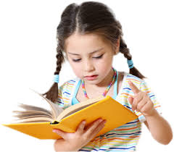
Individual Work
Answer the following questions.
What does Liberation War mean?
The fight for Independence.
Can you tell what The Liberation War Museum
is called in Bangla?
মুক্তিযুদ্ধ যাদুঘর।

Slide 11
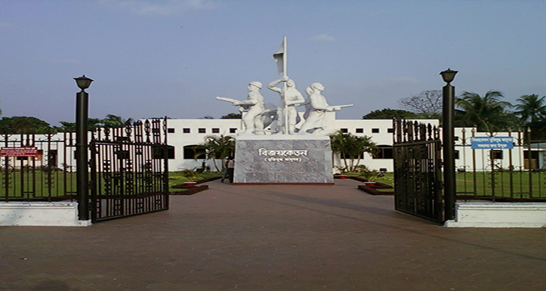
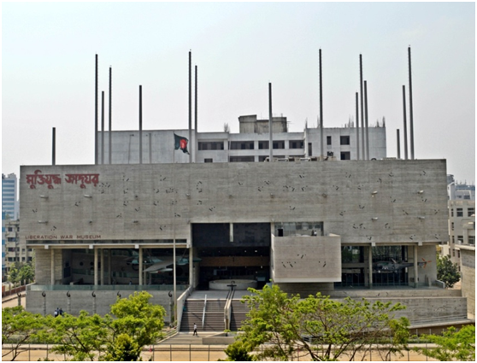
Look at the pictures.
Liberation War Museum. Segunbagicha, Dhaka.
What do you see in these pictures?

Slide 12
Listen to the audio of this text.
Listen to the audio again and repeat after it.

Slide 13
Teacher’s loud reading.
Open at page
74 and repeat
after me.

Slide 14
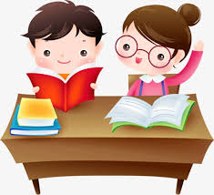
Pair Work
Find out new words from the text and then make sentences.
liberation
independence
Our Liberation War took place in 1971.
warmly
cordially
I invite you warmly.
tour
trip
Our last tour was to Srimangal.
different
various
We visited different book stalls.
gallery
hall
There were 6 galleries.
exhibit
show
He exhibited his paintings.

Slide 15
Students’ silent reading
Read the text silently

Slide 16
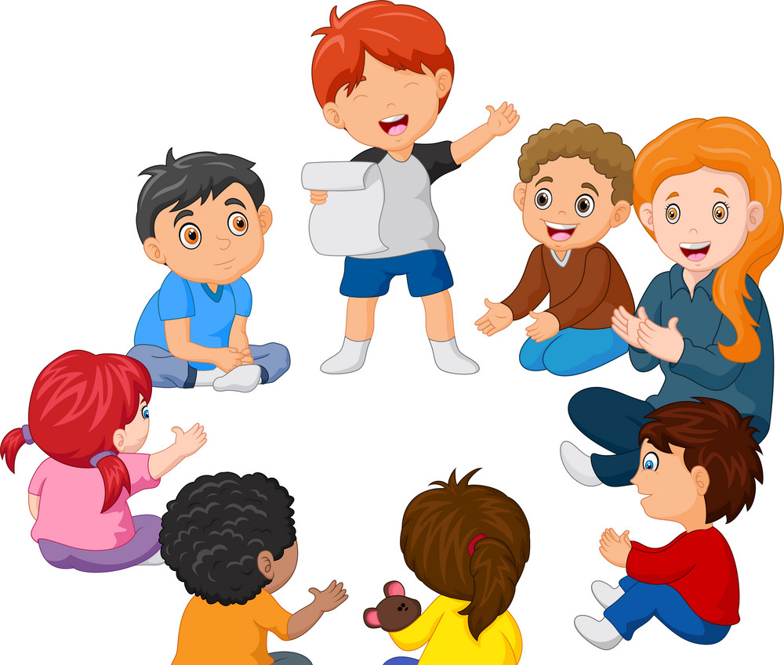
Group Work
Read the text in groups by turns with proper
sounds and stress.

Slide 17
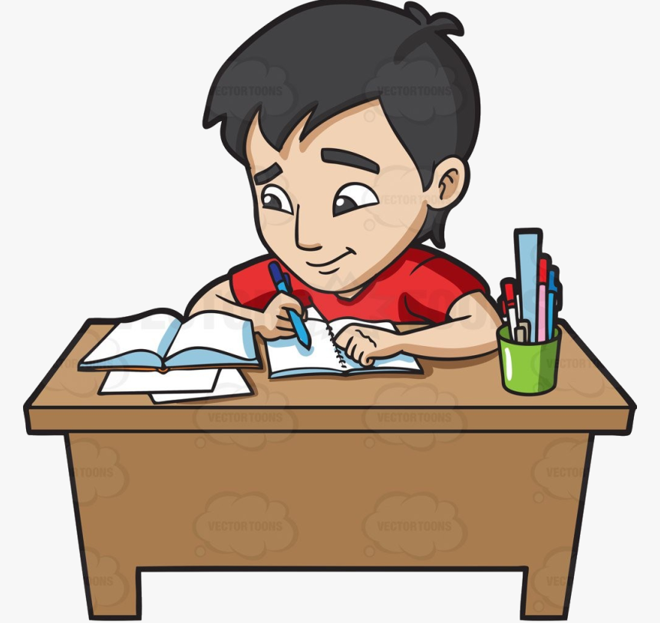
Evaluation
Write the answers in your note books.
When did the students go to the tour?
Where is the Liberation War Museum situated?
Who was waiting for the students?

Slide 18
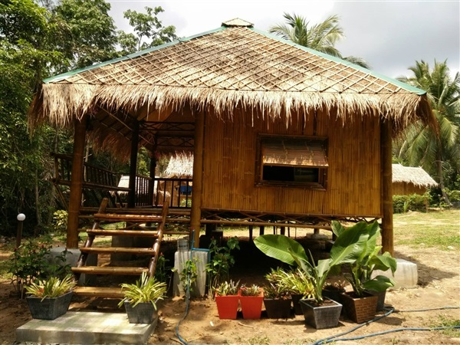
Homework
Rearrange the following words to make meaningful sentences.
went/ / class / our / trip / on / a / field
us / waiting / a / was / guide / for
welcomed / he / us

