Slide 1
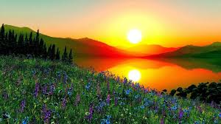
Good Morning

Slide 2
Md.Sultan Ahmed
Assistant: Teacher
Karalya chari R.S high school
Langadu, Rangamati.

Slide 3
English 2nd Paper
Class:9-10
Duration: 40
Date : 22-04-2020

Slide 4
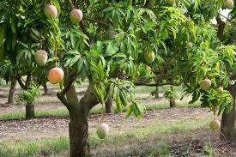
Let’s see some pictures

Slide 5
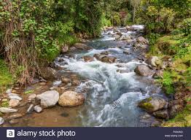

Slide 6
Tense(Present Tense)

Slide 7
FEED BACK
At the end of this class, students can easily be able to -
Make sentences according to tense.
Speak and write, on the basis of tense.
Explain what is tense ?
Correct form of verb ,on the basis of tense.
Classify the tense.

Slide 8
Tense
Present
Past
Future
1. Indefinite
2. Continuous
3. Perfect
4. Perfect Continuous
1. Indefinite
2. Continuous
3. Perfect
4. Perfect Continuous
1.Indefinite
2. Continuous
3. Perfect
4. Perfect Continuous

Slide 9
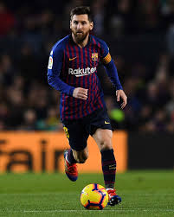
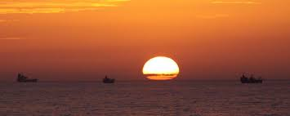
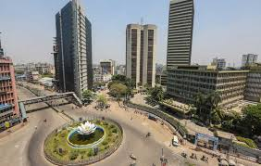
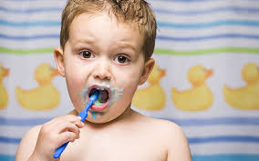
Description of Present Indefinite tense
I play in the field.
Present action
Universal truth
Historical truth
Habitat work
The sun set in the west.
Dhaka is the capital of Bangladesh
Present Indefinite
The boy brushes his teeth everyday

Slide 10
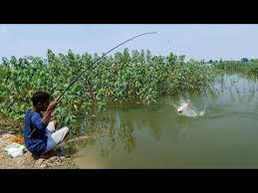
The boy is catching fish.

Slide 11
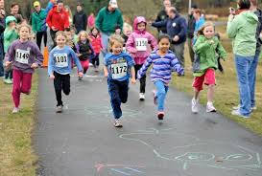
They are runing.

Slide 12
Present Continuous tense
The girl is reading.

Slide 13
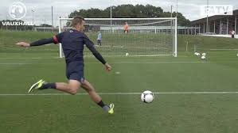
Present Perfect
Just finished

Slide 14
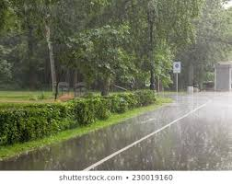
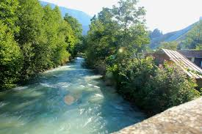
Present Perfect Continuous
Continue any work for long time

Slide 15
Basic structure of English sentence
Subject
+
Verb
+
Object
+
Extension
Auxiliary
Principal
Place
Manner
Time
Sub =?
Verb?
Who, Whose
Obj =?
Verb?
What, Whom
They play football in the field everyday
Sub
Verb?
Obj
Place
Time

Slide 16
Use the Present tense in sentences
Subject
+
Verb
+
Object
+
Extension
Present form
=
Present Indefinite tense
I Play football in the field with my friends everyday
Rana Plays football in the field with my friends everyday
If Sub is 3rd person and singular number,verb will take s/es with it

Slide 17
Subject
+
Verb
+
Object
+
Extension
Am/is/are+(v+ing)
=
Present Continuous tense
They are catching fish in the pond.

Slide 18
Subject
+
Verb
+
Object
+
Extension
Have/has+past participle
=
Present Perfect
Karim has done his duty.

Slide 19
Subject
+
Verb
+
Object
+
Extension
Have been/has been+(v+ing)
Present Perfect Continuous
=
It has been raining for two hours

Slide 20
Group work
Now correct the sentences in Present Indefinite Tense.
Sumaiya (eat) rice.
Snow (fall) on the boughs of the trees.
We human beings (dump) waste materials here and there.
At the sight of the author, Jerry (stand) with bewilderment.

Slide 21
Now correct the sentences in Present Continuous Tense.
The stars (twinkle) in the dark sky.
Snow (fall) on the boughs of the trees.
We human beings (dump) waste materials here and there.
At the sight of the author, Jerry (stand) with bewilderment.

Slide 22
Evalution
Now correct the sentences in Present Perfect Tense.
The stars (twinkle) in the dark sky.
Snow (fall) on the boughs of the trees.
We human beings (dump) waste materials here and there.
At the sight of the author, Jerry (stand) with bewilderment.
The conspirators (hatch) a conspiracy against the patriots.
The old sailor (sail) away the ship to the South

Slide 23
Now correct the sentences in Present perfect Continuous Tense.
The stars (twinkle) in the dark sky.
Snow (fall) on the boughs of the trees.
We human beings (dump) waste materials here and there.
At the sight of the author, Jerry (stand) with bewilderment.
The conspirators (hatch) a conspiracy against the patriots.
The old sailor (sail) away the ship to the South

Slide 24
Home task
Make sentences in present tense form (all) using the below-mentioned words.
Write | sweep | jump | smell | pluck | blow
Pollute | Emit | make | Hang | Throw | clap

Slide 25
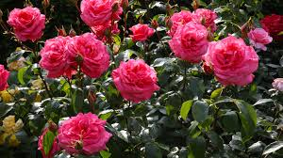
Thanks All

