Slide 1
Welcome to online class

Slide 2
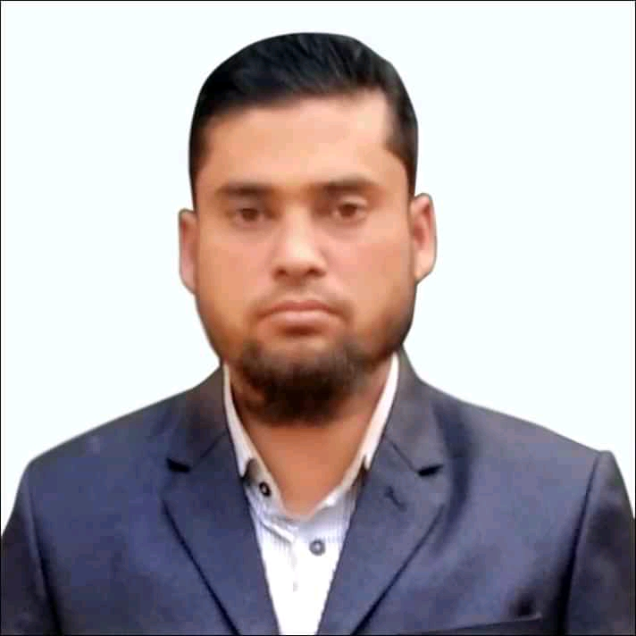
Identity
MD.ALAUDDIN
AssistantTeacher
Pagla Govt.Model High School and College
South Sunamganj,Sunamgan
Class : Nine-Ten
Subject : English Grammar
Date : 00/00/2020

Slide 3
Can you guess what types of sentences they are?
1.He reads attentively so that………………………
2.It is high time we ………………………………
3.If you play well…………………………………
Completing sentence

Slide 4
Our today’s topic is……….
Completing Sentence
Part-1
Question no-7

Slide 5
Learning outcomes……………….
After studying this lesson,students will be able to-----
1. Complete the sentences by using appropriate clauses.
2.Understand some important grammatical rules for completing sentence'

Slide 6
If + Conditional Clause (1st Condition)
If Clause
+
Main Clause
If + Simple Present + Simple Future
If+Sub+V1+Obj
Sub+shall/will+V1+Obj
+
For Example:
If you work hard ,----------------
If he invites to me, ---------------------
You will shine in life .
I shall join his party.
More example-
1.If you read attentively,…………………….....
2.If he comes to me,…………............................
you will pass the exam
I shall help him

Slide 7
If + Present Indefinite+ Ability
If+Sub+V1+Obj
Sub+can+V1+ext.
+
For Example:
I can do the work.
If you help me, ------------
If teachers support us, -------------------
we can solve the problem.
If + Present Indefinite+ possibility
If+Sub+V1+Obj
+
Sub+may/maynot+V1+ext.
For Example:
If it rains, -------------------
If wind blows strongly,--------------------.
I may not go out.
the plane may not take off.

Slide 8
If + Conditional Clause (2nd Condition)
If + Past Indefinite + Past Conditional
If+ Sub+V2+Obj
Sub+would/could+V1+Obj
+
For Example:
If I knew her, ------------------------
If he invited to me,----------------------.
If I had a typewriter, ----------------------.
If I were a king,---------------------.
I would talk with her.
I would join his party.
I could type the letters.
I would help the poor

Slide 9
If + Conditional Clause (3rd Condition)
If+ past perfect
Perfect Conditional
+
If+Sub+had+V3+Obj
Sub+would have/could have+V3+Obj
+
For Example:
If I had known her, ----------------------------------
If he had invited to me, -----------------------------
If they had started earlier, -------------------------------------
If I had been a king, ---------------------------
I would have talked with her.
I would have joined his party.
they could have got the train.
I would have helped the poor.

Slide 10
So+ adj/adv+that….
So……that
+
Sub+cannot/couldnot+V1+ext.
For Example-
He runs so fast that---------------------------------
She spoke so quietly that -----------------------------
The patient is so weak that----------------------------------
He walked so quickly that----------------------------------
I cannot overtake him.
I could not understand him.
he cannot move an inch.
I couldnot follow him.
Note-present tense+that+sub+cannot+V1+ext.
Past tense +that+Sub+couldnot +V1+ext.

Slide 11
So that/in order that
So that
Present tense
Sub+can/may+V1+ ext.
So that
Past tense
Sub+could/might+V1+ext.
For Example-
The boy studies more so that---------------------------------
The farmers worked hard so that -----------------------------
The lady flattered the writer so that----------------------------------
We eat so that----------------------------------
he can make a good result.
they could grow good crops.
she might exploit the young writer.
we may get energy.

Slide 12
By +Gerund(V1+ing)
By+V1+ing+obj
Sub+can+V1+ext.
+
For example
you can shine in life
1.By working hard……………………………………………………
2.By taking physical exercise……………………….
you can be fit for work
3.By eating balanced diet,……………………
we can be healthy

Slide 13
Without+Gerund(V1+ing)
Without+V1+ing+Obj
Sub+cannot+V1+ext.
+
For example
1.Without working hard,……………………………………………………………………
you cannot prosper in life
1.Without reading attentively….…….……………..
you cannot pass the exam

Slide 14
As/Since/Because-Reason+Result
As/Since/Because
+
Present Tense
+
Present Tense+
For Example-
he cannot walk
As/Since he is weak……………………
As/Since/Because
+
Past Tense
+
Past Tense
For Example-
he could not attend the meeting
As/since he was ill……………………………………….
because he knows English
He may get the job……………………………………

Slide 15
No sooner had……….than+Sub+V2+ext.
Hardly had………......when+Sub+V2+ext.
Scarcely had………..when+Sub+V2+ext.
Negative
For example
the bus left
1.No sooner had we reached in the station than……………………
2.Hardly had the teacher entered into the room when…...………………
the students stood up
when he ran away
3.Scarcely had the thief seen the police……………………..

Slide 16
Relative pronoun
If there is relative pronoun (who,which,that,whom,whose) in any incomplete sentence ,these kind of sentences can be completed according to the antecedent that used before relative pronoun. For Example---
came here yesterday/ won lottery.
a) I saw the man who-------------------
he wants to buy.
b) This is the house that ---------------
which is small.
c) The writer took a cabin -----------------
is my brother.
d) The boy whom you met yesterday ------------
father is a doctor.
e) Monira is my friend whose -----------------

Slide 17
Home work
1.If you call me………………………………………………….
2.Hardly had he seen me………………………………………..
3.As they played well……………………………………………
4.If I were a king…………………………………………………
5.He went to Dhaka so that……………………………………
6.By reading newspaper…….………………………………….
7.Without reading attentively………….………………………..
8.If he had asked me…….………………………………………
9.The man is so poor…..………………………………………..
10.This is the boy who….……………………………………….

Slide 18
Continue to content-2
Bye

