Slide 1
Welcome to Sunamgonj online school.
Assalamu alaikom.
This is Md. Nuruddin,
Assistant Teacher,
Kasirgathi government Primary School, Biswambarpur, Sunamgonj.
Hello every one. Good afternoon.
How are you?
I think that all are fine by the grace of almighty Allah. I am also fine.

Slide 2
Welcome to my online class.
My Dear Sweaty students.
Our school is closed a due to corona virus.
Hope all are well and stay at your home with your family member. And passing a good time. Ok?
Today I would like to take a class.
Specially student of class five.
“Hello, Hello, Hello, my friend. Happy to meet you,
Happy to meet you today”
8.Do you feel happy now ?
9.Now I discuss about a topic of your “English for today” book.

Slide 3
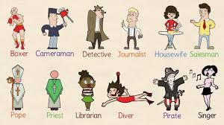
WELCOME TO All

Slide 4
Teacher Identity
Md Nuruddin
Assistant Teacher
Kasirgathi Govt.Primary School
Biswambarpur,Sunamganj.
Lesson Identity
Subject-English, Class-5, Unit-9: Lessons-1-2
Lesson: A Firefighter
Lesson unit A :Raju is a- - - - - - -firefighters.

Slide 5
GREETING
Good morning, students.
Good morning, teacher.
How are you today?
Fine. and you?
Fine, thank you.

Slide 6
Pre-knowledge verification
What are the parts of a letter?
How many parts of a letter?
What should we write in the beginning?

Slide 7
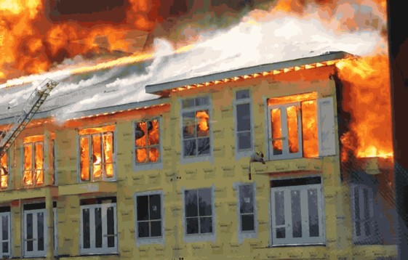
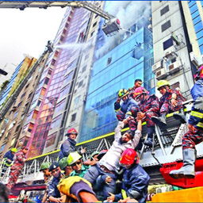
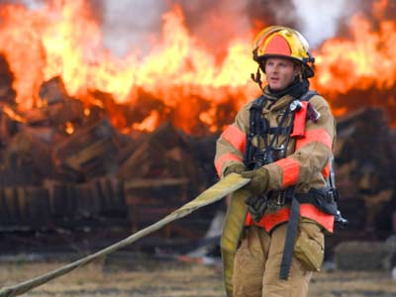
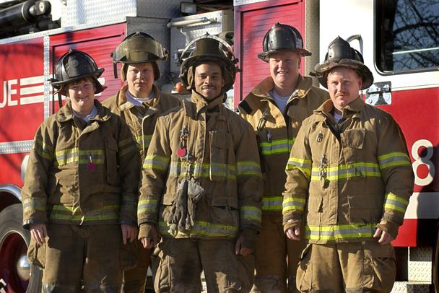
Dear students,Look at the pictures and think alone.
Rescue
Fire
A Fire Fighter
Volunteer

Slide 8
Dear students, Think what will todays topic?
Fire fighter
Yes, Todays topic is occupations (Firefighter)

Slide 9
By the end of the lesson students will be able to……
Listening:
1.3.1 Recognize which words in a sentence are stressed.
3.4.1 Understand statements made by the teacher and students.
4.2.1 Understand and enjoy simple stories.
Speaking:
1.1.1 Say words, phrases and sentence with proper sound and stress.
1.1.2 Say sentence with proper intonation.
6.1.2 Say what others and doing.
Reading:
1.5.1 Read words phrases and sentence in the text with proper pronunciation, stress and intonation.
1.6.1 Recognize and read statements, commands, greetings, questions
and answers.
Writing: 10.1 To write a short piece of composition by answering a set of question.
10.2 To write 5 sentences about a firefighter

Slide 10
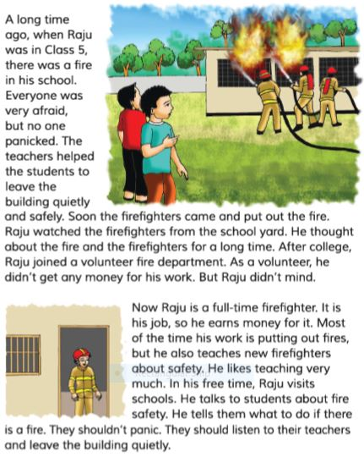
Teacher’s Reading
Students, listen to me, take out of your English book, page 36.Now I read the passage, be attentive, listen to me.

Slide 11
A long time ago, when Raju was in class 5, there was a fire in school. Everyone was very afraid but no one panicked.

Slide 12
The teachers help the students to leave the building safely and quietly. Soon the firefighter came and put out the fire.

Slide 13
Raju watched the firefighter from the school yard. He thought about the fire and the firefighters for a long time.

Slide 14
After college, Raju joined a volunteer fire department. As a volunteer , he didn’t get any money for his work. But Raju didn’t mind.

Slide 15
Now Raju is a full-time firefighter. It is his job, so he earns money for it. Most of the time his work is putting out fires, but he also teaches new fighters about safety. He likes teaching very much.

Slide 16
In his free time , Raju visits school. He talks to students about fire safety. He tells them what to do if there is afire. The student's panic. The should listen to their teachers and leave the building quietly.

Slide 17
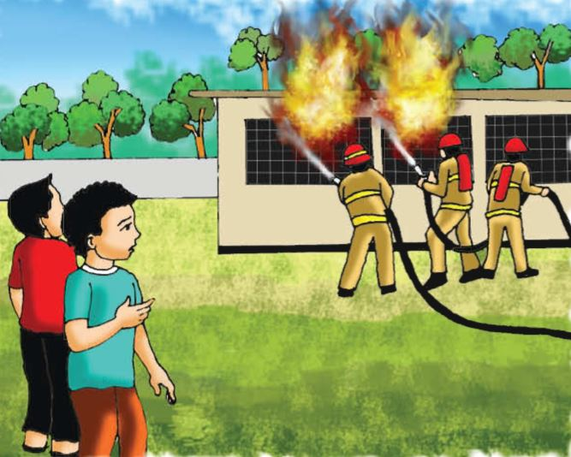
Dear student’s look at the picture and tell me..
what are they doing?
Yes , There is a fire in Raju’s school and three firefighter are trying to put out fire. Raju watch the firefighter from the school yard.

Slide 18
Understanding
Read the text silently and find out the answer
Q.1. Where did the fire take place?
Q.2. Who helps the students to leave the building?
Q.3. Who put out fire?
Q.4. Who watched the fire fighter from the school yard?
Q.5.What Does a teacher do?
Q.6.What does a singer do?

Slide 19
SOME MAIN KEYWORDS OF THE LESSON
আতঙ্ক
1
শিক্ষক
2
দমকলকর্মী
3
স্বেচ্ছাসেবক
4
বিভাগ
5
PANIC
TEACHER
FIRE FIGHTER
VOLUNTEER
DEPARTMENT

Slide 20
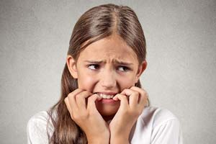
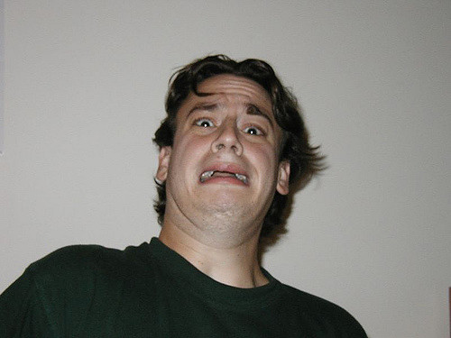
PANIC means-To be afraid or sudden uncontrollable fear or Anxiety.

Slide 21
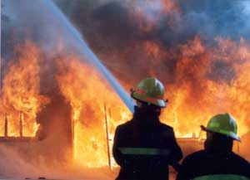
FIREFIGHTER means- A Parson whose job is put out fire.

Slide 22
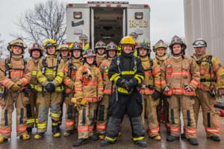
VOLUNTEER means- A Parson who freely offer to do something.

Slide 23
Department means- A division of a large organization such as school, college, university, business etc.

Slide 24
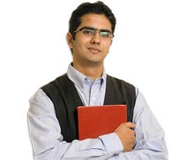
TEACHER means- A Parson who teaches, especially in a school.

Slide 25
VOLUNTEER means- A Parson who freely offer to do something.

Slide 26
Pronunciation drill
Firefighter
Forget
Building
Joined
Panicked
Volunteer
Department
Brigade

Slide 27
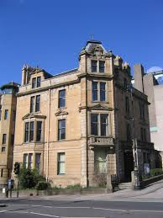
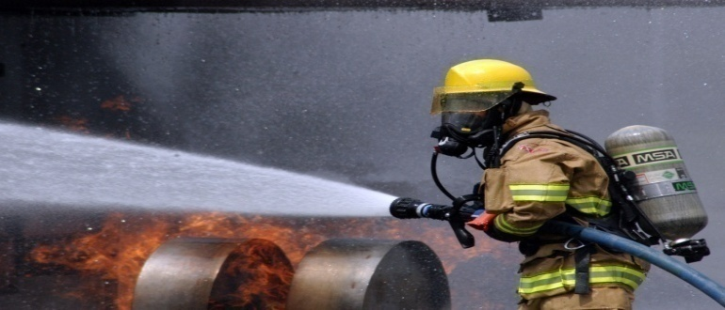
Say the following words and phrases.
Put out
Building
Fire
Firefighter

Slide 28
Sometimes We add –er to a verb to make noun
Farm + er = Farmer
Teach + er = Teacher
Fight + er = Fighter
Sing + er = Singer
Drive + er = Driver

Slide 29
Individual work
Match the words in column A with their meaning in B
Column A
Column B
a) Afraid
i. who puts out fire
ii. calm
b) Safe
iii. frightened
c) Panic
iv. division
d) Quiet
v. be anxious
e) Firefighter
vi. unpaid worker
vii. free from danger

Slide 30
Similar word
Afraid – Frightened, scared, Fearful.
Safe – Out of danger, protected, Assured, Free from danger
Panic – Fear, Alarm, Be anxious.
Quiet – Calm, Cool, Peaceful.
Volunteer – Unpaid worker.
Help – Assistance, Support, Shelter.
Firefighter – Who put out fire.
Department – Division, Section.
Full-time – Work in full time.

Slide 31
Practice-1
Q What is Raju?.
Ans: Raju is a firefighter.
Q:What does a firefighter do?
Ans: A firefighter puts out the fire.
Q:what does Raju do in his free time?
Ans: In his free time Raju likes to visit school.

Slide 32
Evaluation
Rewrite the sentence(s) using punctuation and capital letters where necessary
(a) raju is a firefighter
(b) long time ago when raju was in class 5 there was a fire in his school building
(c) everyone got panic
(d) but soon a fire brigade came and put out the fire
(e) raju could not forgot this for many days

Slide 33
Individual Work
Fill in the gaps the best word from the box.
job | student | firefighter | Safe
yard | safety | put out | happy
student
Raju was a ................ when there was a fire in his school.
Raju wached the firefighter from the school ......... .
The firefighter came to Raju’s school to ............... the fire.
Raju feels .................. for working as a volunteer.
Raju is a ..................... .
yard
put out
happy
firefighter

Slide 34
Write T for true or F for false.
1. There were a fire at Raju’s school when he was in class five.
2. The teachers left the students in the building during the fire.
3. Raju didn’t see the firefighters put out the fire at his school.
4. Raju always earns money for being a firefighter.
5. Raju also likes teaching.
6. Talking to student is part of Raju’s job.

Slide 35
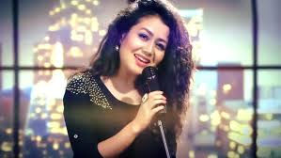
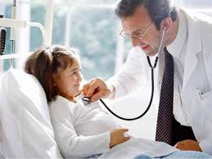
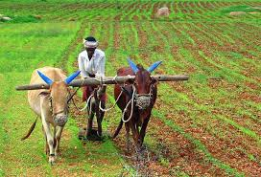
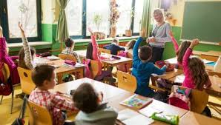
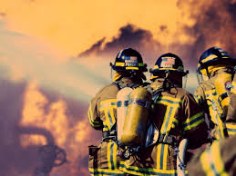
Look at these pictures and think about them
Singer
A person who song professionally.
Doctor
A person who treatment the patient.
Farmer
A person who grows crops.
Teacher
A person who teaches students.
firefighter
A person who puts out fire.

Slide 36
Pracrice-1
Dear student’s
You will write the answers by the following questions.
Q.1. Who joined the fire department?
Q.2. When did Raju join as a volunteer firefighter?
Q.3. What does he talk about with the students?

Slide 37
Creative Home Work-2
Think of a person who works in your area to help you live well. Write a paragraph on this person by answering the following question.
a) What does he/she do?.................................................................... b)What time does he/she start his/her work?......................................... c) How does he/she do the work?.......................................................... d) Does he/she like the job? Why / Why not? ………………………… e) What do you think about his/her job? ………………………………

