Slide 1
Welcome

Slide 2
Identity
Lesson Identity
Teacher’s Identity
Class: 5
Sub: English
Caption of the Lesson:
(My home district)
Lesson:1- 2, Unit: 10
Todays Lesson: “My home…Chandrabati”.
Md. Nurun Nabee
Assistant Teacher
Hazirali Govt. Primary School
Jhikargacha , Jashore

Slide 3
Learning outcomes
Students’ will be able to :
Listening 4.3.1 Enjoy and understand simple stories
Speaking 3.1.1 Ask and answer Wh questions
Reading 5.1.1 Read simple paragraphs
Writing 10.1.1 Answer the short and simple questions

Slide 4
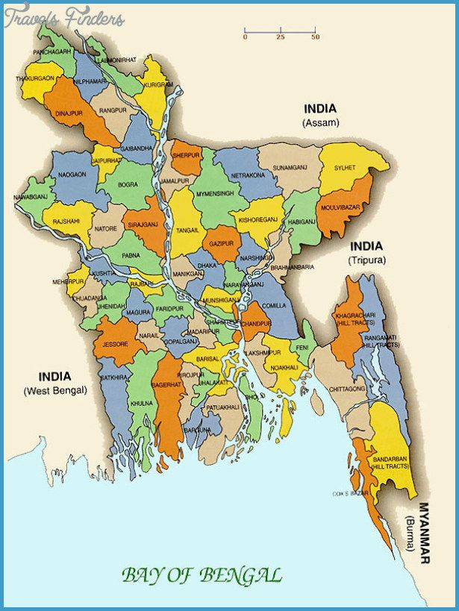
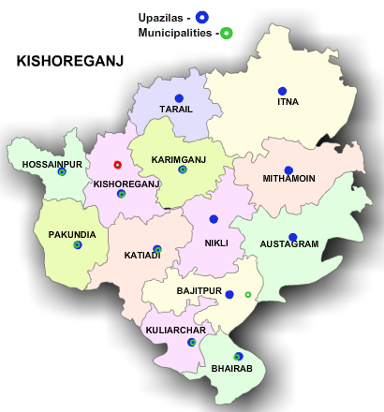
My home district
Unit 10
Lesson 1 – 2
Page 38

Slide 5
Municipality
Landlord
Important
Largest
District
a town that has
local government
a person who owns a
large area of land
- having a great value
- biggest
- an area of a country
Can you tell me the similar word?
Can you tell me the similar word?
Can you tell me the similar word?
Can you tell me the similar word?
Can you tell me the similar word?
sizeable
huge
major
main
manager
city
district
innkeeper
place
locality
বৃহত্তম
গুরুত্বপূর্ণ
পৌরসভা
জমিদার
জেলা

Slide 6
Mosque
Celebrate
Temple
Well-known
Fort
- muslim’s prayer room
to show that a day is important by doing something special on it
- hindu’s prayer room
- a military building
vary familiar to the people
Can you tell me the similar word?
Can you tell me the similar word?
Can you tell me the similar word?
- muslim’s prayer house
Can you tell me the similar word?
Can you tell me the similar word?
church
pagoda
castle
tower
- muslim’s prayer building
popular
common
observe
honour
দূর্গ
মন্দির
মসজিদ
সু-পরিচিত
উৎযাপন

Slide 7
Read about Mamun’s home district.
My home district is Kishoreganj. It is about 145 kilometres from Dhaka. It is a district headquarters. The district has 8 municipalities, 13 upazilas, 108 unions, and 1745 villages.

Slide 8
Read about Mamun’s home district.
The name Kishoreganj comes from the name of an old landlord known as Brojakishore Pramanik or Nandakishore Pramanik. The area of Kishoreganj municipality is about 10 square kilometres.

Slide 9
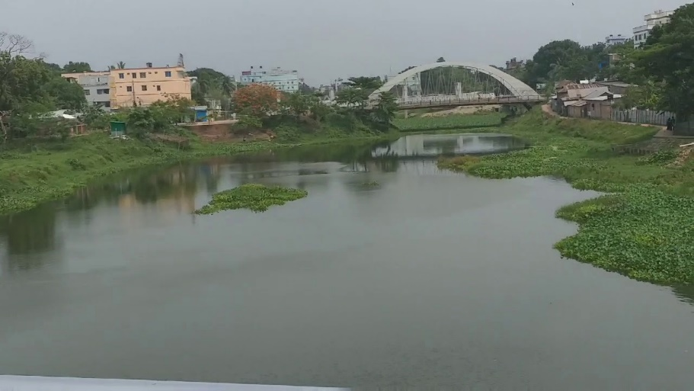
Read about Mamun’s home district.
The river Narasunda flows through the town.

Slide 10
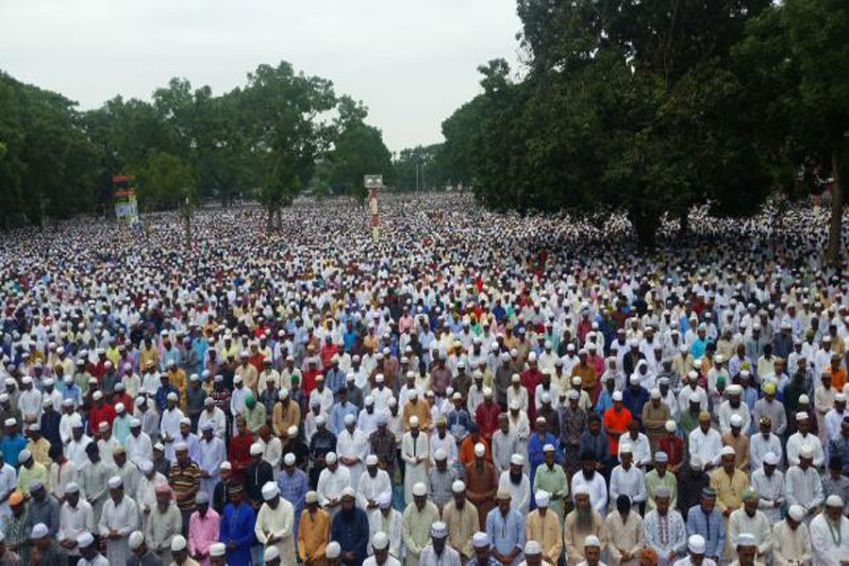
Read about Mamun’s home district.
Kishoreganj is a small town, but there are many important places in and around it. The largest Eid fairgrounds, called Solakia Eid Ground

Slide 11
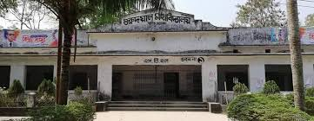
Read about Mamun’s home district.
and the well-known Government Gurudayal College are in the town. People from many districts come to this place to celebrate Eid.

Slide 12
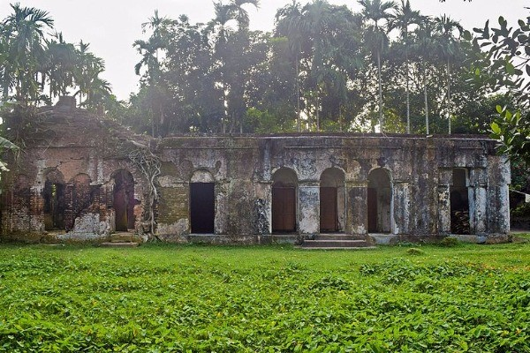
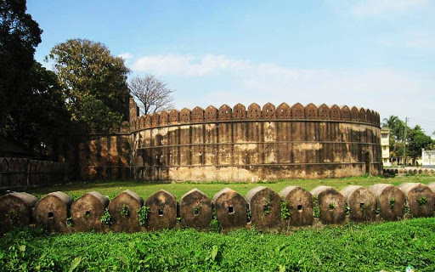
Read about Mamun’s home district.
The Pagla Mosque is also in my home district. Outside the town, you can visit the fort of Isah Khan at Jangal Bari.

Slide 13
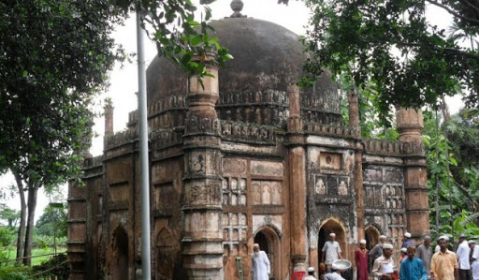
Read about Mamun’s home district.
You can also see the Shah Muhammad Mosque at Egaroshindhur.

Slide 14
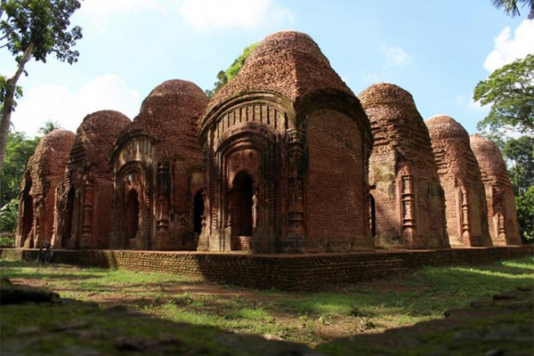
Read about Mamun’s home district.
Near the Fuleshwari River, you can see the Shiva Temple of Chandrabati.

Slide 15
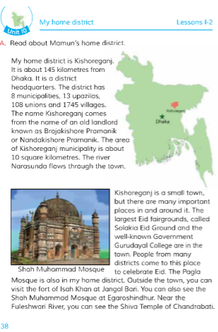
Students now open your text book page at 38.

Slide 16
Read about Mamun’s home district.
My home district is Kishoreganj. It is about 145 kilometres from Dhaka. It is a district headquarters. The district has 8 municipalities, 13 upazilas, 108 unions, and 1745 villages.

Slide 17
Read about Mamun’s home district.
The name Kishoreganj comes from the name of an old landlord known as Brojakishore Pramanik or Nandakishore Pramanik. The area of Kishoreganj municipality is about 10 square kilometres. The river Narasunda flows through the town.

Slide 18
Read about Mamun’s home district.
Kishoreganj is a small town, but there are many important places in and around it. The largest Eid fairgrounds, called Solakia Eid Ground and the well-known Government Gurudayal College are in the town. People from many districts come to this place to celebrate Eid.

Slide 19
Read about Mamun’s home district.
The Pagla Mosque is also in my home district. Outside the town, you can visit the fort of Isah Khan at Jangal Bari. You can also see the Shah Muhammad Mosque at Egaroshindhur. Near the Fuleshwari River, you can see the Shiva Temple of Chandrabati.

Slide 20
1. What’s the name of Mamun’s home district?
Pairwork
2. How far is it from Dhaka?
3. How did Kishoreganj get its name?
4.What is the name of the river in the town?
5. What is the larjest Eid Ground in Kishoreganj?
6. What are two things you can see in the town?

Slide 21
Answer sheet.
Answer the Q no 5.
Answer the Q no 3.
Answer the Q no 4.
Answer the Q no 6.
Answer the Q no 1.
Answer the Q no 2.
Ans: The largest Eid fairground,
called Solakia Eid Ground
Ans: The name Kishoreganj comes from
the name of an old landlord known as
Brojakishore Pramanik or
Nandakishore Pramanik.
Ans: It is about 145 kilometres from Dhaka.
Ans: I can see Solakia Eid Ground and
Government Gurudayal College are
in the town.
Ans: The river Narasunda flows
through the town .
Ans: Mamun’s home district is Kishoreganj.

Slide 22
Group - Red.
Groupwork.
Group-Blue.
1.Jangal Bari. 2. Egaroshindhur.
Egaroshindhur is an important place.
I can also see the Shah Muhammad Mosque at
Egaroshindhur.
How did Kishoreganj get its name?
What is the name of the river in the town?
Write 2 important
places in Kishoreganj.
Write 2 sentences about Egaroshindhur.
The name Kishoreganj comes from the name of an old landlord known as Brojakishore Pramanik or Nandakishore Pramanik.
The river Narasunda flows through the town.

Slide 23
Home work
Write a short composition about your home
district at least 5 sentences.

Slide 24
Thanks to all

