Slide 1
Welcome

Slide 2
Presented by
Md. Nurun Nabee
Assistant Teacher
Hazirali Government Primary School
Jhikargachha, Jashore.

Slide 3
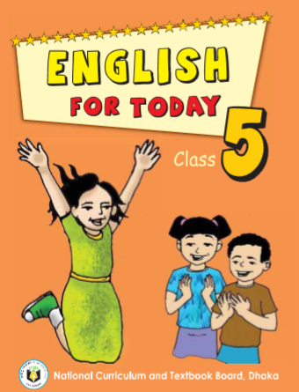
Lesson Identity
Class: 5
Sub: English
Caption of the Lesson:
(The hare and the tortoise)
Lesson:2, Unit: 14
Todays Lesson: “The hare…..the race”.

Slide 4
Learning outcomes
Student will be able to-
4.2.1. understanding and enjoy simple stories .
5.1.2. read the passage.
3.1.1.ask and answer wh questions .
8.1.1. write a short composition.

Slide 5
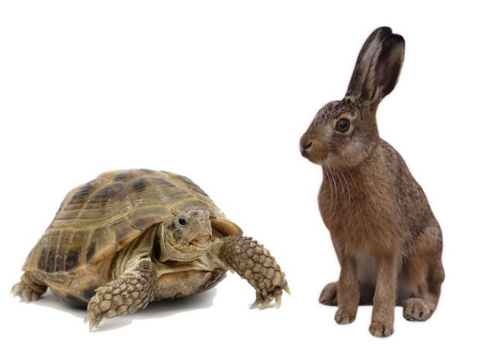
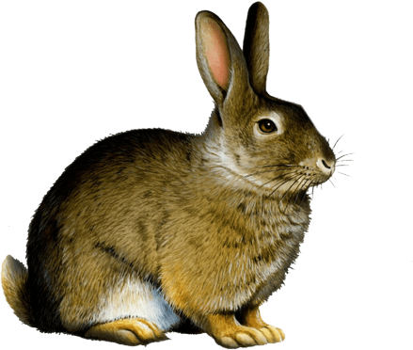
Let’s watch the video
YouTube Link
https://youtu.be/kcx9e9q3aII
Todays lesson is
The hare and the tortoise
Lesson 2, Unit 14, page 55

Slide 6
Quickly
Crossed
Furious
Steadily
Behind
Finish
Competition
desperate
angry
covered
Pass over
rapidly
afterwards
regularly
gradully
beyond
close
fast
contest
tournament
complete
extremely hot
opposed
joined
fire-like
swiftly
backward
In back of
game
speedily
end
match
conclusion
firmly
progressively
অগ্নিমূর্তি
অতিক্রান্ত
দ্রুত / শীঘ্র
অটলভাবে
প্রতিযোগিতা
শেষ / সমাপ্তি
পিছনে
The hare was furious.
The hare ran quickly.
The tortoise crossed the finish line.
Slow but steady wins the race!
The tortoise won the competition.
He looked at the finish line.
The tortoise is very far behind.

Slide 7
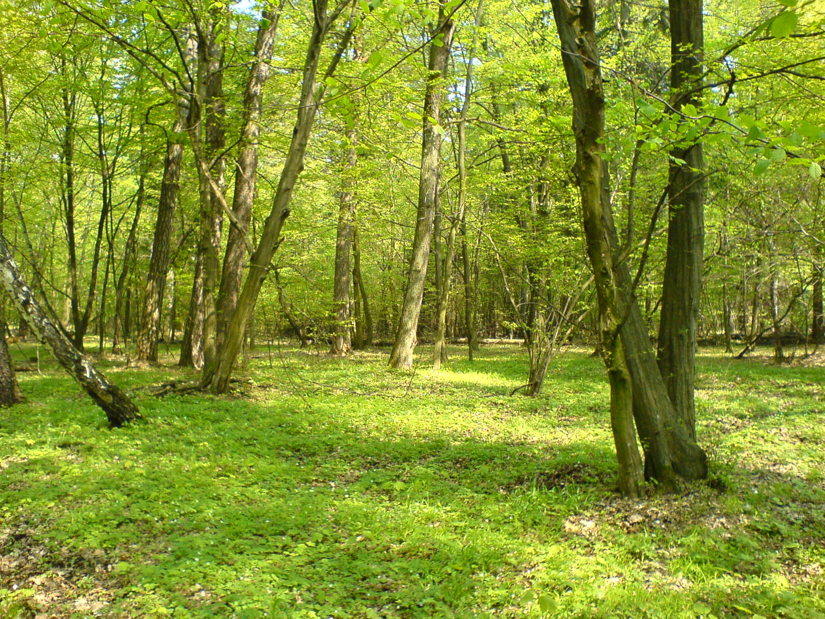
The hare ran quickly and in a few minutes the hare was out of sight.

Slide 8
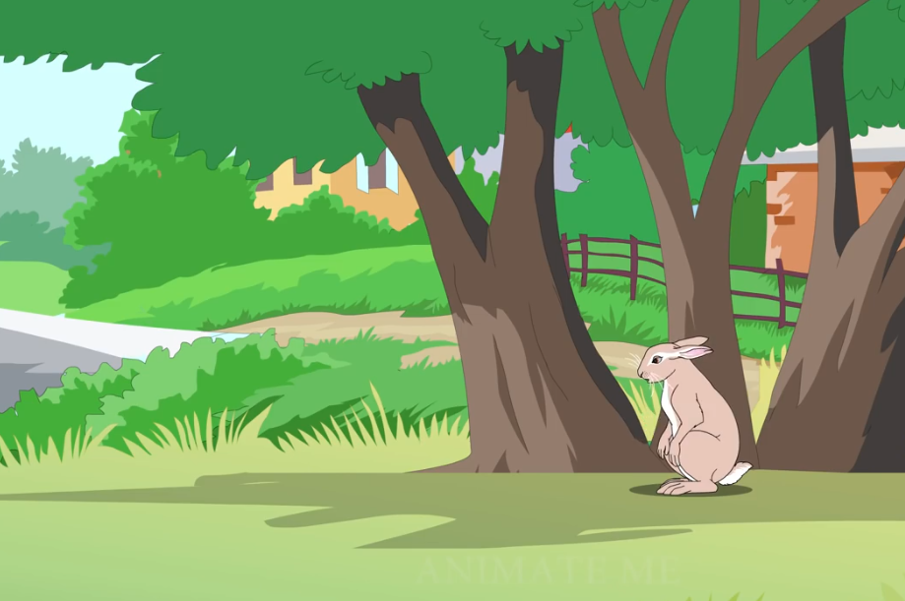
The hare said to himself, “ The tortoise is very far behind. I can see the finish line.

Slide 9
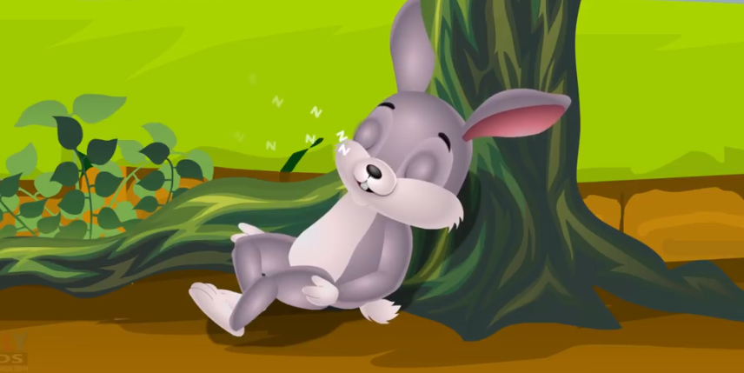
I have time for a nap!” Soon the hare was asleep under a tree next to the path.

Slide 10
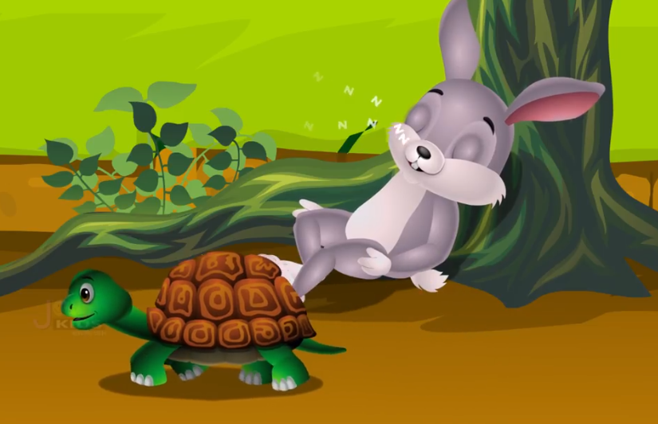
The tortoise walked steadily, on and on. He didn’t stop. Soon, he passed the sleeping hare.

Slide 11
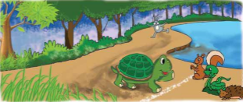
The hare slept for an hour. When he finally woke up, he looked at the finish line. He couldn’t believe his eyes! Tortoise was almost at the finish line!

Slide 12
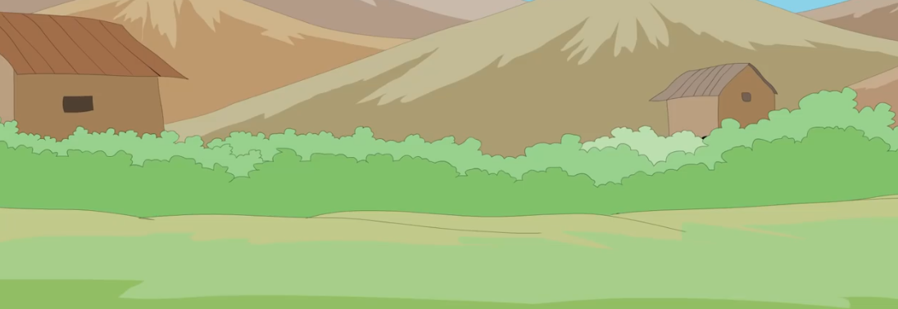
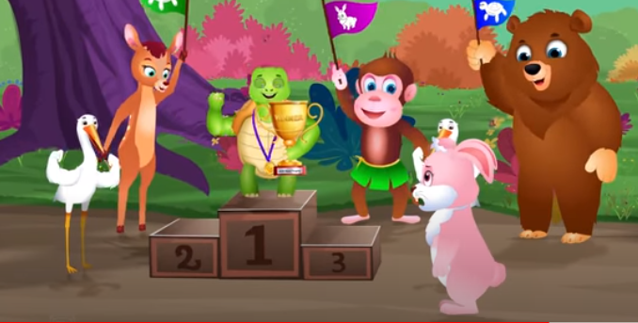
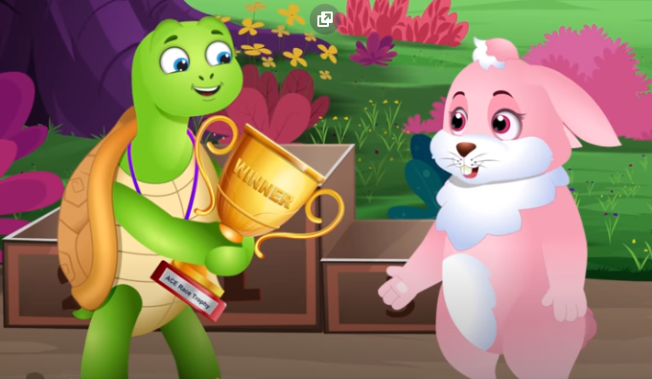
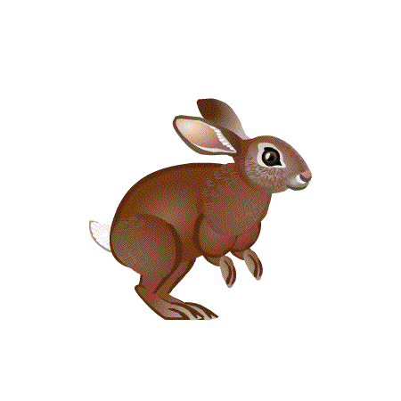
FINISH
The hare ran as fast as he could, but it was too late. The tortoise crossed the finish line and won the competition! The hare was furious!

Slide 13
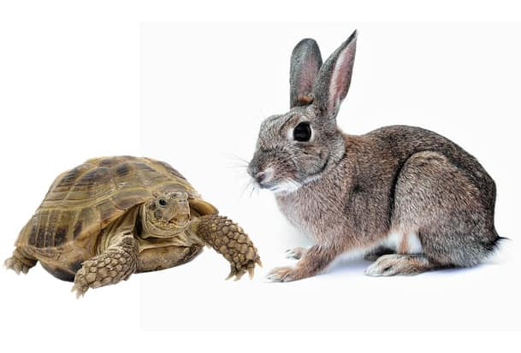
The tortoise looked back at the hare and smiled. Then he said, “Slow but steady wins the race!”

Slide 14
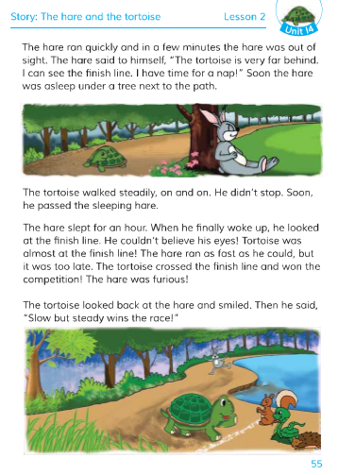
Students now open your text book page at 55.

Slide 15
The hare ran quickly and in a few minutes the hare was out of sight. The hare said to himself, “ The tortoise is very far behind. I can see the finish line. I have time for a nap!” Soon the hare was asleep under a tree next to the path.
The tortoise walked steadily, on and on. He didn’t stop. Soon, he passed the sleeping hare.

Slide 16
The hare slept for an hour. When he finally woke up, he looked at the finish line. He couldn’t believe his eyes! Tortoise was almost at the finish line! The hare ran as fast as he could, but it was too late. The tortoise crossed the finish line and won the competition! The hare was furious!
The tortoise looked back at the hare and smiled. Then he said, “Slow but steady wins the race!”

Slide 17
Pair work
Fill in the blanks with the correct word from the box.
slowly
watch
Forest.
big tree
angry
The hare was walking in the………
2. The tortoise was moving very ………..
The tortoise felt …………
4. The race was started next to a ………..
They called there friends to …………..

Slide 18
Group A
1. Who thogut that he has to time for a nap?
Group B
2. How long did the hare sleep?
Small Group Work
Group C
3. Why did the hare can’t believe his eyes?
Group D
4. What happened when the hare wake up?
Group E
5. What is the moral of the story?

Slide 19
4. What happened when the hare wake up?
1. Who thogut that he has to time for a nap?
2. How long did the hare sleep?
Answer sheet
for
Small Group Work
3. Why did the hare can’t believe his eyes?
5. What is the moral of the story?
Ans: When he finally woke up, he looked that the tortoise was almost at the finish line! The hare ran as fast as he could.
Ans: The hare looked at the finish line and the tortoise was almost at the finish line!
Ans: Slow but steady wins the race!
Ans: The hare thogut that he has to time for a nap.
Ans: The hare slept for an hour.

Slide 20
Home Work
Write a short composition about ‘The hare and the tortoise’ by answering the following questions:
1. Where was the hare walking?
2. Why did the hare laugh at the tortoise?
3. Why was the tortoise angry?
4. What made the hare furious?
5. Why did the hare have a nap
6. Who won the race? How did he win it?

