Slide 1
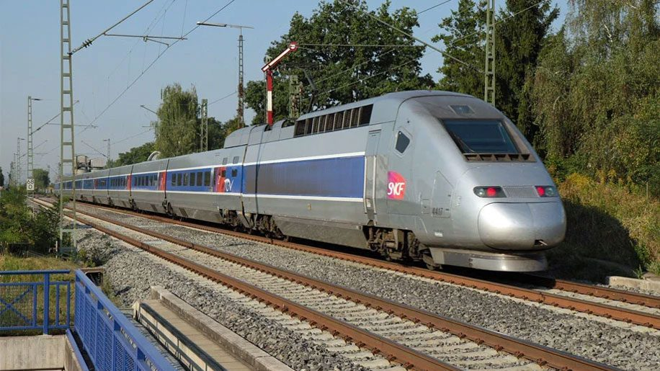
Welcome to the presentation

Slide 2
Introduction
Md. Mizanur Rahman
B.A.(Hons.), M.A. in English, B.Ed.
Assistant Teacher
Police Lines School and College, Pabna.
E-mail: mizanplsc@gmail.com
Cell Phone :01737979719
Class: VIII
Subject: English 1st Paper
Unit: Nine ( Things that have changed our life)
Lesson: Three
Lesson Title: The fastest wheel on earth.
Class Duration: 40 minutes
Date: 15/06/2020

Slide 3
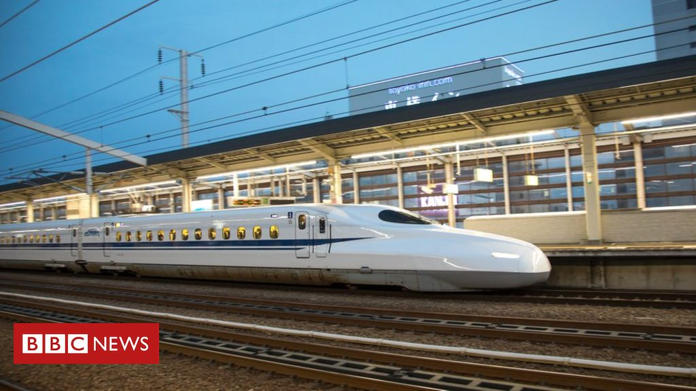
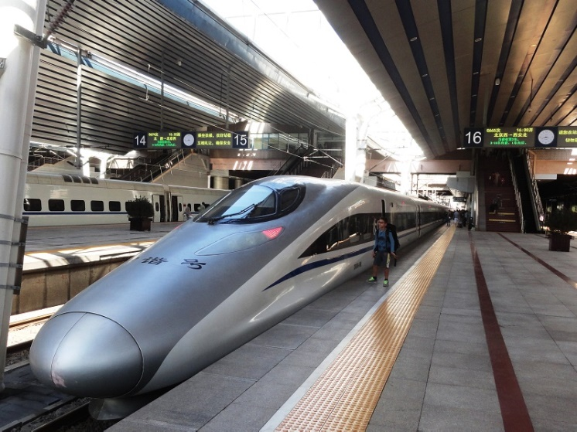
Lets’ see some pictures
TGV train
The Bullet Train
The High- speed Rail
What do you see in the pictures ?

Slide 4
Today’s Lesson
The fastest wheel on earth.

Slide 5
Learning Outcomes
At the end of the lesson, the students will be able to:
ask answer questions.
read and understand text materials.
write answers of the questions.
fill in the gaps.
write simple informal letter.

Slide 6
Key words presentation
Unconventional
Adjective
Meaning : tending to follow what is generally undone.
Syn. unusual
Ant. Ordinary, conventional, usual
Example : Japan set the world record for unconventional magnetic train sets.

Slide 7
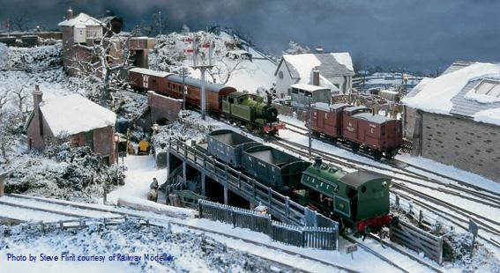
Word : Trainset
Noun
Meaning : a set of railway wagons or carriage
Example : A trainset is used to carry different things

Slide 8
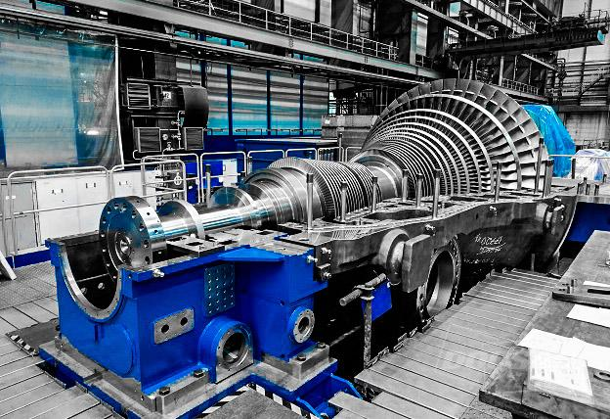
Word : Turbine
Noun
Meaning : a type of machine having a special wheel to generate power.
Example :Turbines are used to generate power.

Slide 9
Read the text silently.
The TGV
The TGV started in the 1970s. Originally, it was powered by gas turbines. But in 1973 , the TGV was changed into electric trains. The TGV service first started between Paris and Lyon in 1981. Later, the network connected other cities in France with Paris.
TGV train
A TGV test train set the world record for the fastest conventional wheeled train on 3 April 2007 . It reached the speed of 574.8 km/h on the test run. But the regular TGV trains operate at the highest speed of 320 km/h . It is the present world record of speed of a conventional commercial train.

Slide 10
The Bullet Train
It is the network of high- speed train service in Japan. It started operation in1964 on a limited route. But at present, most manor cities of Japan come under the network.
The Bullet Train
The bullet train runs at a maximum speed of 300 km/h . It plans to increase speed up to 320 km/h. In 2003, Japan set the world record for unconventional magnetic train sets. In a test run, the speed was 581 km/h . But it is not yet in regular commercial operation.

Slide 11
The High-speed Rail
It service in China started operation on April 18, 2007. Currently, China has started building a high- speed passenger rail network. It will be similar to French TGV or Japanese Bullet Trains.
The High- speed Rail
The usual top speed of China’s conventional quick trains is 300 km/h .
Recently, China has set the world record of a speed of 487.3km/h. In 2011, this record was set by an unconventional magnetic train set called the ‘ Harmony Express’. This is the highest speed of an unconventional magnetic train set in regular commercial operation

Slide 12
Individual Work
Imagine your partner is a railway official and you are a reporter. You asked questions and the official gave the above information in answers. Now, write what the questions might be. For example:
What is the official name of our rail service?
Where is the headquarters of Bangladesh Railway?
Next Page

Slide 13
Now continue--------------------------
-----------------------------------------------------------?
-----------------------------------------------------------?
-----------------------------------------------------------?
-----------------------------------------------------------?
-----------------------------------------------------------?

Slide 14
Now, discuss with your partner to fill in the blank slots in the following grid with the information about high –speed trains.
Pair Work
Name of the country | Name of the train | Years of introduction | Top speed of conventional train | Top speed of unconventional train | Holds world record for

Slide 15
Group Work
Discuss in groups to decide which of the above three rail services you like best and whey. Finally, write a paragraph and present it in the class.

Slide 16
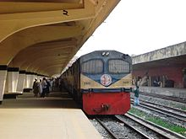
Evaluation
Read the basic information about Bangladesh Railway below. Share with your partner and write a composition using the information.
Bangladesh Railway.
Next Page

Slide 17
Headquarters : Dhaka
Zones : Eastern and Western
Numbers of stations : 459 ; number of engines: 284; number of passenger carriages : 1245; number of wagons : 12948
Total length of railroad : 2855 kilometers; Passengers transported annually : 42 millions; total number of employees : 34168
Nature of present operations : International ( Dhaka – Kolkata) ; inter-city ; local

Slide 18
Home Work
Write a short note about train journey which you have enjoyed if not imagine and write about it.

Slide 19
Thanks to all.
See you again in the next class.

