Slide 1
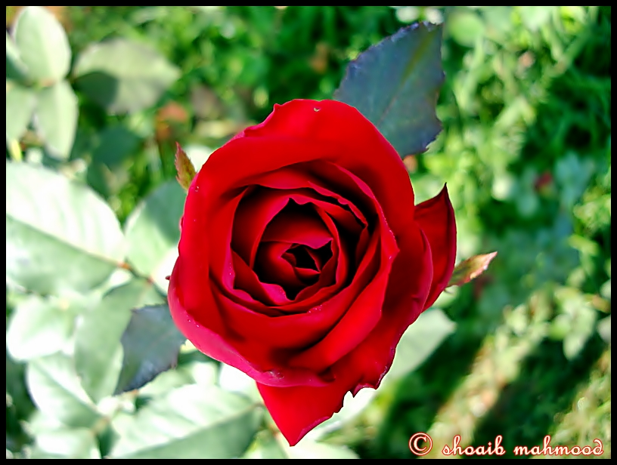
Good Morning , students.

Slide 2
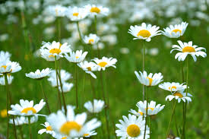
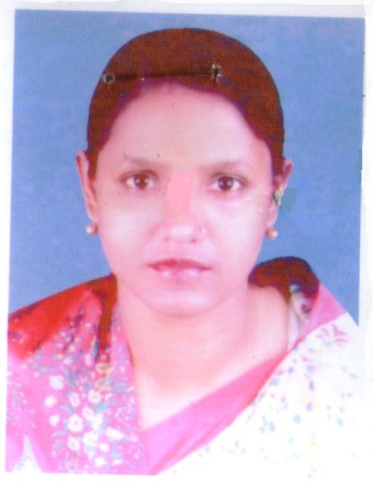
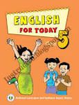
Identy of Teacher
Identy of Lesson
5
Name: Aliza Begum
Head Teacher
Pallimangal Govt. Primary Sch00l . Dakshin Surma,Sylhet
Email:hmpmgps@gmail.com
Class: Five
Subject: English
Lesson:My Mother land
Time:45 min

Slide 3
By the end of this lesson’s students will be able to…
5.1.3 Read silently with understanding dialogues
8.1.1 Make sentences using words and phrases given in the
textbook.

Slide 4
Let us,we see a vedio

Slide 5
Think about the video
What do you see in the video
Boat,water grass,man,

Slide 6
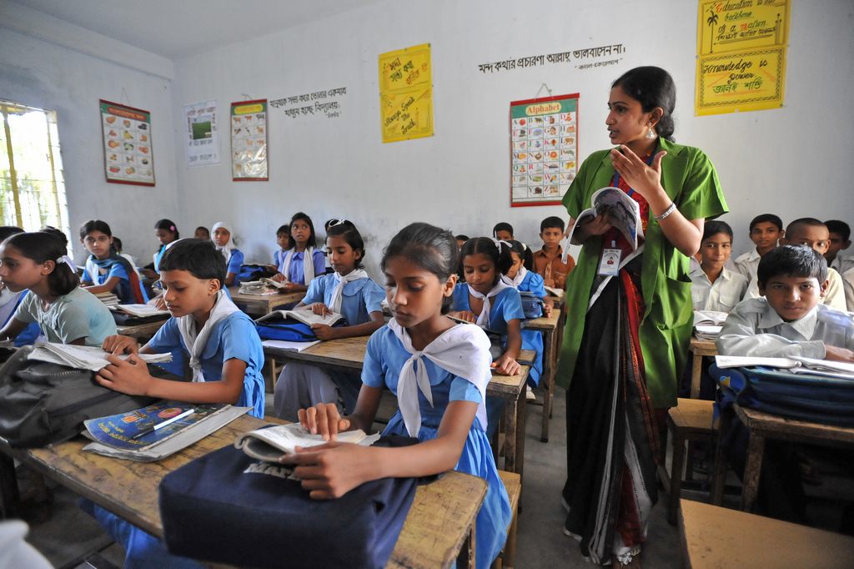
Dear students, what do you understand from the video?
Our country

Slide 7
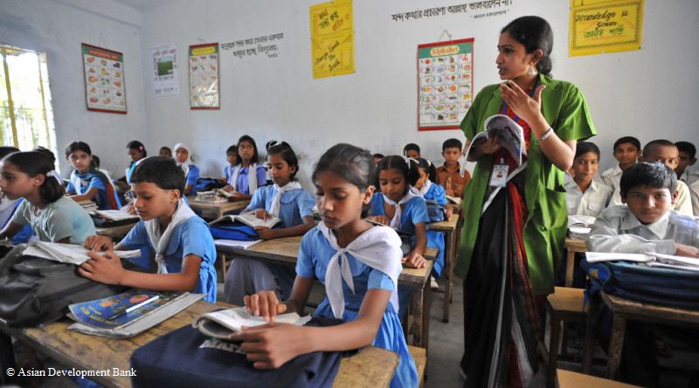
Dear students, guess what story do we read today?

Slide 8
Today’s lesson
Chapter : My Motherland
Time:- 40 minute.

Slide 9
Some new words with pronounce
Independent
Declared
Victory
season
Language
Proud

Slide 10
Some new words with spelling
Independent
Declared
Victory
Season
Language
Proud

Slide 11
Somewords meaning
Independent | Free
Declare | Announce
Victory | Win
Season | Time
Language | Tongue
Proud | Glorious

Slide 12
New words meaning(Bangoli)
Word | Meaning
Independent | স্বাধীনতা
Declare | ঘোষণা করা
Victory | বিজয়
Season | ঋতু
Language | ভাষা
Proud | গর্বিত

Slide 13
Read the following question and answer them from the text.
a)When did Bangladesh get the victory? B)Who did declare the independence of Bangladesh? C)What is the national fruit of Bangladesh? D) How many seasons we have ? E) Where arethe main source of fish ?

Slide 14
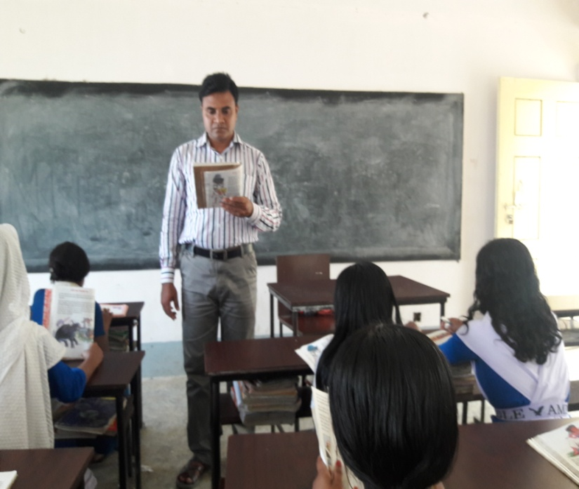
Dear students, open your EFT book and listen to me what I read.

Slide 15
অঞ্চে থেরে লাইভBangladesh is ourmotherland Bangladesh is our motherland.It is an independent country.The Independent of Bangladesh was declared on the 26th March,1971 by the father of the nation,Bangabandhu Sheikh Mujibur Rahman. We got our victory on the 16th December ,1971 after a long war . Bangladesh is a small country with a large popoulation . Most of the people of the country are Muslims.But people of other religions also live here in peace. Dhaka is the capital of Bangladesh. It is also called the city of mosques. There are so many beautiful places in Bangladesh. It is a beautiful country with many resources. We have six seasons and the weather in our country is comfortable.The land of this country is so fertilethat people can grow crops easily. Most of the people of this country are farmers. The main crop of this country is rice .But the farmers grow jute,sugarcane,tea and fruts also. Jackfruit is the national fruit of Bangladesh. Bangladesh is also a country of rivers. There are so many rivers in the country. The Padma,the Meghna and the Jamuna are the main rivers of the country. These rivers are the min source of fish. Hilsha is our national fish. The mother language of our country is Bangla. We are very proud of our country.

Slide 16
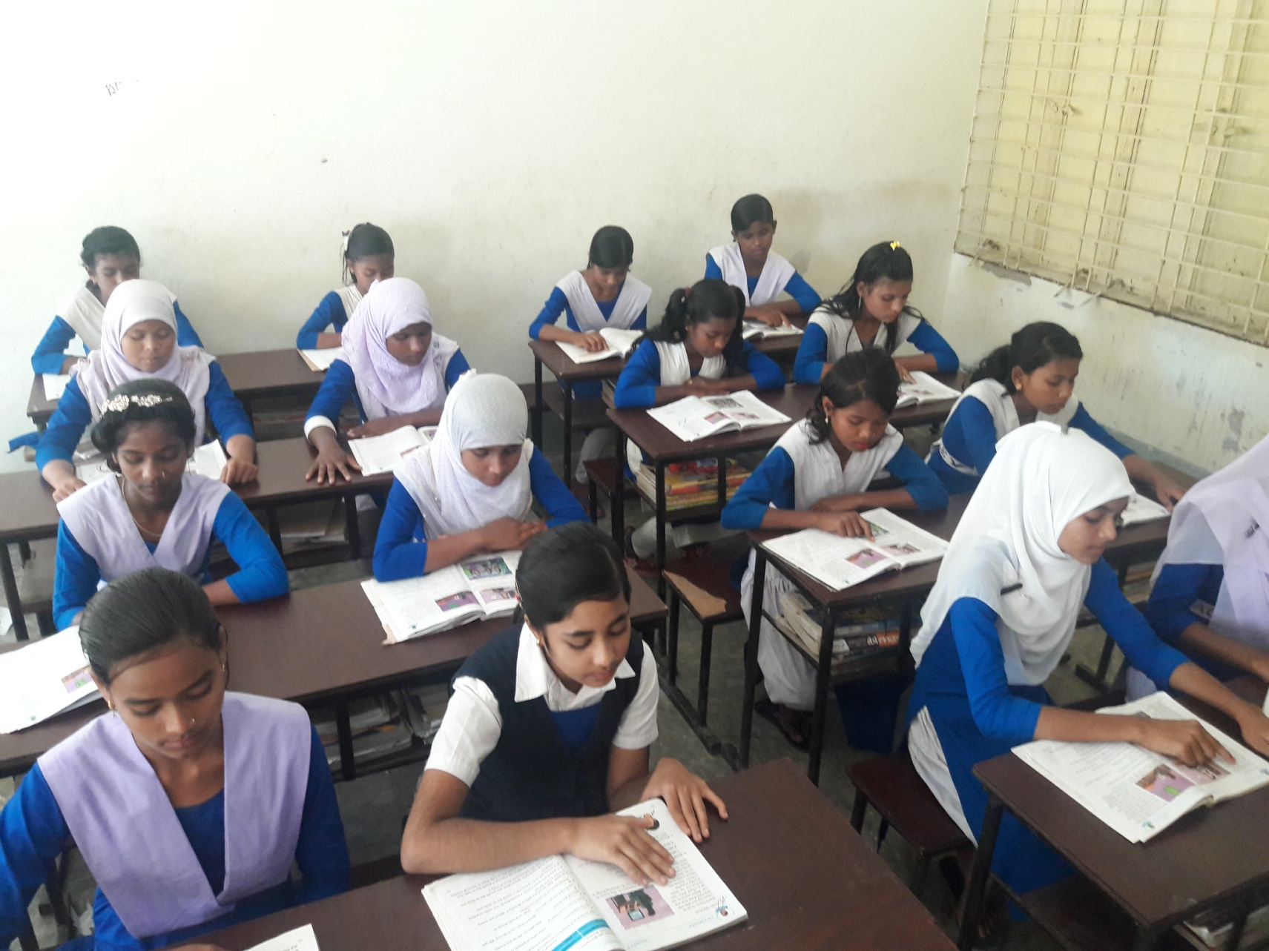
Dear students, read the text again and again.

Slide 17
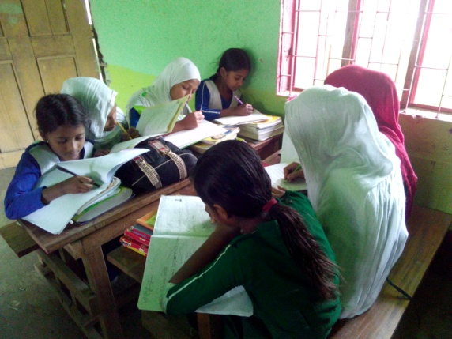
Group work
Write five sentences about our country .
Group A
Group B
Write five sentences about our rivers .

Slide 18
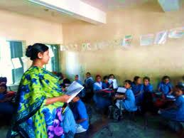
Evaluation

Slide 19
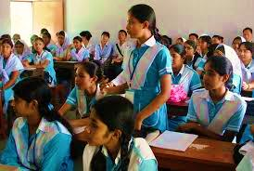
Who say …..
What did you learn from the lesson?
Everyone should love their country.

Slide 20
1. What is the capital city of Bangladesh?
2. How is our weather ?
3. Write the names of two crops of Bangldesh .
4. What is the mother language of Bangladesh ?
5. Why are we proud of our country?
a)Dhaka is the capital city of Bangladesh . b)Our weather is comfortable . c) Rice and jute . d)Bangla is our mother language . e) Bangladesh is our motherland . So we are proud of our country .

Slide 21
Fill in the blank | Write true or false
a)Bangladesh is our --------- | a)The population of Bangladesh is small .
b)There are ---------season in Bangladesh . . | b)The national fish of Bangladesh is Hilsha .
c)Most of the people of-------- are farmers. | c)The main crop of Bangladesh is jute.
motherland
F
six
T
This country
F

Slide 22
Evaluation
Now we play a bango game.
Bangladesh
Rice
Jackfruit l
Hilsha
Padma

Slide 23
Home work
Suppose you are Babul . You live in Bangladesh.Your friend Jonson who lives in England. He wants to know about your country . Now write a letter to your friend about your country .

Slide 24
One day one word
Motherland=মাতৃভূমি

Slide 25
Thank you every body.
No more today.

