Slide 1
W
E
L
C
O
M
E
Mahia Rahman
Assistant Teacher
English
B.A Hons,M.A (English)

Slide 2
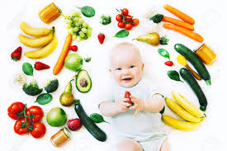

Slide 3
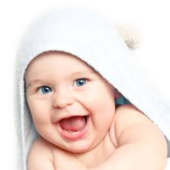

Slide 4
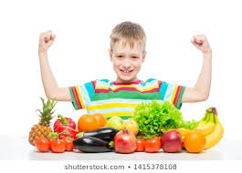

Slide 5
The pictures is about good health and good food

Slide 6
Health is wealth
Lesson-9

Slide 7
After completing the lesson students will be able to
1.Ask and answer question
2.read and understand texts.
3.Read and understand written instructions.

Slide 8
New word:
Anxiety-
Disease-
Functioning-
Organs-
Cheerful-

Slide 9
Work with a partner in groups.
What do we mean by hygiene?
What are essential for good health?
What are the rules of personal hygiene?
What do we mean by balanced diet?

Slide 10
Home-work
Write a short paragraph on the rules of good health. Take your cues from E.

