Slide 1
Welcome

Slide 2
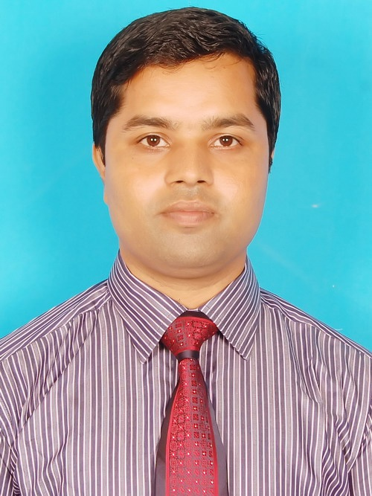
Teacher’s Identity
Asim Kumar Talukder
Lecturer in English
Fenchuganj Govt. College
Fenchuganj, Sylhet.
Email Id: aktalukder@gmail.com
01716348110

Slide 3
Introduction of the lesson
English 1st Paper
Class: xi
Unit Two
Traffic Education
Lesson 1

Slide 4
Look at the Picture

Slide 5
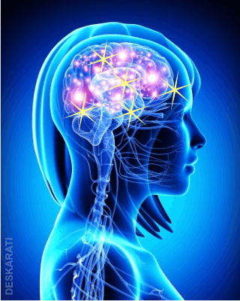
What have you seen in the picture?
Ans: Someone is driving a car.
2. Which organs are using to drive a car?
Ans: a. Hands
b. Legs
c. Eyes
d. Behind all, there is another organ which is needed to drive a car.
To know it
(Click here)

Slide 6
Announcement of the Lesson
How Your Brain Negotiates Traffic
Unit -2, Lesson -1

Slide 7
Learning outcomes
Students will be able to…….
# Read a text and understand the differences between CPU and human brain.
# Listen for specific information
# Compare driving in the roads and highways and driving in the racing circuit.
# Narrate something in writing

Slide 8
Pair work
What is CPU?
“Human brain is different from CPU.” Do you agree or not? Explain in two swntences.
And that is the Central Processing Unit (CPU), your brain. CPUs are artificially intelligent machines that are programmed to do specific jobs under fixed conditions and judgements. But the human brain is intelligent by nature. It is the most sophisticated machine that is able to operate on ever-changing conditions and standards of judgement. As conditions in the traffic keep invariably changing, this virtue of sophistication of your brain must be at work when you are driving.
Silent Reading.
Read the passage carefully and answer the following questions.
To read the passage
(Click Here)

Slide 9
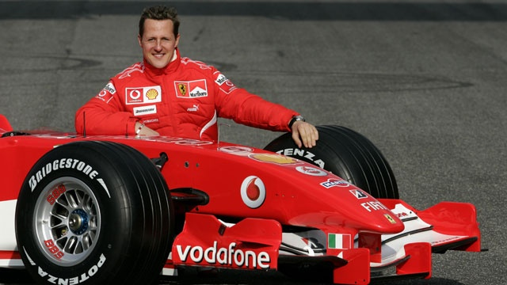
Look at the Picture
Michael Schumacher

Slide 10
Individual work

Slide 11
1. Michael Schumacher was a ---- racing driver
Japanize (b) German (c) English (d) Indian
2. How many times was he Formula One World Champion?
Two time (b) eight time (c) seven time (d) three time
3. How many times was he named Laureus World Sportsman of the Year?
(a) Four times (b) thrice (c) twice (d) once
Listen the audio about Michael Schumacher and choose the best answer.
$$$$
$$$$
$$$$

Slide 12
Group work

Slide 13
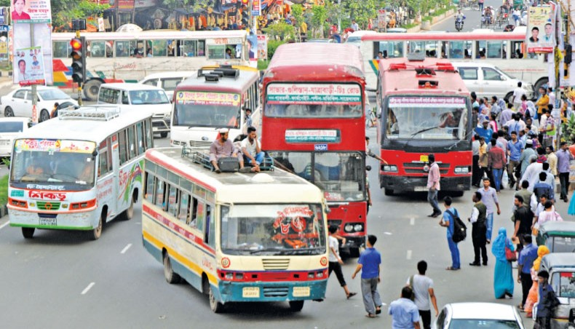
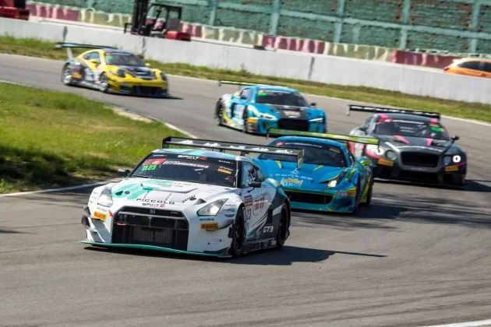
Ans: To drive in the roads and highways-
There is no room for fantasy
Drivers must be ready to encounter
unexpected behavior from any vehicle or pedestrian.
(c) Drivers should keep themselves cool
(d) Drivers must restrain themselves
(e) They should be conscious.
Traffic in the roads and highways
Traffic in the racing circuit
How is driving in the roads and highways different from racing circuit?
To match the answer (Click Here)

Slide 14
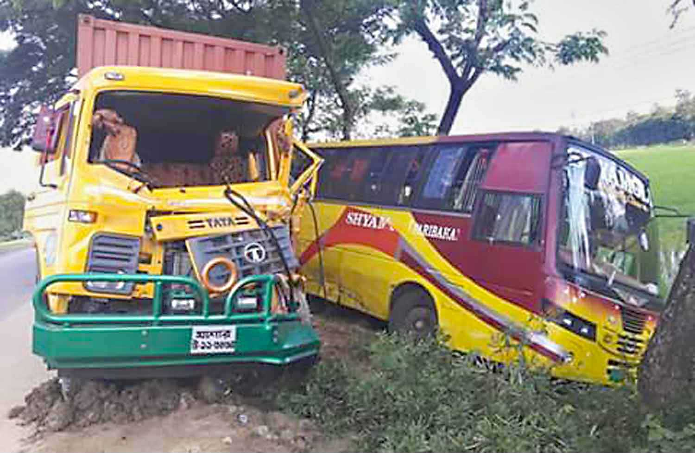
Home Work
Do you think the bus and truck drivers of our highways maintain traffic discipline? What are the reasons of road accidents in our country? Write a paragraph answering the questions within 200 words.

Slide 15
THANK YOU

