Slide 1
Welcome to online class
Md.Alauddin,Assistant teacher,Pagla Govt.Model High&College,Sunamganj

Slide 2
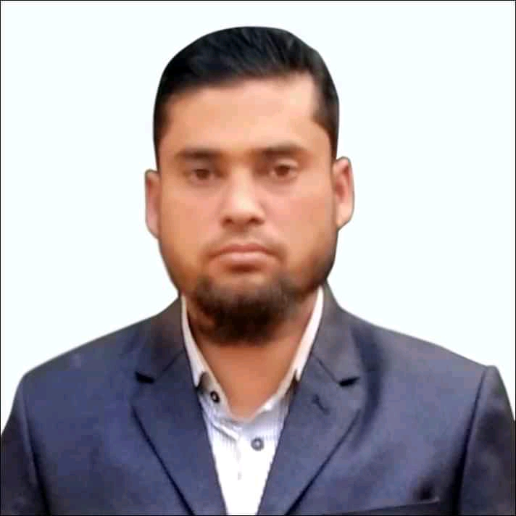
Identity
MD.ALAUDDIN
AssistantTeacher
Pagla Govt.Model High School and College
South Sunamganj,Sunamgan
Class : Nine-Ten
Subject : English Grammar
Date : 00/00/2020
Md.Alauddin,Assistant teacher,Pagla Govt.Model High&College,Sunamganj

Slide 3
Can you guess what types of sentences they are?
1.He reads attentively so that………………………
2.It is high time we ………………………………
3.If you play well…………………………………
Completing sentence
Md.Alauddin,Assistant teacher,Pagla Govt.Model High&College,Sunamganj

Slide 4
Learning outcomes……………….
After studying this lesson,students will be able to-----
1. Complete the sentences by using appropriate clauses.
2.Understand some important grammatical rules for completing sentence'
Md.Alauddin,Assistant teacher,Pagla Govt.Model High&College,Sunamganj

Slide 5
Our today’s topic is……….
Completing Sentence
Part-2
Question no-7
Md.Alauddin,Assistant teacher,Pagla Govt.Model High&College,Sunamganj

Slide 6
It is time/It is high time
It is time/It is high time+Sub+V2+ext.
we changed our bad habit
1.It is time/It is high time…………………………
we gave up smoking
2.It is time………………………………………
Note-Suppose something should be done.It is already a little bit late,in this case we use It is high time/it is time
Md.Alauddin,Assistant teacher,Pagla Govt.Model High&College,Sunamganj

Slide 7
As if/As though
1.Simple present+ as if/as though+Simple past
1.Mina talks as if/as though………………………
she knew everything
2.Simple past +as if/as though+Past perfect
Sub+V2+obj+as if /as though+Sub+had+V3+ext.
she had known everyting
2.Mina talked as if/as though…………………………..
Md.Alauddin,Assistant teacher,Pagla Govt.Model High&College,Sunamganj

Slide 8
Since
1.Present tense+since+Simple past
we met last
1.It is long time since…………………
2.Past tense+since+Past perfect tense
Sub+V2+obj+since+Sub+had+V3++ext.
we had me last
2.It was a long time since………………….
Md.Alauddin,Assistant teacher,Pagla Govt.Model High&College,Sunamganj

Slide 9
Relative pronoun
If there is relative pronoun (who,which,that,whom,whose) in any incomplete sentence ,these kind of sentences can be completed according to the antecedent that used before relative pronoun. For Example---
came here yesterday/ won lottery.
a) I saw the man who-------------------
he wants to buy.
b) This is the house that ---------------
which is small.
c) The writer took a cabin -----------------
is my brother.
d) The boy whom you met yesterday ------------
Md.Alauddin,Assistant teacher,Pagla Govt.Model High&College,Sunamganj

Slide 10
Would that/I wish
Would that/Iwish+Sub+were/could be+other word
I wish/would that.....……………………
I were/could be a bird
Would that/I wish……………………………...
I were /could be a child again
Note-Would/I wish is used to express the unreal past.
Md.Alauddin,Assistant teacher,Pagla Govt.Model High&College,Sunamganj

Slide 11
Lest………..should
Sub+any tense+lest+Sub+should/might+V1+ext.
1.He walked fast lest…………………………….
he should miss the bus
you should fail the exam
2.Read attentively lest…………………………
Note-Lest…….should,is used to show any fear,danger or any harmful matter.
Md.Alauddin,Assistant teacher,Pagla Govt.Model High&College,Sunamganj

Slide 12
Too…………To
Sub+verb+too+adj/adv+to+V1+other word
buy the food
1.He is too poor to………………..
perform the job
2.Mr Alom is too young to…………………
Note-Too-----to,is used to express something in negative way.
Md.Alauddin,Assistant teacher,Pagla Govt.Model High&College,Sunamganj

Slide 13
As soon as
As soon as+past tense+past tense
we stood up
1.As soon as we saw our teacher,……………….
As soon as we reached the station…………………..
the train started
Note- As soon as is used to do something instantly .
Md.Alauddin,Assistant teacher,Pagla Govt.Model High&College,Sunamganj

Slide 14
When/While clause
When/while+past continuous+past simple
I saw a snake
While/when I was walking in the garden………………
When/while+past simple+past continuous
It was raining outside
When/while I was in my room……………………………
Note-When/while clause is used to continue two works in the same time,
Md.Alauddin,Assistant teacher,Pagla Govt.Model High&College,Sunamganj

Slide 15
Unless
Unless+present simple+Sub+can not/will not+V1+ext.
you can not shine in life
Unless you work hard………………………………..
you will not shine in life
Unless you read attentively…………………………..
Md.Alauddin,Assistant teacher,Pagla Govt.Model High&College,Sunamganj

Slide 16
Home work
1.It is high time………………………...........
2.He is too weak………………………………
3.Unless you take physical exercise……………
4.He pretends as if ………………………………
5.Walk fast lest…………………………………..
6.It is a long time since………………………….
7.When I went to market……………………….
8.As soon as he saw me…………………………….
Md.Alauddin,Assistant teacher,Pagla Govt.Model High&College,Sunamganj

Slide 17
Continue to content-3
Bye
Md.Alauddin,Assistant teacher,Pagla Govt.Model High&College,Sunamganj

