Slide 1
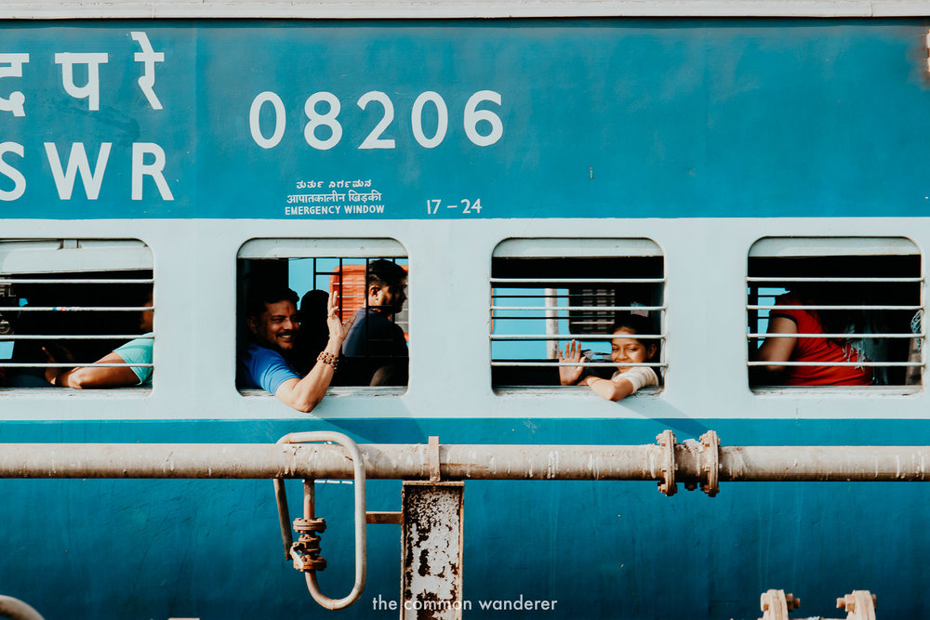
Welcome

Slide 2
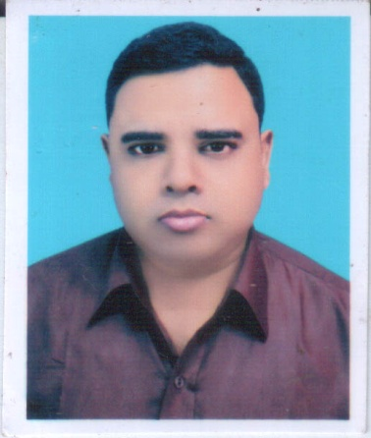
Abdul Aziz
B.A(Hon’s), M.A(English)
Assistant Teacher (English)
Madhaia Bazar Sadim High School
Chandina,Cumilla
E-mail: azizabidpur@gmail.com
English For Today
Class –Seven
Unit –06
Lesson –03
Travelling by Train 2

Slide 3
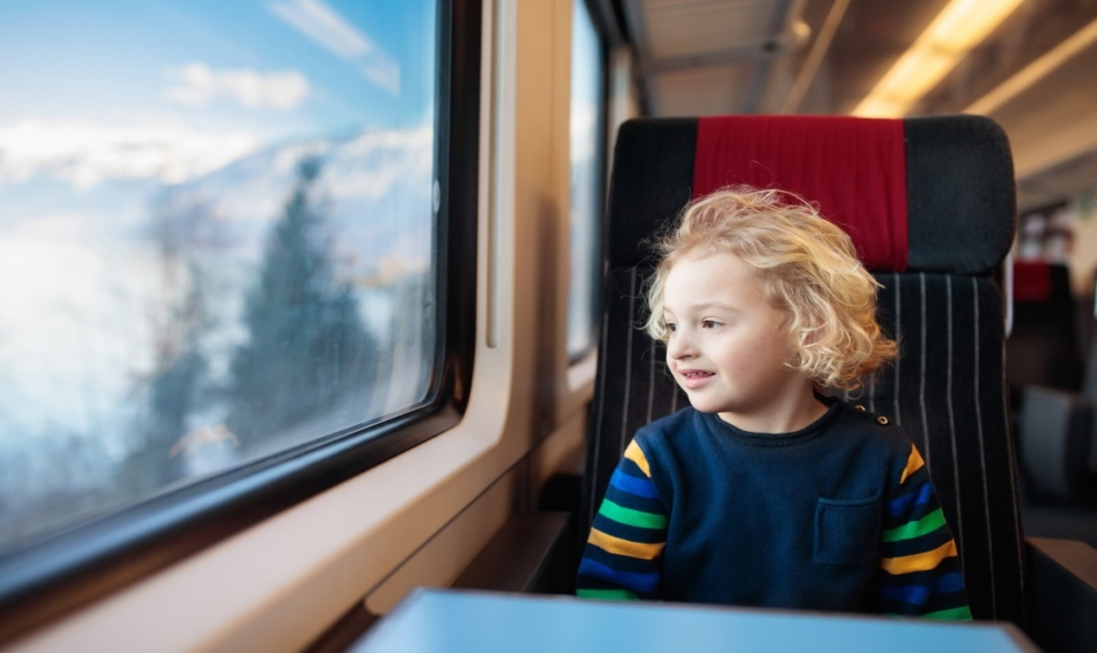
Look at the pictures and Talk about these questions
Have you ever looked through the window from a running train? If you have, what did you see?
Yes, I have looked through the window from a running train.
I saw some farmers working in the fields. Besides, them
Many cows and goats were eating grass. Some boys were playing on
a dusty fields.

Slide 4
So, Our Today’s Lesson is
Travelling by train (2)

Slide 5
Learning Outcomes
Students will be able to
Talk about travelling by train
Describe a Train Journey
Ask and Answer questions

Slide 6
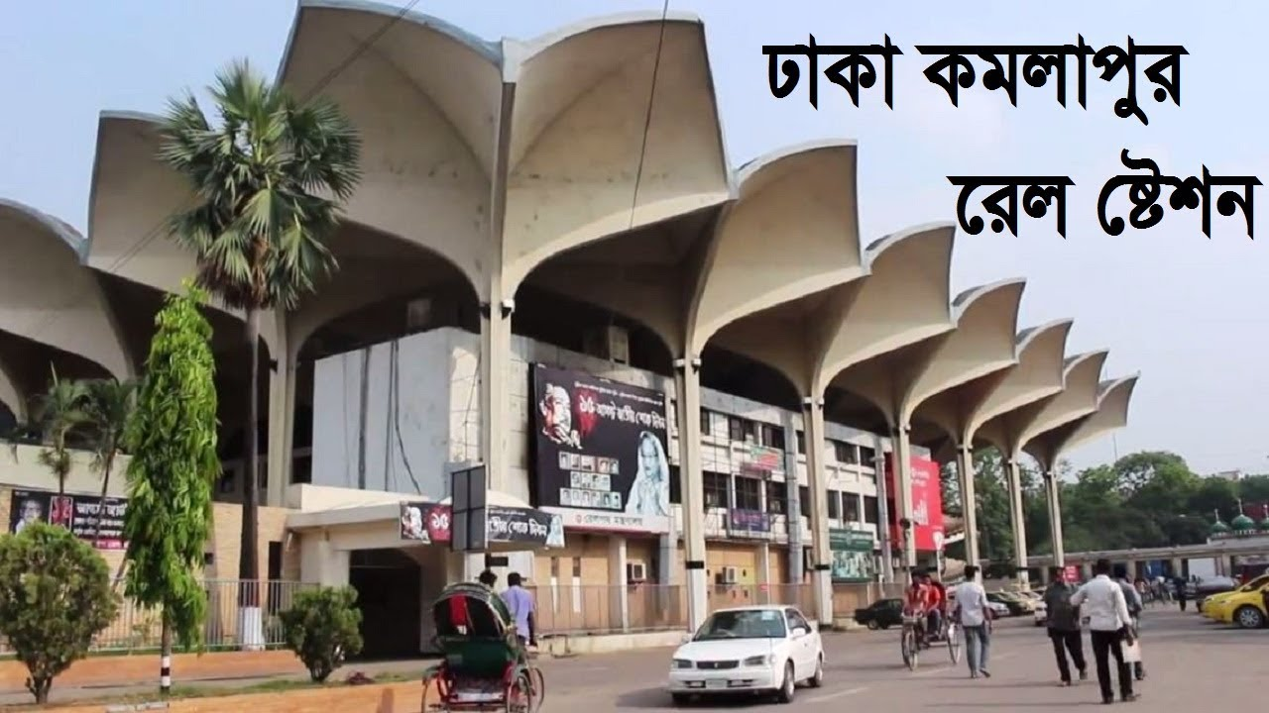
Zishan, Julie and their parents Mr. and Mrs. Arif Khan got into a 1st class compartment at Kamalapur Railway Station. It was Dewanganj –bound Tista Express. The Train left at 8 o'clock. Zishan saw that the departure time on the big time table at the station was 7:30. However, the train was running quite fast. The children sat the window beside their parents. The compartment was half empty.
Connection with book
Page – 59, Section: B
Read the text.

Slide 7
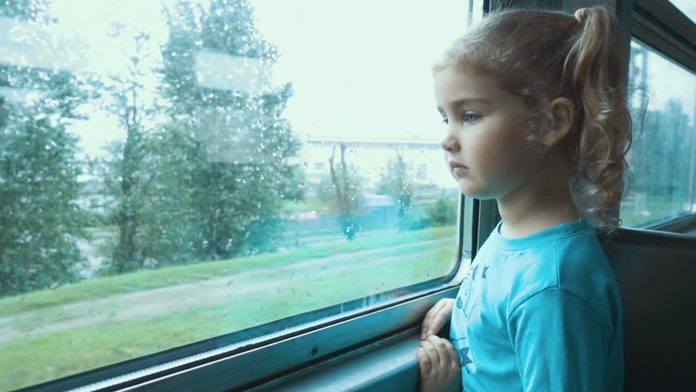
Yesterday Julie downloaded a beautiful poem on a train journey by Robert Louis Stevenson. She took a print out of the poem. Now while looking out of the windows, she found similarities between the poem and real scenery. She took out the poem and began to read.

Slide 8
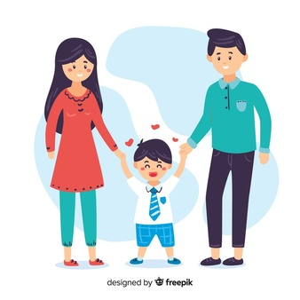
Key words
Parents
Individual Work
Meaning
Father and mother of any person

Slide 9
Key words
Window
Meaning
Opening in the wall/roof

Slide 10
Key words
Journey
Meaning
Tour, travelling

Slide 11
Key words
Take
Meaning
Obtain,receive,acquire

Slide 12
Key words
Poem
Meaning
A piece of writing with sound and rhythm

Slide 13
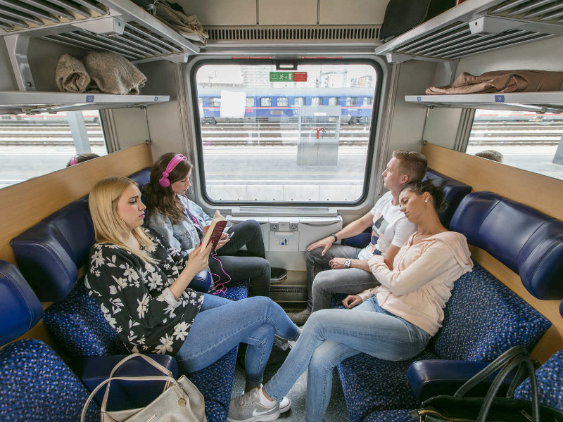
Evaluation
Work in pairs.
Were all the seats taken in the compartment
No, all the seats are not taken in the compartments.
Where did Zishan sit?
Zishan sat by the window.
Where was the train going?
The train was going to Dewangonj.

Slide 14
Homework
Write a short paragraph “Travelling by Train”

