Slide 1
Welcome to the
students
Notes:
This is welcome slide. Teacher may change it according to his will.

Slide 2
Introduction
Md. Ismail Hossain
Assistant Teacher (English)
Ganguria High School
Porsha, Naogaon.
English For Today
Class-IX-X
Notes:
Introduction of teacher & class.

Slide 3
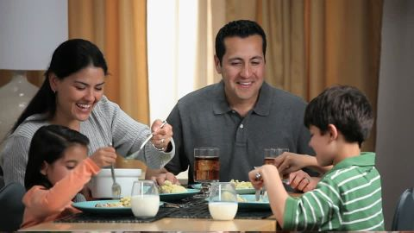
Eating together looks happy.
Eating alone looks gloomy.
Notes:
Difference between doing something together & alone

Slide 4
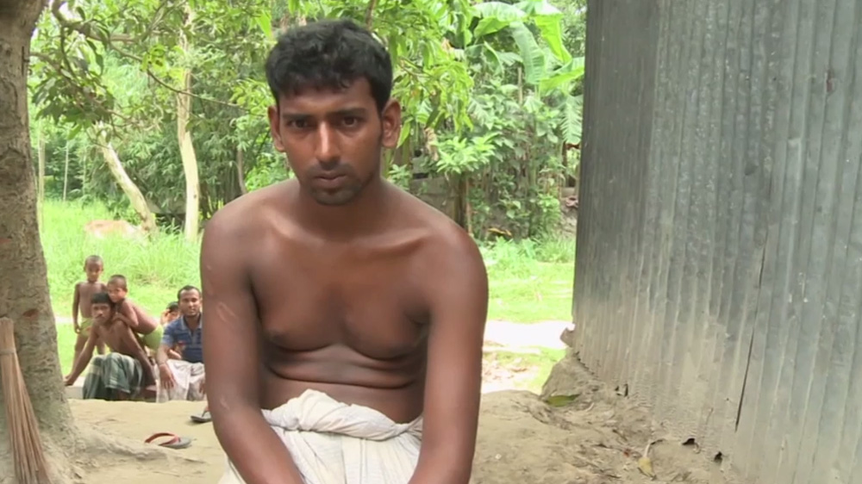
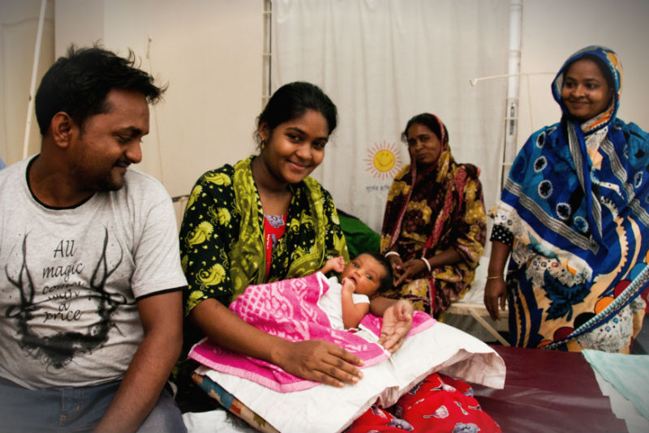
Living alone
Living with family
Notes:
Difference between living together and living alone.

Slide 5
Which one do you
unlike between the two?

Slide 6
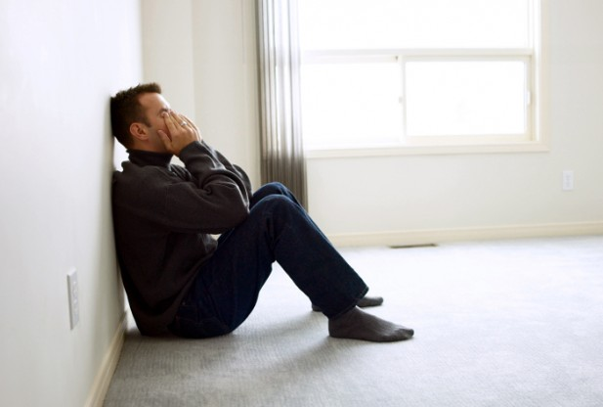
Our today’s lesson is-
Living alone.
Can you live alone?
Unit-1, Lesson-1

Slide 7
Learning outcomes
After we have studied this lesson, we will be able to-
ask and answer questions
read and understand the text through silent reading
write incidents
participate in discussions
Notes:
All the four skills will be focused in this lesson.

Slide 8
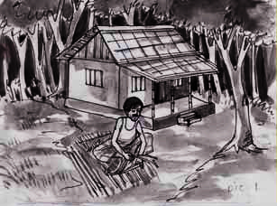
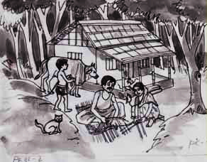
A Look at the pictures and discuss in pairs the following questions.
1 Can you live alone in a house?
2 Make a list of the problems you think you will have if you live alone in a
house, e.g. having accidents, cooking, etc.

Slide 9
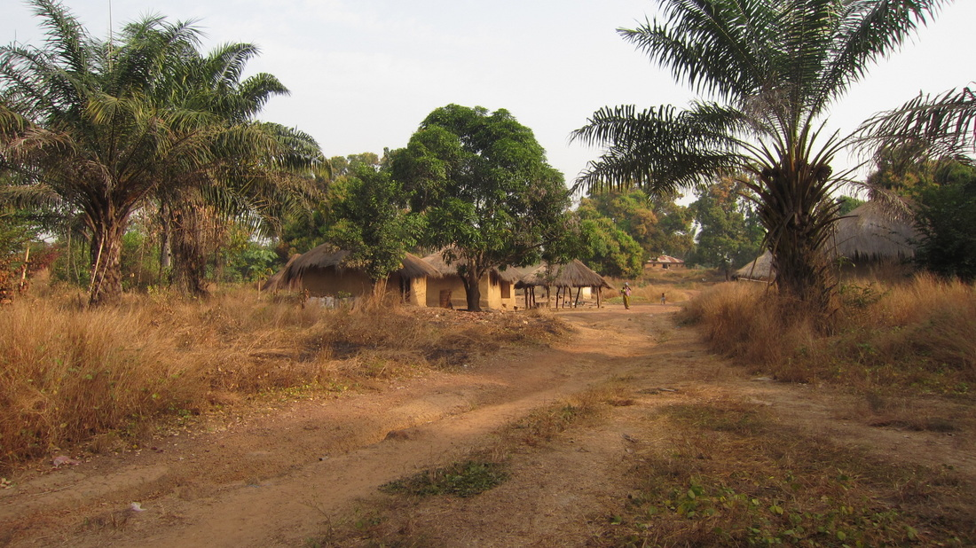
Long ago, a young man lived in a beautiful village.
Notes:
The picture is the symbol of the village where the man lived.

Slide 10
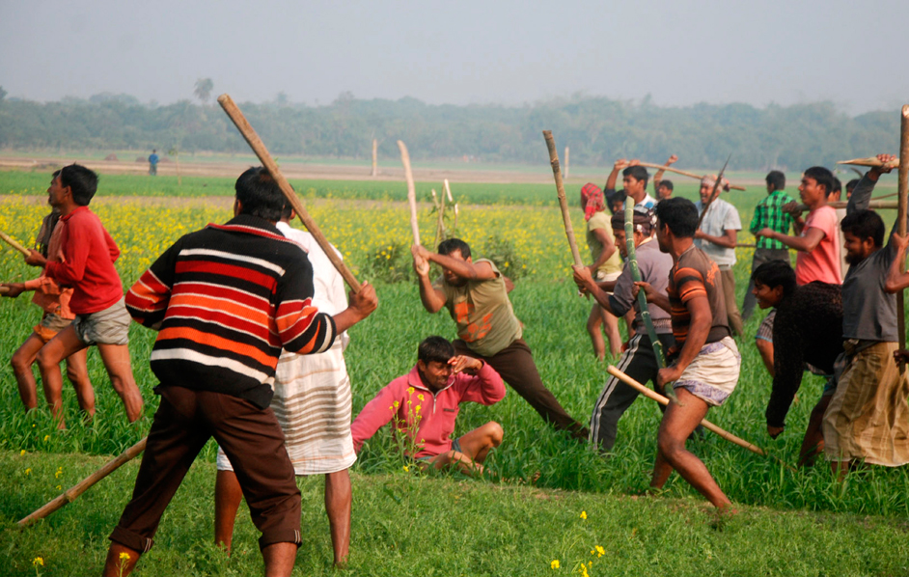
But it was full of problems and sufferings. Quarrels, ill-feelings, jealously, enmity - all were part of everyday life there.
Notes:
The village people are habituated to negative activities.

Slide 11
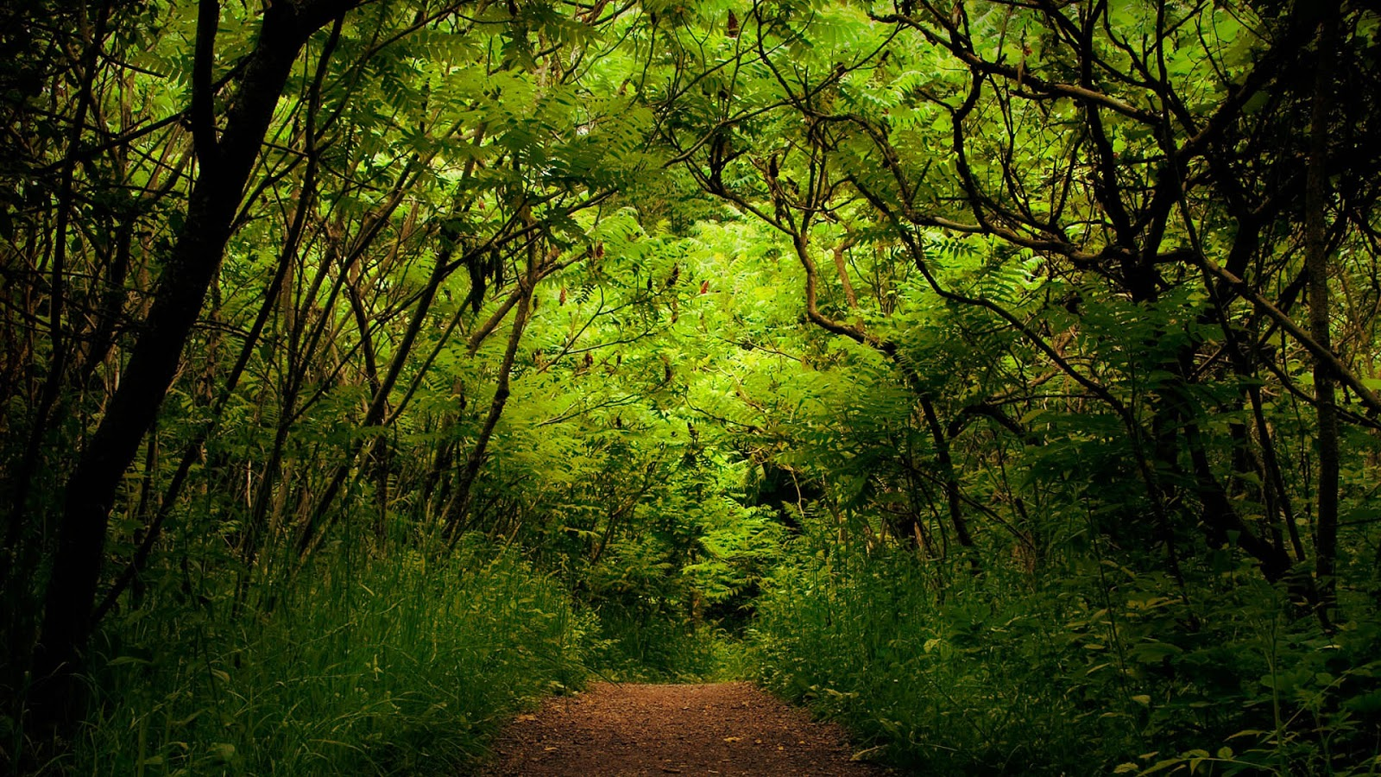
So he decided to go to a -
jungle
Notes:
Wrong deed of the man.

Slide 12
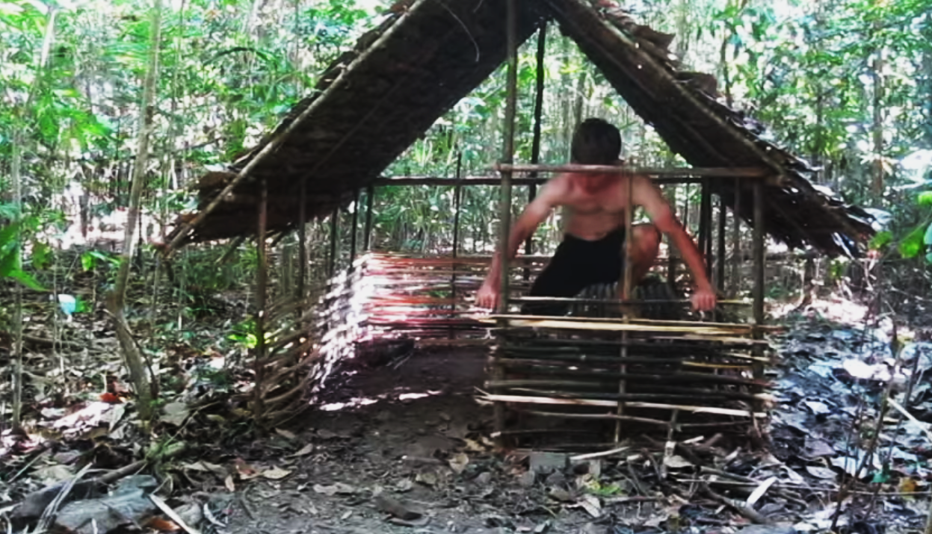
So he left his house and went to a jungle to live by himself. There he made a nice little hut with wood, bamboo and reeds. "Ah, how happy I am here!" said the man to himself.
Notes:
Activities on wrong decision.

Slide 13
But one day-
he found some mice in his hut. The little creatures soon made holes in his blanket.
Notes:
Problems began to arise.

Slide 14
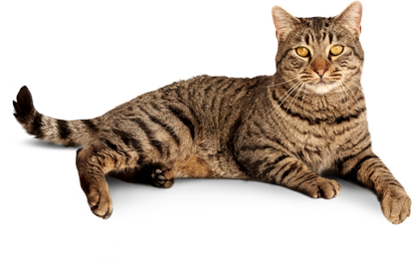
So he brought a-
Notes:
First step of need.

Slide 15
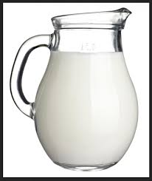
But the cat
needed –
milk
Notes:
2nd step of the man.

Slide 16
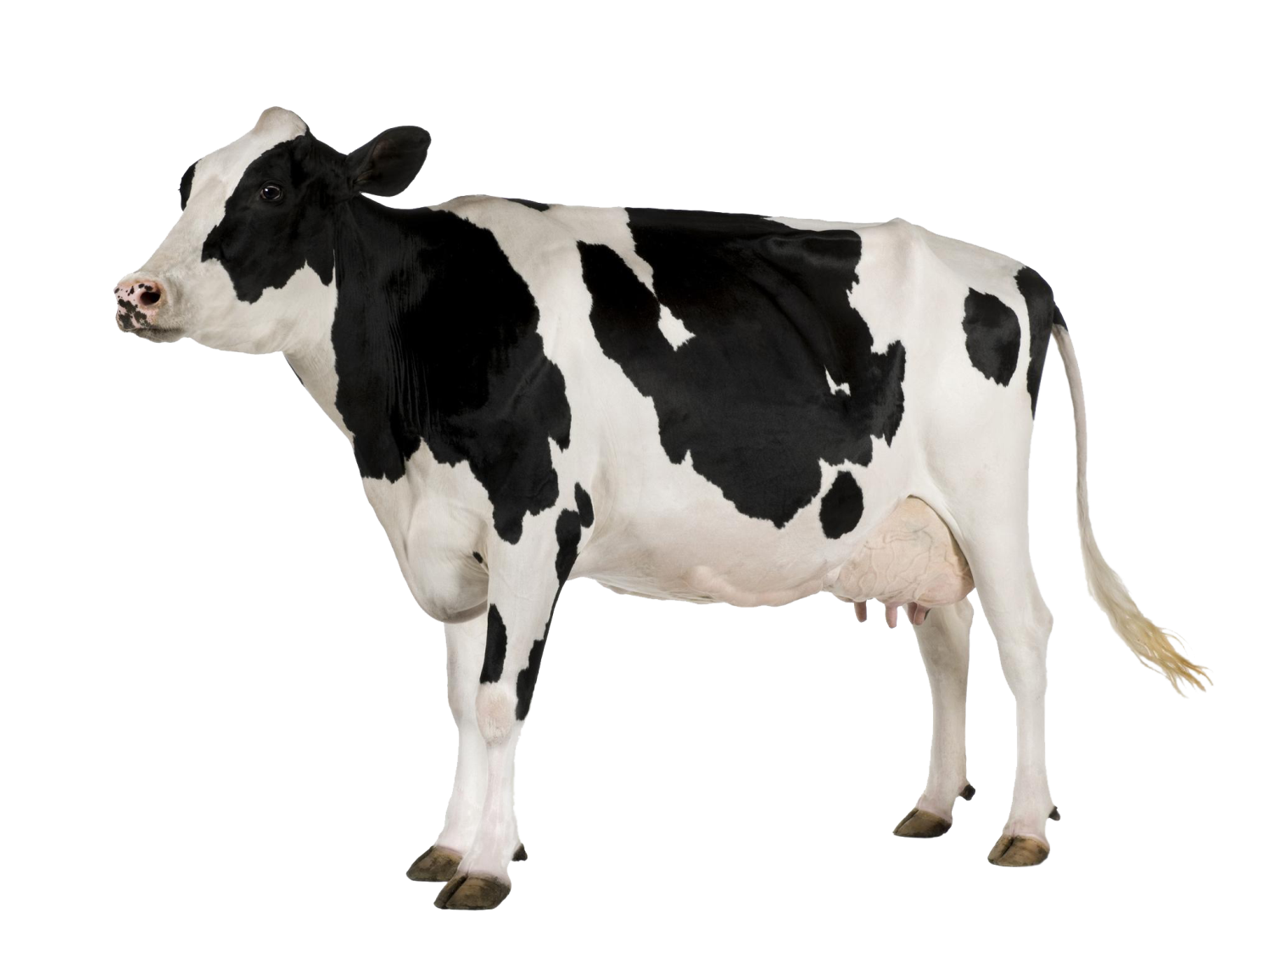
In order to supply milk
he had to bring a-
cow.
Notes:
3rd step of the man.

Slide 17
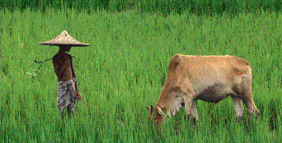
To take care of the cow he
had to bring a -
Notes:
Continuation of human want.

Slide 18
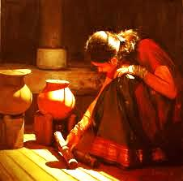
The cowboy needed food. So he had to bring a--
Wife.
Notes:
This is the nature of human character.

Slide 19
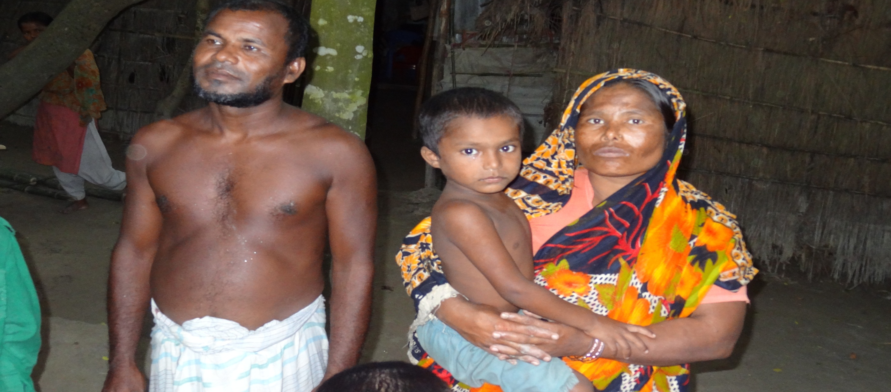
At last he found himself in a family.
Notes:
At last the man returned to the reality. This picture is not the actual family of the man. This is a symbolic family picture only.

Slide 20
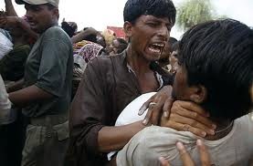
Let us know some key/new words to understand the topic clearly.
Ill-feelings
Bad mentality/
bad thinking/
misconduct
Ill feelings should not be the quality of human beings.
Notes:
The text words are triggered. If you click on the word, you will find the meaning of the word. If you click blank or on the picture, you will find the sentence made with the word. Now you can do any one you like to conduct this option.

Slide 21
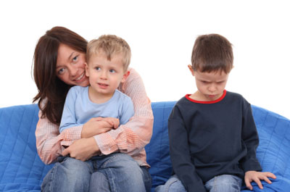
Jealousy
Protectiveness,
distrust
The boy feels jealousy to the other boy.
Notes:
The text words are triggered. If you click on the word, you will find the meaning of the word. If you click blank or on the picture, you will find the sentence made with the word. Now you can do any one you like to conduct this option.

Slide 22
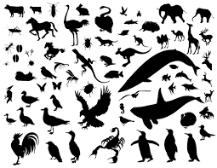
Creatures
Living beings,
Creation of life
Man, animals,
birds and insects
All creatures are essential for environment.
Notes:
The text words are triggered. If you click on the word, you will find the meaning of the word. If you click blank or on the picture, you will find the sentence made with the word. Now you can do any one you like to conduct this option.

Slide 23
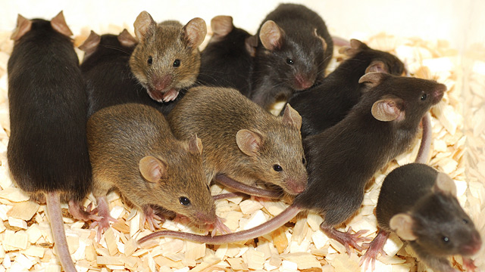
Mice
A group of mouse
Plural number of mouse
The mice cut the blanket of Ruplal.
Notes:
The text words are triggered. If you click on the word, you will find the meaning of the word. If you click blank or on the picture, you will find the sentence made with the word. Now you can do any one you like to conduct this option.

Slide 24
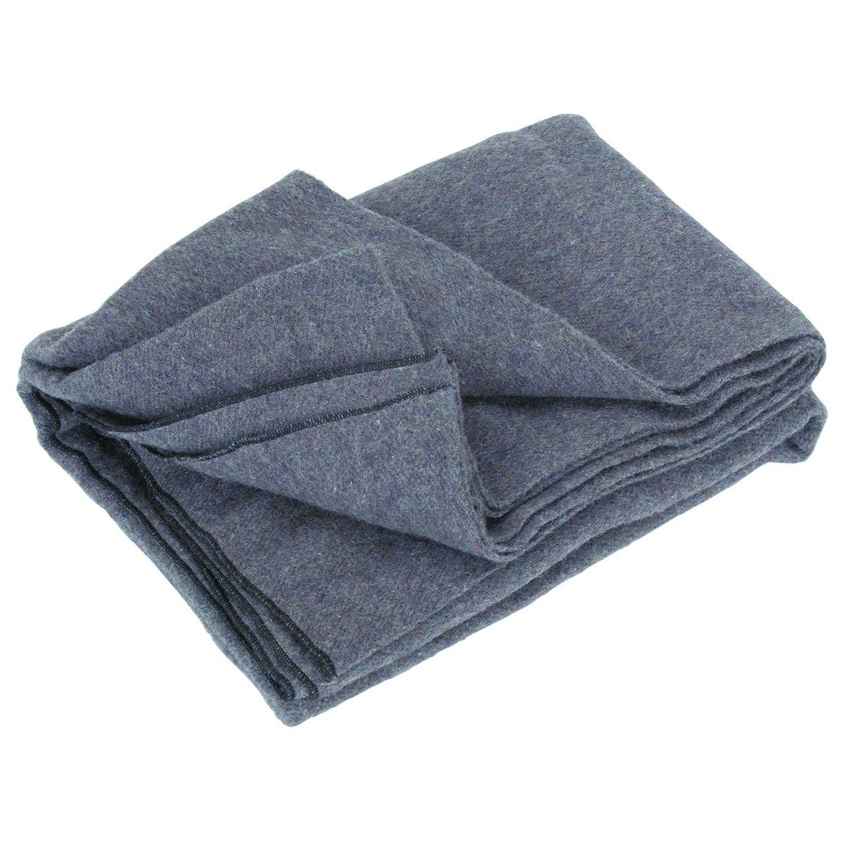
Blanket
Thick cloth
to protect cold,
in Bengali ‘kombol’
We use blanket during winter to protect cold.
Notes:
The text words are triggered. If you click on the word, you will find the meaning of the word. If you click blank or on the picture, you will find the sentence made with the word. Now you can do any one you like to conduct this option.

Slide 25
Notes for the teachers
Dear colleagues,
Digital presentation is actually finished with slide no 25. Now you may conduct the rest of the session manually with board, marker books and other necessaries. You may conduct section B by silent reading or loud reading with proper pronunciation, stress and intonation if you have time. You may assist the students doing all these.
Notes:
Teacher may ask the learners to open their books at page 02 to conduct the lesson.

Slide 26
B Read the story and answer the questions that follow.
Long ago, a young man found life in the family in his village full of problems and sufferings. Quarrels, ill-feelings, jealously, enmity - all were part of everyday life there. So he left his house and went to a jungle to live by himself. There he made a nice little hut with wood, bamboo and reeds. “Ah, how happy I am here!” said the man to himself. But one day he found some mice in his hut. The little creatures soon made holes in his blanket. So he brought a cat to kill the mice. The cat needed milk. So he brought a cow. The cow needed grass and hay. So he brought a cowboy. The cowboy needed food. So he took a wife to cook meals. Then children were born to them, and the man found himself again in a family. So nobody can live alone, unless they are either angels or devils. People need food, shelter, companions and cooperation. They need to help each other. And if they live in a family or community, their need can be fulfilled. Hence living in society can make people good and happy citizens.
Notes:
Teacher may use it at any purpose he likes. It may be helpful to the students those have not brought books with them.

Slide 27
C (Books shut) What five things did the young man do in the jungle? Now
divide into groups of five. Tell the story to the groups sequentially.
D Answer these questions. First discuss in pairs, then write the answers
individually.
1 Why did the young man leave his house?
2 Where did he make a hut? What did he make the hut with?
3 Was the man happy in his hut?
4 How did he find himself again in a family?
5 Where and how can a person be happy?
6 What is the moral of the story?
Notes:
Teacher may go according to the text.

Slide 28
Home Work
Write a paragraph on
“ The problems and comforts
of living in a society,”
Notes:
This is a creative work that the students will perform at home to show the teacher in the nest class.

Slide 29
That’s all
Allah Hafez
Notes:
Ending slide.

