Slide 1
Welcome to the presentation

Slide 2
Introduction
Md. Mizanur Rahman
B.A.(Hons.), M.A. in English, B.Ed.
Assistant Teacher
Police Lines School and College, Pabna.
E-mail: mizanplsc@gmail.com
Cell Phone :01737979719
Class: VIII
Subject: English 1st Paper
Unit: Nine ( Things that have changed our life)
Lesson: Four
Lesson Title: Taking off
Class Duration: 40 minutes
Date: 17/06/2020

Slide 3
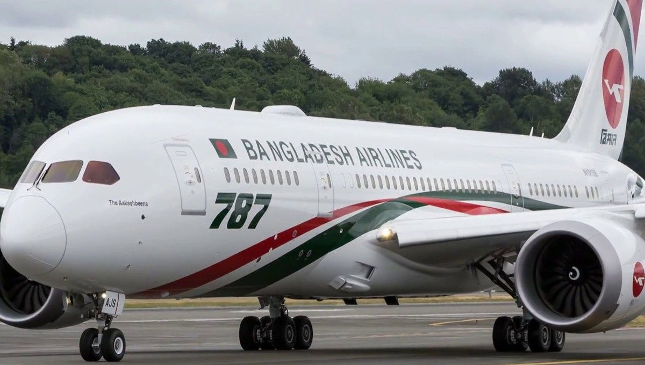
Look at the picture
What do you see in the picture?

Slide 4
Today’s Lesson
Taking off

Slide 5
Learning Outcomes
At the end of the lesson, the students will be able to:
read and understand text .
write the answer of questions.
write short a note on the project.
choose the best answer and fill in the gaps.

Slide 6
Key words presentation
Word : Aircraft
Noun
Meaning : an airplane, helicopter or other machine capable of flight.
Syn. Airplane, aero plane, jet
Example : Modern aircraft companies are making revolutions in aviation technology.

Slide 7
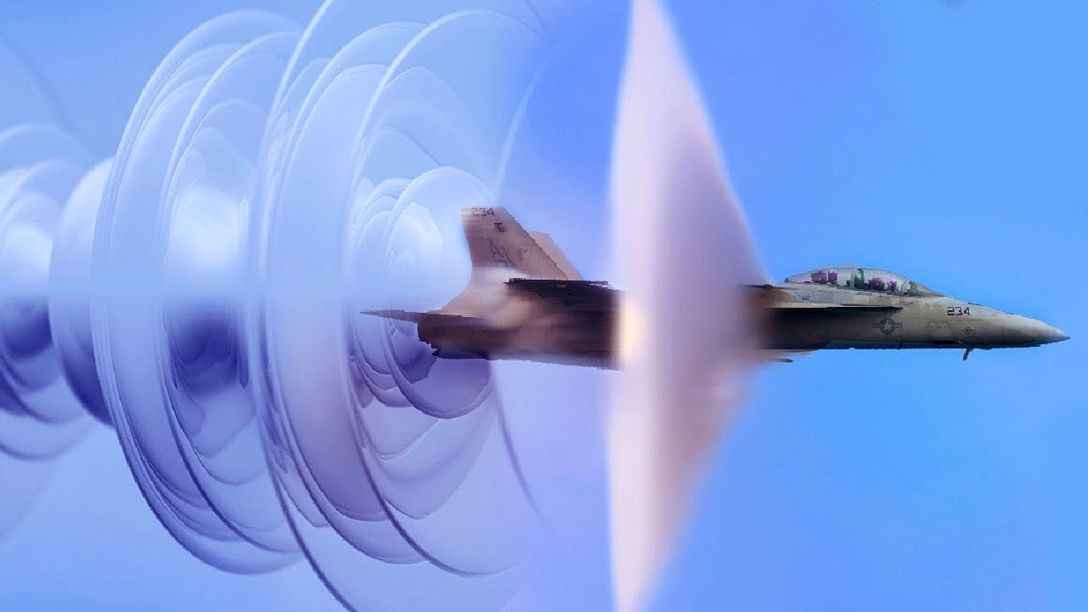
Word : supersonic speed
Phrase
Meaning : faster than the speed of sound
Example : Now the ‘ aka airplane’ has got a supersonic speed.

Slide 8
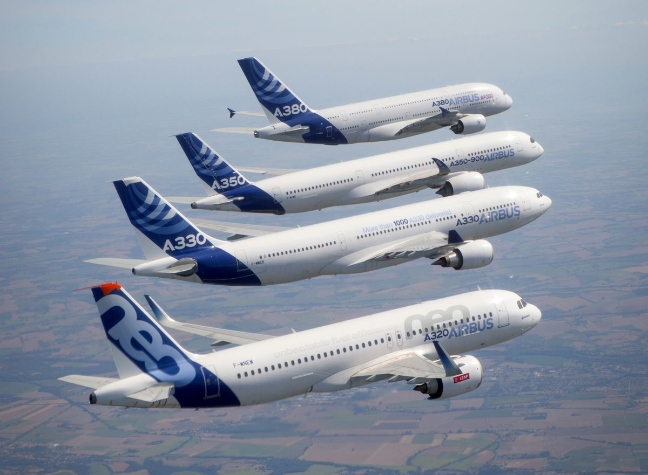
Word : Revolution
Noun
Meaning: A very important change in the way that people do things
Example : Modern aircraft companies are making revolutions in aviation technology.

Slide 9
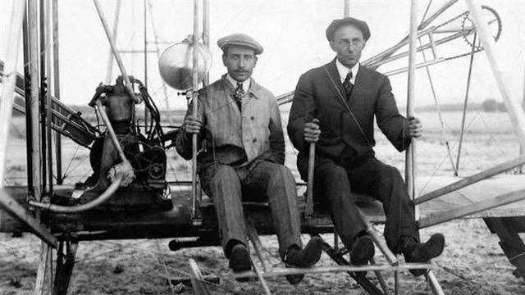
Read the text silently.
Human beings conquered the distance on earth by discovering wheel. They endeavored further. Then on December 17,1903, the Wright brothers in America made the first experiment of flying in a plane.
Wright Brothers
In the experiment, a machine carried a man and rose above by its own power. The machine was called ‘aka airplane’. It flew naturally in a smooth speed, and finally landed without damage. That was human being’s first real take off. And now, they have got a supersonic speed. In a supersonic speed, something travels faster than sound! So the sky’s the limit now!

Slide 10
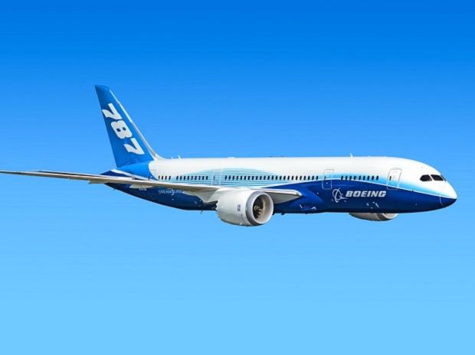
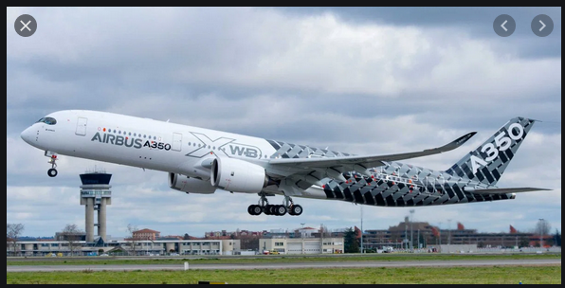
Modern aircraft companies are making revolutions in aviation technology. Boeing as well as Airbus is producing modern passenger airplanes.
Boeing 787
Airbus 350
These planes fly very fast. Boeing 787 flies 950 km/h. However, Airbus 350 is expected to fly in a couple of years. Its speed will be 945 km/h.
You find attractive ads on the websites of both Boeing and Airbus planes. Both have excellent features. But in speed, neither could beat the Concorde. It is the world’s fastest supersonic passenger air craft. Its normal speed was 2170 km/h. The Concorde was a joint project by France and Britain. It started passenger flight in 1976. Unfortunately, the Concorde fleet was grounded forever in 2003 after a major accident

Slide 11
Individual Work
Answer the following questions
Who made the first successful experiment in flying an airplane?
What was the first flying machine called?
What do you mean by ‘supersonic’ ?
What was world’s fastest passenger airplane?
When was Concorde fleet finally grounded?

Slide 12
Pair Work
Complete these statements using the correct form of words in the brackets.
Airbus 350 is a bit than Boeing 787.
Concorde flew among all passenger aircrafts.
Even sound cannot travel as as Concorde.
In supersonic speeds, Concorde flies in the sky than Boeing.
To many, Concorde looks than other passenger aircrafts.
Airbus A380 is the passenger aircraft in the world now.
Airbus A380 can carry passengers than Boeing 787.
slower
fastest
fast
higher
more beautiful
largest
more

Slide 13
Group Work
Project Work:
Suppose, your teacher will buy a mobile handset. Visit in pairs a nearby mobile phone shop. Make a list of different models of handset with their price and other features. Then discuss with your partner to compare and decide which one will be the best handset and why. Share your findings with other groups.
Then write a short note on your experience.

Slide 14
F. Choose the best answer to each question from the alternatives given and write the corresponding number of the answers in your answer script.
Evaluation
The word ‘ supersonic’ in the text means --------.
As fast as the speed in the sky ii. Not as fast as the speed of sound
iii. Very high pitched sound iv. Faster than the speed of sound
b. What does the word ‘aviation’ mean in the text?
The act of flying in the sky ii. Airplane manufacture, development, and design
iii. Denoting the activity in the air iv. The business of selling aircraft
c. What does the word ‘aircraft’ mean in the text?
Any vehicle capable of flying ii. A plane manufacturing company
iii. A passenger plane iv. A supersonic plane

Slide 15
d. By discovering wheels, human beings----------.
Achieved freedom ii. Became chained
iii. Took control over distance iv. Got prize
e. ‘Aka airplane’ was a/ an ------------.
Wheel ii. Giant iii. Machine iv. Old engine
f. Who are the pioneers in inventing airplane?
Pilot ii. Passengers
iii. Wright brothers iv. Crews
g. What does the idiom ‘the sky’s the limit’ mean in the passage?
Man cannot go beyond the sky.
There is no limit to what someone can achieve.
Someone should fly in the sky
Sky has no limitation

Slide 16
Home Work
Read the following text and fill in the gaps with appropriate words to make it a meaningful one.
Communication of ideas is at the centre of civilization. It needs written records. Most of our documents in the modern age are on (a) . Though writing was
very early, paper is more
invention. For long in history, people
(d) ideas through speaking and listening. Then there came the (e) of writing.
paper
invented
recent
exchanged
art

Slide 17
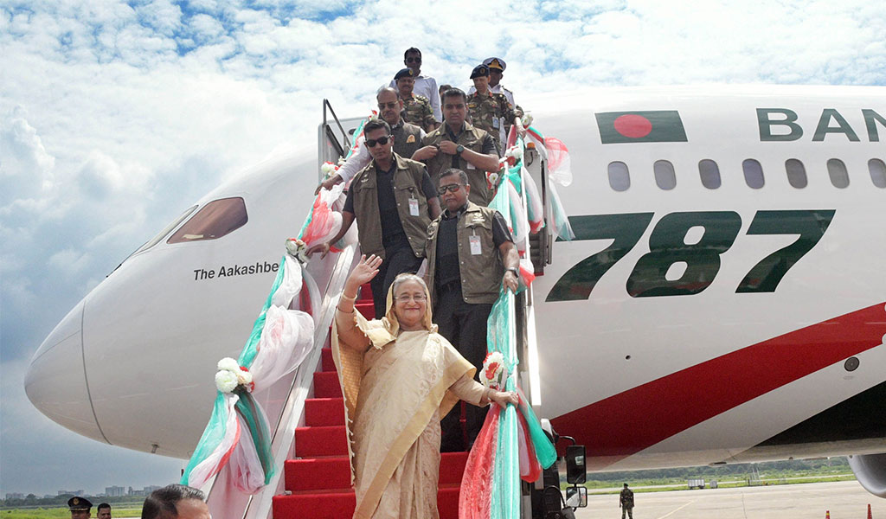
Thanks to all
See you again in the next class.

