Slide 1
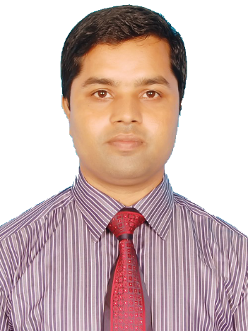
“Stat Home,
Stay Safe.”
Asim Kumar Talukder
Lecturer , Dept. of English
Fenchuganj Govt. College

Slide 3
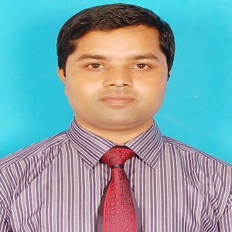
Introduction
Asim Kumar Talukder
Lecturer in English
Fenchuganj Govt. College
Fenchuganj, Sylhet.
Email Id: aktalukder@gmail.com
01716348110
Class: Eleven/Twelve
Subject: English 1st Paper
Unit: 02, Lesson: 03
Time: 50 Minutes

Slide 4
Learning outcomes
Students will be able to…….
know why a traffic policeman works hard
know how a traffic policeman works
know what kind of the personal difficulties a traffic police faces.
understand a poem and write the summary of the poem

Slide 5
Look at the pictures
What are the pictures about?

Slide 6
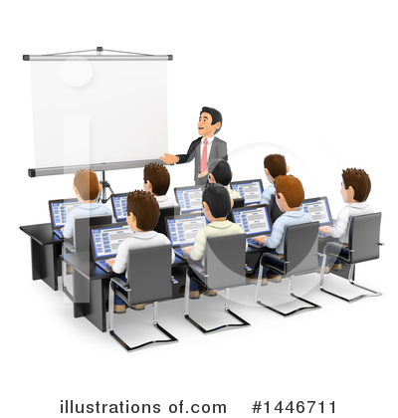
The Traffic Police
Unit:2, Lesson:3
Declaration of Lesson

Slide 7
Amidst killer speeds I stand
Facing the traffic, stretching my hand.

Slide 8
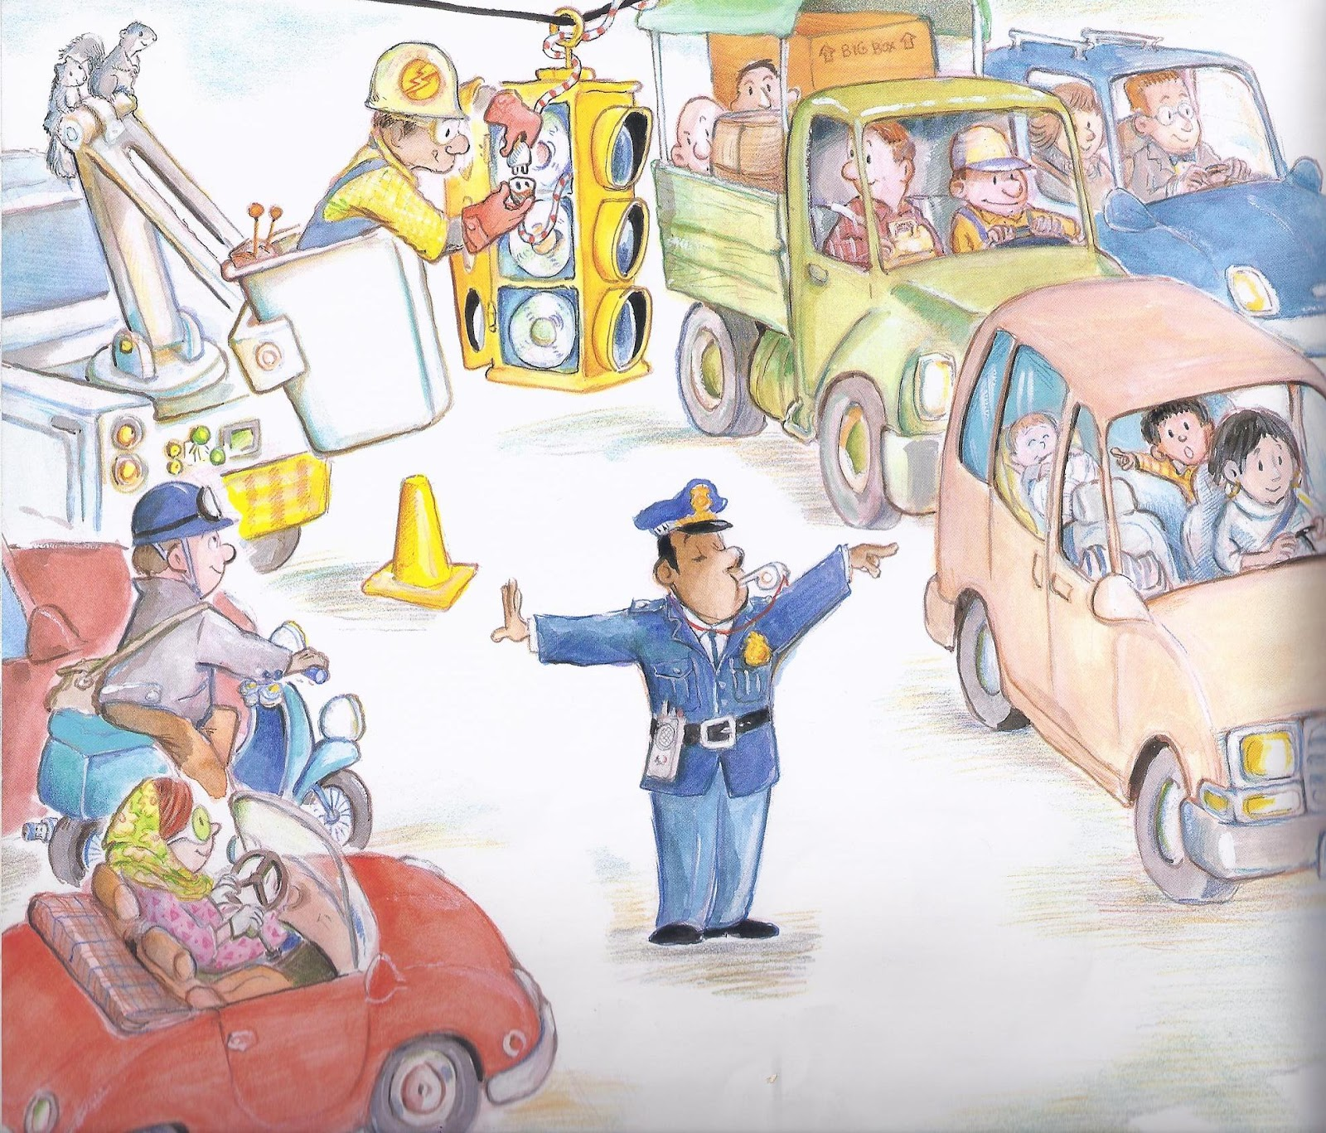
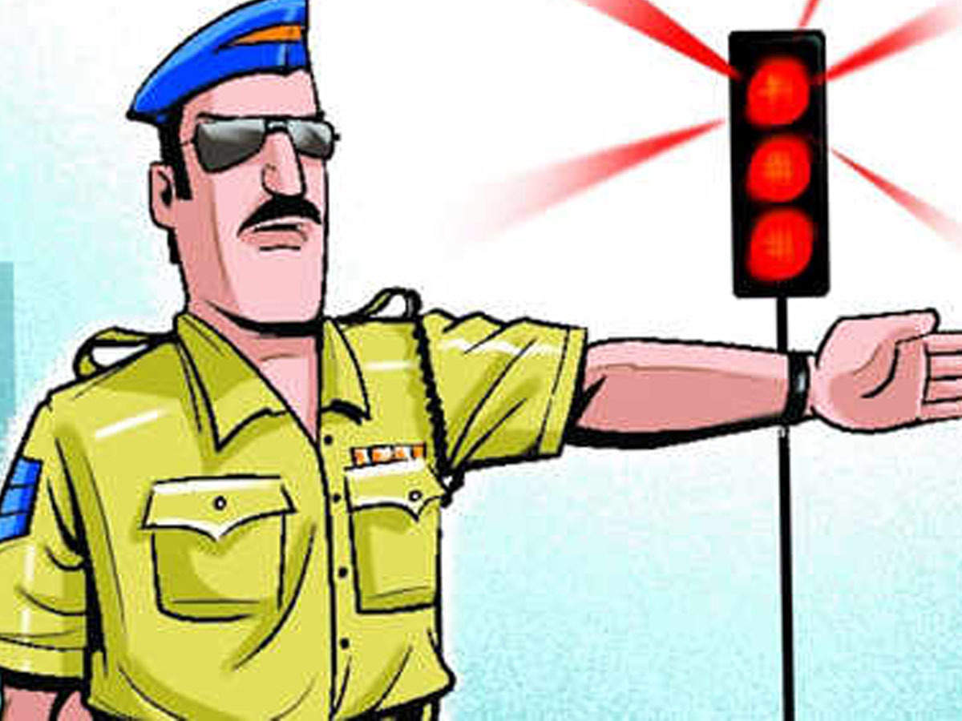
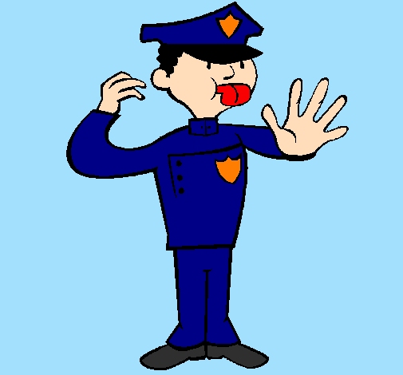
I am seen on kid’s books and as cartoons everywhere
Educating people and asking them to beware
Of the erratic traffic the signboards
Seen on almost all the roads.
Look at the Pictures

Slide 9
Why does a traffic policeman work so hard?
How does he work?
Pair Work
Now, match the answer according to the poem

Slide 10
So that you’re safe I see each one of you
But my sweat, my plight on the road sees who?
Be it sunny or rain,
For your safety I must be
Vigil and agile, on the middle
Standing erect, as fit as a fiddle.

Slide 11
1. What kind of the personal difficulties does a traffic police face?
Group Work
Now, match the answer according to the poem

Slide 12
Oh! My ear hurts! Oh! My head aches!
Oh! Look at the weather….. such unpredictable days!
But I cannot swerve; I must be on duty.
I care for your safety.
Be it noisy or dusty; Be it sunny or rainy;
I must be on duty. I care for your safety.

Slide 13
Home work
Write the summary of the poem

Slide 14
Thank you

