Slide 1
W
E
L
M
E
C
O
Notes:
Masjid Sultan Qaboos in Oman.

Slide 2
INTRODUCTION
Md Amir Hossain
Asst, Teacher
Madinatul Ulum Dakhil Madrasah
Mobil No: 01714-315772

Slide 3
English Ist Paper
Class- Nine
Unit-9
Lesson-3
Date:19/06/2020

Slide 4
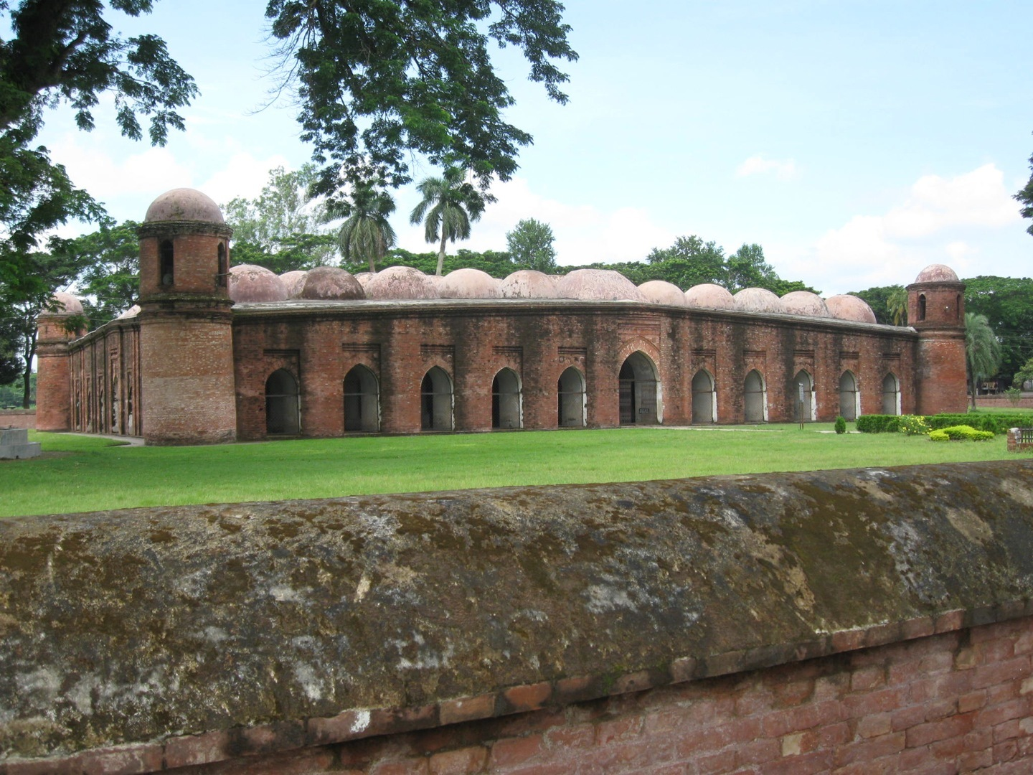
What do you see in the picture? Describe it .
This is the Shat Gombuj Mosque. It is one of the historical places of Bangladesh. It is also one of the world heritages.
Notes:
The teacher can ask the question to the students first. The students may be able to answer or may not. If any student can answer, the teacher can ask few other question related to the picture. Then the teacher can show the information given below the picture.

Slide 5
Today our topic is
The Shat Gambuj Mosque

Slide 6
Learning Outcomes Of The Lesson
After this lesson the students will be able to----
1. talk about a picture.
2. listen for specific information.
3.read and understand the text through silent reading.
4. write about a place.
5. infer the meaning from the text.

Slide 8
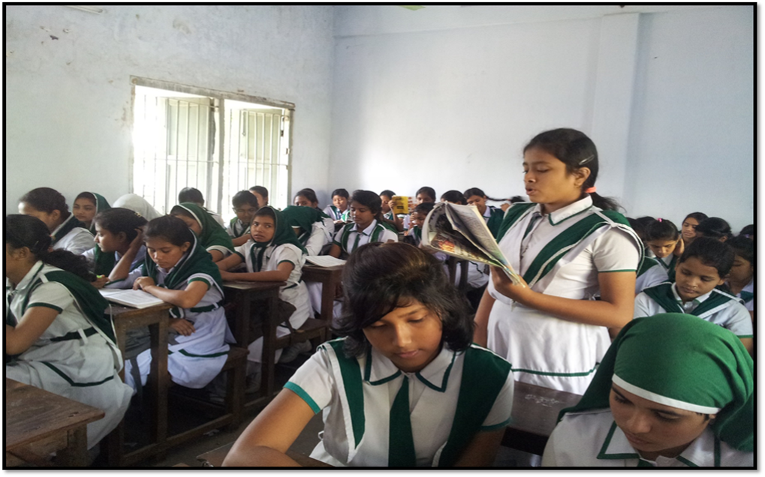
Silent reading

Slide 9
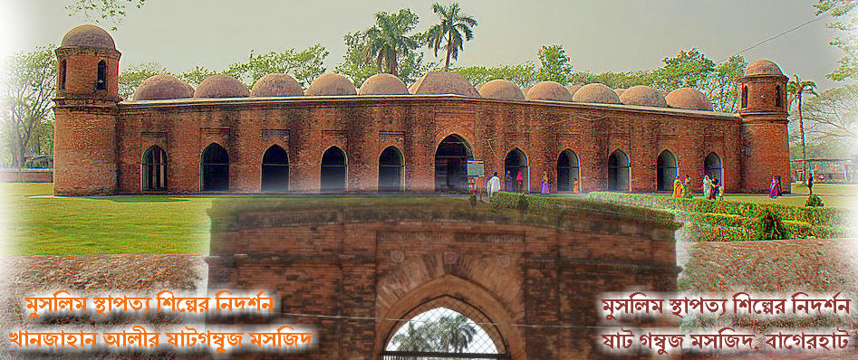
Have a look outside the mosque.
Four corners have 4 smaller dooms
77 low height dooms
11 Arched doorways on east

Slide 10
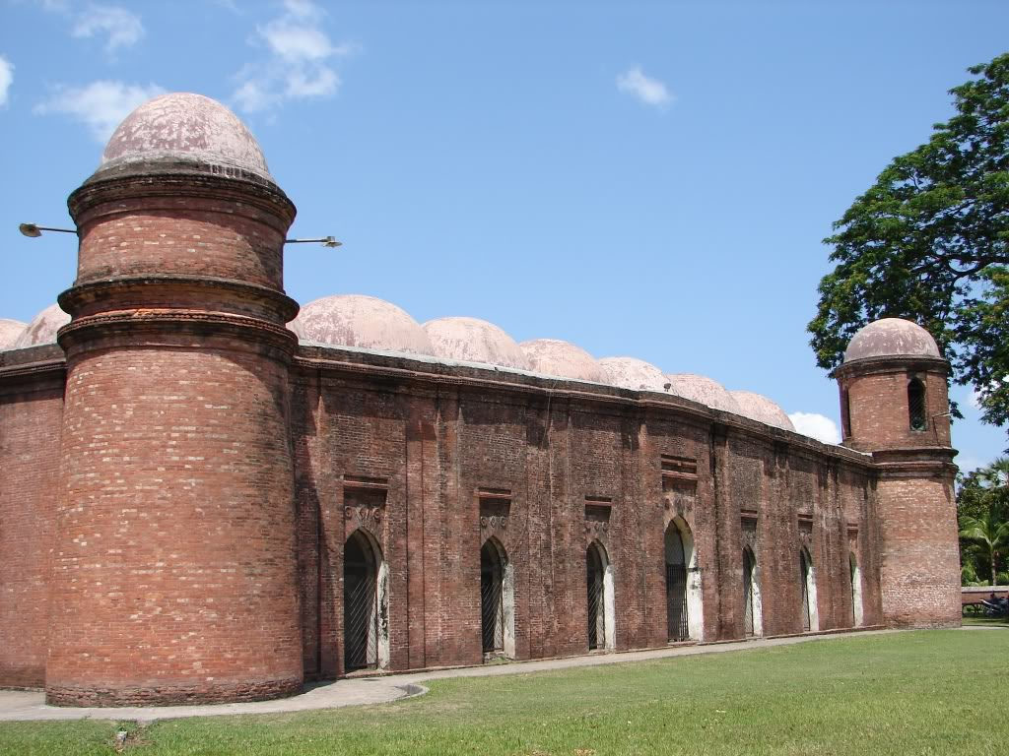
7 Arched doorways each on north and south

Slide 11
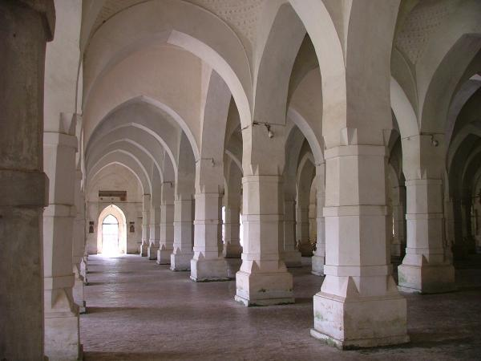
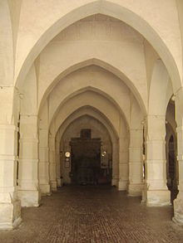
What do you see inside the mosque?

Slide 12
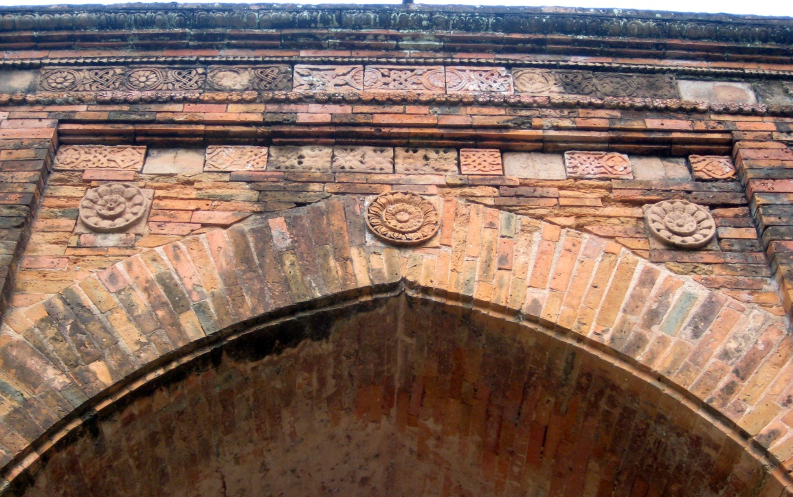
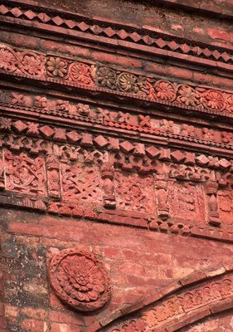
The interior western wall of the mosque is beautifully decorated with terracotta .

Slide 13
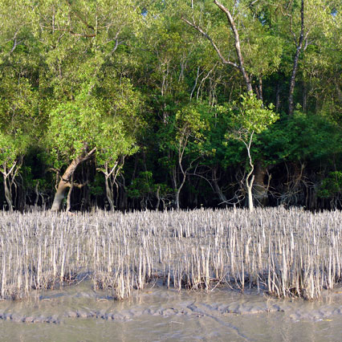
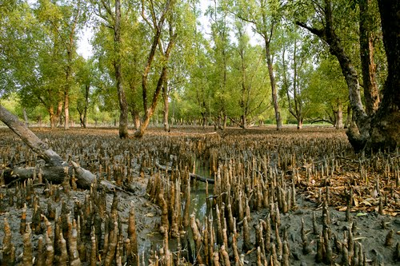
Mangrove
New Words
A tree or shrub that grows in wet mud at the edge of river
Meaning
Sundarban is a mangrove forest.
Notes:
First, the word will be shown. The SS will be asked to pronounce the word. If it is needed teacher can help. Then the picture and the sentence will be shown and asked to guess the meaning. After that the meaning will be shown. Then the teacher can ask the students to make a sentence of their own. In the same way, slide no. 8-12 can be conducted.

Slide 14
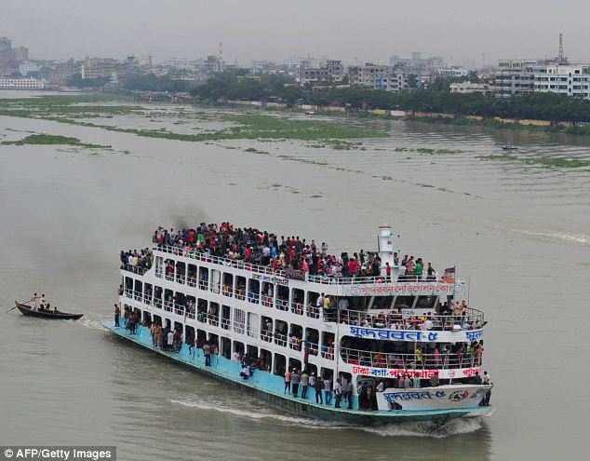
Outskirts
Meaning
The outer parts of a town or city.
The Buriganga river is at the outskirts of Dhaka city.

Slide 15
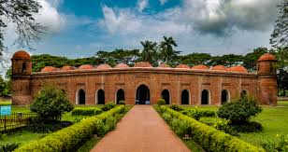
Remarkable
Meaning
Worthy of attention
The mosque is very remarkable for its various colourful flowers.

Slide 16
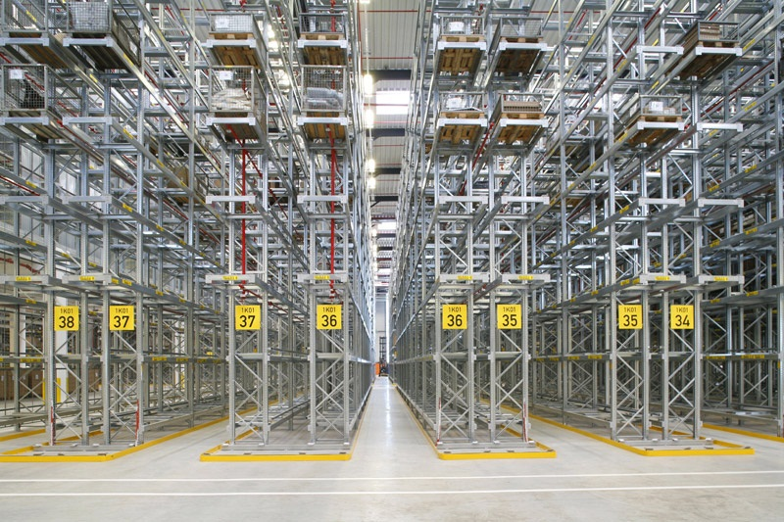
Aisle
Meaning
Path/ corridor
We can see five aisles in the picture.

Slide 17
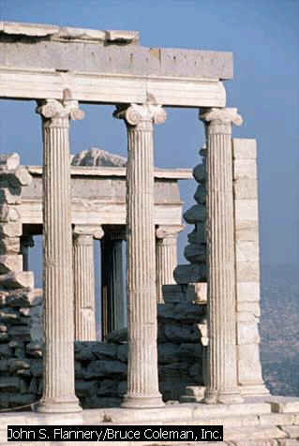
Column
Slender
A tall pillar made of stone
Thin
Few slender columns of the destroyed building are still standing.

Slide 18
Read the text again and fill the table . [pair work]
Who/What | Event/Activities | When/Why
The Shat Gombuj Mosque | a) …………….. | in 1985
It | was founded | b) ………………
Khan Jahan Ali | c) ……………... | to fit the city to live in.
The mosque | is unique | d) ….………….
It | e) ……………… | for its architectural beauties.
a) became a UNESCO World Heritage Site
b) in the 15th century.
c) built a networks of roads, bridges, public buildings and reservoirs
d) for its 60 pillars that supports the roof with 77 low height domes.
e) attracts the tourists

Slide 19
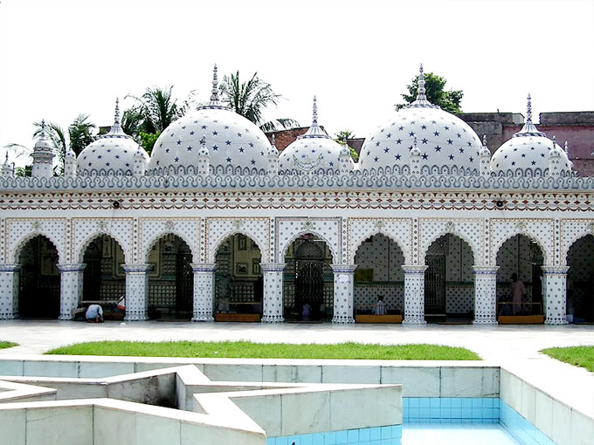
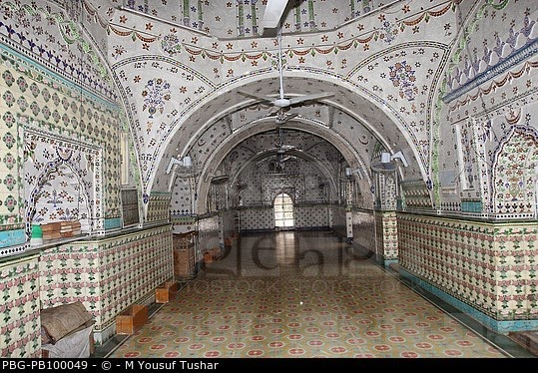
Group work
Look at the picture of the Star Mosque in Dhaka. Write a description on the Star Mosque with the help of the given clues. ( See the clues in the text book).

Slide 20
Homework
Write a short paragrap “Shat Gombuj Mosque or the Star Mosque”

Slide 21
Thank You

