Slide 2
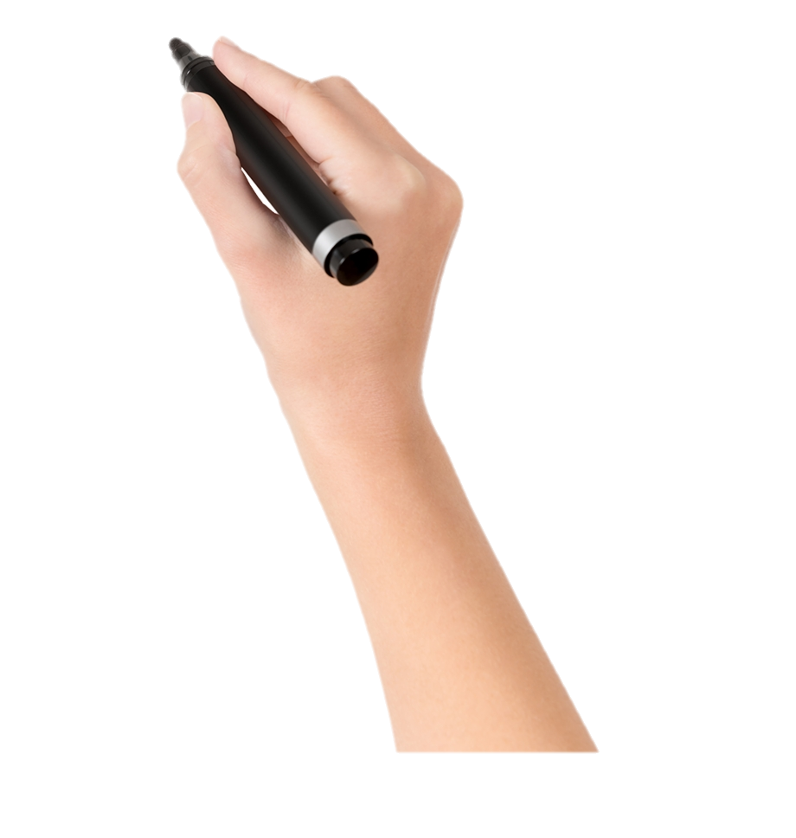
Welcome

Slide 3
Identity
MD. NOOR E ALAM SIDDIKI
Asstt. Teacher
NAGESWARI KERAMOTIA M.L HIGH SCHOOL.
Mobile- 01716962418
Email- nooralam.na35@gmail.com
Title-voice (2)
Unit-8,lesson-2

Slide 4
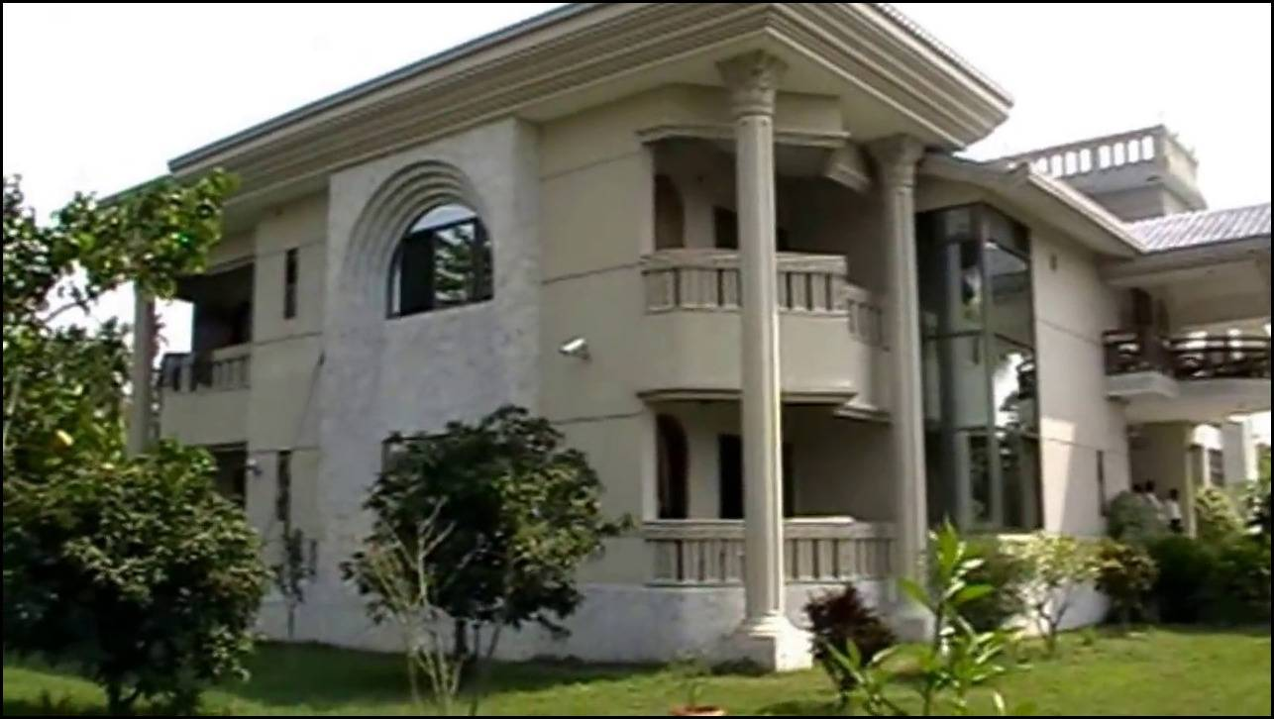
What can you see in the picture?
What text is inscribed on the signboard?
What kinds of sentence is it?
What is the subject of the sentence?
The house will be sold.
Passive voice.
There is no subject in the sentence.
The house will be sold.
A house and there is a signboard in front of the house.

Slide 5
Todays lesson is…
Voice
Unit- 8, lesson-2

Slide 6
Learning outcome
After studied this lesson, the students will be able to…
1. make passive from present indefinite tense.
2. make passive from present continuous tense.
3. make passive from present perfect tense.

Slide 7
I
write
an application.
An application
is
written
by
me.
Structure- Sub+ be verbs( am,is,are)+ past participleof the main verb +by + object.

Slide 8
Time- 10 minutes
Now change the following sentences into passive…
1. we read novels.
2. Najibur pulls the cart.
3. My mother tells me a story.
4. We love our country.
5. The fisherman catches fish in the river.

Slide 9
Present Indefinite questions and negatives
Look at the table below to understand the changes to active to passive.
Active
Passive
Do you play cricket?
Is cricket played by you?
What do you want?
What is wanted by you?
Why does he call me?
Why am I called by him?
Don’t you sing a song?
Isn’t a song sung by you?

Slide 10
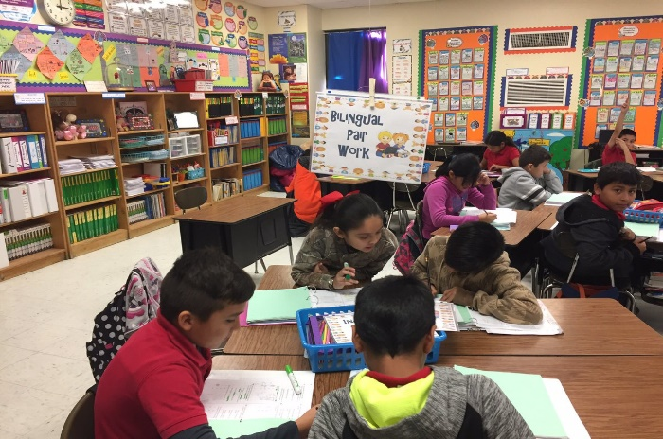
Follow the structures…
Time- 10 minutes
What can you see in the picture?
Wh word + am/ is /are+ Sub +past participle+ by+ object ?
Wh word +am/ is /are + not +sub+ past participle +by + Object?
Change the following questions to passive.
a) Do you like tea?
Pair work
b) Doesn’t mother cook rice pudding?
c) Why do they like you?
d) When does your father read newspaper?
e) What do you say?
f) Doesn’t your sister teach you English?

Slide 11
Match your answer.
a) Is tea liked by you?
b) Isn’t rice pudding cooked by mother?
c) Why are you liked by them?
d) When is newspaper read by your father?
e) What is said by you?
f) Aren’t you taught English by your sister?

Slide 12
Voice of present continuous tense.
I
am eating
an apple.
An apple
is
being
eaten
by
me.
Structure- Sub + be verb + being + past participle + by + object.

Slide 13
Present continuous tense questions and negatives.
Look at the table and try to understand the changes of active to Passive.
Active
Passive
Are you composing an email?
Is an email being written by you?
Aren’t you writing a letter?
Is a letter being written by you?

Slide 14
Change the following questions into passive…
1. Is she watching television?
2. Are they playing chess?
3. Is Mr. Samir teaching you English?
4. Is the mother feeding the baby?
5. Is the head teacher calling me?

Slide 15
Match your answer.
1. Is television being watched by her?
2. Is chess being played by them?
3. Are you being taught English by Mr. Samir?
4. Is the baby being fed by the mother?
5. Am I being called by the head teacher?

Slide 16
Present perfect tense
I have eaten a banana.
A banana has been eaten by me.
Structure- Sub + have/has + been+ past participle + by+ object.

Slide 17
Change the following sentences into passive individually…
1. Alim has opened the window.
2. I have read the news.
3. We have won the match.
4. The hungry boy has eaten all the mangoes.
5. Have they done the work?

Slide 18
Class Over
Bye. See you again.

