Slide 1
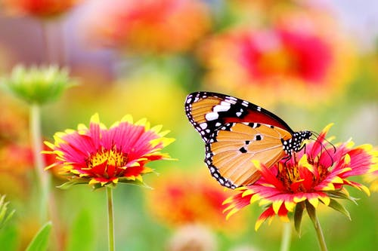
Good morning
Notes:
Md. Saiful Islam, Assistant teacher, Bagbari Chowbaria High School, Sadar Tangail.

Slide 2
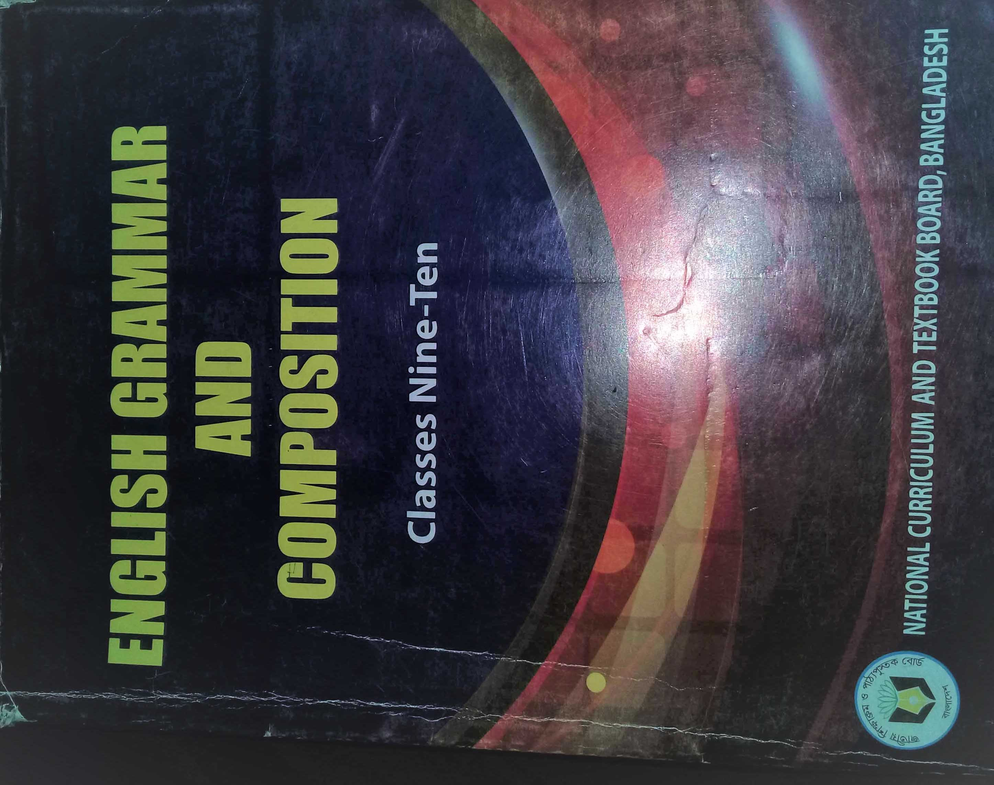
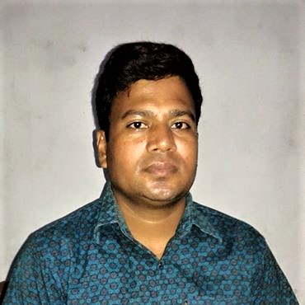
Introducing
Class: nine-ten
Subject: English 2nd paper
(Grammar)
Unit: 06
Topic: Verbal
Date: 14-05-2020
Md. Saiful Islam
Assistant Teacher (English)
Bagbari Chowbaria High School, Tangail Sadar, Tangail
Notes:
Md. Saiful Islam, Assistant teacher, Bagbari Chowbaria High School, Sadar Tangail.

Slide 3
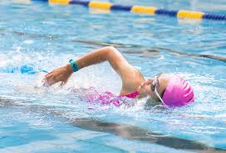
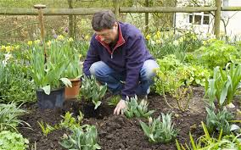
Look at the following examples:
(1) Swimming is good for health.
(2) My hobby is reading books.
(3) Mr. Samad likes to make a garden.
They are verbal.
Notes:
Md. Saiful Islam, Assistant teacher, Bagbari Chowbaria High School, Sadar Tangail.

Slide 4
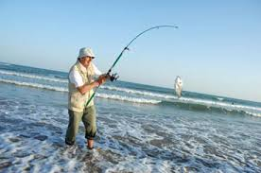
Lesson declaration
Verbal
Notes:
Md. Saiful Islam, Assistant teacher, Bagbari Chowbaria High School, Sadar Tangail.

Slide 5
Learning outcomes:
After finishing the lesson, learners will be able to-
define verbal.
define infinitives, gerund, participle and verbal noun.
choose the best answer.
write a paragraph using verbal.
fill in the gaps.
answer the questions.
Notes:
Md. Saiful Islam, Assistant teacher, Bagbari Chowbaria High School, Sadar Tangail.

Slide 6
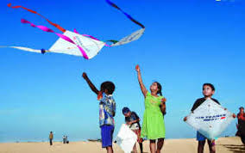
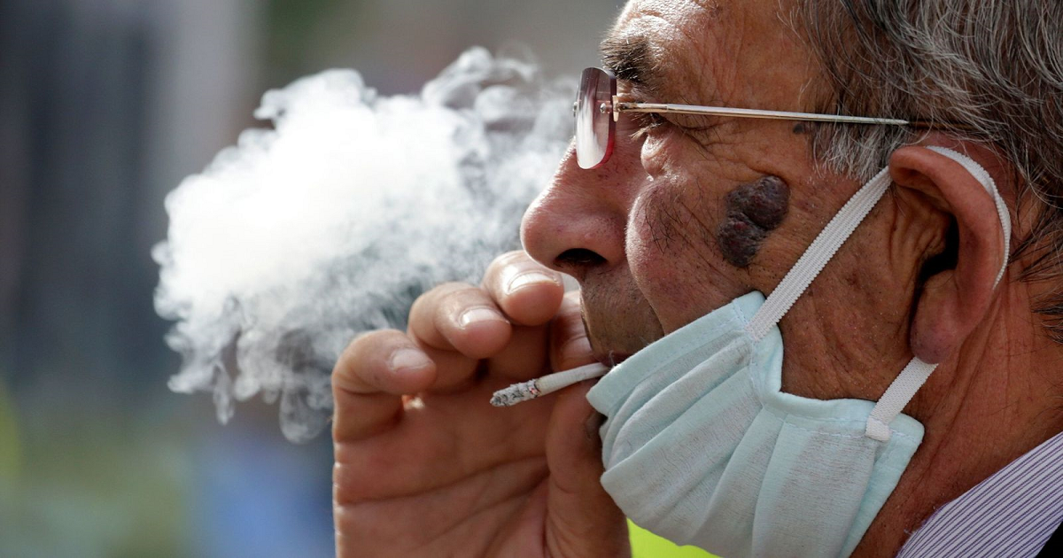
What is verbal?
The form of verb which does not follow its subject and tense is called verbal.
(a) I like to drink tea.
(b) I saw them flying kites.
(c) Smoking is injurious to health.
[ In the above sentences the underlined words do not follow their subject and tense, so they are verbal.]
Notes:
Md. Saiful Islam, Assistant teacher, Bagbari Chowbaria High School, Sadar Tangail.

Slide 7
Kinds of verbal:
There are three kinds of verbal. They are:
Verbal
Gerund
Infinitives
Participle
Notes:
Md. Saiful Islam, Assistant teacher, Bagbari Chowbaria High School, Sadar Tangail.

Slide 8
Gerund:
The form of verb which does the function of both verb and noun is called gerund.
The formation of gerund: Base form of verb + ing + extension.
(a) Walking is a good form of exercise.
(c) Fishing is very enjoyable.
(b) The girl started reading.
[In the above sentences, the underlined words are gerund because they do the function of both verb and noun.]
Notes:
Md. Saiful Islam, Assistant teacher, Bagbari Chowbaria High School, Sadar Tangail.

Slide 9
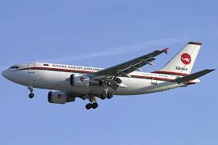
Participle:
The form of verb which does the function of both verb and adjective is called participle.
There are three kinds of participle: (1) present participle (2) Past participle (3) Perfect participle.
The formation of participle:
Present participle: the base form of verb + ing.
Closing the door, Karim went to the field.
Past participle: the base form of verb + d, ed, t , en , ne.
Give me the promised money.
Perfect participle: Having + the past participle form of verb.
Having taken the passengers, the plane flew away.
[ In the above sentences, the underlined words are participle because they do the functions of both verb and adjective.]
Notes:
Md. Saiful Islam, Assistant teacher, Bagbari Chowbaria High School, Sadar Tangail.

Slide 10
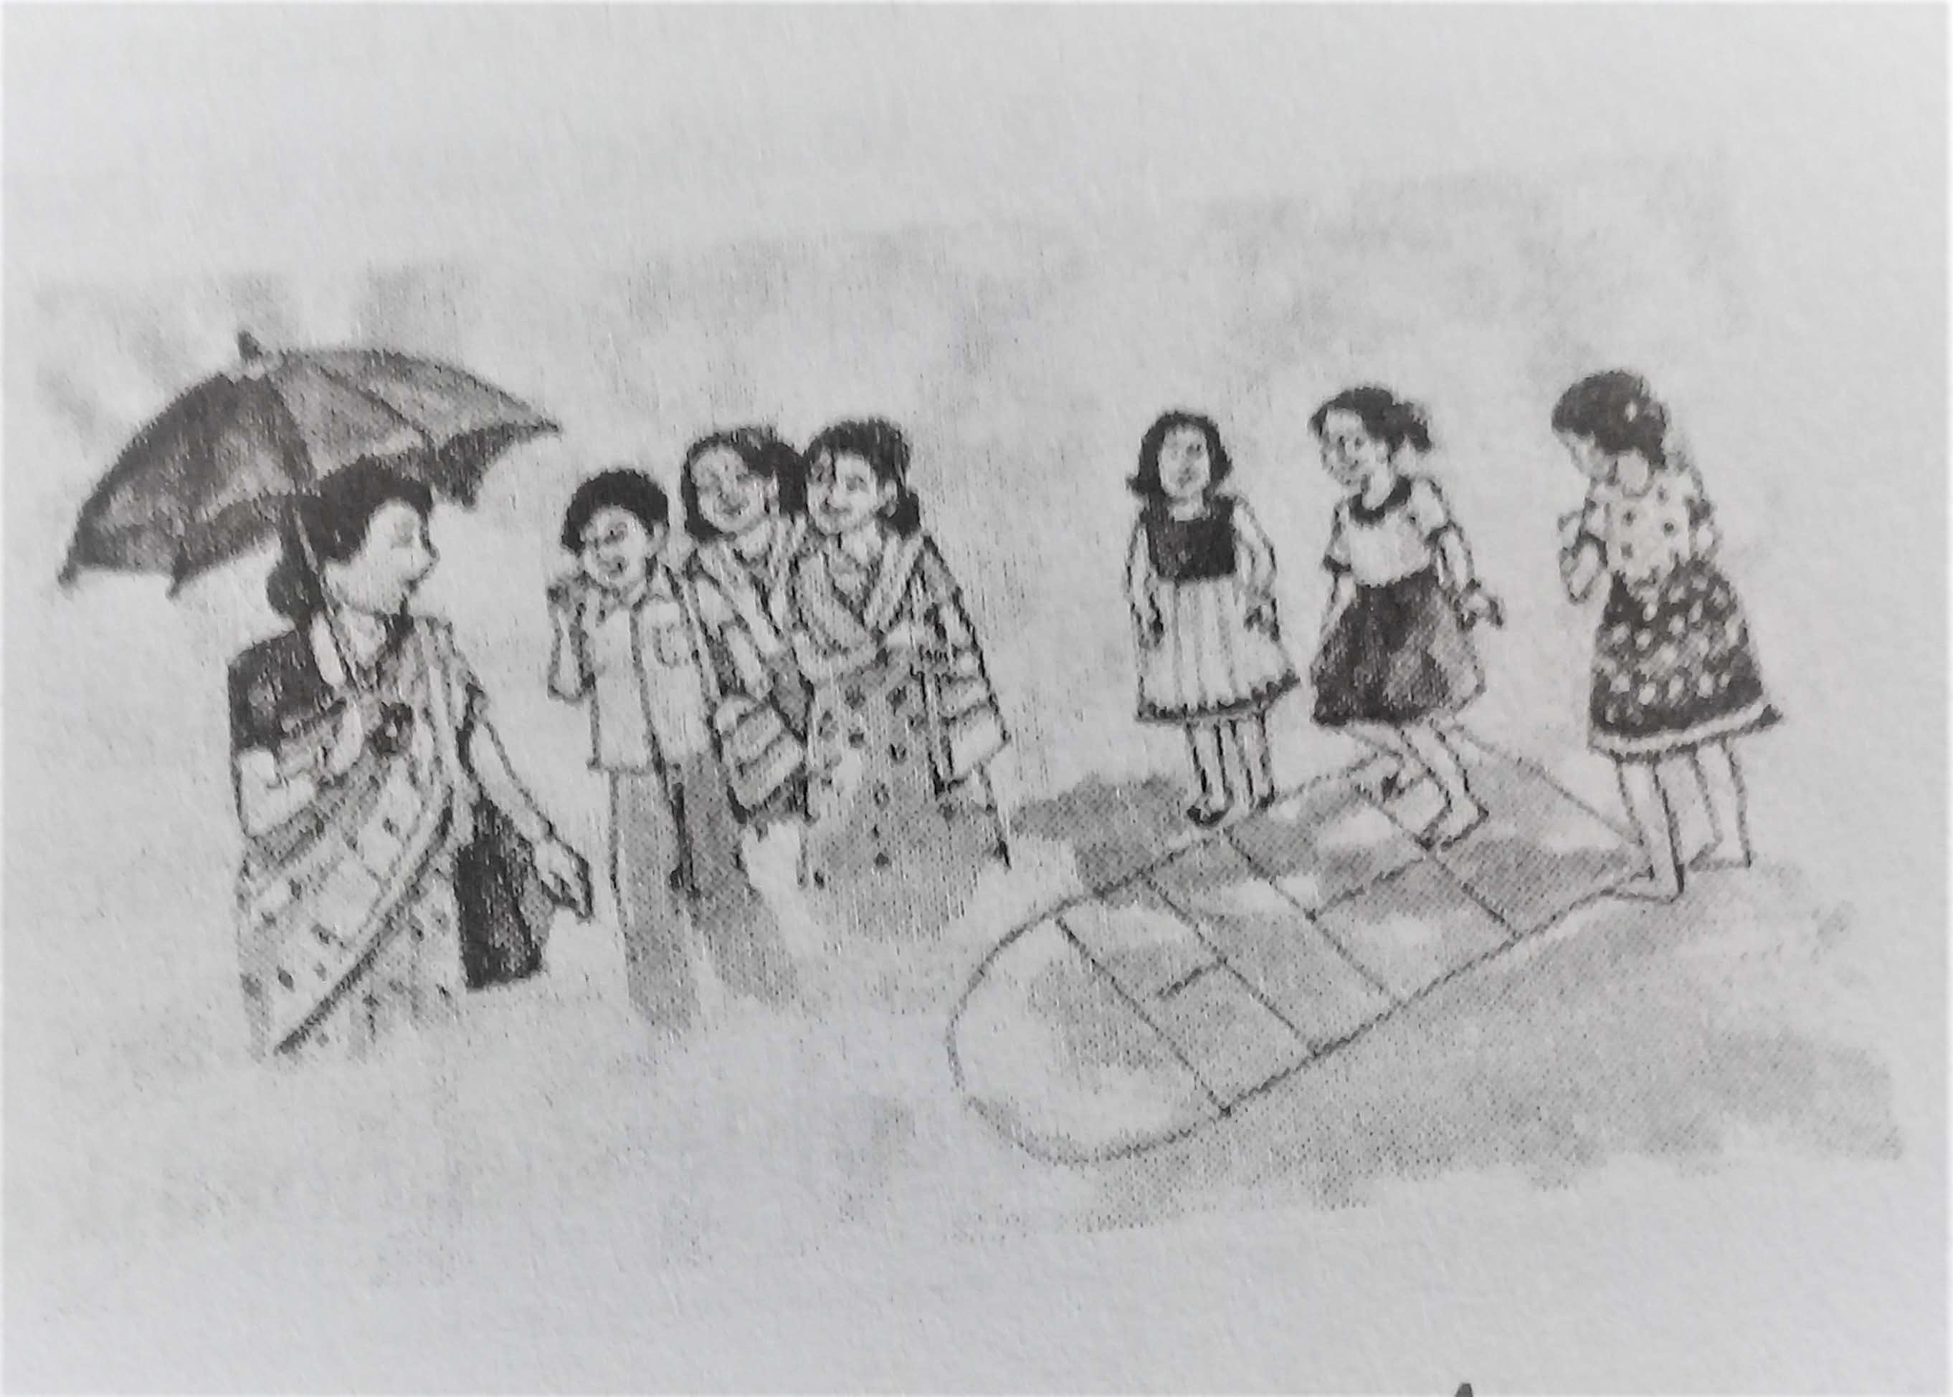
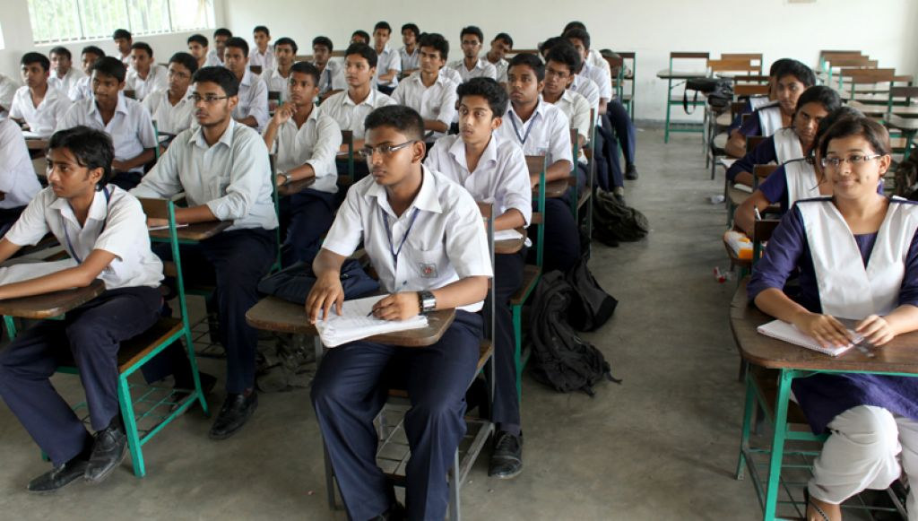
Infinitives:
If there is ‘to’ before the base form of verb and does the function of both verb and noun is called infinitive.
The formation of infinitive: To + base form of verb.
There are two kinds of infinitives: (1) Simple Infinitive (2) Gerundial Infinitive
When the infinitive does the function of a Noun, it is called Simple or Noun Infinitive.
(a) It is our duty to respect our teacher.
(b)To err is human.
When an infinitive qualify or Modify another parts of Speech or sentences, it is called Gerundial or qualifying Infinitive.
(a) We read to acquire knowledge
(b) To speak the truth, he is an honest man.
[ In the above sentences, the underlined words are infinitives because they do the functions of both verb and noun.]
Notes:
Md. Saiful Islam, Assistant teacher, Bagbari Chowbaria High School, Sadar Tangail.

Slide 11
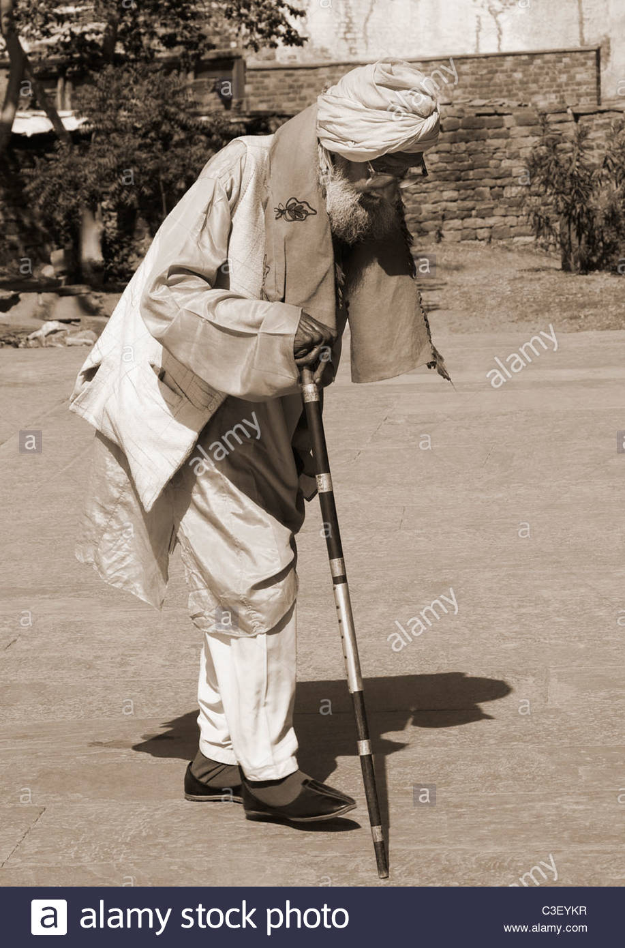
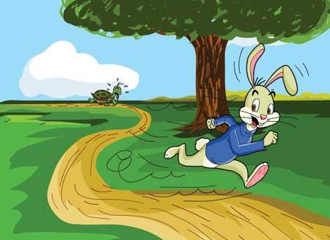
The usages of Gerundial or Qualifying Infinitive :
Modify adjective: (a) He was too old to walk. (b) We are ready to go.
Modify verb: (a) We ask to know. (b) I went to read.
Qualify noun: (a) This is a book to sell. (b) I have no friend to play with.
Modify a sentence : (a) Do not forget to post the letter. (b) Mother likes to cook chicken.
Modify adverb: (a) He came to me to see the picture. (b) The hare ran fast to win the race.
Notes:
Md. Saiful Islam, Assistant teacher, Bagbari Chowbaria High School, Sadar Tangail.

Slide 12
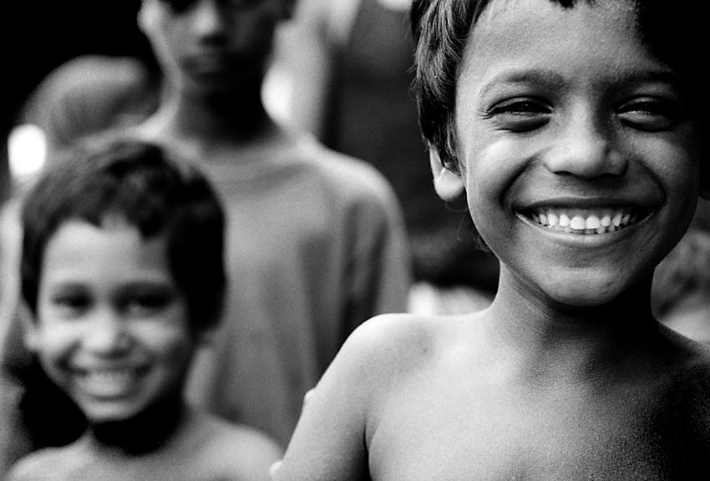
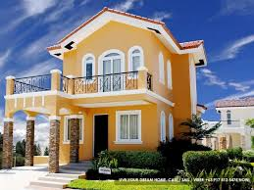
The usages of Simple or Noun Infinitive :
Subject of verb: To swim is a good exercise. (b) To err is human.
Object of verb: (a) He likes to draw picture. (b) I wants to help him.
Object of preposition: (a) The patient is about to die. (b) They were about to run.
Complement of verb: (a) They seem to be happy. (b) He pretended to be tired.
Object of complement: (a) We thought him to be a fool. (b) Teacher advised me to study well.
With too/ Enough: (a) He was too weak to move. (b) The man was not strong enough to stand.
Qualifier of noun: (a) I have no time to waste. (b) This is a house to let.
Notes:
Md. Saiful Islam, Assistant teacher, Bagbari Chowbaria High School, Sadar Tangail.

Slide 13
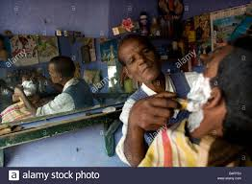
Omissions of Infinitive
let, make, need, hear, watch, see, dare, watch, feel, had better, had rather, would rather, sooner than, rather than.
The above verbs do not take infinitive.
I make the barber cut my hare.
You had better leave the place.
Notes:
Md. Saiful Islam, Assistant teacher, Bagbari Chowbaria High School, Sadar Tangail.

Slide 14
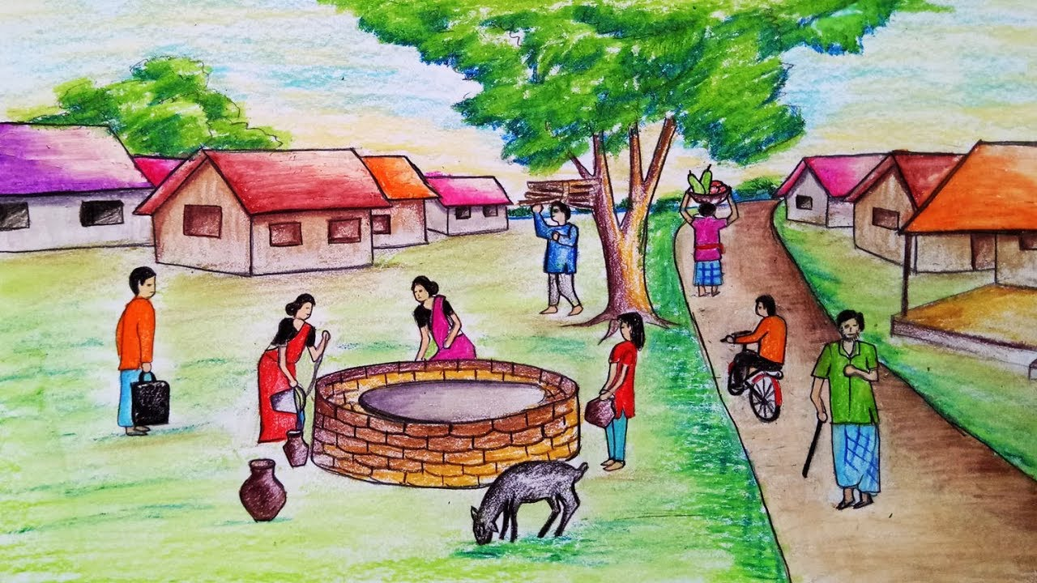
Verbal noun
If there is ‘the’ before ‘gerund’ and ‘of’ after ‘gerund’ it is called Verbal Noun.
Formation of Verbal Noun: The + base form of verb + ing +of +extension.
(a) The reading history of Karim is interesting.
(b) The painting of the wall looks very beautiful.
(c) The drawing of the boy was excellent.
Notes:
Md. Saiful Islam, Assistant teacher, Bagbari Chowbaria High School, Sadar Tangail.

Slide 15
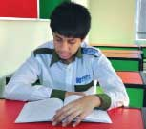
Individual work:
Answer the following questions:
1. What is called verbal? How many kinds of verbal are there? Write their names.
Answer: (1) The form of verb that does not follow its subject and tense is called verbal. There are three kinds of verbal. They are: (1) Gerund (2) infinitive (3) Participle.
2. What is the difference between ‘Gerund and Participle’?
Answer: (2) The difference between ‘Gerund and Participle’ is that ‘Gerund’ does the function of both verb and noun but ‘Participle’ does the function of both verb and adjective.
Notes:
Md. Saiful Islam, Assistant teacher, Bagbari Chowbaria High School, Sadar Tangail.

Slide 16
Pair work:
Find out ‘Gerund, Participle and Infinitives from the following sentences:
Give me the promised money.
(b) Killing the bird, the old man brought bad luck.
(c) It is easy to say but difficult to do.
(d) Walking is good for health.
(e) To tell a lie is a great sin.
(f) Swimming is a good form of exercise.
Notes:
Md. Saiful Islam, Assistant teacher, Bagbari Chowbaria High School, Sadar Tangail.

Slide 17
Group work:
Choose the best answer from the alternatives.
Lucy is planning ----- to Dhaka to work with an NGO.
Coming (b) have come (c) to come (d) came
2. She intends ----- here fore one year.
(a) stayed (b) to say (c) have stayed (d) stay
3. She wishes -----Bangla after she comes to Bangladesh.
(a) learnt (b) to learn (c) have learnt (d) learn
4. Lucy carried a pictorial album of Bangladesh which she loves ---to her colleagues in office.
(a) showed (b) show (c) to show (d) have shown
5. She tells them that she hopes ------ as many places in Bangladesh as she can.
(a) visit (b) visited (c) to visit (d) have visited
6. The beautiful pictures of the people and the landscape of the country have made her ------- in love with Bangladesh.
(a) have fallen (b) fall (c) to fall (d) fell
Notes:
Md. Saiful Islam, Assistant teacher, Bagbari Chowbaria High School, Sadar Tangail.

Slide 18
Evaluation:
Run | print | change | fly | shine | love | go | work
Read the following text and fill in the gaps using present participle. Pick the suitable words from the above box.
Uncle Tom had a printing press. It was the first press in the city. He was very proud of his machines. When he died, his son, Rod, became the owner of the (a) ----------business. Initially he was doing fine. After few months his university (b)------- brother came home. He was a kind of (c) -------- bird and didn’t have any interest in business. Yet one day he came to the press and told Rod to replace the old machines with digital ones. He also expressed his desire to be his (d) ------------- partner. Tom agreed. Later he took him to London to show modern (e) ----------- machines with digital technology. But Rod had limited ideas about them. So he took time to think. His (f) ---------- brother was not happy to see the big brother’s (g) -------- -----mind.
running
going
flying
working
printing
loving
changing
Notes:
Md. Saiful Islam, Assistant teacher, Bagbari Chowbaria High School, Sadar Tangail.

Slide 19
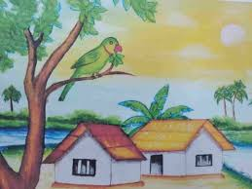
Heme work:
Write a paragraph about a tea stall using ‘gerund,infinitive and participle’.
Notes:
Md. Saiful Islam, Assistant teacher, Bagbari Chowbaria High School, Sadar Tangail.

Slide 20
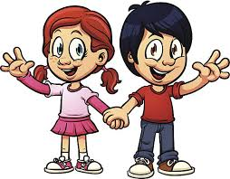
Notes:
Md. Saiful Islam, Assistant teacher, Bagbari Chowbaria High School, Sadar Tangail.

