Slide 1
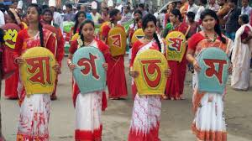
WELCOME

Slide 2
MD. ABU SAYED
Lecturer in English
Indrakul Akbaria Alim Madrsah,
Bauphal, Patuakhali.
CLASS: 09-10
SUBJECT: ENGLISH 1ST PAPER
UNIT: 03
LESSON: 05

Slide 3
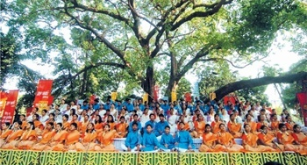
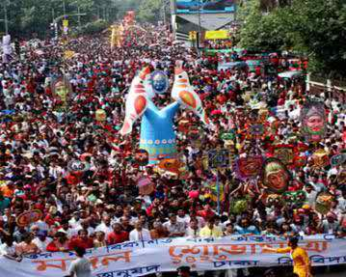
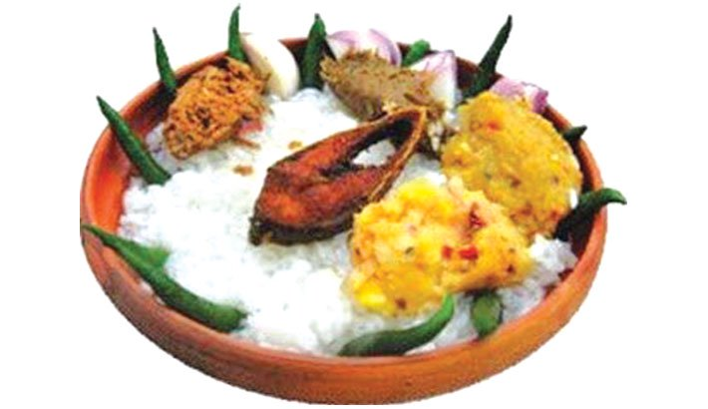
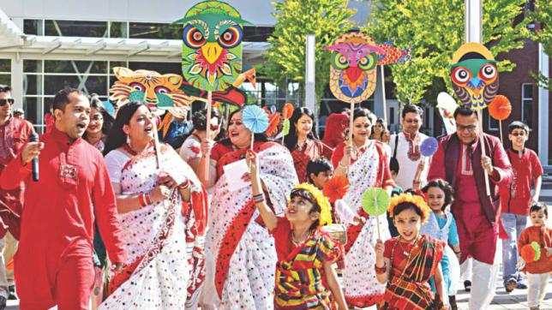

Slide 4
The topic we discuss today is…..
PAHELA BAISHAKH

Slide 5
LEARNING OUTCOMES:
AFTER COMPLETING THIS LESSON S STUDENTS WILL BE ABLE TO:
talk about events and festivals.
ask and answer questions.
give opinions about traditional activities
discuss about the culture.

Slide 6
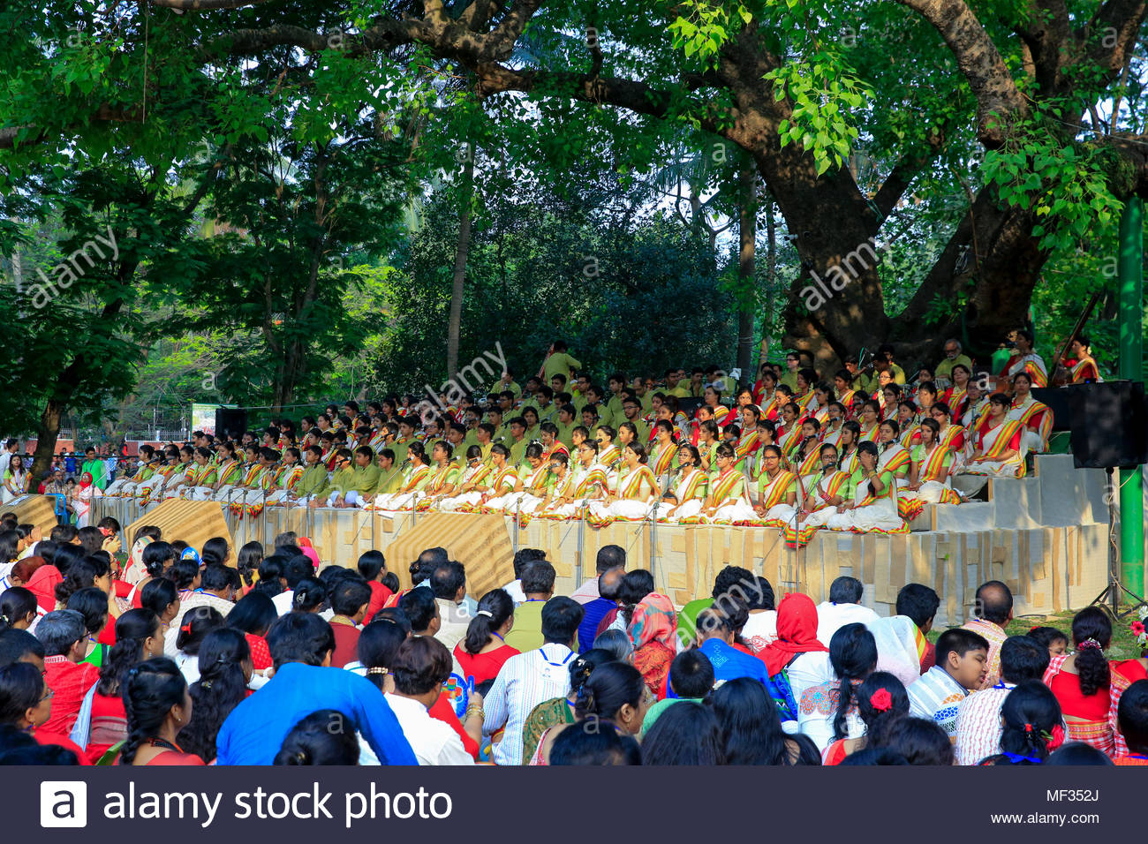
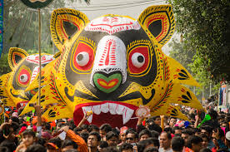
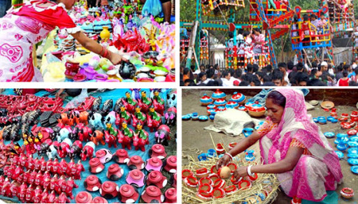
Answer the questions given below.
What’s the picture about?
Where do you think it is?
What are the people doing?

Slide 7
Let’s see a Video on Pahela Baishakh….
Click

Slide 8
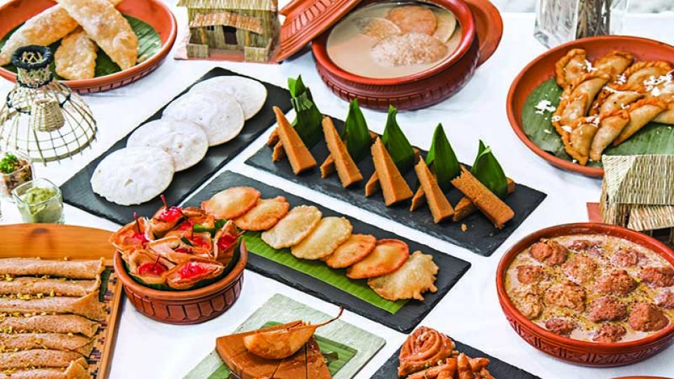
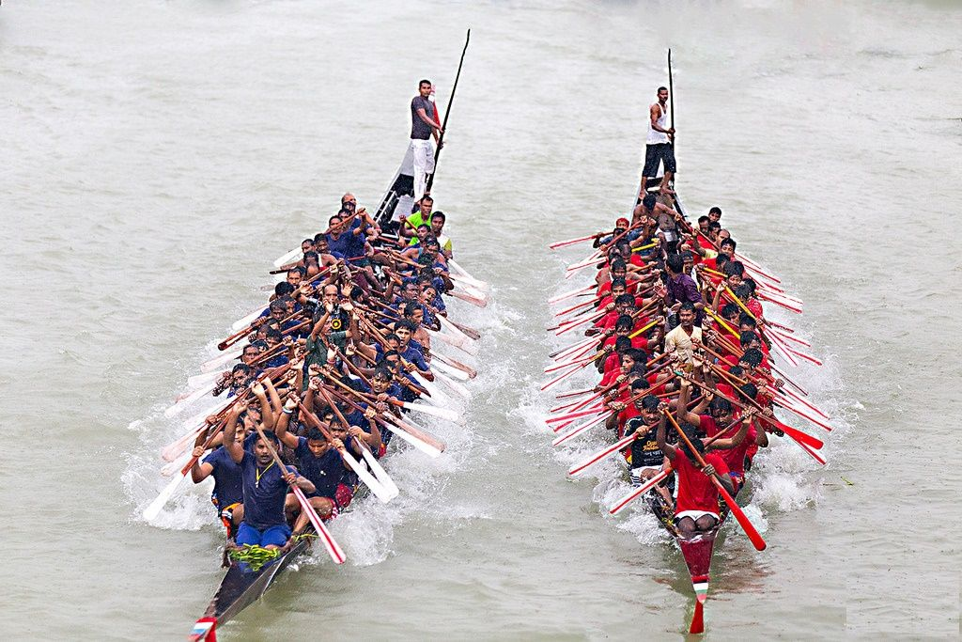
Reading and understanding through meaning with pictures.
‘Pahela Boishakh’ is the first day of Bangla new year. The day is a public holiday. This day has a special significance for us as it forms a part of Bangalee culture and tradition. People from all walks of life, irrespective of their ethnic identity or religious beliefs, celebrate the day with traditional festivities. On this day, the whole of Bangladesh is in a festive mood. The day inspires people to start life with renewed hopes and inspirations. Every year the day is celebrated traditionally

Slide 9
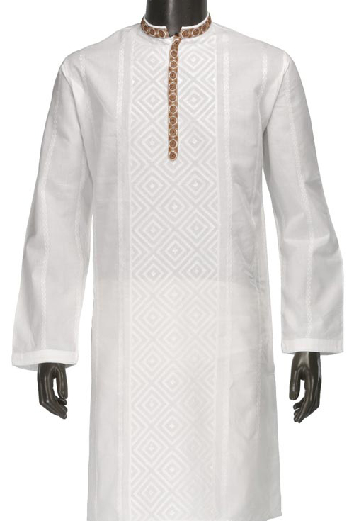
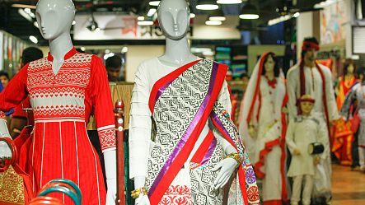
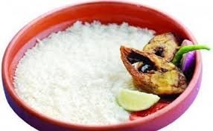
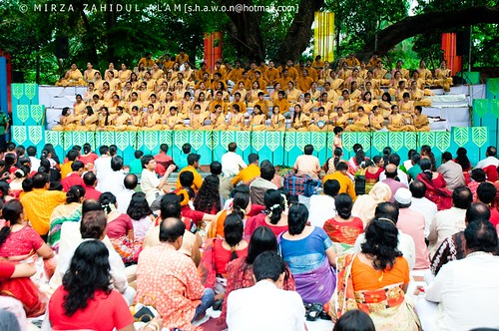
People wake up early in the morning, have a bath and wear their traditional clothes. Women wear white saris with red borders and adorn themselves with colourful churis and flowers, while men dress themselves with pajamas and punjabis. It is a day when people love eating traditional food. This day the most colourful event is held in Dhaka. Early in the morning, people in hundreds and thousands pour in from all directions to attend the cultural function at Ramna Batamul organised by Chhyanata. The cultural programme begins just with sunrise and the renowned artists of the country take part in the program that starts with the famous Tagore-song Esho-he-Boishakh, Esho Esho ........ . Artists also sing traditional folk songs, and display classical dances with the rhythm of musical instruments.

Slide 10
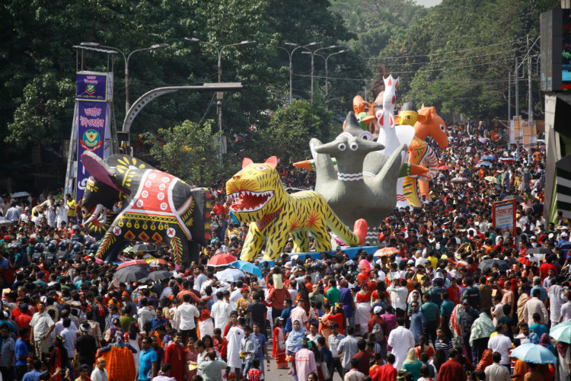
People also come to join the colourful processions, the biggest carnival of the
country, organised by the Fine Arts students of Dhaka University. The procession usually displays the traditional practices of Bangalee culture. The masks and wreaths worn by the people are so fascinating! Often they symbolise contemporary worries or happiness in the national life. It attracts increasing number of foreign tourists every year.

Slide 11
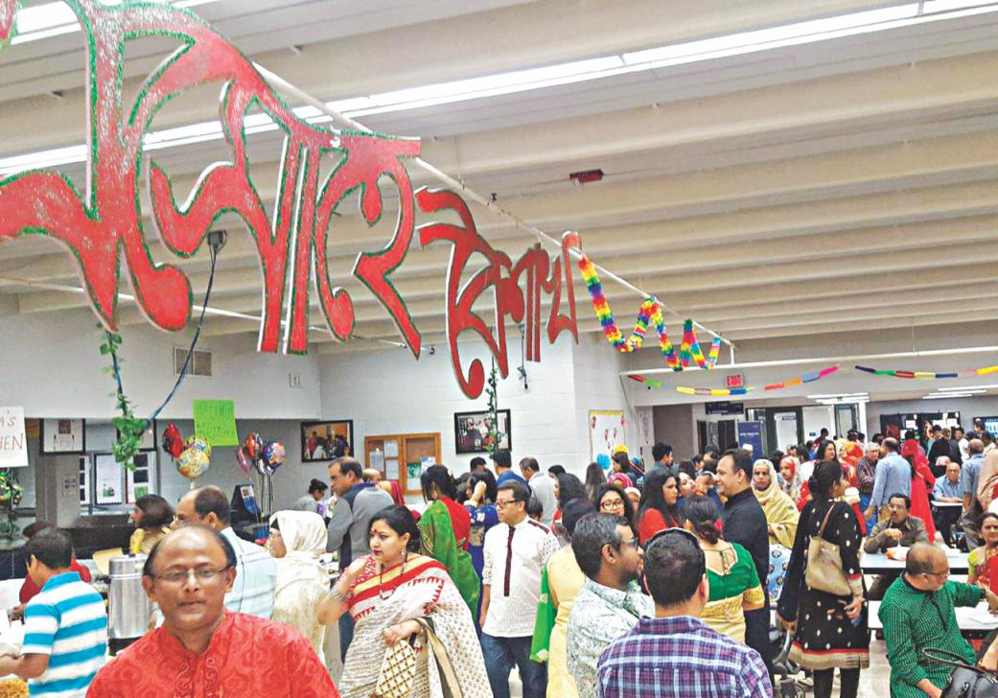
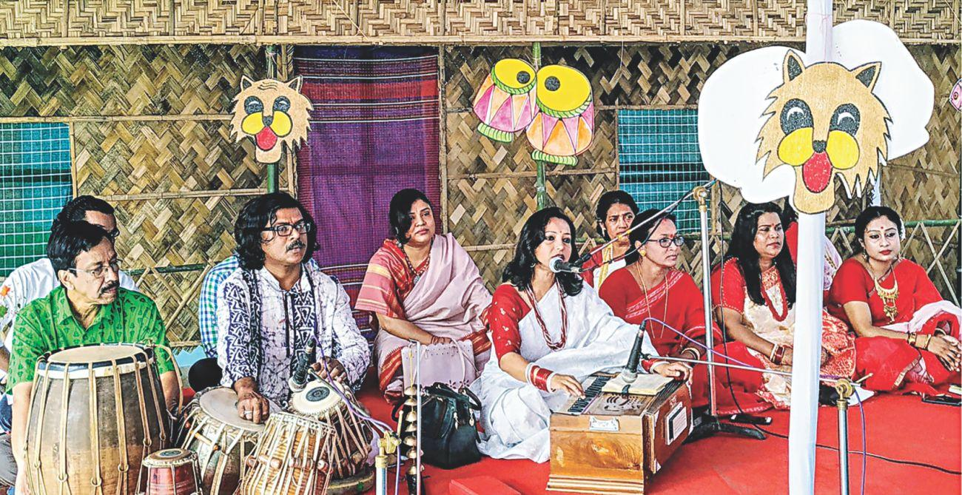
The day is also observed all over the country. Different social and cultural organisations and educational institutions celebrate the day with their own cultural
programmes.
On this day, newspapers bring out special supplements. There are also special programmes on the radio and television channels.
The celebration of Pahela Boishakh marks a day of cultural unity for the whole nation irrespective of caste and creed.

Slide 12
Complete the passage with suitable words.
The word Pahela means the first and Boishakh is the _____ month of Bangla calendar. The day is observed not _____ in Bangladesh but _____ in some other parts of the world. It is celebrated in West Bengal, Assam and Tripura. It is also ______ in Australia and the UK. In Australia, the largest ______ for Bangla new year is the Sydney Boishakhi Mela held ______ Sydney Olympic Park. In England, the Bangalees ______ celebrate the day with a street ________ in London. It is the ______ Asian festival in Europe, _______ Bangladesh and West Bengal.

Slide 13
Match the following words with the picture….
dance
Songs
Festive
food

Slide 14
Flowers
cultural
Religious
colorful

Slide 15
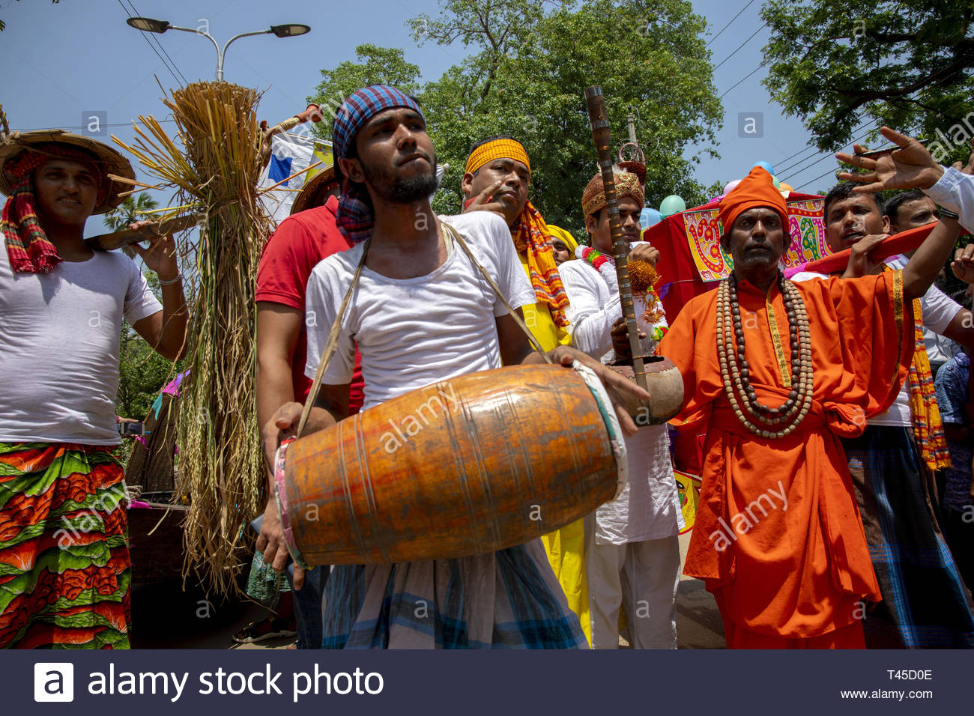
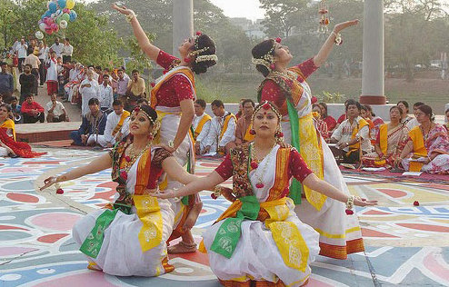
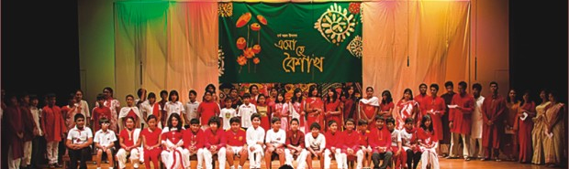

Slide 16
Ask and answer these questions in pairs.
1 Do you go out in the morning of Pahela Boishakh? If you do, where do you go?
If not, what do you do?
2 What kind of food do you eat in the morning of Pahela Boishakh?
3 Do you wear any special clothes on this occasion?

Slide 17
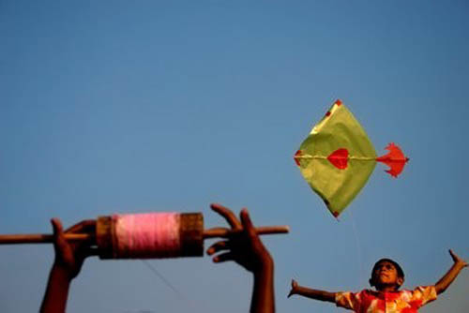
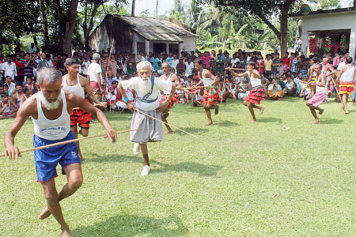
** What are these picture about? Do you know anything?
**Do these activities really exist now at present?

Slide 18
Evaluation
**** Write down five activities what we do on the day of Pahela Baishakh.
**** Write a short paragraph about Pahela Baishakh that you have witnessed earlier.

Slide 19
Thank you………….

