Slide 1
Welcome to Online Math Class

Slide 2
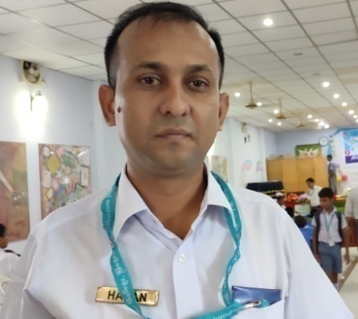
Teacher’s Information
Md. Hasan-ul-Bari
Lecturer, Mathematics
Millennium Scholastic School & College
Jahangirabad Cantonment, Bogura.
Cell No.: 01716103858, 01769129001
E-mail: hubari1976@gmail.com

Slide 3
Lesson’s Information
Class : IX
Chapter : Five (Exercise-5.1)
Subject : Mathematics
Period : 1st
Time: 9:30-10:00 am
Date: 13/06/2020

Slide 4
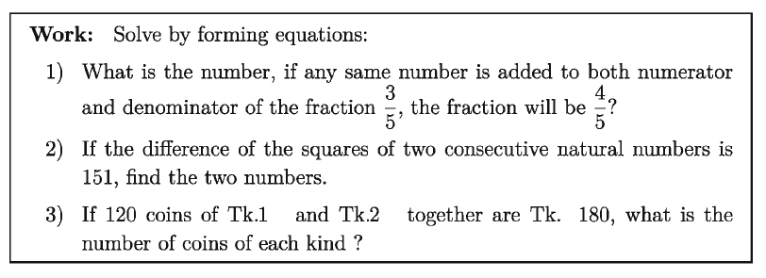
Observe the following

Slide 5
Topic = ?
Word problem using equation in one variable

Slide 6
Learning Outcomes /Objectives
At the end of the lesson, the students
will be able to ………..
Form the equation in one variable
Solve the linear equations from word problems
Maths Lab Centre, Bogura. Cell: 01716103858

Slide 7
Solve by forming equations

Slide 8
Solve by forming equations
Maths Lab Centre, Bogura. Cell: 01716103858

Slide 9
Individual Work
Solve by forming equations

Slide 10
Solve by forming equations
Maths Lab Centre, Bogura. Cell: 01716103858

Slide 11
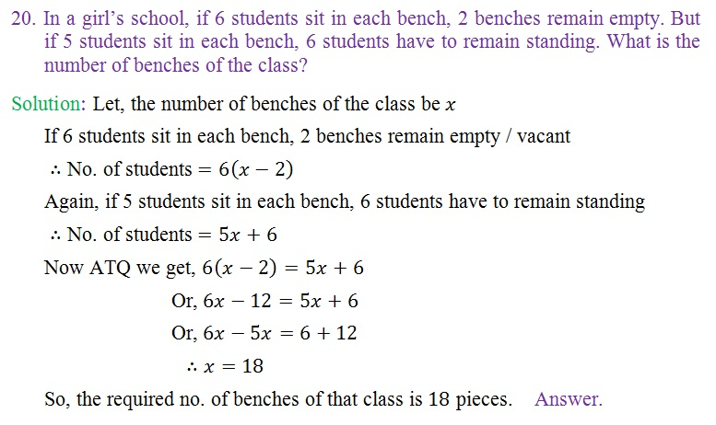
Solve by forming equations
Maths Lab Centre, Bogura. Cell: 01716103858

Slide 12
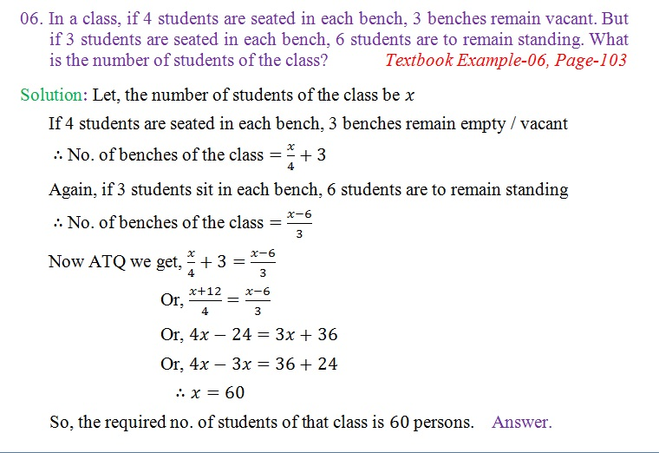
Solve by forming equations
Maths Lab Centre, Bogura. Cell: 01716103858

Slide 13
Solve by forming equations
Maths Lab Centre, Bogura. Cell: 01716103858

Slide 14
Group Work
Solve by forming equations
17. Sum of the digits of a number consisting of two digits is 9; If the number obtained by interchanging the places of the digits is less by 45 than the given number, what is the number?

Slide 15
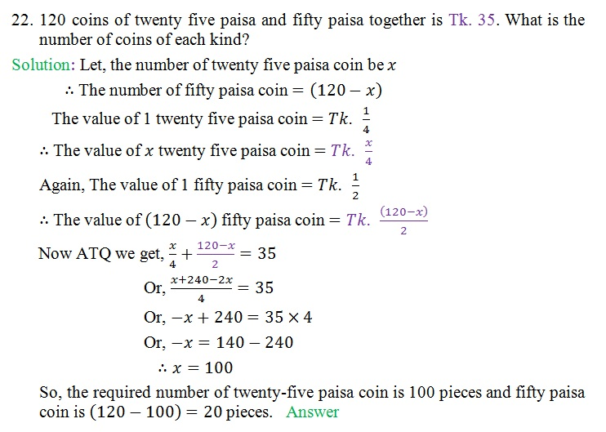
Solve by forming equations
Maths Lab Centre, Bogura. Cell: 01716103858

Slide 16
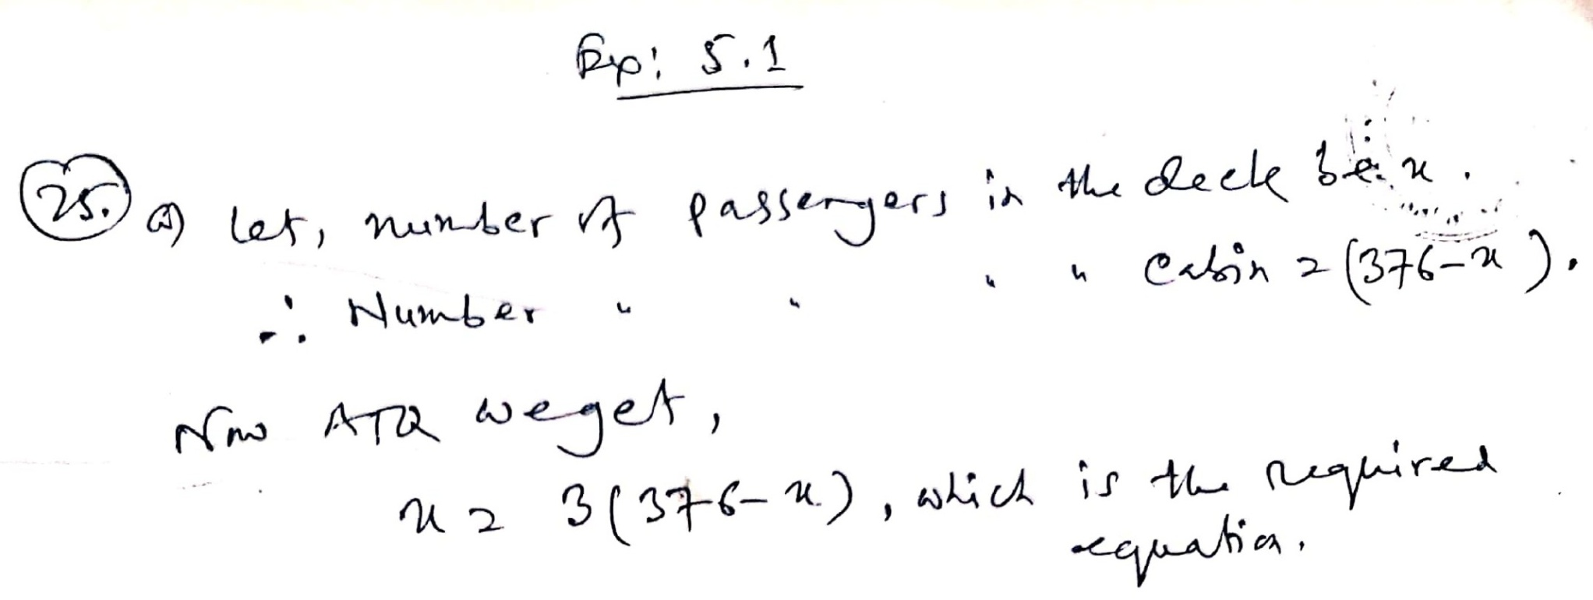
Solve by forming equations
Maths Lab Centre, Bogura. Cell: 01716103858 Continue ………

Slide 17
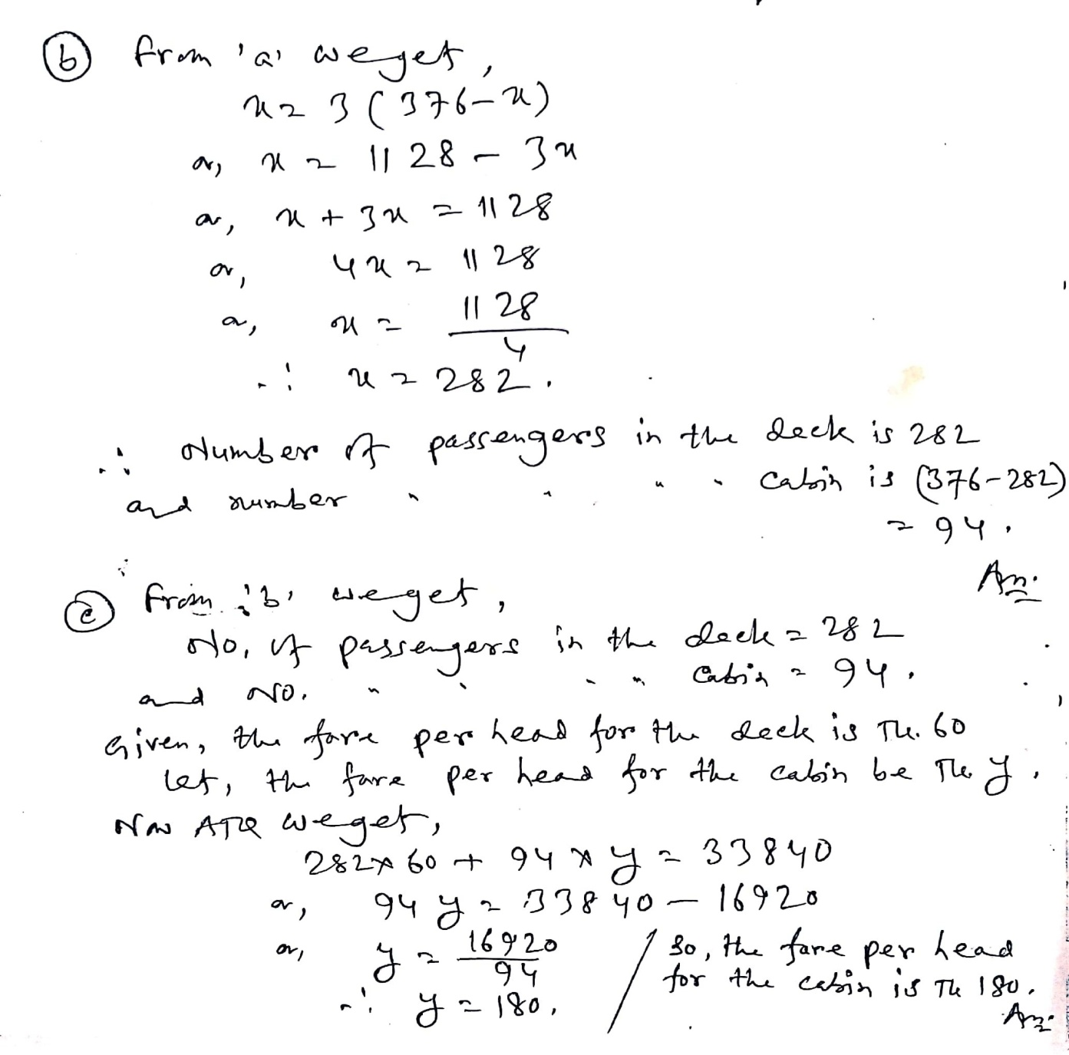
Solve by forming equations
Maths Lab Centre, Bogura. Cell: 01716103858

Slide 18
Homework
Solve by forming equations
In class X, three students sit in each bench, one student is left out. If four students sit on each bench, one bench will be left out. What is the number of students and the number of benches in that class?
Maths Lab Centre, Bogura. Cell: 01716103858

Slide 19
Homework
Solve by forming equations
19. A petty merchant by investing Tk. 5600 got the profit of 5% on some of the money and profit of 4% on the rest of the money. If the total profit is 256, then how much money did he get the profit of 5%?
Maths Lab Centre, Bogura. Cell: 01716103858

Slide 21
