Slide 1
Welcome

Slide 2
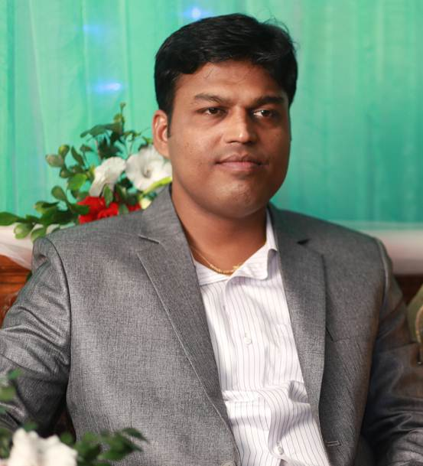
Introduction
Teacher
Lesson
Hirendra Debnath
MA(English),Bed
Assistant Teacher(English)
Puran Bazar Girls’ High School
01789-916684
Rotarian Hirendra Debnath
hirendra0501@gmail.com
English Grammar and Composition
Class : VI-X

Slide 3
The sight looks so nice.
Doesn’t the sight look so nice?
Isn’t it a very beautiful sight?
It is a very beautiful sight.

Slide 4
Can you guess what we are going to discuss today?
Assertive to Interrogative
Notes:
This is to take out declaration from the students.

Slide 5
So, our today’s lesson is --
Transformation of sentence
Part-2 (Assertive to Interrogative)

Slide 6
Learning outcomes
After completing this lesson, the ss will be able to—
a) apply the use of be verb with negative
b) apply the use of auxiliary verbs with negative
c) apply question word (‘wh’ word) in interrogative
d) change from assertive to interrogative

Slide 7
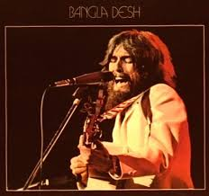
Rules of using ‘not’
He has not organised The concert for Banglsdesh to make the world aware of the sufferings of Bangladesh.
He has organised The concert for Banglsdesh to make the world aware of the sufferings of Bangladesh.
He helped us during our Liberation War of 1971. He had great love for us.
He did not help us during our Liberation War of 1971. He did not have great love for us.
His name is George Harrison.
His name is not George Harrison.
In case of ‘action’ verb and ‘have’ verb ---- do not/does not/did not + V₀
In case of ‘be’ verb ---- ‘be’ verb + not
In case of ‘auxiliary’ verb ---- ‘auxiliary’ verb + not

Slide 8
Notice carefully
Computer is most essential for us. (Interrogative)
Isn’t computer most essential for us?
It plays a very important role in our life. (Interrogative)
Doesn’t it play a very important role in our life?
Everybody needs it. (Interrogative)
Who does not need it?

Slide 9
How to change Assertive(with be verb) to Interrogative
Human mind is very short.(Interrogative)
Isn’t human mind very short?
I am the best gift of Allah to my mother. (Interrogative)
Aren’t I the best gift of Allah to my mother?
Akbar was the greatest king of India. (Interrogative)
Wasn’t Akbar the greatest king of India?
If the assertive sentence is, subject + be ( am, is, are, was, were) + extension,
it will be--
Be(isn’t/aren’t/wasn’t/weren’t +subject +extension +?

Slide 10
Activities
Change the sentences into Interrogative
1. I am an ardent follower of Hazrat Muhammad (SM).
2. He is the guide of the human being.
3. We are obedient to him.
4. Hazrat Abu Bakar (R) was the first man to receive his invitation.
5. Hazrat Omar & Ali (R) were the next caliphs of Hazrat Abu Bakar.

Slide 11
Check your answer
1. Aren’t I an ardent follower of Hazrat Muhammad (SM)?
2. Isn’t he the guide of the human being?
3. Aren’t we obedient to him?
4. Wasn’t Hazrat Abu Bakar (R) the first man to receive his invitation?
5. Weren’t Hazrat Omar & Ali (R) the next caliphs of Hazrat Abu Bakar?

Slide 12
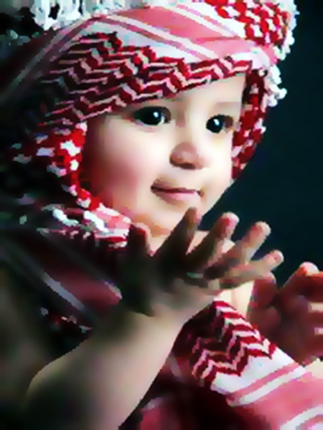
How to change Assertive (with action verb) to Interrogative
I say my prayer five times regularly. (Interrogative)
Don’t I say my prayer five times regularly?
My mother wants me to be a model of truth. (Inter)
Doesn’t my mother want me to be a model of truth?
Our prophet ordered us to follow him (Interrogative)
Didn’t our prophet order us to follow him?
If there is action verb in the sentence, Interrogative will be started with Don’t/Doesn’t/Didn’t according to tense, subject & number.

Slide 13
Activities
Change the sentences into Interrogative
1. Religion plays an important role in human life.
2. Noble people follow their religions properly.
3. All the prophets sacrificed their lives for the sake of religion.
4. Religions teach us morality.
5. It shows the way of truth.

Slide 14
Check your answer
1. Doesn’t religion play an important role in human life?
2. Don’t noble people follow their religions properly?
3. Didn’t all the prophets sacrifice their lives for the sake of religion?
4. Don’t religions teach us morality?
5. Doesn’t it show the way of truth?

Slide 15
Assertive (with Every) to Interrogative
Everybody wishes to be happy.(Interrogative)
Who does not wish to be happy?
No one can do this. (Interrogative)
Who can do this?
If the assertive sentence starts with ‘nobody’, Interrogative will be ------
Who + verb + extension + ?
If the assertive sentence starts with ‘everybody’, Interrogative will be ------
Who + verb + not + extension + ?

Slide 16
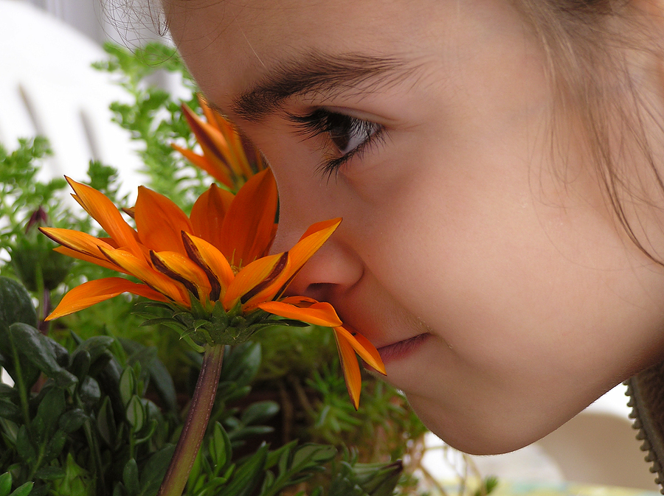
Activities
Change the sentences into negative
1. Everybody loves flowers.
2. Nobody hates it.
3. Everyone smells flowers.
4. Everybody enjoys it.
5. All desire its beauty.

Slide 17
Check your answer
1. Who does not love flowers?
2. Who hates it?
3. Who does not smell flowers?
4. Who does not enjoy it?
5. Who don’t desire its beauty?

Slide 18
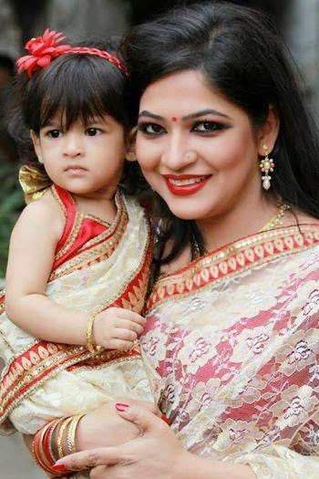
Assertive (with Every+ noun) to Interrogative
Every mother loves her child.(Interrogative)
Is there any mother who does not love her child?
If the assertive sentence starts with ‘Every + noun’, Interrogative will be ------
Is there any + noun + who + verb + not + extension + ?

Slide 19
Change the sentences into interrogative
1. Every man loves flowers.
2. Every person hates a liar.
2. Is there any person who does not hate a liar?
3. Every baby wants toys.
1. Is there any man who does not love flowers?
4. Is there any baby who does not want toys?
4. Every woman likes ornament.
5. Every house has a television set.
4. Is there any woman who does not like ornament?
5. Is there any house without a television set?

Slide 20
Assertive (with never/nothing) to Interrogative
I never drink tea.
Do I ever drink tea?
I had nothing to say.
Had I anything to say?

Slide 21
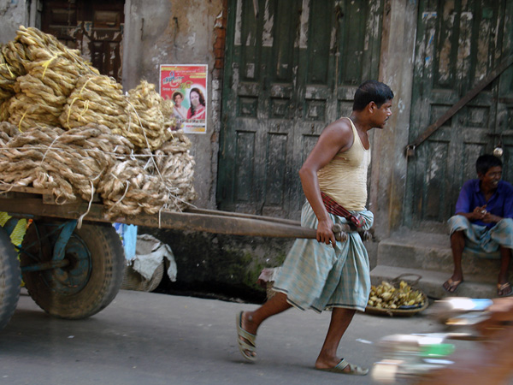
Assertive (with do not/does not/ did not) to Interrogative
He does not work hard.
Does
he work hard?
If the assertive sentence begins with do not/does not/did not,
‘not’ will be omitted at the time of changing into interrogative.

Slide 22
Activities at home
Change the sentences into Interrogative.
1. He is a noble man.
2. Everybody likes him.
3. He was a bright student.
4. He studied regularly in his student life.
5. He did not do any work subversive to state and society.
6. He is now a model of the society.
7. We are proud of him.
8. We pray for him to be a famous person.

Slide 23
Inviting you to enjoy part-3
Goodbye

