Slide 1
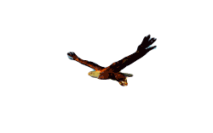
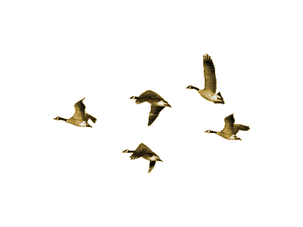
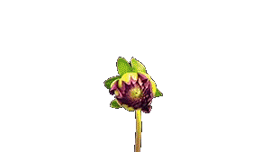
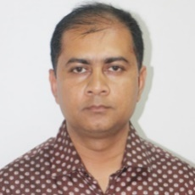
“আমার বাড়ি আমার স্কুল”
Welcome to
Narail Online Primary School
Bibek Biswas, Assistant Teacher, Rameshworpur Government Primary School, Narail Sadar, Narail. Email: bibekmitna@gmail.com, fbook: bibekbiswas, contact: 01914244847

Slide 2
Lesson’s Information
Class: Five
Questions No: 10
Unit: 16
Lessons 6-7
Page No: 65
Making a glass of sherbet
Teacher’s Information
Bibek Biswas
Assistant Teacher
Rameshworpur Government Primary School
Narail Sadar, Narail.
Email: bibekmitna@gmail.com
fbook: bibekbiswas
Contact: 01914244847
Bibek Biswas, Assistant Teacher, Rameshworpur Government Primary School, Narail Sadar, Narail. Email: bibekmitna@gmail.com, fbook: bibekbiswas, contact: 01914244847

Slide 4
Dear students, Let’s sing a song together
Out in the garden, One fine day
With my ball
I like to play
I bounced it right I bounced it left
I bounced it well
On one fine day
Out in the garden, one fine day
With my kite I like to play
I flew it right, I flew it left
I flew it high, on one fine day
Bibek Biswas, Assistant Teacher, Rameshworpur Government Primary School, Narail Sadar, Narail. Email: bibekmitna@gmail.com, fbook: bibekbiswas, contact: 01914244847

Slide 5
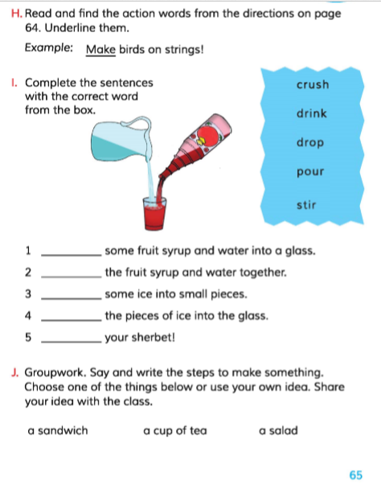

Slide 6
Today we will practice 10 no. questions according to NAPE questions guideline.
10. Read the instructions about how to make a glass of sherbet, then answer the following questions.
You will need some fruit syrup, ice, pure water and glass.
Pour some fruit syrup and water in to a glass.
Stir the fruit syrup and water together.
Crush some ice into small pieces.
Drop the pieces of ice into the glass. And the sherbet is ready to drink.
Questions:
What do you need to make a glass of sherbet?
Why do you drink a glass of sherbet?
How do you make a glass of sherbet?
Bibek Biswas, Assistant Teacher, Rameshworpur Government Primary School, Narail Sadar, Narail. Email: bibekmitna@gmail.com, fbook: bibekbiswas, contact: 01914244847

Slide 7
10. Read the instructions about how to make a glass of sherbet, then answer the following questions.
You will need some fruit syrup, ice, pure water and glass.
Pour some fruit syrup and water in to a glass.
Stir the fruit syrup and water together.
Crush some ice into small pieces.
Drop the pieces of ice into the glass. And the sherbet is ready to drink.
Questions:
What do you need to make a glass of sherbet?
Why do you drink a glass of sherbet?
How do you make a glass of sherbet?
Bibek Biswas, Assistant Teacher, Rameshworpur Government Primary School, Narail Sadar, Narail. Email: bibekmitna@gmail.com, fbook: bibekbiswas, contact: 01914244847

Slide 8
10. Read the instructions about how to make a glass of sherbet, then answer the following questions.
You will need some fruit syrup, ice, pure water and glass.
Pour some fruit syrup and water in to a glass.
Stir the fruit syrup and water together.
Crush some ice into small pieces.
Drop the pieces of ice into the glass. And the sherbet is ready to drink.
Questions:
Answer: I need some fruit syrup, ice and pure water to make
a glass of sherbet.
B) Why do you drink a glass of sherbet?
C) How do you make a glass of sherbet?
Bibek Biswas, Assistant Teacher, Rameshworpur Government Primary School, Narail Sadar, Narail. Email: bibekmitna@gmail.com, fbook: bibekbiswas, contact: 01914244847

Slide 9
10. Read the instructions about how to make a glass of sherbet, then answer the following questions.
You will need some fruit syrup, ice, pure water and glass.
Pour some fruit syrup and water in to a glass.
Stir the fruit syrup and water together.
Crush some ice into small pieces.
Drop the pieces of ice into the glass. And the sherbet is ready to enjoy.
Questions:
Answer: I need some fruit syrup, ice and pure water to make
a glass of sherbet.
B) Why do you drink a glass of sherbet?
C) How do you make a glass of sherbet?
Bibek Biswas, Assistant Teacher, Rameshworpur Government Primary School, Narail Sadar, Narail. Email: bibekmitna@gmail.com, fbook: bibekbiswas, contact: 01914244847

Slide 10
10. Read the instructions about how to make a glass of sherbet, then answer the following questions.
You will need some fruit syrup, ice, pure water and glass.
Pour some fruit syrup and water in to a glass.
Stir the fruit syrup and water together.
Crush some ice into small pieces.
Drop the pieces of ice into the glass. And the sherbet is ready to enjoy.
Questions:
Answer: I need some fruit syrup, ice and pure water to make
a glass of sherbet.
B) I drink a glass of sherbet to refresh myself.
C) How do you make a glass of sherbet?
Bibek Biswas, Assistant Teacher, Rameshworpur Government Primary School, Narail Sadar, Narail. Email: bibekmitna@gmail.com, fbook: bibekbiswas, contact: 01914244847

Slide 11
10. Read the instructions about how to make a glass of sherbet, then answer the following questions.
You will need some fruit syrup, ice, pure water and glass.
Pour some fruit syrup and water in to a glass.
Stir the fruit syrup and water together.
Crush some ice into small pieces.
Drop the pieces of ice into the glass. And the sherbet is ready to enjoy.
Questions:
Answer: I need some fruit syrup, ice and pure water to make
a glass of sherbet.
B) I drink a glass of sherbet to refresh myself.
C) How do you make a glass of sherbet?
Bibek Biswas, Assistant Teacher, Rameshworpur Government Primary School, Narail Sadar, Narail. Email: bibekmitna@gmail.com, fbook: bibekbiswas, contact: 01914244847

Slide 12
10. Read the instructions about how to make a glass of sherbet, then answer the following questions.
You will need some fruit syrup, ice, pure water and glass.
Pour some fruit syrup and water in to a glass.
Stir the fruit syrup and water together.
Crush some ice into small pieces.
Drop the pieces of ice into the glass. And the sherbet is ready to enjoy.
Questions:
Answer: I need some fruit syrup, ice and pure water to make
a glass of sherbet.
B) I drink a glass of sherbet to refresh myself.
C) At first, I take some fruit syrup, ice, pure water and glass. Then I pore some fruit syrup and water in to a glass. Then I stir the fruit syrup and water together. I crush some ice into small pieces and drop the pieces of ice into the glass. In this way I will make a glass of sherbet.
Bibek Biswas, Assistant Teacher, Rameshworpur Government Primary School, Narail Sadar, Narail. Email: bibekmitna@gmail.com, fbook: bibekbiswas, contact: 01914244847

Slide 13
Home work
10. Read the instructions about visiting a patient in a hospital, then answer the following questions. 1+2+3=6
Wash your hands and feet with soap.
Put on mask and shoes.
Do not talk much to the patient.
Do not talk loudly.
Leave the patient as soon as possible.
Questions:
What should you put on before visiting a patient?
Why should you put on mask and shoes?
How should you behave with the patient?

Slide 14
Practice more and more...............
No more today
Thank you students for your keen attention and active participation
Bibek Biswas, Assistant Teacher, Rameshworpur Government Primary School, Narail Sadar, Narail. Email: bibekmitna@gmail.com, fbook: bibekbiswas, contact: 01914244847

Slide 15
Be connected with our facebook page:
https://web.facebook.com/groups/254410455614637/
Or my personal address:
Fbook: www.facebook.com/bibekbiswas
Mail: bibekmitna@gmail.com
Phone: 01914244847

