Slide 1
Welcome

Slide 2
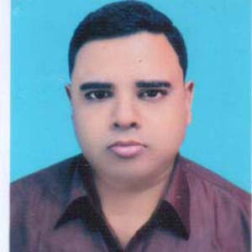
Introduction
Abdul Aziz
Assistant Teacher (English)
Madhaia Bazar Sadim High School
E-mail : azizabidpur@gmail.com
Class –Seven
English First Paper
Unit -07, Lesson -04
Sports personalities

Slide 3
Learning Outcomes
After the end of the lesson, Students will be able to –
Talk about a sportsman
Participate debate on sports personalities.
Ask and Answer Questions

Slide 4
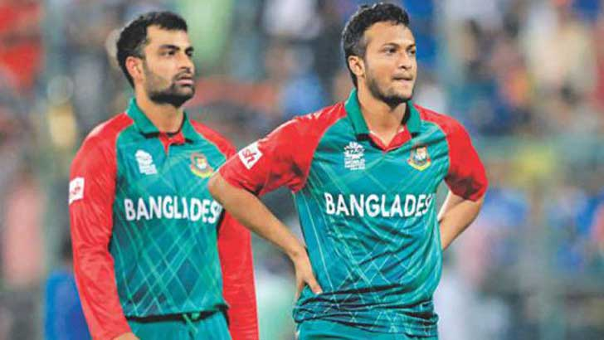
Look at the pictures
What can you see in the picture?
In the picture, I can see Bangladeshi best cricket players Tamim Iqbal and Shakib Al Hasan. Both of them are sports men.

Slide 5
So, Our Today’s Lesson is
Sports personalities

Slide 6
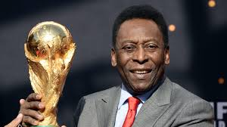
Pele is widely regarded as one of the greatest football players of all times. In 1999, he was voted Football Players of the Century by the IFFHS. IFFHS stands for International Federation of Football History and Statistics. In 1999 the International Olympic Committee(IOC) named Pele the “Athlete of the Century”. In his career he scored more than 1200 goals. Thus he has become the top scorer of all time. In his own country-Brazil. Pele is a national hero. People call him “The king of Football”. “The king Pele” of simply “The King”. He is the all time leading scorer of the Brazillian national team. He is the only footballer to be a part of three World Cup-winning squads and the only player in the world to have three World Cup winning medals.
Read the text. Page :78 Sec: D
Individual Work

Slide 7
Pair Work
In 1999 Pele was voted Football Player of the Century by IOC
False.
C/A:In 1999 Pele was voted Football Player of the Century by IFFHS
In the sage year Pele was honoured as the Athlete of the century
True.
He is one of the football players with three World Cup winning medals
False.
C/A: He is the only footballer in the world with 3 World Cup medals

Slide 8
Evaluation
Write short answer to the following questions.
1. What does IOC stand for?
2. How has Pele become top scorer of all time?
3. How was Pele rewarded in the world?
4. What did IFFHS vote him as?

Slide 9
Write a short paragraph on”Pele”

