Slide 1
Welcome Everybody

Slide 2
Teacher’s Identity
Mst. Zakia Sultana
Head Teacher
Pouta Govt. Primary School
Adamdighi, Bogura

Slide 3
LESSON INDENTITY
Class: one
Subject: English
Unit: 24 Lesson : 4-6
Lesson Title: Alphabet.

Slide 4
Learning Outcome
Student will be able to
Students will be able to:
1.1.2-say simple words and phrases.
1.2.1-recognize and read the alphabet both small and capital.
1.1.1-practise letter shapes.

Slide 5
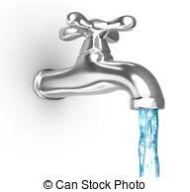
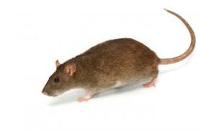
Look and say , What is the name of the pictures.

Slide 6
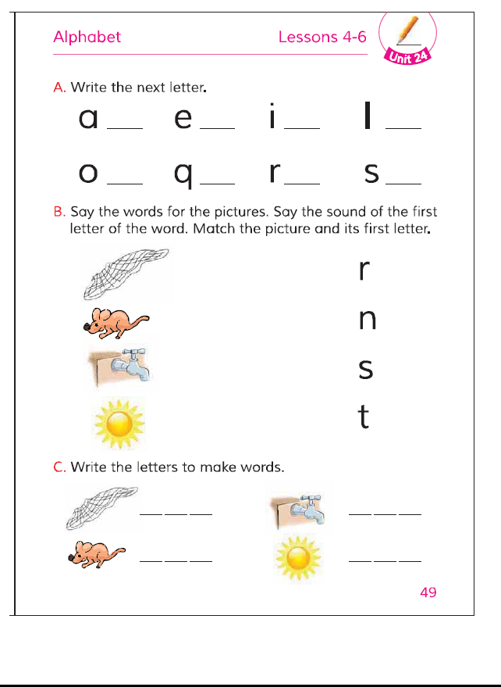
Open your book page at 49.

Slide 7
Lesson Declaration
Alphabet R r N n S s T t.

Slide 8
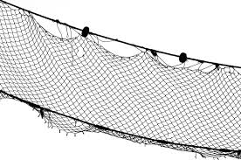
Students loudly read with teacher’s.
n for
net

Slide 9
Write the letter to make words.
____ _____ _____.

Slide 10
Students loudly read with teacher’s
r for
rat

Slide 11
Write the letter to make words
___ ____ ____.

Slide 12
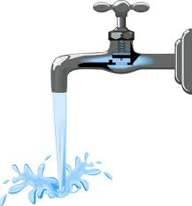
Students loudly read with teacher’s
T for
tap

Slide 13
Write the letter to make words
___ ___ _____

Slide 14
Students loudly read with teacher’s
s for
sun

Slide 15
Write the letter to make words
___ ___ ____.

Slide 16
Find Out ‘r , n , t, s.’
p | u | r
m | n | b
q | s | A
g | c | t

Slide 17
Pair work
Write capital letter.
r n s t.

Slide 18
Groupwork
Tell one word r for, n for, s for, t for.

Slide 19
No more to day.

