Slide 1
You are most welcome
To Attend
Class

Slide 2
Identity
Md Ismail Hossain
Senior Assistant Teacher (english)
Ganguria High School
Porsha, Naogaon
English
For
To day
Class- 9

Slide 3
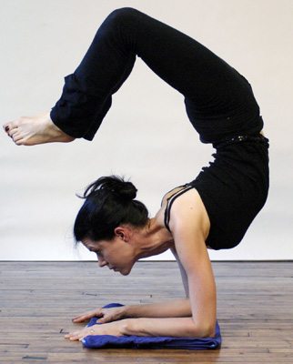
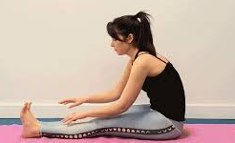
This is the example of Yoga.
Do you know what kind of work this is?

Slide 4
Today’s Lesson-
Unit- 1, Pastime
Lesson-1, Have you any favourite Pastime?
Yoga

Slide 5
Learning
Outcomes
After the End of the Lesson :
Students will be able to-
* tell how yoga works on our memory,
* explain the benefit of yoga,
* express the importance of yoga,

Slide 6
Follow the
sequence

Slide 7
Yoga (যোগ)
One Kind of Physical Exercise

Slide 8
Let’s know the meaning of some related words

Slide 9
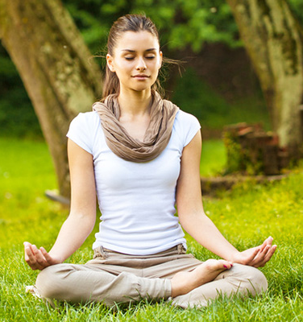
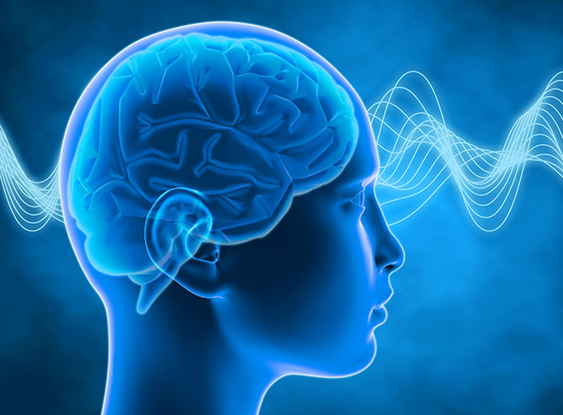
Main Word: Meditation
‡gwW‡Ukb
Meaning: Contemplation, concentration of mind
Noun
Example: Meditation grows mental force of man.

Slide 10
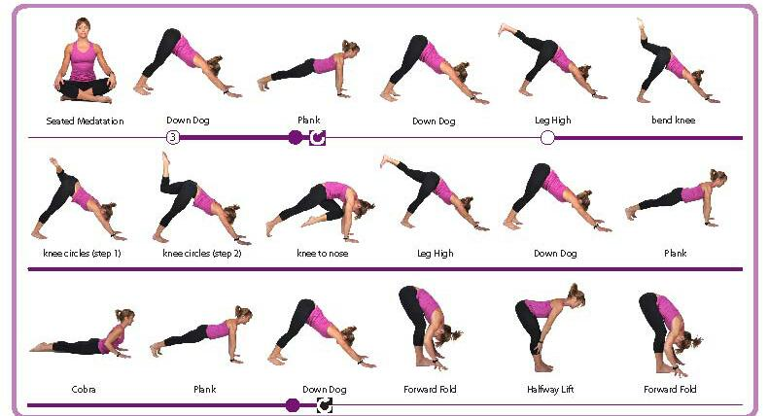
Main Word: Posture
cvP&Uvi
Meaning: gesture / situation/disposition
Noun
Example: Yoga is posture of body.

Slide 11
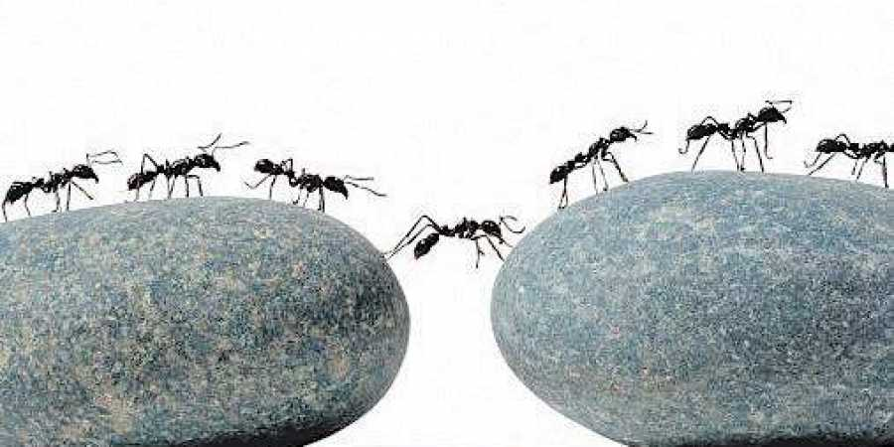
Main Word: Discipline
Meaning: system of any work
Noun
Example: Discipline is the key to success in life.

Slide 12
Main Word: Relax
Meaning: rest / loosen
Verb
Example: If become tired, you should relax for sometime.

Slide 13
Main Word: Management
Meaning: administration/govern/ controlling,..
Noun
Example: Management is a quality that is necessary for everybody.

Slide 14
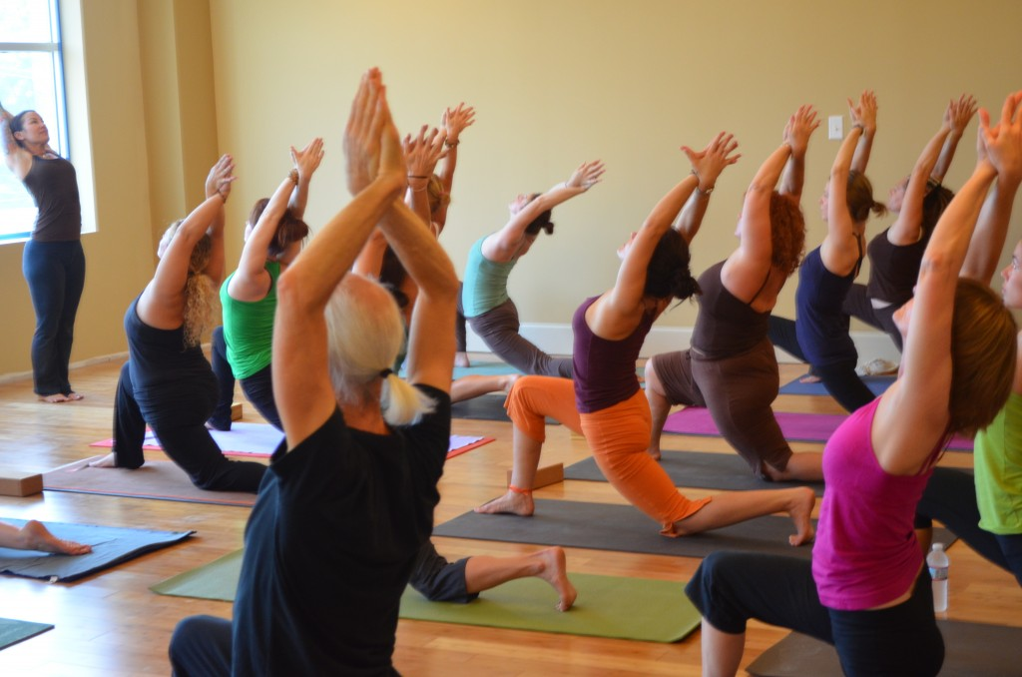
Main Word: Trainer
Meaning: teacher, master, instructor, ….
Trainer
Trainee
Noun
Example: A trainee cannot receive training perfectly without skilled trainer.

Slide 15
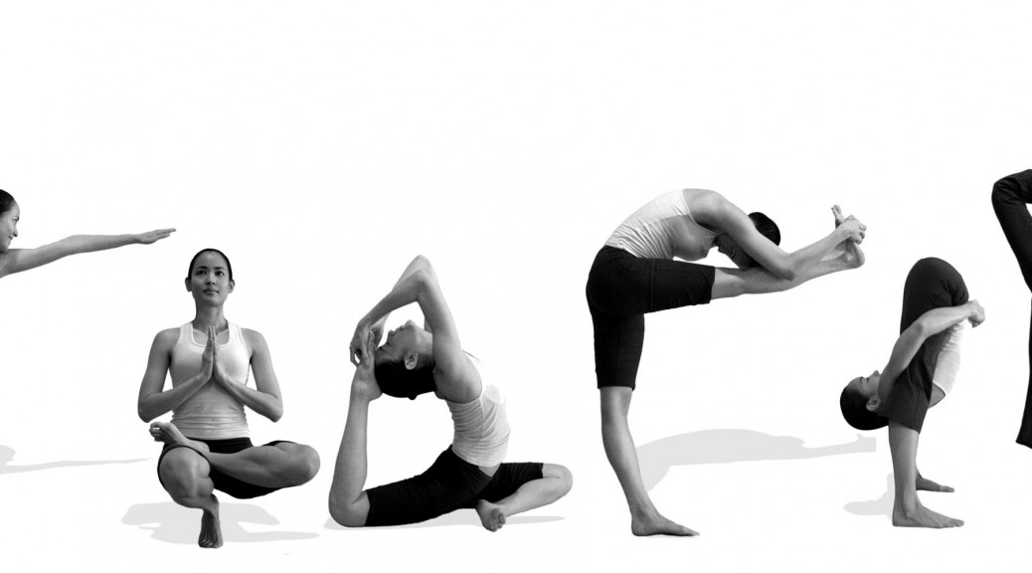
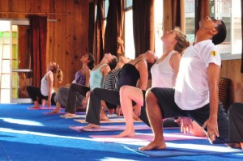
Main Word: Practitioner
cÖvK&wUkbvi
Meaning: practicing person /trainee
Noun
Example: The trainer trains the practitioner perfectly.

Slide 16
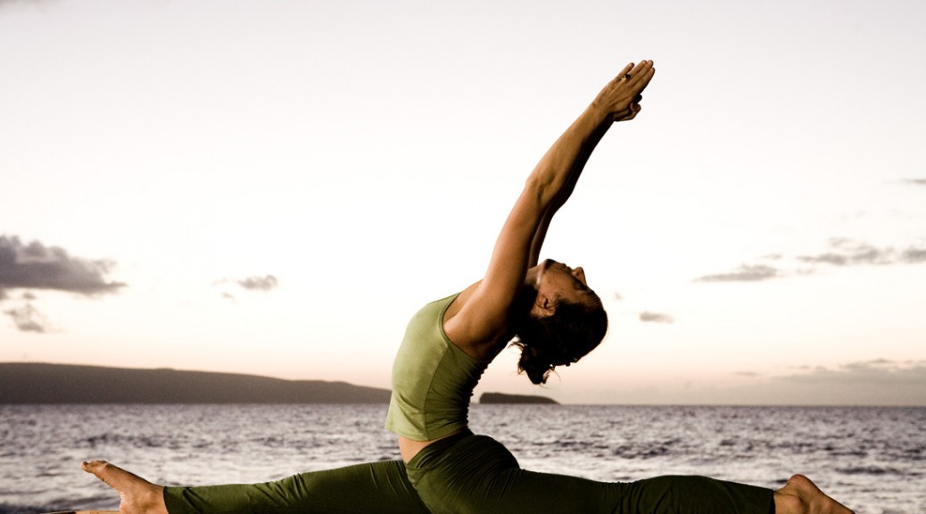
Main Word: Pose
‡c¨ŠR
Meaning: gesture/ attitude
Noun
Example: If we want to practice, yoga we must know the rule of pose

Slide 17
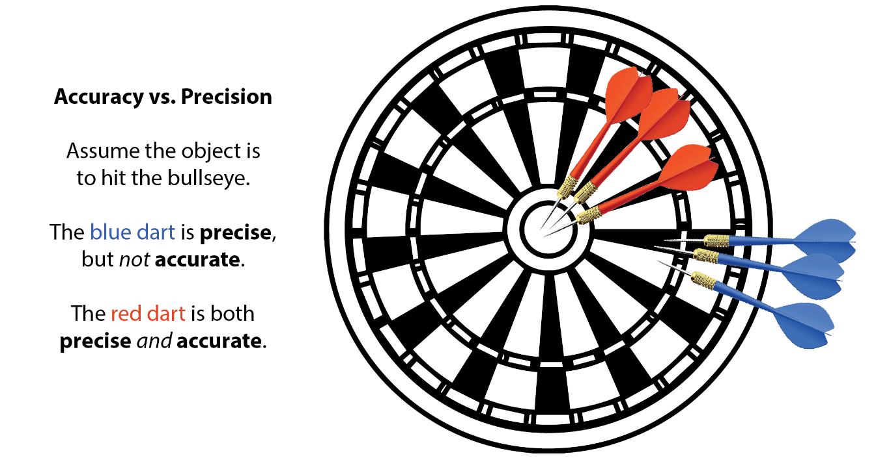
Main Word: Precise
wcªmvBm
Meaning: definite
Adjective
Example: When we practice physical exercise we should follow the precise rule of it

Slide 18
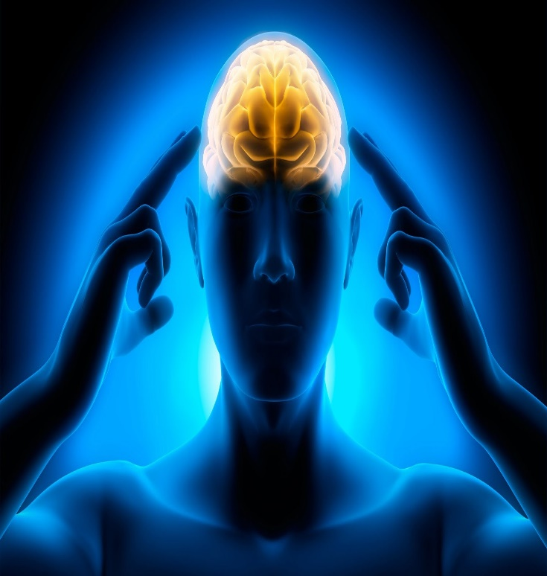
Main Word: Concentration
Kb‡mb&‡Uªkb
Meaning: center of mind
Noun
Example: Pay concentration if you want to gain success in any work.

Slide 19
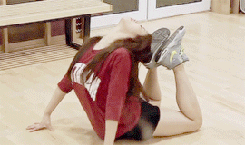
Main Word: Flexibility
‡d¬MwRwewjwU
Meaning: pliancy / softness
Noun
Example: The flexibility of this bodies is notable.

Slide 20
Main Word: Endeavor
Gb&‡Wfvi
Meaning: attempt / try/ effort
Verb
Example: People endeavor to win any problem at last they become successful.

Slide 21
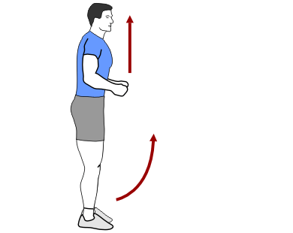
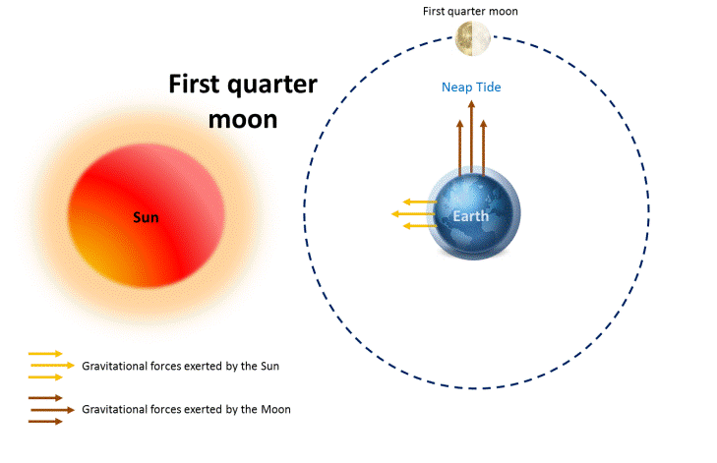
Main Word: Motion
Meaning: Movement, moving body or anything,
Motion of body
Motion of the moon
Noun
Example: The motion of the earth on her excise creates day and night.

Slide 22
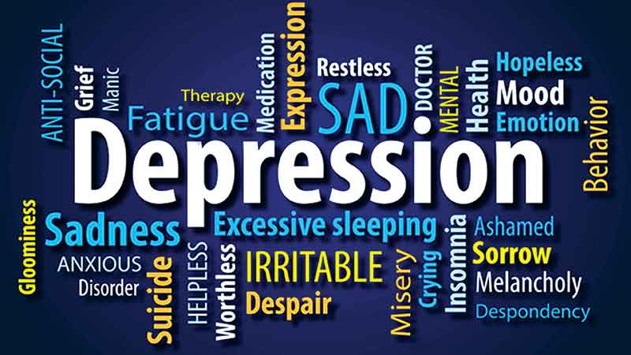
Main Word: Depression
Meaning: dejection/low sprit
Noun
Example: Over tension causes depression of mind.

Slide 23
Main Word: Pain
Meaning: distress, ache, ….
Noun
Example: Wow! I feel pain in my body.

Slide 24
Main Word: Insomnia
Bb&‡mvg&wbqv
Meaning: sleeplessness, having no sleep
Noun
Example: Insomnia is a serious disease.

Slide 25
Main Word: Fatigue
d¨vwUM&
Meaning: weariness/toil/tire
Noun
Example: We should practice regularly to remove our fatigue.

Slide 26
Meaning at a glance
Posture – gesture / situation/disposition
Discipline – system of any work
Relax – rest / loosen
Management – administration/govern
Lifestyle – pattern of life
Trainers – teachers, master,….
Practitioners – practising person /trainee
Potential – important
Pose – gesture/ attitude
Numerous – uncountable, many many, a lot of, ..
Precise - definite
Chaotic – noisy
Concentration – centre of mind
Flexibility – pliancy / softness
Endeavour – attempt / try/ effort

Slide 27
Range- Area, Region,
Motion- Movement
Cancer – (a fatal disease)
Caused by damaging body’s cell
Depression – dejection/low sprit
Pain – distress
Anxiety – worry, Tension, …..
Insomnia – sleeplessness
Fatigue – weariness/toil/tire
Disorder – wrong/ disturb
Combined – together
Supplement – extra element

Slide 28
Reading Text ( loudly)
&
Correcting pronunciation

Slide 29
Understanding Yoga
Yoga is a kind of posture and breathing exercises. It brings together physical and mental disciplines to achieve peace of body and mind, helping you relax and manage stress and anxiety. Traditional yoga puts emphasis on behavior, diet and meditation. But if you’re just looking for better stress management and not an entire lifestyle change, yoga can still help. Yoga trainers gradually choose easier to complex activities for practitioners. However, all practitioners do not necessarily need the same kinds of practice.

Slide 30
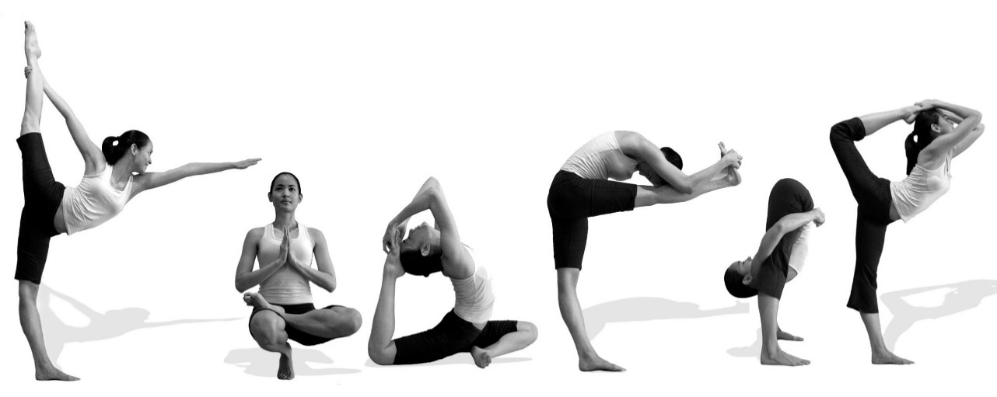
The health benefits of yoga
The potential health benefits of yoga are numerous and may include:
Stress reduction. With its quiet, precise movements, yoga draws your focus away from your busy, chaotic day and towards calm as you move your body through poses that require balance and concentration.

Slide 31
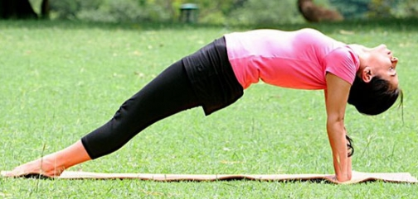
Increased fitness. As you learn and refine new poses, you may enjoy improved balance, flexibility, range of motion and strength. And this means you’re less likely to injure yourself in other physical endeavours or in your daily activities.

Slide 32
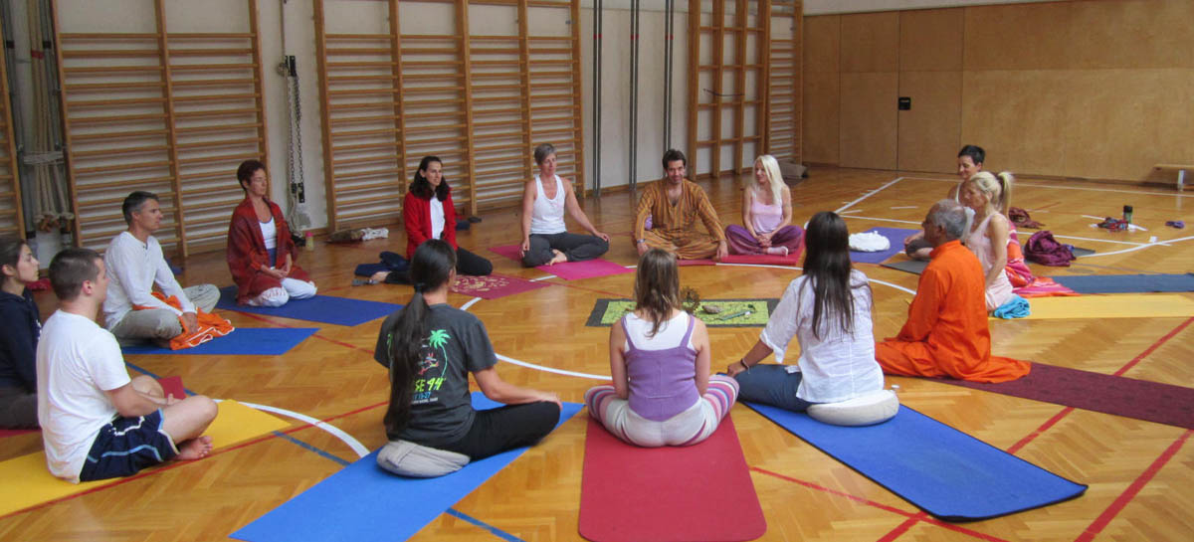
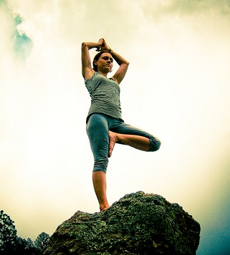
Management of chronic health conditions. Yoga might help with a variety of health condition, such as cancer, depression, pain, anxiety and insomnia, fatigue mood. You can also help reduce heart rate and blood pressure.

Slide 33
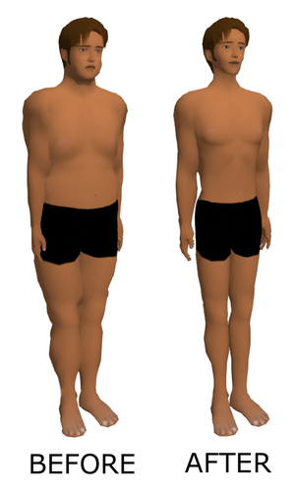
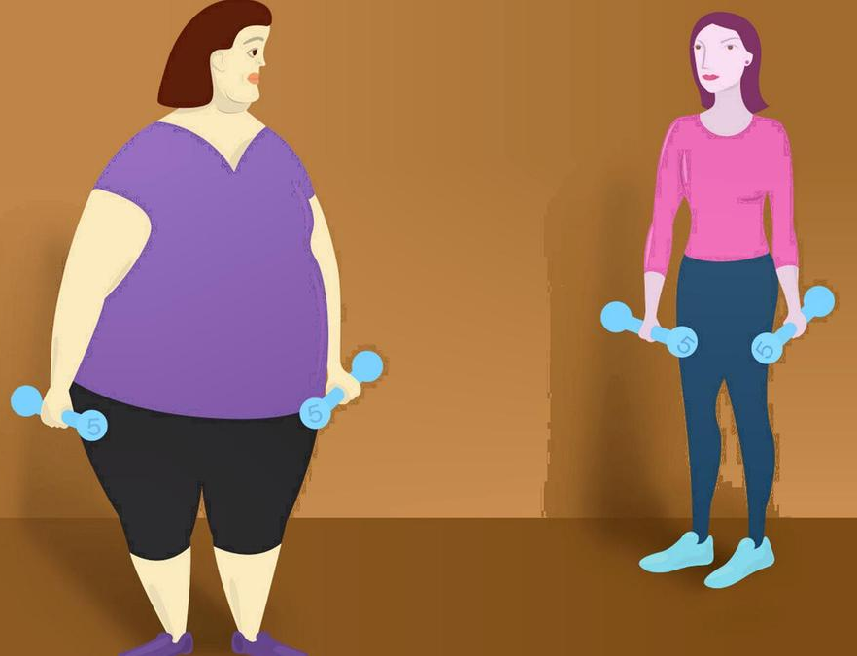
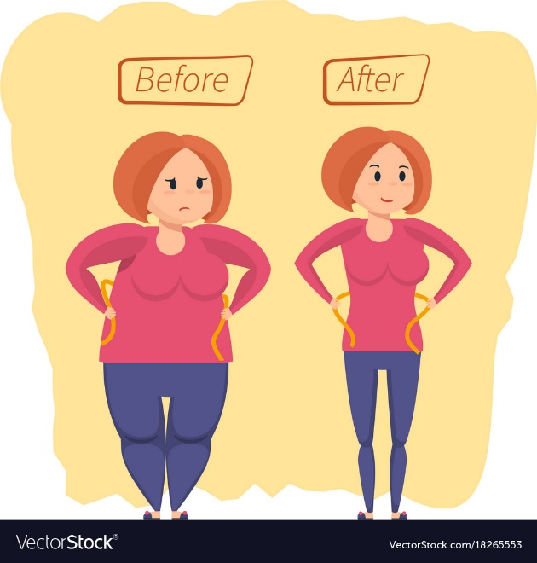
Weight loss. If you’re overweight or have eating disorder, yoga may help you make the healthy lifestyle changes necessary to gain control of your eating drop those extra pounds.

Slide 34
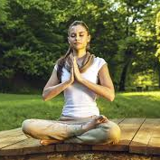
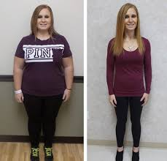
While you shouldn’t expect yoga to cure you or offer you relief 100 percent, it can help some health conditions when combined with standard treatment. And if you already enjoy good health, yoga can be an enjoyable supplement to your regular fitness.

Slide 35
Now solve following questions-
As below:

Slide 36
Pair Work-1
D Discuss these question. Give your own opinions.
How does exercise work on our memory?
What other benefits can you think of from exercise?
What is the most important benefit of exercise to you and why?
6 Minutes

Slide 37
Probable Answer:
Pair Work-1
How does exercise work on our memory?
Answer: Through quiet, precise movement, yoga draws our focus away from our busy, chaotic day and towards calm as we move our body through poses.

Slide 38
What other benefits can you think of from exercise?
Answer: There also have other benefits of Yoga such as it increases physical fitness. We may enjoy improved balance, flexibility, range of motion and strength. It also helps in variety of health conditions, such as cancer, depression, pain, anxiety and insomnia, fatigue and mood shifts. It also helps to reduce heart rate, blood pressure and over weight .

Slide 39
What is the most important benefit of exercise to you and why?
Answer: The most important benefit of exercise is keeping our body fit. While we should not expect yoga to cure or 100 percent relief, it can help some health conditions when combined with standard treatment. It is also supplement to our health for maintaining our being good health.

Slide 40
Pair Work-2
E Complete the sentences.
Yoga is a practice of-----------------
Traditional Yoga works through ------------------
Yoga is very effective in managing----------------
Through the poses of balance and concentration Yoga--------------------
-------------------- results in increased fitness.
Yoga can reduce or work for -------------------
Yoga can control-------------------------
Yoga cannot control 100 percent, but-----------------
8 Minutes

Slide 41
Probable Answer:
Yoga is a practice of posture and breathing.
Traditional Yoga works through behavior , diet, and meditation.
Yoga is very effective in managing stress.
Through the poses of balance and concentration Yoga draws our focus away from our busy, chaotic day and towards calm as we move our body.
Yoga results in increased fitness.
Yoga can reduce or work for heart rate and blood pressure.
Yoga can control over weight and eating disorder.
Yoga cannot control 100 percent, but it can be a enjoyable supplement to fitness routine.

Slide 42
F Check (√) the statements about yoga below.
5 Minutes
a | Yoga improves fitness
b | Yoga has little to do with eating habits.
c | It may differ according to practitioners levels.
d | It helps people to shake off all types of physical and mental disorder.
e | It works both on body and mind.
f | It helps practitioners undergo similar level of difficulty.
g | If you know yoga, you have better control over your real life hazards.
h | It also helps you live longer.

Slide 43
Evaluation: (Orally)
What is yoga?
What are the benefits of yoga?
Where do we practice yoga?

Slide 44
Home Task
Write a short passage about Yoga giving importance on it.

Slide 45
Content Reference-
f
Face book
Text Book
Internet

Slide 46
Good
Bye
For
Today

