Slide 1
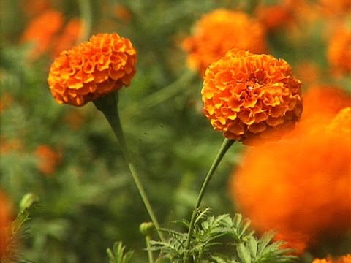
mj
Well-come

Slide 2
Introduction
Class- six
Subject- English
Noun
Md. Shamsur ahaman, A.T,
M. M. Dakhil Madrasha,
Sakhipur, Tangail.

Slide 3
Learning Outcomes
After the end of the lesson
SS will be able to
Define different nouns.
Ask and answer about noun.
Describe about pictures.
Write about the classification of nouns.

Slide 4
What can you see in the picture?
Noun: A noun is a word naming any person, any place, thing or action.
A flower
A child

Slide 5
Pair Work :A dialogue on noun
Rahim: Hi,Bithy. Can you define Noun?
Bithy: Yes, A noun is a naming word.
Rahim: How many kinds of noun are there?
Bithy: There are two kinds of noun. They are
1.Concreat noun 2. Abstract noun.
Rahim: How many kinds of noun according to number are there?
Bithy: According to number, there are two kinds of noun.
They are: 1. singular noun. 2.plural noun.
Rahim: you are right. Thank you.
Bithy: Thank you, too.
Notes:
l[]’
|

Slide 6
Singular noun and Plural noun.
Singular noun : Flower
Plural noun : Flowers

Slide 7
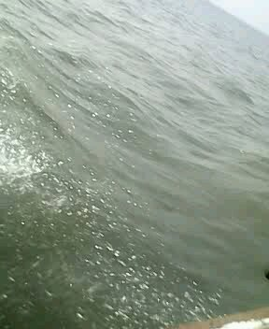
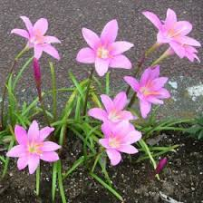
Countable And Uncountable Noun
The nouns which can be counted are called countable noun.
The nouns which can be measured are called uncountable noun.
Men
Water
Flowers
Love

Slide 8
Concrete and Abstract noun
A noun having physical structure is called concrete noun.
A noun without physical
structure is called abstract noun.
affection
soil

Slide 9
Classification of Nouns
1. Proper
Noun
2. Common
Noun
3.Collective
Noun
4.Material
Noun
5.Abstract
Noun

Slide 10
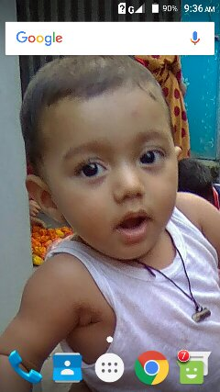
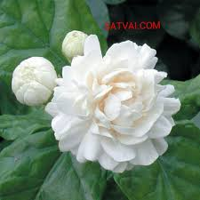
1. Proper Noun
The name of a person, a place or a thing is called proper noun.
Nafis Hasan
Bely
The Jamuna
The Jamuna is a big river.

Slide 11
2. Common Noun
The name which is common to a kind or a class is called common noun.
Boy
Flower
River
Everybody loves flower.

Slide 12
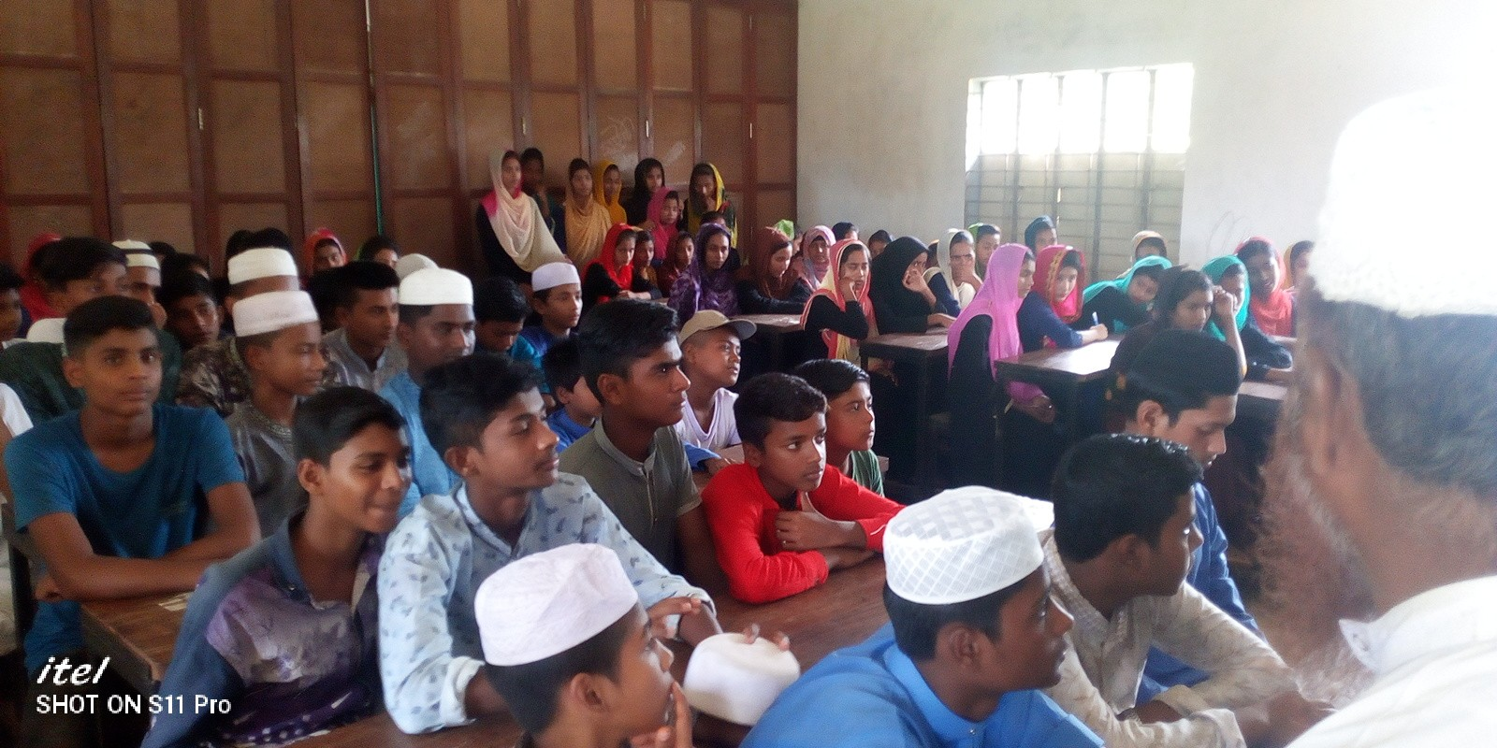
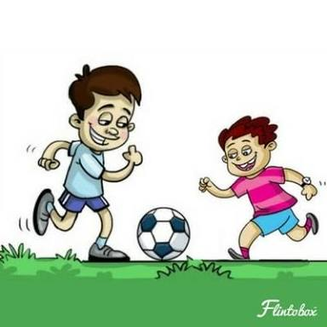
3. Collective Noun
The name of a collection of person or thing is called collective noun.
Class
Team
The students of class ten are making their football team.

Slide 13
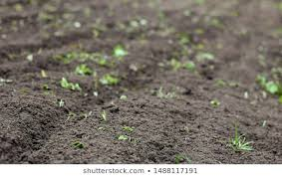
4. Material Noun
The name of measurable substances are material noun.
ROCK
Soil
Water
Give me a glass of water.

Slide 14
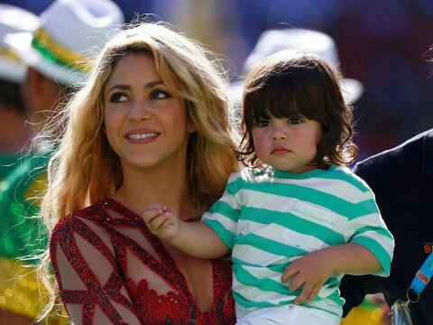
5. Abstract Noun
The name of a quality or a state is called abstract noun.
Childhood
Sweet-smell
Love
From my childhood l love the sweet-smell of flowers.

Slide 15
Individual work: Evaluation
Indentify different kinds of nouns from the text and write down in your exercise book.
Shahanaz Is a good student. She reads in class ten. She is a very kind girl. She has a great love for her country.
Bangladesh is a small country. Must of her people are farmers. They work in the field in sun and rain. They grow crops for all. We should have love and respect for them.

Slide 16
Home work
Define different kinds of noun with your own examples.

Slide 17
Thank you very much

