Slide 1
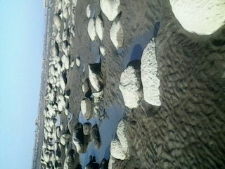
Well-come

Slide 2
Introduction
Class- Eight
Subject- English 2nd paper
Paragraph
My Favorite Hobby
Md. Shamsur Rahaman,A.T,
M. M. Dakhil Madrasha,
Sakhipur, Tangail.

Slide 3
Learning Outcomes
After the end of lesson SS will be able to
Define hobby.
Ask and answer about gardening.
Describe about pictures.
Write a paragraph on Gardening.

Slide 4
What can you see in the picture?
Boys are playing football.
A girl is drawing picture.
Deferent people have deferent hobby.

Slide 5
Deferent Hobbies

Slide 6
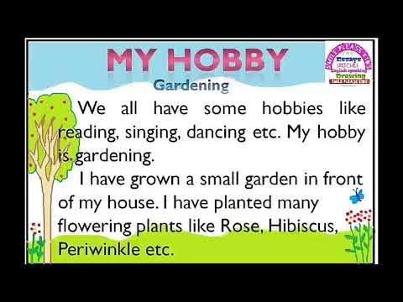

Slide 7
land
Take care
flowers
Pleasure
Gardening
At first, I have selected a piece of land in front of my house to make a garden.
I take care my garden regularly. I water my plants, weed them, make a fiancé to protect the flowers.
I get beautiful flowers from my garden and feel very happy.
My garden is a great source of pleasure for me.

Slide 8
What can you see in the pictures?
A peace of land selected for garden
Planting seeds of flowers in the garden
After selecting a suitable peace of land I prepare it with tractor. And I plant the seed of deferent kinds of flowers.

Slide 9
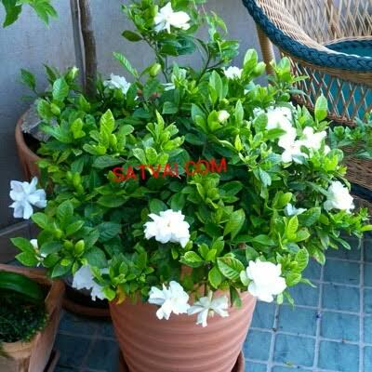
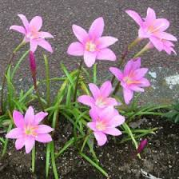
Various kinds of flower
There are many kinds of colorful and sweet- smelling flowers in my garden like the rose, the marigold, the rajonighondha, the hasnahena, the beli,the ghondharaj, the jui,the jaba etc.

Slide 10
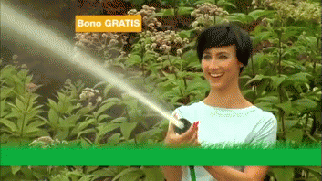
What can you see in the pictures?
I water my plants everyday.
I collect flower from my garden.

Slide 11
Flower collection and selling
Sometimes selling flowers I earn a lot of money.

Slide 12
Ask and answer in pairs
1
What’s your favorite hobby?
My favorite hobby is Gardening.
2
When do you work in the garden?
In my free time I work in my garden.
3
What do you get from the garden?
I get vegetables, flowers and a lot of pleasure from my garden.

Slide 13
Write five sentences about ‘Your Favorite Hobby’
Individual work

Slide 14
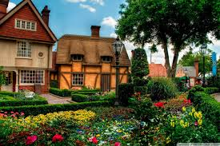
Home Work Write a short paragraph on your favorite hobby

Slide 15
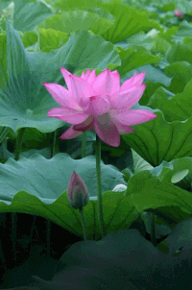
Thanks
… … …

