Slide 1
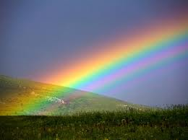
Wellcome to my multimedia class.

Slide 2
IDENTITY
Nahid akhtar parvin.assistant Teacher.
jagodishpurGovt.
Primary school.
Email ID:nahidprimary@
gmail.com.
Class : two
Subject : English
Lesson: The rainbow.
unite : 5
Lesson:1
Time : 40 minutes.
Date :21/06/2020

Slide 3
Learning out comes
Student will be able to
1.1.1 become familiar with English sounds by listening to common English word.
4.1.1 repeat rhymes after the teacher.
4.1.2 recite rhymes independently.

Slide 4
What can you see in this picture
Yes, various colours

Slide 5
YELLOW
BLUE
ORANGE
VIOLET
INDIGO
RED
GREEN

Slide 6
Indivisual work
Say the colour’s name .

Slide 7
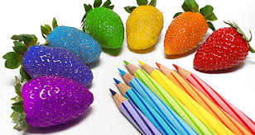
Pair work

Slide 8
Group work

Slide 9
THE RAINBOW
“”

Slide 10
Do you want to hear a rainbow song?
Let’s see the video.

Slide 11
Now we read the rhyme.
“RAINBOW”

Slide 12
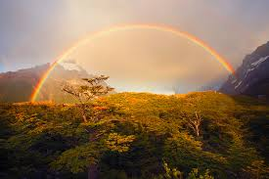
I see rainbows

Slide 13
I see rainbows

Slide 14
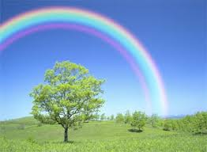
Way up high

Slide 15
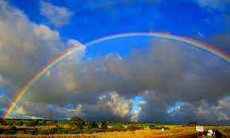
In the sky

Slide 16
I see red and
orange
RED
ORANGE

Slide 17
Yellow ,
green
and blue
BLUE
YELLOW
GREEN

Slide 18
Indigo and Violet too
VIOLET
INDIGO

Slide 19
What a view !

Slide 20
Input
Students repeat the rhyme after me.

Slide 21
I see rainbows
I see rainbows

Slide 22
In the sky
Way up high

Slide 23
I see red and orange
RED
ORANGE
Yellow , green and blue
BLUE
YELLOW
GREEN
Violet , indigo too
VIOLET
INDIGO

Slide 24
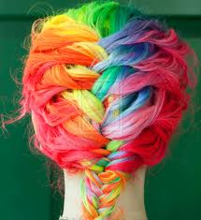
THANKS

