Slide 1
You are most welcome to my class.

Slide 2
Introduction
Teacher
Lesson
Hirendra Debnath
MA(English),Bed
Assistant Teacher(English)
Puran Bazar Girls’ High School
01789-916684
Rotarian Hirendra Debnath
hirendra0501@gmail.com
English Grammar and Composition
Class : VI-X

Slide 3
Let us watch and guess a video …
How dangerous the sea is!
The sea is so dangerous.

Slide 4
Can you guess what we are going to discuss today?
Assertive to Exclamatory
Notes:
This is to take out declaration from the students.

Slide 5
So, our today’s topic is--
Transformation of sentence
Part-3 (Assertive to Exclamatory)

Slide 6
Learning outcomes
After completing this lesson, the ss will be able to-
a) identify assertive sentence
b) identify exclamatory sentence and its classifications
c) change from assertive to exclamatory sentence

Slide 7
Let’s enjoy an exciting show …..
We enjoyed a very exciting show.
What an exciting show we enjoyed!
Notes:
Leading to the main lesson by the video and example.

Slide 8
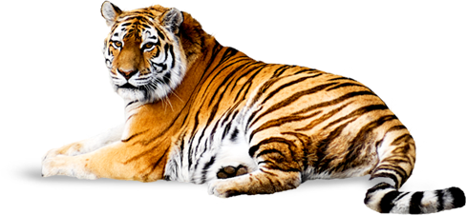
The tiger is a ferocious animal.
Assertive sentence
What a ferocious animal the tiger is!.
Exclamatory sentence

Slide 9
Structure of Assertive Sentence
(a) Subject + verb + a/an + adjective + noun.
(‘very/so/too/great’ may have or not after verb)
(b) Subject + verb + adjective.
(‘very/so/too/great’ may have or not after verb)
It is a very interesting story. / It is an interesting story.
It is very interesting./ It is interesting.

Slide 10
Structure of Exclamatory Sentence
(a) What + a/an + adjective + noun + subject + verb + !
( adverb ‘very/so/too/great’ will be omitted)
(b) How + adjective + a/an + noun + subject + verb + !
( adverb ‘very/so/too/great’ will be omitted)
(c) How +adjective + Subject + Verb + !
( adverb ‘very/so/too/great’ will be omitted)
What an interesting story it is!
How interesting a story it is!
How interesting it is!

Slide 11
If assertive sentence with a/an, exclamatory sentence starts with ‘What’ or ‘How’
Assertive
Exclamatory
Subject + verb + a/an + adjective + noun.
What + a/an + adjective + noun + subject + verb + !
Or, How + adjective + a/an + noun + subject + verb + !
If assertive without a/an, exclamatory sentence starts with only ‘How’
Assertive
Exclamatory
Subject + verb + adjective.
How + adjective + subject + verb + !

Slide 12
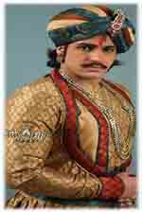
Class Activities
Change the sentences into Exclamatory
1. Akbar was a very powerful king of India.
2. He was very handsome.
3. There was an aristocratic throne for him.
4. It looked very gorgeous.
5. He was indeed a successful king.

Slide 13
Check your answer
1. What a powerful king of India Akbar was!
Or, How powerful a king of India Akbar was!
2. How handsome he was!
3. How aristocratic a throne there was for him!
Or, What an aristocratic throne there was for him!
4. How gorgeous it looked!
5. What a successful king he was indeed!
Or, How successful a king he was indeed!

Slide 14
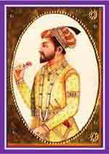
If I had the wings of a bird!
Or, Would that I had the wings of a bird!
Or, Had I the wings of a bird!
I wish I had the wings of a bird.
If I were a king!
Or, Would that I were a king!
Or, Were I a king!
I wish I were a king.

Slide 15
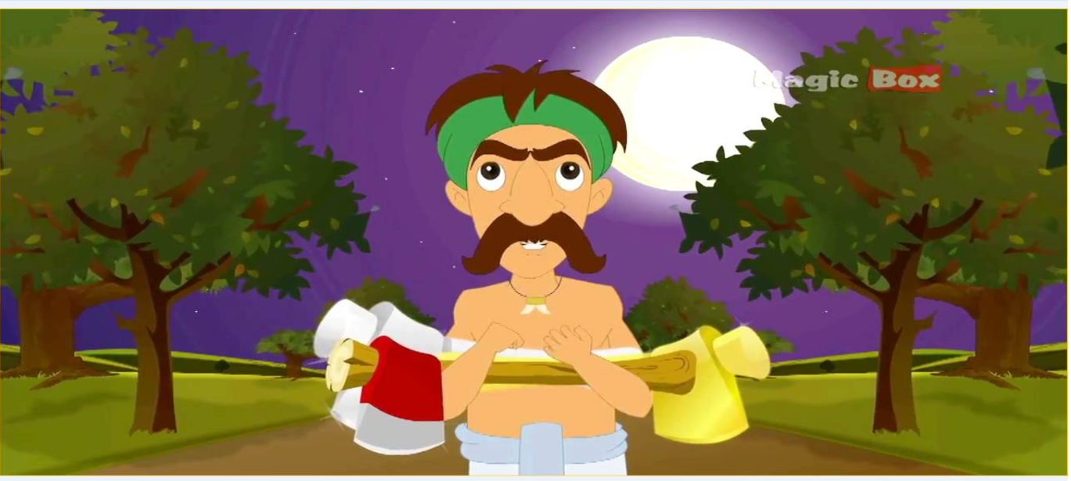
Honesty is a great virtue.
What a virtue honesty is!
Notes:
Sub + verb + a/an + great + noun. = What + a/an + noun + sub + verb + !

Slide 16
Activities at home
1. The Padma is a very big river.
2. It is so deep.
3. The river contains a vast water.
4. The water of the river is very useful for the people.
5. It is beneficial for cultivation.
6. The fishermen enjoy fishing in the river very cheerfully.
7. The fish of this river is really tasty.
8. I wish I had a boat.
9. I wish I were a fisher man.
10. I like the river very dearly.
11. He has done a great job.

Slide 17
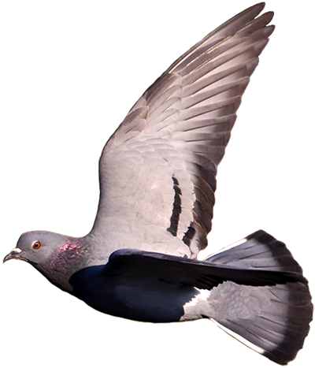
Inviting to part-4
May God keep you safe and sound.

