Slide 1
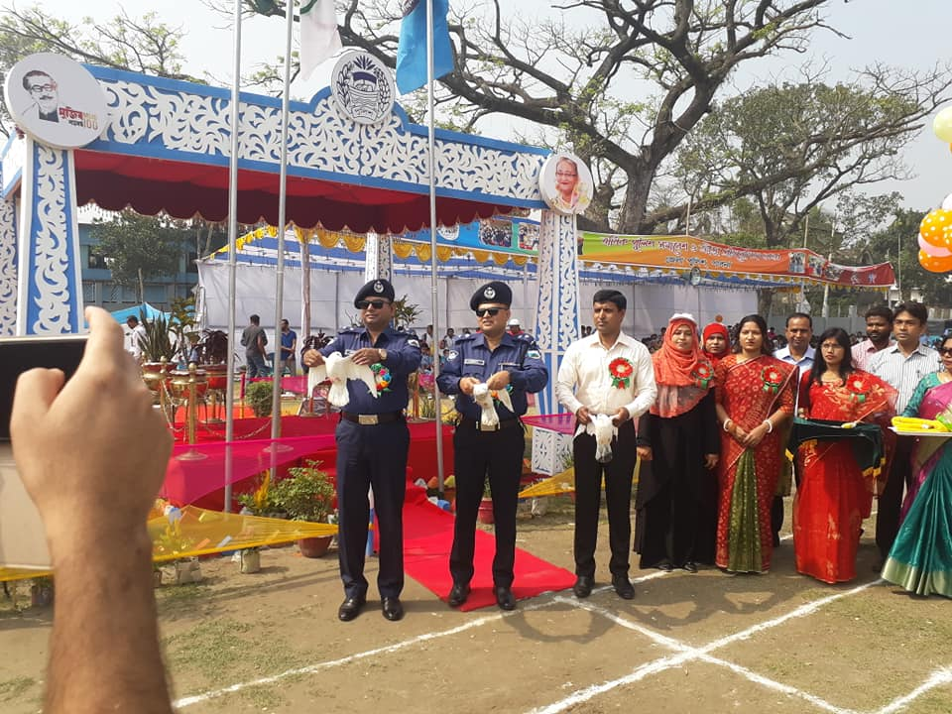
Welcome to the Class

Slide 2
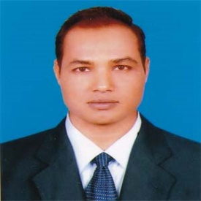
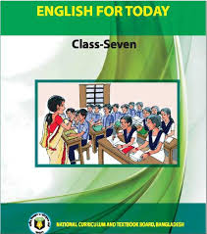
Introduction
Md. Mizanur Rahman
B.A.(Hons.), M.A. in English, B.Ed.
Assistant Teacher
Police Lines School and College, Pabna.
E-mail: mizanplsc@gmail.com
Cell Phone :01737979719
Class: VII
Subject: English 1st Paper
Unit: Three ( What are friends for)
Lesson: One
Lesson Title: Prize- giving day at school.
Class Duration: 40 minutes
Date: 22/06/2020

Slide 3
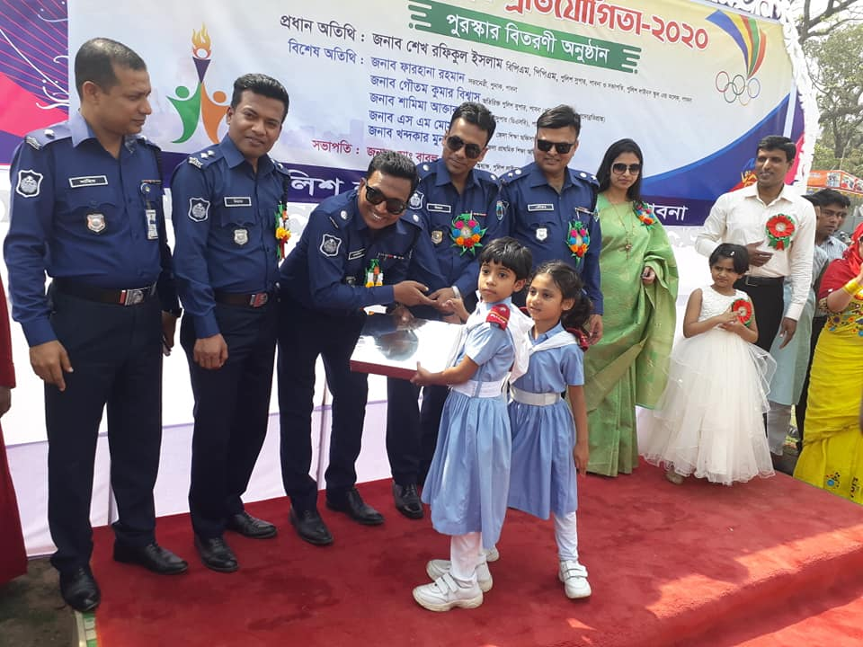
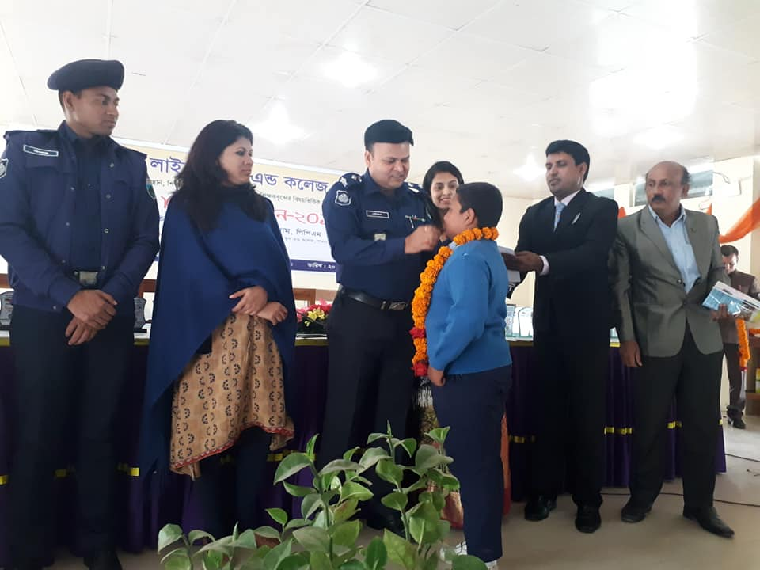
Look at the picture
What can you see in the picture?
Why do we read them?

Slide 4
Today’s Lesson
Prize- giving day at school.

Slide 5
Learning Outcomes
At the end of the lesson, the students will be able to:
read and understand text .
ask and the answer of questions.
complete the sentences and choose the best answer.
write the sports day of their school.

Slide 6
Key words presentation
Word : Eminent
adjective
Synonym : important, famous
Ant. Unimportant, insignificant
Meaning : Famous in a particular profession
Example: Some eminent persons were of the locality attended the function.

Slide 7
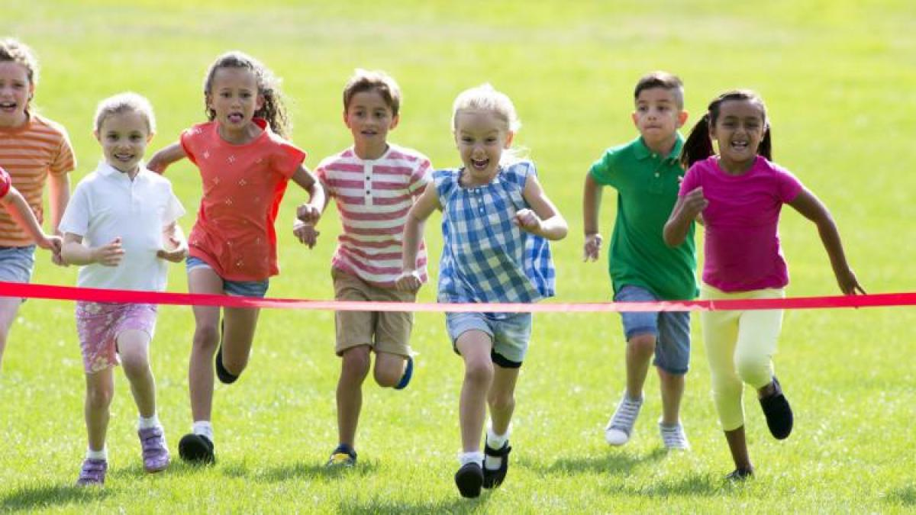
Word : Outstanding
adjective
Syn. Great, unique
Ant. ordinary
Meaning : exceptionally good
Example : The chief guest gave away the prizes among the students for their outstanding activities.

Slide 8
Word : performance
Noun
Meaning: the act of achieving something
Syn. achievement
Example : The principal highly praised the overall performance of the school.

Slide 9
A. Read the lesson silently.
Farabi is Flora’s best friend. They live in the same area. Also they are both in class 7. But they go to different schools.
It is a school holiday. Flora has come to visit Farabi. They are talking. Flora wants to know about the prize- giving ceremony of Farabi’s school.
“Yesterday was our school prize-giving day,” Farabi says. “On this occasion our school auditorium and its dais were brightly decorated . Prizes were also neatly displayed on a separate table on the dais. All the students were present at the function. Among eminent persons of the locality attended the function,” Farabi continues . “The principal of PN College was the chief guest.”

Slide 10
“When did the function start?” Flora asked.
“Oh, it started on time- just at 4 pm,” Farabi says. “Our Head teacher first read out the annual report. Then the Chief Guest gave a short speech. He highly praised the overall performance of the school and its excellent JSC and SSC Exam results. Then he gave away the prizes among the students for their outstanding activities.”
“Did you get any prizes, Farabi?” Flora enquires.
“Yes, I did”, Farabi replies. “I have got two prizes – one for regular attendance and the other for good result in the last year- ending exams.

Slide 11
Individual Work
Match words with their meanings .
Words | meanings
Visit | * speak highly of something or somebody
Ceremony | * Extremely good
Eminent | * Go to see a person or place
Praise | * Put something in a place where you can see it easily
Outstanding | * function
display | * People having lots of power and influence

Slide 12
Pair Work
Ask and answer in pairs. Make questions and then choose answers from this table.
Questions
How | was did | the prize –giving function held?
What |  | the auditorium decorated?
Who |  | the chief guest at the function?
where |  | the Head teacher do at the beginning of the function?

Slide 13
Answers.
1. The principal of PN College.
2. In the school auditorium.
3. Read out the annual report.
4. Brightly.

Slide 14
Group Work
Complete the passage with the verbs in the box. Give their correct forms.
be | sing | speak | stage
At the end of the prize – giving function there(a) a cultural show. The students (b) , danced and
© a one-act play. It was so good that everyone(d) highly of it.
was
sang
staged
spoke

Slide 15
Evaluation
Choose the correct answer to each question from the alternatives given and write the corresponding number of the answers in your answer script.
But they go to different schools. Here ‘different’ means-------
Various ii. Separate iii. Alike iv. Related
2. Flora has come to visit Farabi. What does ‘visit’ mean?
Invite ii. Talk iii. Entertain iv. Meet

Slide 16
3. Prizes were also neatly displayed on a separate table on the dais. Here ‘neatly’ means
Messily ii. Systematically
iii. Clumsily iv. Untidily
4. ---- and some eminent persons of the locality attended the function. The meaning of the word ‘eminent’ is------------.
Minor ii. Notorious
iii. Prominent iv. Negligible 5. ‘Our Headmaster first read out the annual report’ what does the phrase ‘read out mean here?
Read aloud ii. Announce
iii. Recite iv. deliver

Slide 17
Home Work
Do you have a sports day at your school? First tell the class about it and then write about it in your notebook.

Slide 18
Thanks to all

