Slide 1
Welcome to my class

Slide 2
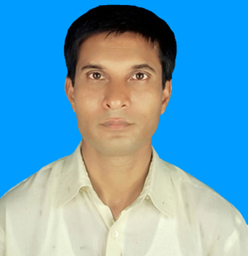
introduction
Unit-1 ,Lesson-4
Md Ismail Hossain
Senior Ass. Teacher (English)
Ganguria High School
Porsha, Naogaon

Slide 3
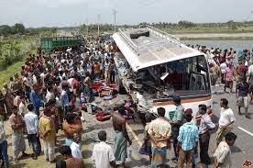
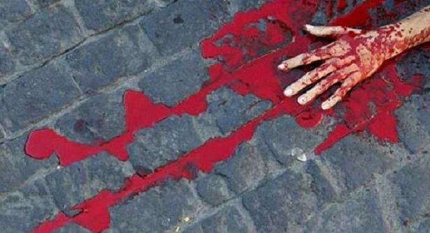
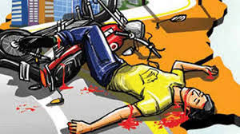
Some serious road accidents happened.

Slide 4
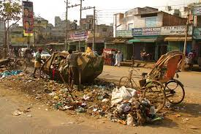
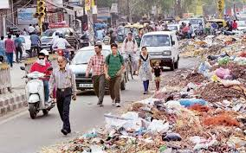
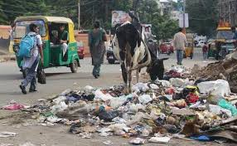
Do you know, what is our responsibilities?

Slide 5
Today’s topic
Responsibilities

Slide 6
After we have studied the lesson we will be able to –
explain the responsibility
Compare and contrast responsibilities between him/her and the Govt.
Read and narrate the incidents.
Make a list of responsibilities.

Slide 7
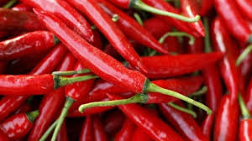
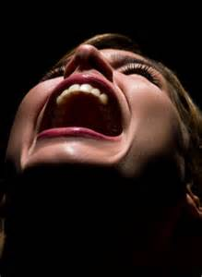
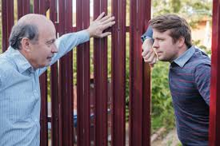
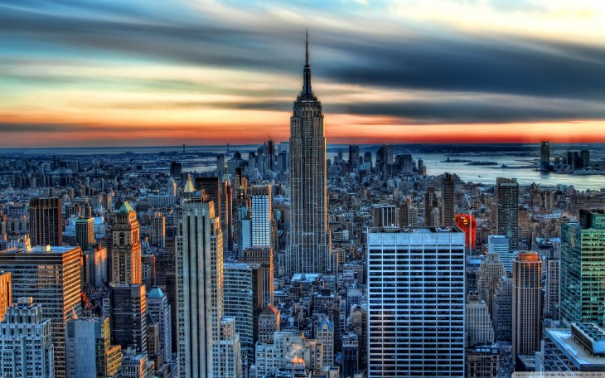
Pursue
Chillies
Groam
Neighbour
Building

Slide 8
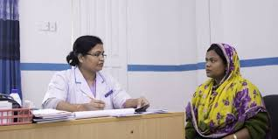
an establishment or hospital department where outpatients are given medical treatment or advice, especially of a specialist nature.
Clinic
Noun
Clinic is a place where people get medical service.

Slide 9
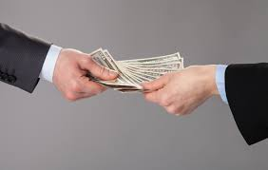
Paid
Verb
(of work or leave) for or during which one receives pay.
Helal paid the money to the taxi driver.

Slide 10
Read the text carefully. Now discuss in groups the following questions.
Did Rony do right or wrong? Why?
2. What do you think his mother will do when Rony comes back home without salt and chilies?
3. What do you mean by responsibilities?

Slide 11
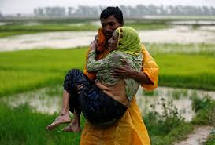
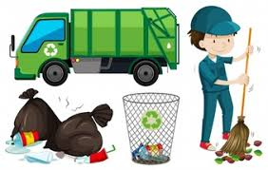
This is our responsibility to take care of aged parents.
This is our government responsibility to clean the road.

Slide 12
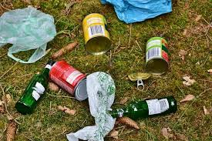
People throw garbage into environment. This is irresponsibility.
People use bin throwing garbage. This is awareness creating by Government.

Slide 13
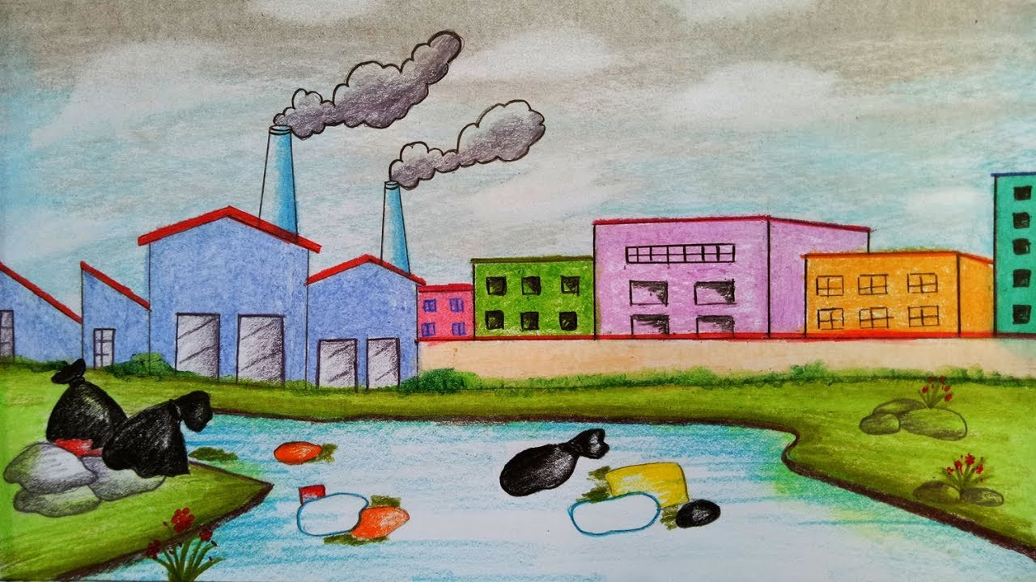
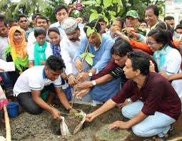
This is great irresponsibility of human being to create pollution.
This is our responsibility to plant more and more trees to save environment. Our govt. is trying to save environment taking responsibility.

Slide 14
Discuss in groups and write answer to these question.
1. Where or who can you get your responsibilities from? Make a list.
1. Parents.
2. Elders.
3. Grand parents & respectable neighbors.

Slide 15
Discuss in groups and write answer to these question.
Make a list of responsibilities as students you have at home , school and in society.
1. At home as a student always obey my parents, elders and neighbors.
2. In school as a student always respect my teachers and do well in my class.
3. In society as a student always try to maintain discipline.

Slide 16
Discuss in groups and write answer to these question.
Make another list of things you shouldn’t do at home , school and in society.
1. At home I shouldn’t throw garbage around the environment.
2. In school I shouldn’t throw wastage in my classroom as well as my school compound.
3. In society I shouldn’t commit bad to all.

Slide 17
A list of responsibilities is given below:
1. Take care of parents.
2. Take care of ill fated & victims of accident.
3. Attend School regularly.
4. Help neighbors.
5. To ensure basic needs for all.
6. To keep the environment clean for all.

Slide 18
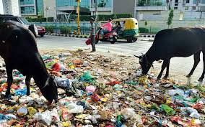
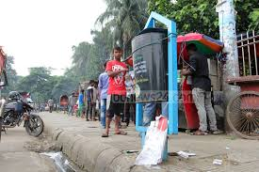
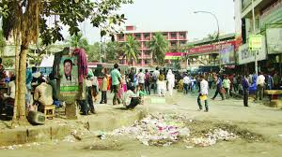
Look at the picture. Work in pairs.
Suppose this road is near your school. As students of this school , what responsibilities do you think you have to get rid of this nuisance? Make a list.

Slide 19
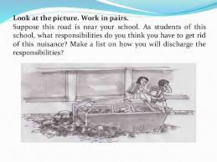
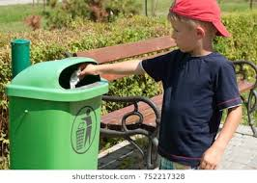
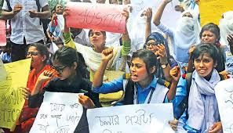
A list of responsibilities that get rid of this nuisance.
1.Creating awareness among mass people.
2. Fixed a place to emit garbage for protecting environment.
3.Use bin for throwing garbage.
4. Clean the road and bin everyday.
5. Showing some placard and festoon.

Slide 20
Home work
*. Make a list of responsibilities other people have towards you. Briefly describe what might happen if they fail to fulfill the responsibilities.

Slide 21
Thank You For Watching Class

