Slide 1
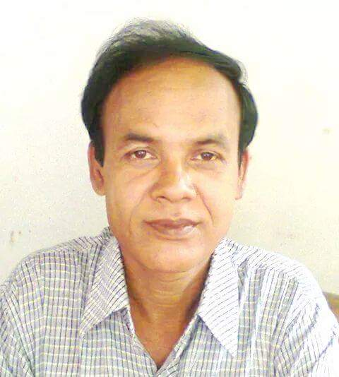
Md. Azharul Islam
Senior Assistant Teacher (English)
Barrister Jamiruddin Sircar Collegiate Institute,
Panchagarh
Email : azharul1965@gmail.com
Mobile : 01716849848
English 2nd Paper
Class : VIII - X

Slide 2
Adjectives ( Part – II )

Slide 3
Other Adjectives
Other Adjectives
Proper
Relative
Emphatic
Compound
Exclamatory

Slide 4
Proper Adjective
Comes from Proper Noun
Proper Noun
Italy
Bangladesh
India
Shakespeare
Proper Adjective
Italian
Bangladeshi
Indian
Shakespearean

Slide 5
Relative Adjective
S + V + O + WH + Noun + S + V + O
Example:
Ask him which book he needs
I know which fruit he wants

Slide 6
Exclamatory Adjective
Example:
What a mistake !
What inhumanity is this !

Slide 7
Emphatic Adjective
Own
Very
+ Noun
I saw the accident with my own eyes
This is the very pen which I want

Slide 8
Compound Adjective
He has completed a three-year diploma course
I have a three-week vacation
I saw a man-eating alligator
I live in an English-speaking country
He is a well-known writer
Our house is in a twenty-storey building

Slide 9
Compound Adjective
I saw a man-eating alligator
Not same in
meaning
I saw a man eating alligator

Slide 10
Home work
Write three examples of each of the following adjectives …
Proper
Relative
Exclamatory
Emphatic
Compound

Slide 11
Thank you all

