Slide 1
Welcome to my multimedia class

Slide 2
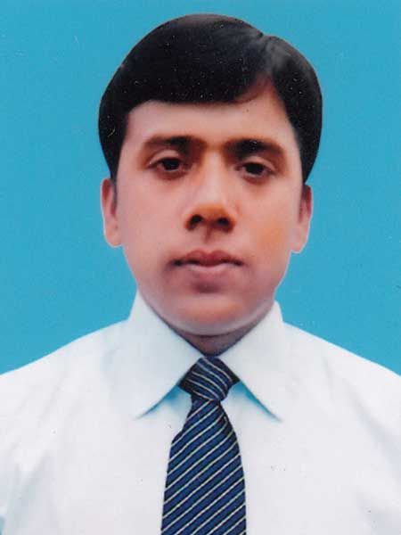
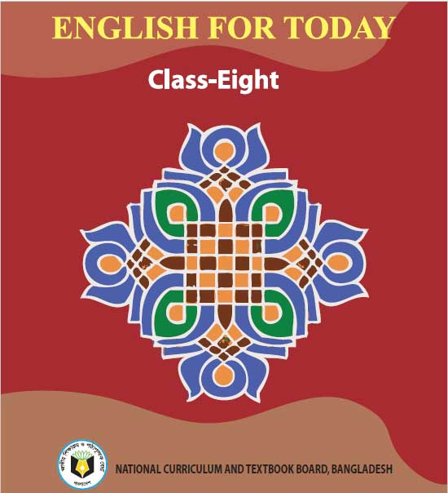
Identity
Md. Robiul Islam
English For Today
Assistant Teacher English
Class - Eight
Pioneer Girls’ High School, Khulna
Unit- One, Lesson- 4
ICT4E Ambassador
E- mail. robittck@gmail.com
Cell no. 01914223493

Slide 3
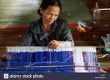
A. Look at the pictures and talk with your partner about them.

Slide 4
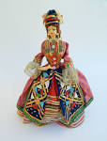
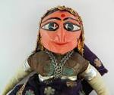
Have you heard the word “Ethnic People”? Can you tell what it means?

Slide 5
Today we are going to learn about -
Our ethnic friends (2)

Slide 6
After we have studied this unit, we will be able to -
Read and understand texts through silent reading.
Infer meaning from context.
Ask and answer questions.

Slide 7
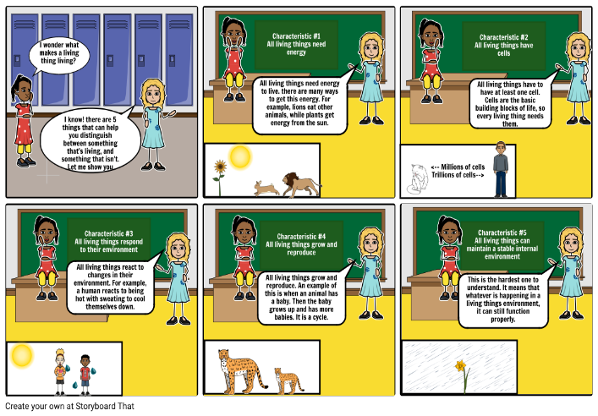
Characteristics
Qualitative
Adjective
Most of these ethnic people living in Bangladesh have some common Characteristics.
Antonym
Characteristic less

Slide 8
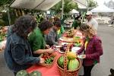
Communities
People, Race
Noun
They have good relation in their own communities.
Antonym
Folk less

Slide 9
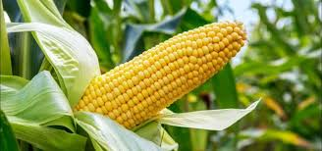
Maize
Noun
Millet, Indian Corn
Our ethnics eat maize, fish and vegetables.

Slide 10
A. Now read the text.
Most of these ethnic people living in Bangladesh have some common characteristics. They have their own lifestyles. They build their houses on bamboo or wooden platforms called “machang.” Rice is their staple food. They eat vegetables, maize and fish, poultry and meat. Their kitchen utensils are bamboo, wooden and earthen pots which they make themselves. Men wear lungis and women wear thamis or sarongs angis. Women weave their own clothes. Hunting and fishing are their favorite pastimes. They are fond of songs, music, dances, theatre and fairs. Traditional musical instruments used are bugles made from buffalo horns, drums and bamboo flutes. Wrestling is a popular sport for them.

Slide 11
Foods of ethnic friends
Vegetables
Maize
Fish
Poultry
Meat

Slide 12
Pastimes of ethnic friends
Hunting
Fishing

Slide 13
Find the answers from column B to the questions in column A and write them in complete sentences.
A | B
1. Where do the ethnic people build their houses? | a) traditional musical instrument made from a buffalo horn.
2.What are their favorite pastimes? | b) clay, bamboo and wood.
3.What is a bugle? | c) rice
4. What do the women wear? | d)on the wooden or bamboo platforms
5. What are their kitchen utensils made of? | e) Fishing and hunting
6. What is their staple food? | f) thamis or sarongs and angis
1. The ethnic people build their houses on the wooden or bamboo platforms..
2. Their favorite pastimes are fishing and hunting.
3. A bugle is a traditional musical instrument made from buffalo horn.
4. The women wear thamis or sarongs and angis.
5. Their kitchen utensils made of clay , bamboo and wood.
6. Their staple food is rice.

Slide 14
C. Complete the paragraph. Use the words below to fill in the gaps. There are more words than necessary.
Lungi
sport
earthen
machang
weave
wrestling
song
rice
fishing
lifestyles
wooden
bugle
The tribal people follow their --------------. The platform they build their houses on is called ------------. Men wear ------------- . Women ------------ their own clothes. Their staple food is ------------ . They are fond of songs , dance, music and ------------. --------------- is their favorite sport.

Slide 15
Grammatical Task
List of to be Verbs
Am
Is
Are
Was
Were

Slide 16
Home Work
Imagine you are Sajeed and you have a Marma friend called Masing. Now write a dialogue asking and answering questions about dress.

Slide 17
Thank You

