Slide 1
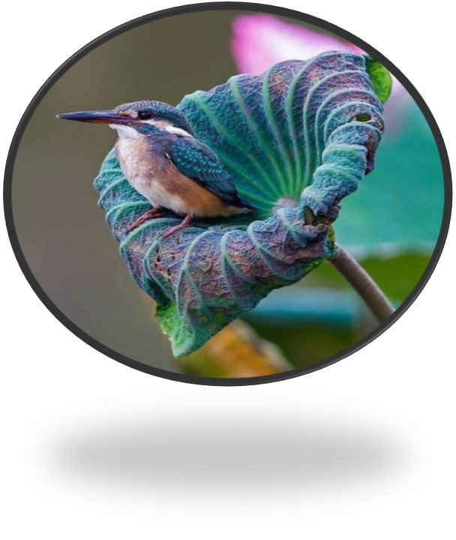
Welcome

Slide 2
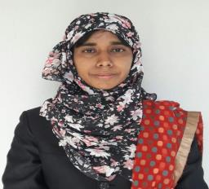
Introducing
Nasrin Akther Assistant Head Teacher Mahamuni Anglo-Pali High School,Raozan,Chattogram
G-mail : nasrinakther984@gmail.com
Y-mail: nasrin_akther800@yahoo.com
Facebook Id : nasrin.akter.714655
Microsoft Id : akthernasrin17@outlook.com

Slide 3
Sub:-English For Today
Class-Eight
Time-50 Minutes

Slide 4
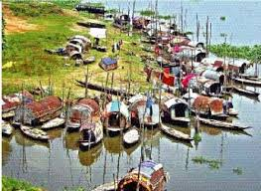
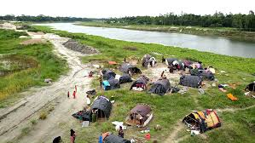
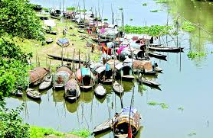
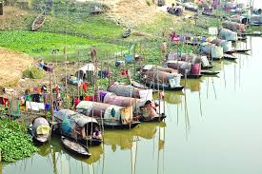
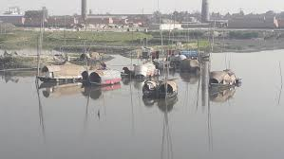
What do you see in the pictures?

Slide 5
Our Today’s Lesson is-
Unit : Seven
Lesson :3
River gypsies in Bangladesh

Slide 6
Learning Outcomes
By the end of the lesson students will be able to…
use the vocabs ( gypsy, ethnic, nomadic, roam, tarpaulin, tents, remedy, vend, heal, talisman)
write a short paragraph.

Slide 7
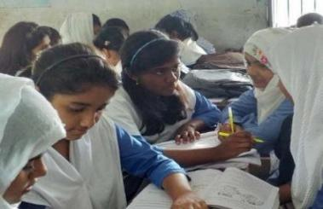
Dear students, open your text book, at page 74 and read the text silently. Try to understand the text and find out the unknown words. After finishing the text we will know about the new words.
River gypsies are an ethnic group of people in Bangladesh. They are known as bedey to local people. The gypsies have their own lifestyle and culture. They live in groups and do not own any land. Therefore, they live a nomadic life, travelling from one place to another. These people roam across our rivers and waters from May to December in small country boats. These boats are their houses and these people are a part of our waters. In winter, many water bodies dry up. At that time they return to the mainland and live in make-shift tarpaulin tents on open river banks. You can see their men relaxing in the tents. Toddlers play with dogs or other pets in the dust. Women often idle away time by hair doing, picking off lice in twos or threes sitting in a row.
Throughout the monsoon, they remain busy with fishing. They also dive for natural pearls in waters. Sometimes, they camp for a couple of weeks. Men catch snakes and entertain people with snake charming and sell herbal cures. Women go from door to door to sell bangles, cosmetics and other things. They also try to heal pains of old people often by sucking out blood from their body.
Many villagers believe in the magical power of the gypsies. They can make an evil spirit leave someone’s body by magic or special powers.
Silent Reading

Slide 8
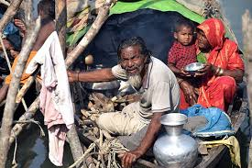
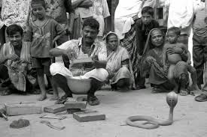
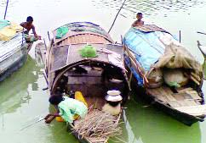
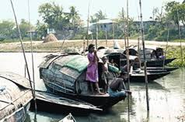
Vocabulary
Words & Meaning
Key Words
Gypsy
A number of travelling people with dark skin and hair living by itinerant trade and fortune telling.
Associated with or belonging to a particular race or group of people who have a culture that is different from the main culture of a country.
Ethnic
Travelling from place to place.
Nomadic
Roam
To move from place to place without obvious plan.

Slide 9
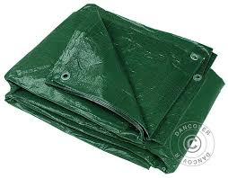
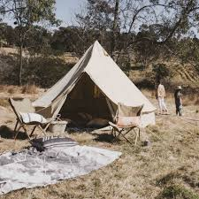
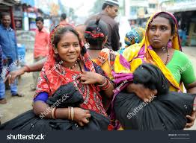
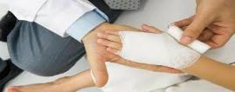
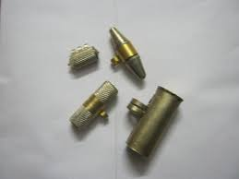
Tarpaulin
A large number of heavy waterproof cloth used as a covering.
Collapsible shelter of material stretched and supported by poles
Tents
Remedy
A medicine or treatment that cures or relieves, antidote.
Vend
To sell a hawker.
Heal
To make or become sound.
Talisman
An object thought to act as good fortune

Slide 10
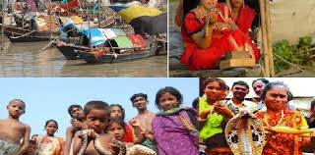
Who are river gypsies?
River gypsies are an ethnic group of
people in Bangladesh. They are
known as bedey to local people.
They live in small country boats travelling from one
place to another across water ways. Therefore, they live a nomadic life.

Slide 11
What do the river gypsies do in winter?
In winter, many water bodies dry up. At that time they return to the mainland and live in make-shift tarpaulin tents on open river banks.

Slide 12
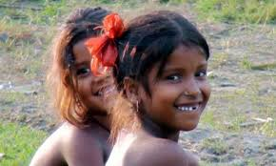
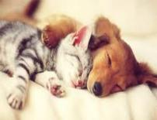
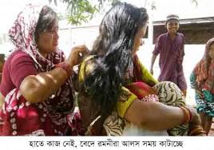
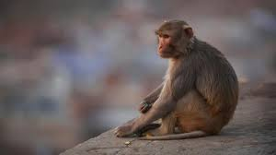
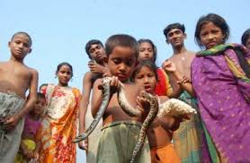
How do the gypsy women often spend their time in winter ?
How do the toddlers play?
The toddlers play with dogs or other pets in the dust.
In winter, the women often idle away time by hair doing, picking off lice in twos or threes sitting in a row.

Slide 13
Single Work
3 Minutes
How do the river gypsies live?

Slide 14
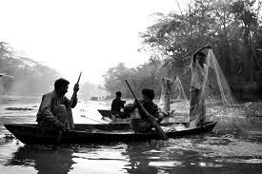
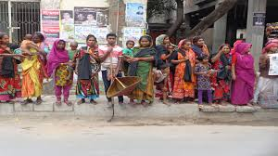
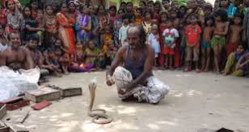
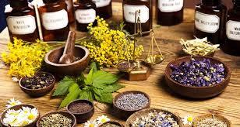
Do you know the four activities of the river gypsies.
Yes, they are:
They catch fish in the rainy season;
They dive for natural pearls;
They catch snakes and entertain people with snake charming;
They sell herbal cures and try to heal pains of old people.

Slide 15
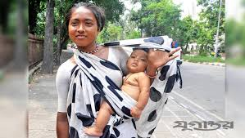
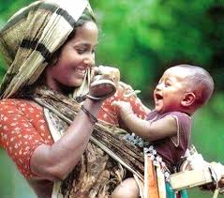
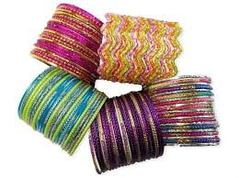
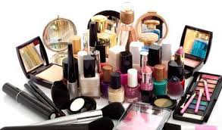
Why do the gypsy women go from door to door?
The gypsy women go from door to door to sell bangles,
cosmetics and other things to the local villagers.

Slide 16
Let’s watch a video .
How do gypsy women try to heal pain of old people ?
Gypsy women try to heal pains of old people
often by sucking out blood from their bodies.

Slide 17
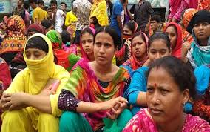
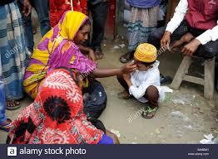
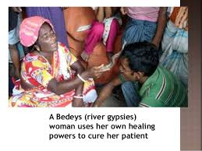
How do they drive away the evil spirit?
They drive away the evil spirit by magic or
special powers.

Slide 18
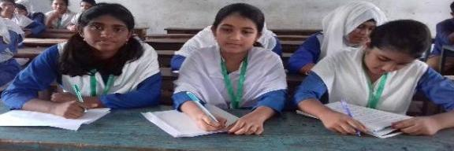
Pair Works
5 Minutes
Fill in the gaps using clues from the boxes.
groups
any
ethnic
culture
nomadic
across
bedey
from
travelling
own
River gypsies are an (a)________ group of people in Bangladesh. They are known as (b) ________ to local people. The gypsies have their (c)________ lifestyle and (d)_______. They live in (e)________ and do not own (f)________ land. Therefore, they live a (g)________ life, (h)__________ from one place to another. These people roam (i)________ our rivers and waters (j)________ May to December in small country boats.

Slide 19
Evaluation
True or false? If false, give the correct information.
1. River gypsies live in roaming boats and tents.
True
2. River gypsies roam around on their boats about seven months a year.
False.
Correct Inf : River gypsies roam around on their boats about eight months a year.
3. River gypsies are the people who travel from one place to another for
pleasure .
False.
Correct Inf: River gypsies are the people who move from one place to another by boat to earn their livelihood.

Slide 20
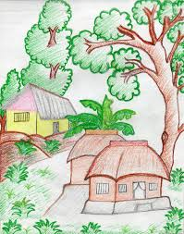
Home Work
Write down the main ideas in your own words.

Slide 21
Good Bye

