Slide 2
WELLCOME TO ALL

Slide 3
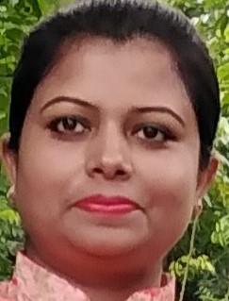
TEACHER’S IDENTITY
NAHIDA AKHTER
ASSISTANT TEACHER
KALIKACCHA NORTH GOVT. PRIMARY SCHOOL
SARAIL,BRAHMANBARIA.

Slide 4
LEASSON
CLASS:THREE
UNIT :2
LESSON :1&3 LESSON’S TITLE:INTRODUCING A TEACHER
TODAYS LESSON:A

Slide 5
LEARNING OUTCOMES
Listening:
3.1.1 understand simple questions about students,family and friends.
3.3.1 understand statements.
Reading:
1.5.1 read simple sentences with correct pronunciation and stress.

Slide 6
Let’s watch a video

Slide 7
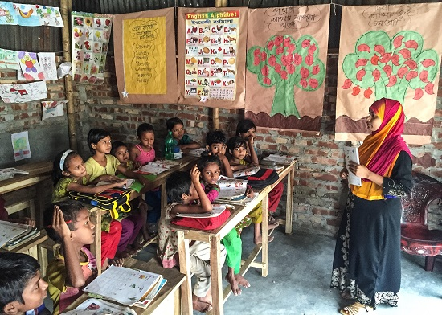
Think about the picture.
Who is she?
This is the picture of a teacher.
Today we know about introducing a teacher.

Slide 8
Introducing a teacher

Slide 9
New words
New word | Word meaning
Teacher | One who teaches.
Work | To do something.
Primary school | A school for children between the ages of about five to ten.

Slide 10
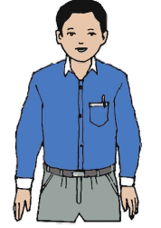
This is Mahbub Alam. He is 30 years old.

Slide 11
He’s an English teacher.

Slide 12
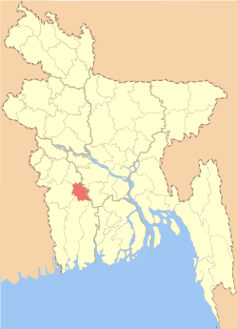
He works in a primary school in Narail.

Slide 13
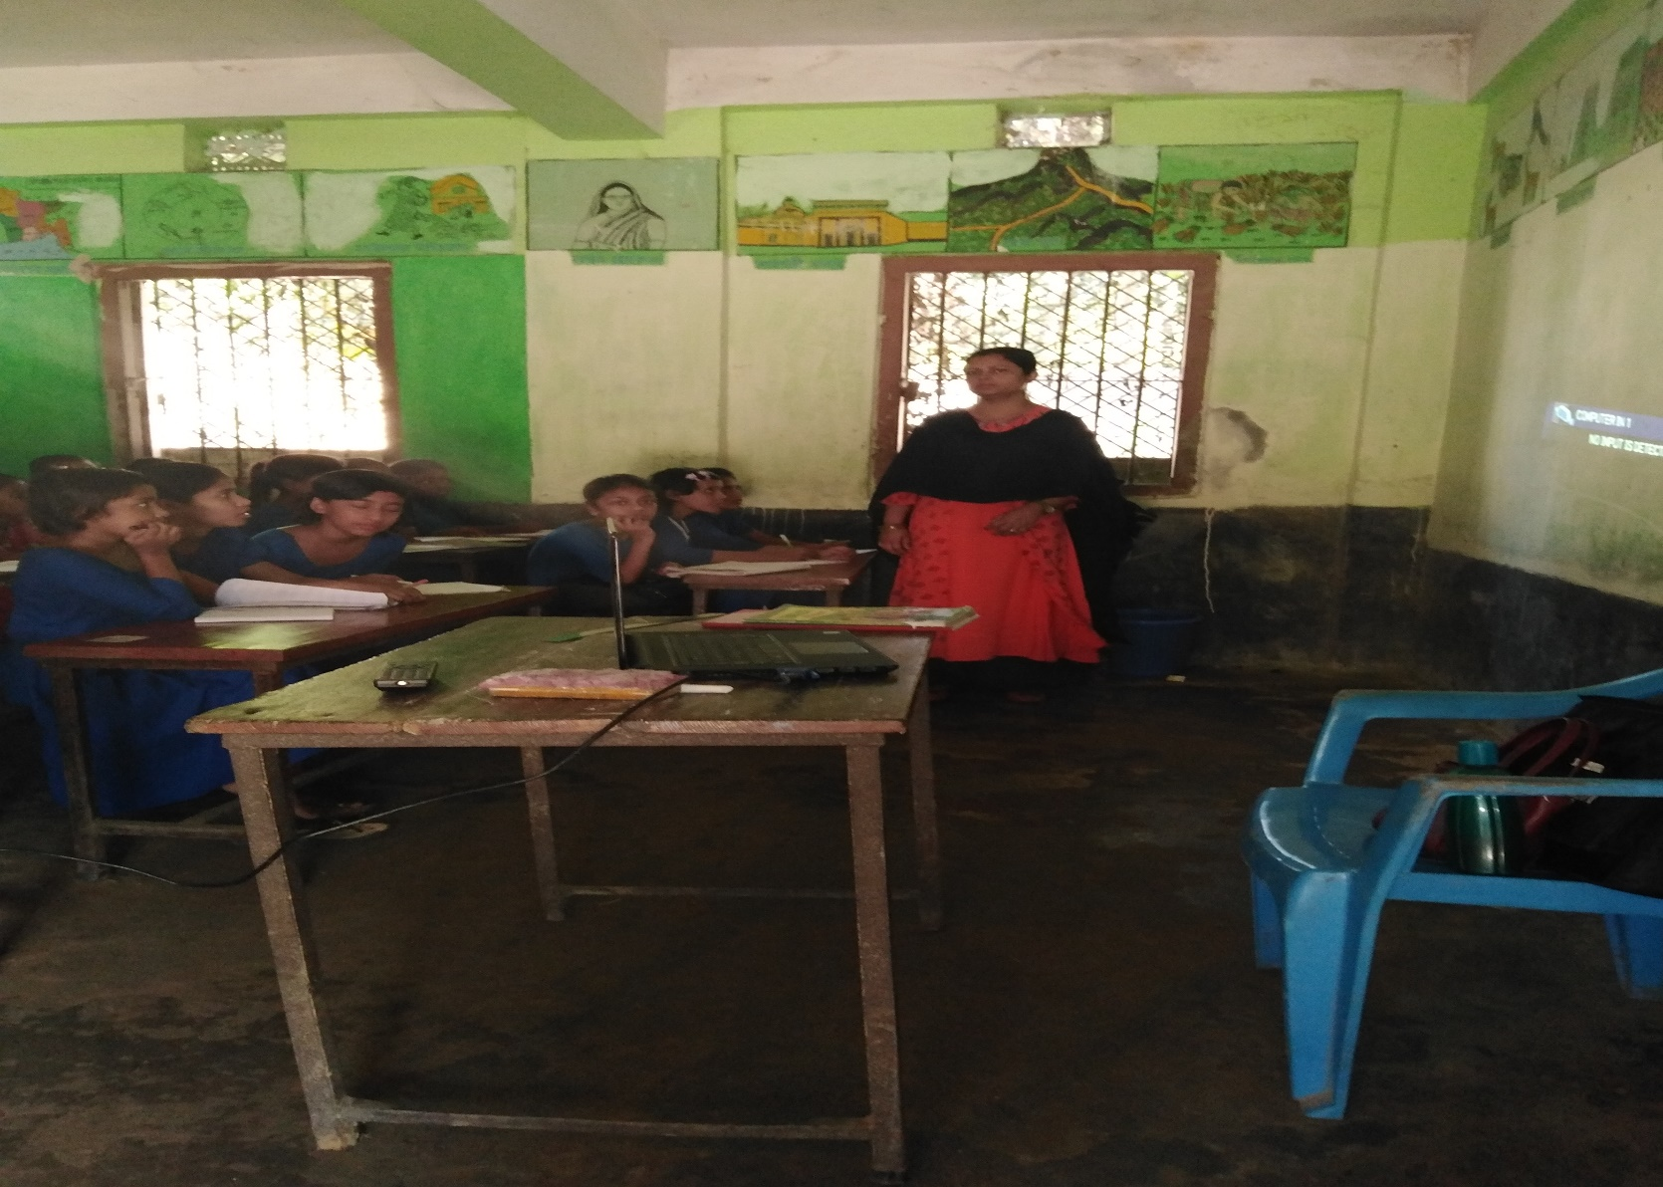
TEACHER’S LOUD READING

Slide 14
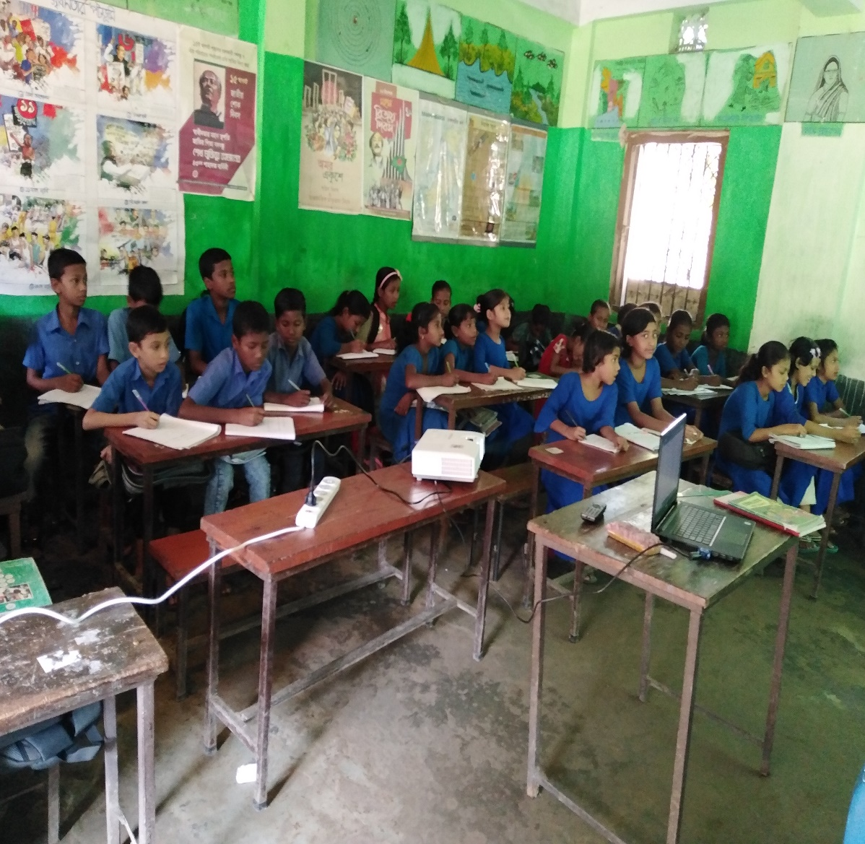
STUDENT’S SILENT READING

Slide 15
Group work
Group no | Work
Group no 1 | Read the passage silently with correct pronunciation.
Group no 2 | Read the passage silently with correct pronunciation
Group no 3 | Read the passage silently with correct pronunciation

Slide 16
Evaluation
1.Who is Mahbub?
Ans: Mahbub is a teacher.
2. How old is he?
Ans: He’s 30 years old.

Slide 17
Home work
Write three sentences about your teacher.

Slide 18
No more today
Stay at home.
Goodby & thank you

