Slide 1
Most Welcome

Slide 2
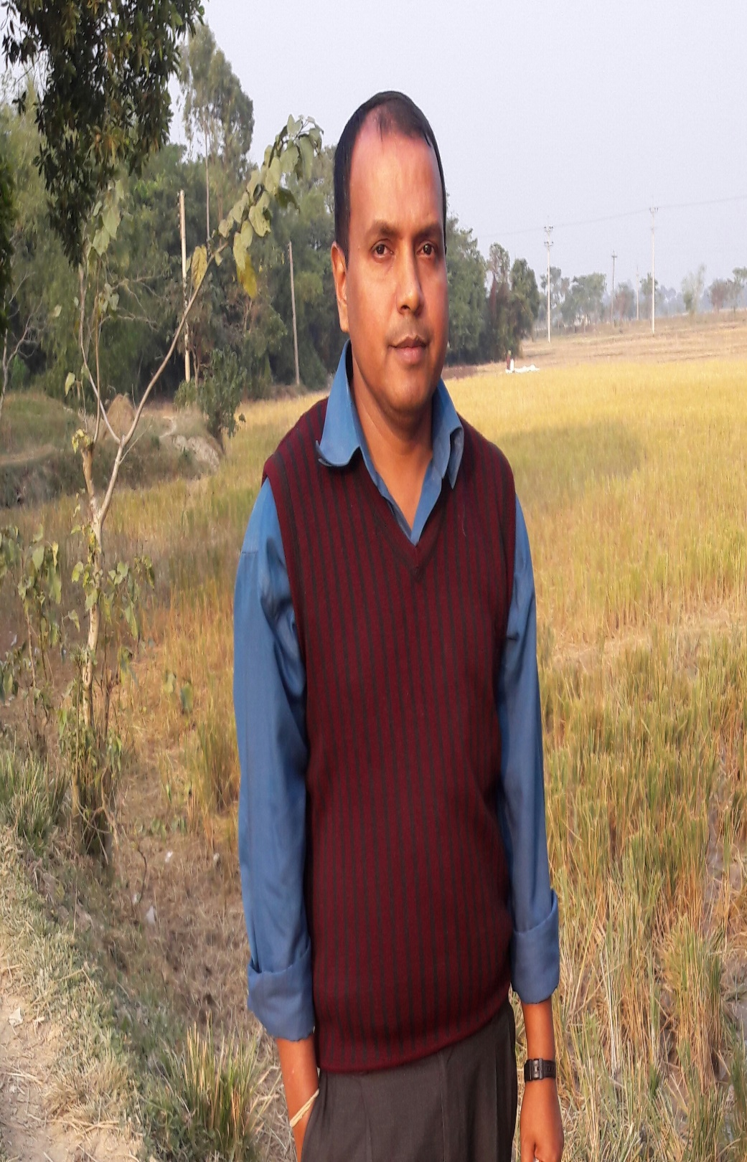
Teacher’s Identity
Sanjit Bhattacharjee
Assistant Teacher
Chonditure Govt. Primary School ,
Sunamgonj sadar.

Slide 3
Lesson Identity
Class : Five
Subject : English
Unit : 20
Lesson : 1-2 A

Slide 4
Learning Outcomes
Students will be able to :
1.5.1 read words, phrases and sentences in the text
with proper pronunciation, stress and intonation.
3.3.1 understand questions about objects around them.
3.4.1 understand statements made by the teacher and
Students.
5.1.1 read silently with understanding paragraph.
3.1.2 write, words, phrases and sentences using
non-cursive small letters..

Slide 5
Today`s
lesson
Life is beautiful

Slide 6
It’s a beautiful spring day. Maria gets up early. She feels happy. She knows that it’s a nice day because she puts her hand on the glass of the window. It is very warm. She opens the window and the singing of the birds fills the room. She can smell the flowers outside her home. They smell sweet and fresh. After Maria gets dressed and has her breakfast, she puts her books in her bag. She is ready for school.

Slide 7
Do you know the meaning
of the words?
Word | Meaning
Spring | Name of the season
Smell | Flavor
Dressed | Wearing
Warm | Hot
Spring, Smell,
Dressed, Warm

