Slide 1
WELCOME

Slide 2
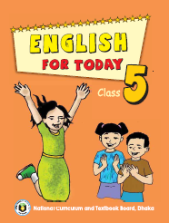
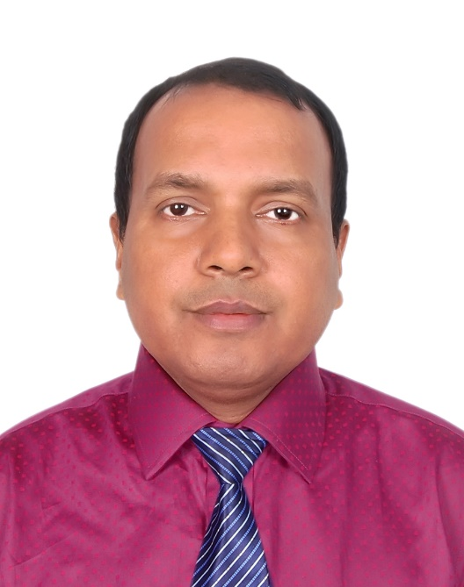
INTRODUCTION
Sanjit Bhattacharjee
( M A; C-in-Ed )
Assistant teacher
Conditure Govt. Primary School.
Sunamgonj Sadar , Sunamgonj.
Class: Five
Subject: English
Unit:15,Lesson: 1.
Date:
Time: 40 Minutes

Slide 3
CREATING EMOTION
Good morning , students.
Good morning , teacher.
How are you?
Fine . And you?
I’m also fine. But you are looking pale .(By showing a student)
Have you any problem?
No/Yes , Sir.
Let’s sing a song “Happy Birthday to you…”

Slide 5
We celebrate many occasions by singing songs.
Normally in one’s birthday which song is sung?
“HAPPY BIRTHDAY TO YOU……….”
Today’s topic is “Happy Birthday”.

Slide 6
LEARNING OUTCOMES
Students will be able to………
3.4.1: Understand statements made by the teacher and students.
1.1.1: Say words, phrases and sentences with proper sound stress and intonation .
5.1 .To read silently with understanding paragraph, stories,
Dialogues, personal letters and others texts materials.
3.1 Write sentences using non-cursive and cursive capital and small letters.

Slide 7
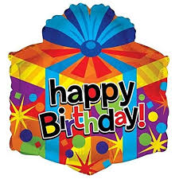
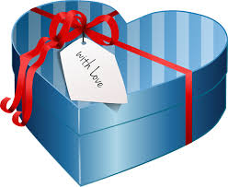
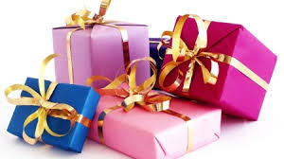
Please think about the pictures and discuss in pairs.
What kinds of these pictures?
Thank you.
These are the common picture of “Birthday Gift”.

Slide 8
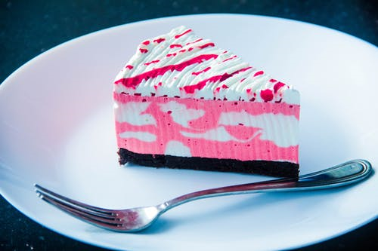
Please think about this picture and discuss in pairs.
What do you see in the picture?

Slide 9
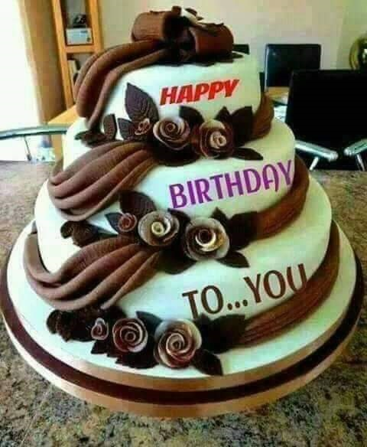
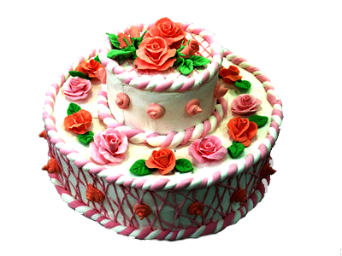
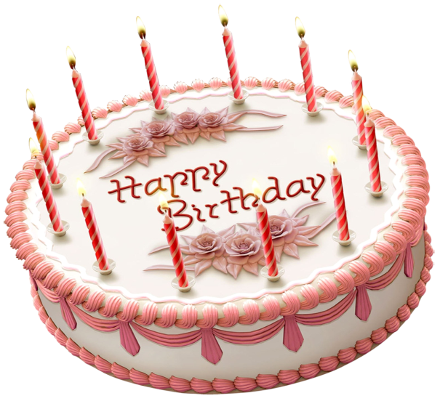
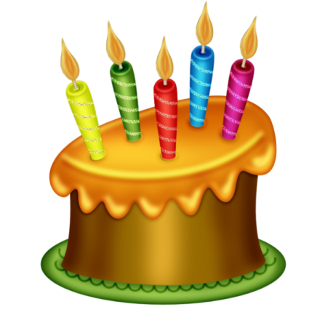
Please think about these pictures and discuss in pairs.
What kind of cake is these?
Thank you.
These are the common picture of “Birthday Cake”.

Slide 10
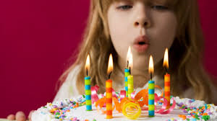
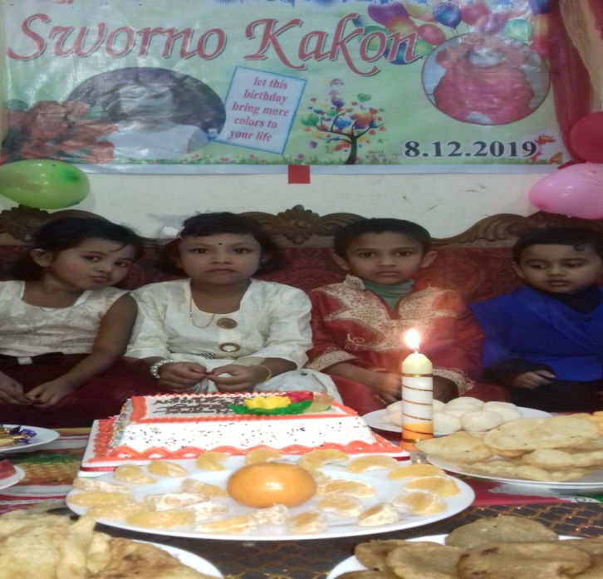
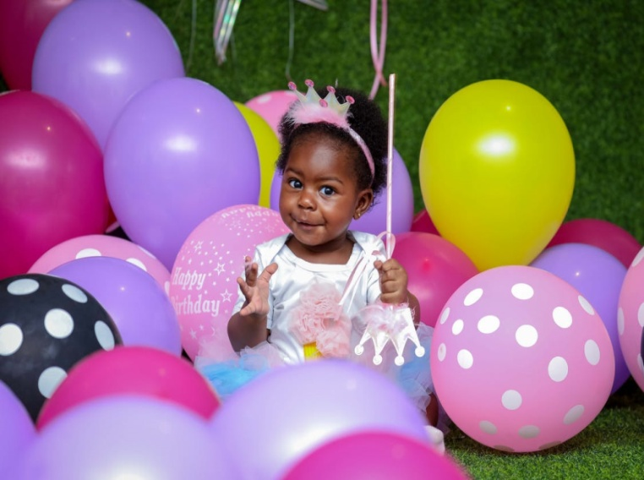
Which ceremony is this ?
Thank you.
It’s the birthday ceremony.

Slide 11
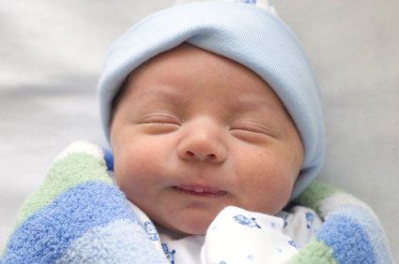
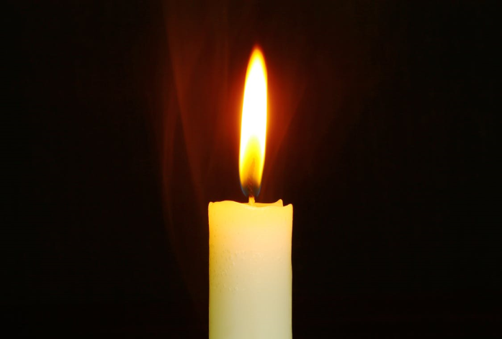
NEW WORDS MEANINGS
Birthday : The date when a person was born.
Candle

Slide 12
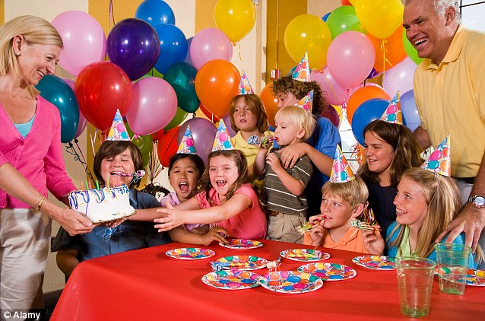
Children around the world have fun on this day. Parents ask other children to come and have a party.

Slide 13
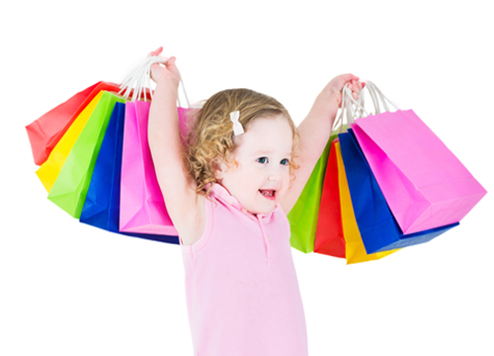
They wear new clothes, sing songs , play games and enjoy the day in different ways.

Slide 14
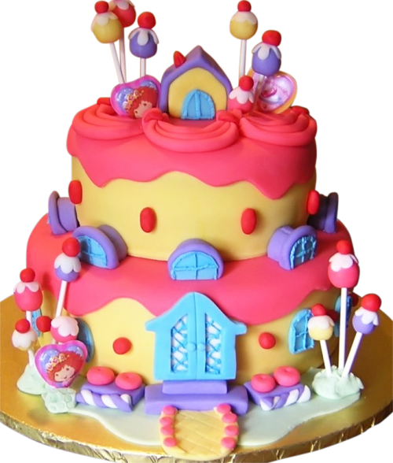
There is usually a birthday cake.

Slide 15
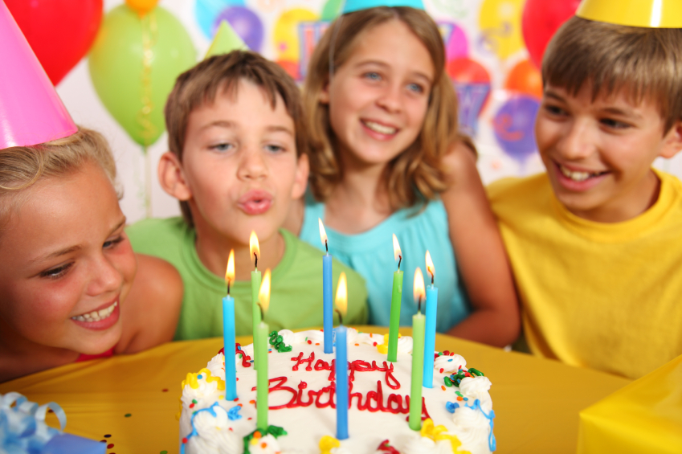
Candles are lit on it. The number of candles depends on how old a child is.

Slide 16
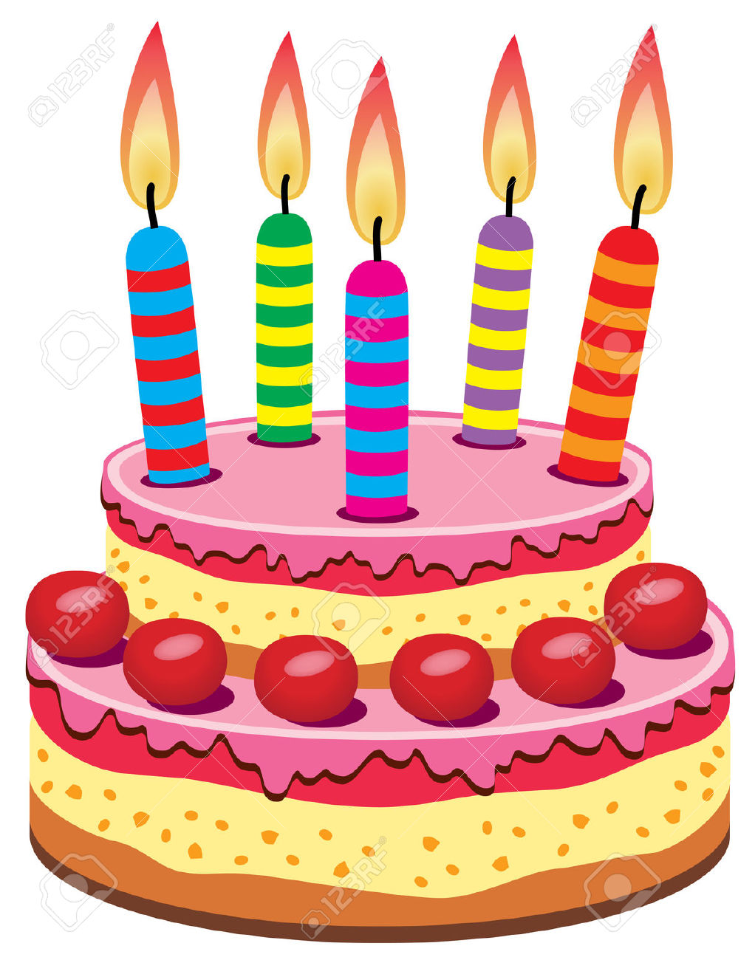
In the picture there are five candles. It means that the boy is five year old.

Slide 17
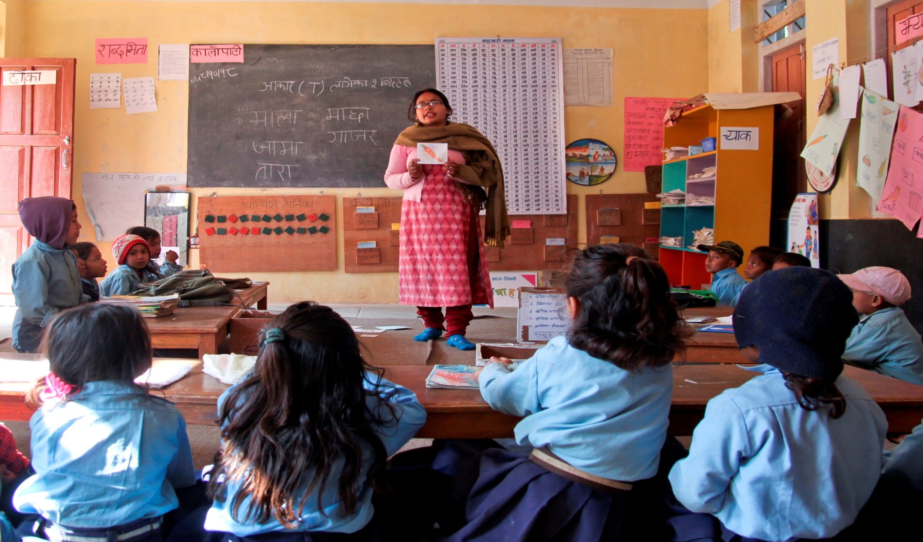
The Teacher reads the story in front of the students loudly.

Slide 18
New word of the story.
Birthday
A day one who is born
Memorable
Being special
Fun
To do enjoy
Candle
That is lit to produce light
Different
Not same
Usually
Generaly

Slide 19
Fill in the gaps with appropriate words.
world
usually
birthday
picture
A ………… is a memorable day in one’s life.
Children around the ……… have fun on this day.
There is……........a birthday cake.
d. In the………….there are five candles.

Slide 20
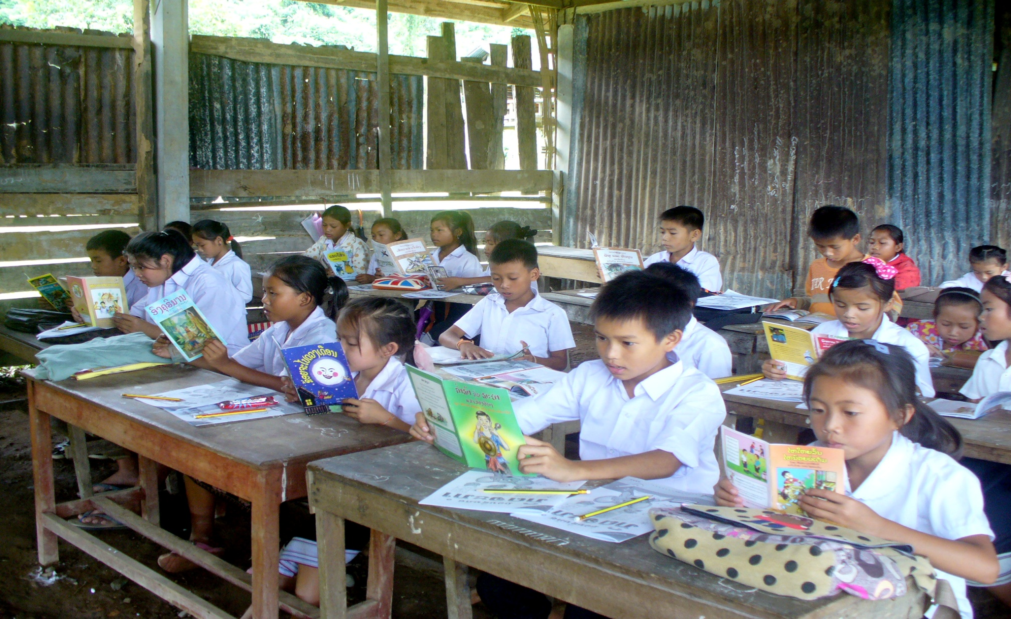
Open at page 69 and read silently

Slide 21
Group Work
Padma
Megna
Which is a memorable day in one’s life?
There is ……………… a birthday cake.
What does birthday means?
2. Candles are lit…….
it.

Slide 22
Padma
Megna
Ans: Birthday is a memorable day in one’s life.
2. Ans: usually
1.Ans: Birthday is a memorable day when one was born.
2. Ans: on

Slide 23
Evalution (written)
What does birthday means?
2. In a birthday party what are the children do?

Slide 24
Answer
1. Birthday is a memorable day when one is born.
2. The children wear new clothes, sing songs, play games and enjoy the day.

Slide 25
Home work
Write some sentences about your birthday party.

Slide 26
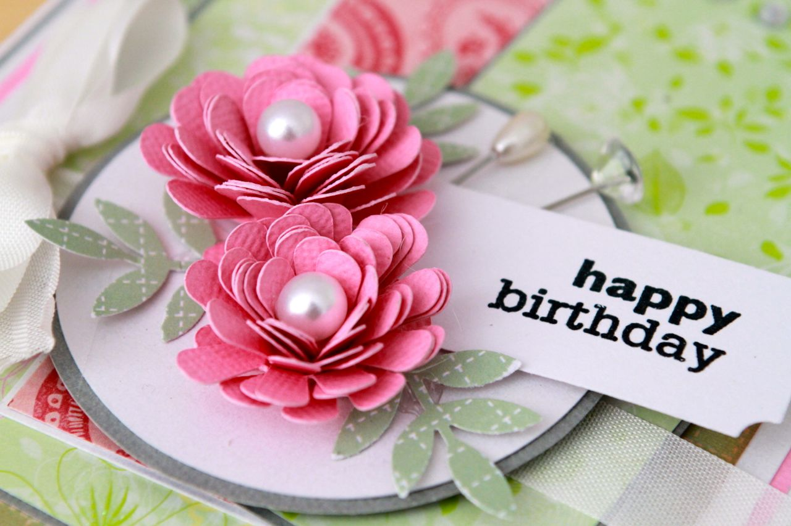
Thank you, see you again…….

