Slide 1
Welcome

Slide 2
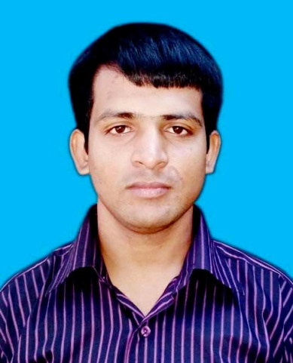
Teacher’s Introduction
Md. Monir Hossain
Assistant teacher
Dainchari Poratan Government Primary School.
Manikchari, Khagrachari.
Mobile: 01823421733
E-mail: monir106809@gmail.com

Slide 3
Lesson ntroduction
Class: One
Subject : English
Unite:5,Lesson:1-3
Commands
Time: 40 min

Slide 4
Student will be able to know
1.1.1 Repeat after the teacher simple words and phrases.
1.1.2 Say simple words and phrases.

Slide 5
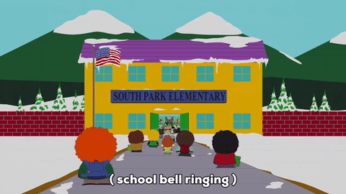
Let’s go we see pictures
What do you see in the picture?

Slide 6
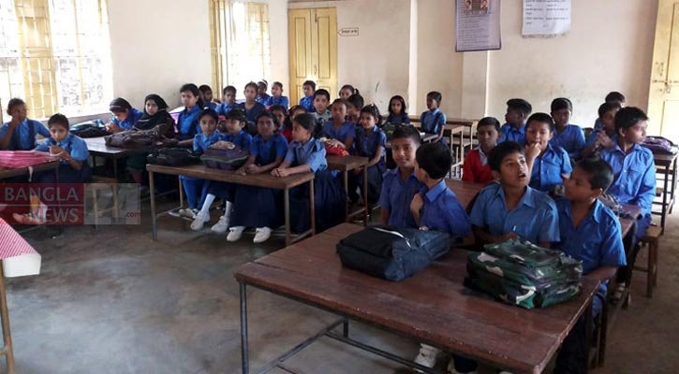
What do you see in the classroom?

Slide 7
Today we will read
Commands

Slide 8
What is this ?
window
What is this ?
door

Slide 9
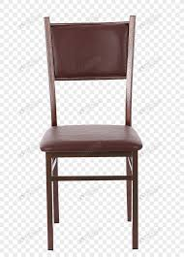
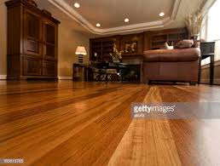
What is this ?
chair
What is this ?
floor

Slide 10
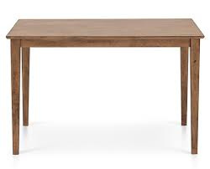
What is this ?
table
What is this ?
book

Slide 11
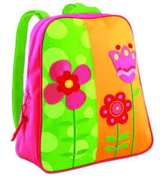
What is this?
pencil
What is this?
bag

Slide 12
Now we will open the book at page 10.
I am reading the text. Students listen to me.
Then you will repeat after me .

Slide 13
Lets go to make some pairs.
Say pictures' name one to another in English.
I will see the pair work.

Slide 14
What is this ?
window
What is this ?
door

Slide 15
What is this ?
table
What is this ?
book

Slide 16
No more today.
Thanks everyone
Good bye
G

Slide 17
