Slide 1
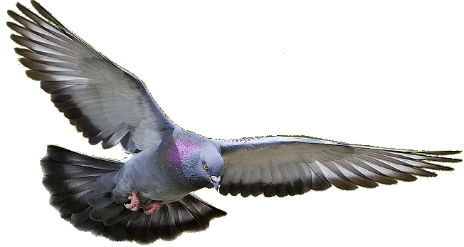
Welcome to HD PPT Presentation.
Notes:
Welcome slide

Slide 2
Introduction
Teacher
Lesson
Hirendra Debnath
MA(English), Bed
Assistant Teacher(English)
Puran Bazar Girls’ High School
01789-916684
Hirendra Debnath
hirendra0501@gmail.com
English Grammar and Composition
Class : VI-X

Slide 3
An apple is eaten by Rabbi.
Rabbi eats an apple.
An apple
Rabbi
An apple
Rabbi
Notes:
Suspension 1 to lead the lesson.

Slide 4
I say my prayer regularly.
My prayer
is said
by me
regularly.
What is it related to?
Notes:
Suspension 2 to lead the lesson.

Slide 5
Voice change
Let us discuss about voice
change in our today’s class.
Notes:
Lesson declaration

Slide 6
Learning outcomes
After the ss have studied this lesson, they will be able to---
a) identify the definition of voice
b) identify the classification of voice
c) identify the structure s of active and passive voice
d) change voice from active to passive
Notes:
Basic rules of voice change will be taught from this content.

Slide 7
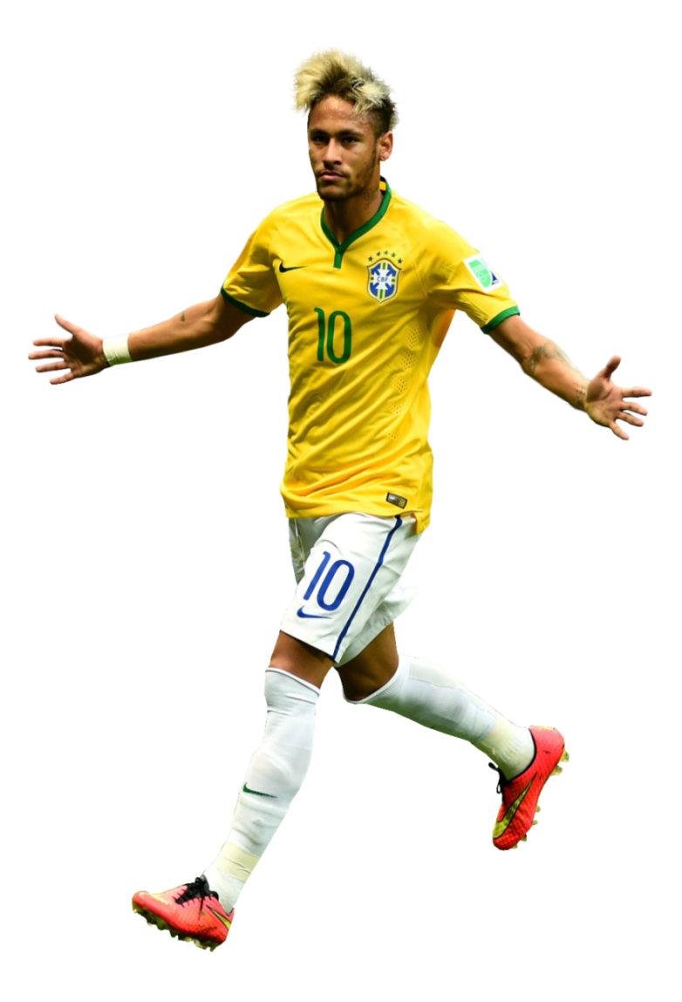
What is voice?
Voice is a form of verb which indicates whether the subject
does something or something is done by subject.
Neymar plays football.
Football is played by Neymar.
Notes:
Delimitation of the voice

Slide 8
Voice is classified into two kinds
Active voice
Passive voice
When the subject does
something .
When something is
done by the subject.
Notes:
Classification of voice is focused in this slide.

Slide 9
Active - passive
Structure of active voice
Extension₁
+
Subject
+
A/V
+
Extension₂
+
Transitive verb
+
Object
+
Extension₃
Structure of passive voice
Object
of subject
Extension₁
+
Subject
of
object
+
A/V
+
Extension₂
+
Transitive verb₃
+
+
Extension₃
So, he will then read a book in the evening.
So, a book will then read by him in the evening.
Notes:
Formation of active voice and passive voice with examples.

Slide 10
List of some subjects and their objects
Subject | object
I | me
We | us
You | you
They | them
He | him
She | her
Rahim/Karim | Rahim/Karim
The pen | the pen
Animals | animals
Notes:
Basic of all grammar items.

Slide 11
Auxiliary verbs of passive voice
If the active voice is- | Auxiliary of passive voice will be--
Present indefinite tense | am/is/are
Present continuous tense | am being/ is being/are being
Present perfect tense | have been/ has been
Present perfect continuous tense | have been being/ has been being
Past indefinite tense | was/ were
Past continuous tense | was being/ were being
Past perfect tense | had been
Past perfect continuous tense | had been being
Future indefinite tense | shall be/ will be
Future continuous tense | shall be being/ will be being
Future perfect tense | shall have been/will have been
Future perfect continuous tense | shall have been being/ will have been being
Modal verbs (can/ should/ must/ may etc) | can be/should be/must be/may be etc
Notes:
Fundamental items of voice change.

Slide 12
Active to passive
Assertive sentence.
He pulls a rickshaw (make it passive).
A rickshaw is pulled by him.
We should respect a rickshaw puller (Make it passive)
A rickshaw puller should be respected by us.
Notes:
How to change from active to passive shown here.

Slide 13
The fisherman is catching fish. (Make it passive)
Fish is being caught by the fisherman.
Notes:
Practice on changing into passive from present continuous tense.

Slide 14
Activities
Transform the sentences into passive voice
1. I visited the Nayagra waterfall last year.
2. Many people enjoy the waterfall all the year round.
3. The waterfall makes a beautiful view.
4. You may enjoy it if you want.
5. I will visit it again.
Notes:
Class work according to previous slides.

Slide 15
Check your answer
1. The Nayagra waterfall was visited last year by me.
2. The waterfall is enjoyed all the year round by many people.
3. A beautiful view is made by the waterfall.
4. It may be enjoyed if it is wanted by you.
5. It will be visited again by me.

Slide 16
Let us know the voice change of double object.
He teaches us English.
Sub
Verb transitive
indirect obj
direct obj
(us) = indirect object
Double object
(English) = direct object
Note: You can use any object as the subject of passive voice.
But the indirect object is preferred for the subject.
Notes:
Indirect object we mean man/woman that sit before direct object. Direct object we mean other than man/woman (object)

Slide 17
Let’s practice
He teaches us English.
We are taught English by him.
English is taught to us by him.
English is taught us by him.
Now try to change it into passive voice.
1. He gave me a book.
2. I taught him a lesson.
3. They feed me fruits.
4. We made him captain.
5. She informed me this.
Notes:
Practice on double object.

Slide 18
Passive voice of silent infinitive
I told him do this.
Sometime Infinitive remains silent in the active voice
He was told to do this by me.
Infinitive must be shown in
the passive voice
Notes:
How to change into passive voice from silent infinitive.

Slide 19
Class activities
Change the active voice into passive voice.
1. He advised me tell the truth.
2. They elected him go there.
3. He ordered Rahim solve it.
4. The bird made the wind blow.
5. The teacher told him do the sum.
Notes:
Practice or evaluation.

Slide 20
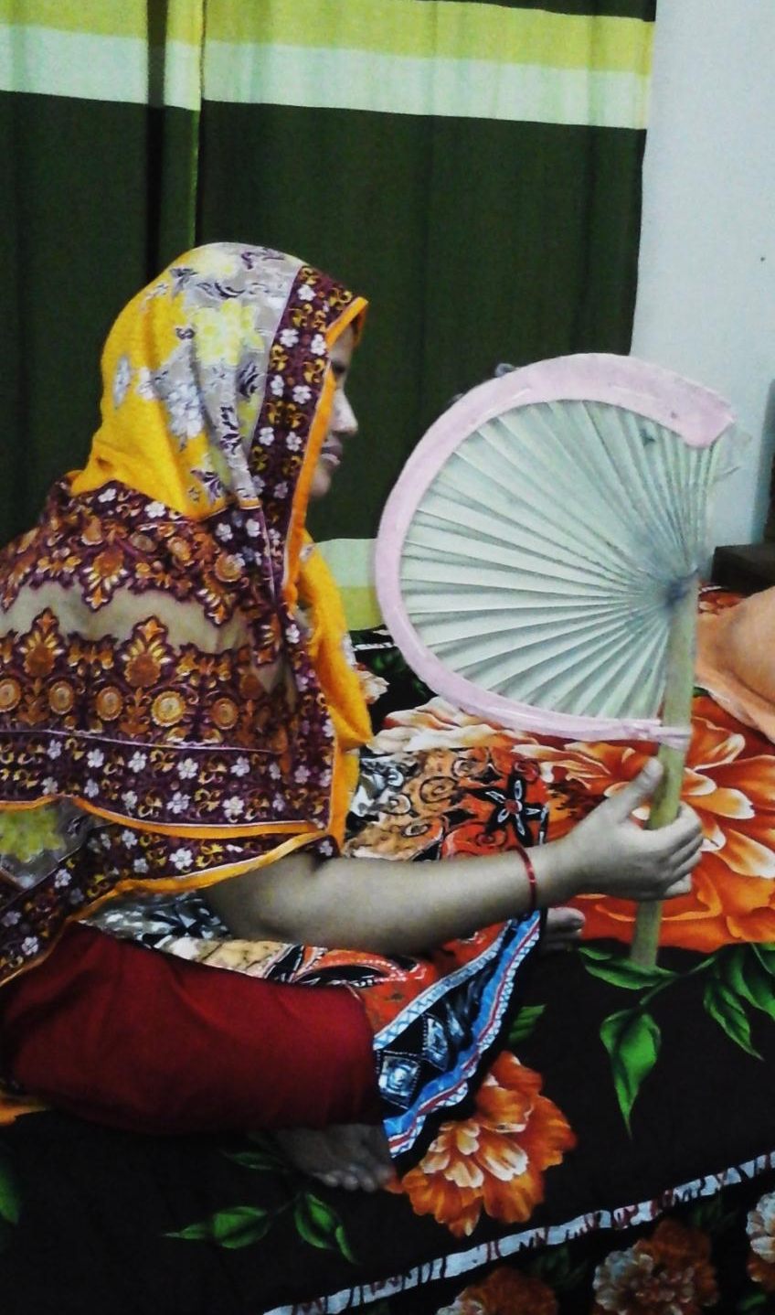
Exception-1
If the active voice is with reflexive pronoun--
Subject + auxiliary verb + v₃ + by + reflexive pronoun
She fans herself.
She is fanned by herself.
He killed himself.
He was killed by himself.
Note: If there is reflexive pronoun as object of the sentence, subject and object will not be changed to make it passive.
Notes:
How to change into passive from reflexive pronoun.

Slide 21
Exception-2
If the active voice is with quasi-passive verb-
Subject + auxiliary verb + v₃ + adjective
The rose smells sweet.
The rose is smelt sweet.
The sight looks charming.
The sight is looked charming.
Note: If there is an adjective after the verb of the sentence, subject and adjective will not be changed in the passive voice
Notes:
How to change into passive with quasi-passive voice.

Slide 22
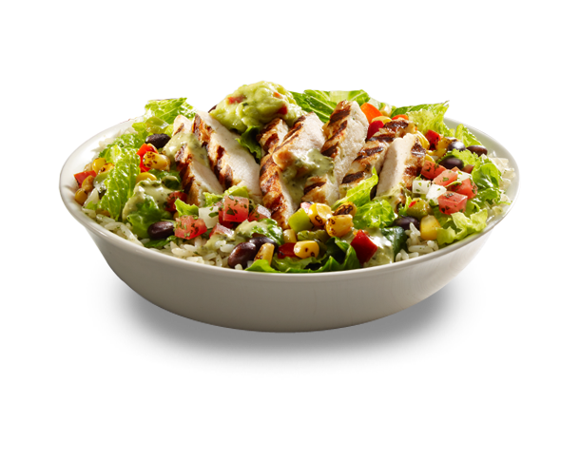
Class activities
Change the active voice into passive voice.
1. Honey tastes sweet.
2. The pill tastes bitter.
3. The food looks delicious.
4. The man seems strong.
5. The sky appears blue.
Notes:
Evaluation/Practice.

Slide 23
Inviting to part-2
See you again.
Notes:
Ending slide.

